Slide 1
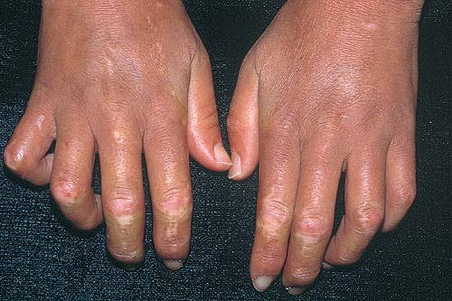
Autoimmune Diseases

Slide 2
Autoimmune Diseases Lecture Objectives
What causes Autoimmune Disease?
Define tolerance and self-tolerance, and explain why there aren’t tons of self-reactive lymphocytes floating around in the body.
Describe how genetic and environmental factors contribute to causing autoimmune diseases.
Lupus
Describe the most common clinical findings seen in lupus.
List the autoantibodies most commonly seen in lupus, and explain how they lead to tissue damage.
Explain how a FANA is done (and why).
Describe the typical clinical course and treatment of lupus.

Slide 3
Rheumatoid Arthritis (RA)
Describe the characteristic clinical and morphologic findings seen in the joints of patients with RA.
List the systemic findings that can be seen in RA.
Explain what rheumatoid factor is, and describe how it can be used in the diagnosis of RA.
Identify the main cause of the tissue damage seen in RA.
Describe the treatment and prognosis of RA.

Slide 4
Sjögren syndrome
Explain what we know about the cause of Sjögren syndrome, and identify the autoantibody seen in most patients.
Describe the clinical findings seen in Sjögren syndrome
Describe how patients with Sjögren syndrome are treated.
Scleroderma
Explain what we know about the cause of scleroderma,
and identify the autoantibody seen in most patients.
Describe the clinical findings seen in scleroderma.
Describe the difference between diffuse and limited scleroderma, and explain what CREST syndrome is.
Describe the overall prognosis for patients with scleroderma.

Slide 5
Immune Diseases Outline
  What causes autoimmune disease?
  Lupus
  Rheumatoid arthritis
  Sjögren syndrome
  Scleroderma

Slide 6
Immunologic Tolerance
Tolerance = unresponsiveness to an antigen
Self-tolerance = unresponsiveness to one’s own antigens
In generating billions of B and T cells, some will react against self antigens!
There are two ways of muzzling these cells: central tolerance and peripheral tolerance

Slide 7
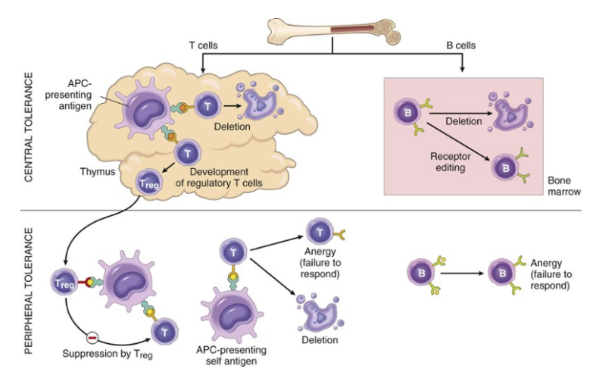

Slide 8
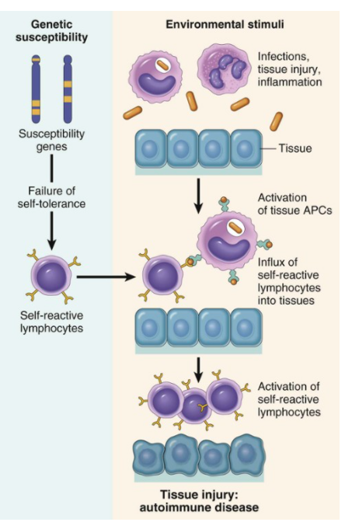
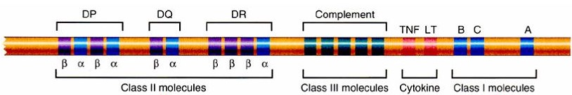
What causes autoimmune disease?
Genes
+
Environment
HLA-DR4:
↑
risk for rheumatoid arthritis

Slide 9
Systemic Lupus Erythematosus
(SLE)
KNOW THIS
Typical patient: young woman with butterfly rash
Symptoms unpredictable (relapsing/remitting)
Multisystem (skin, kidneys, joints, heart)
Antinuclear antibodies

Slide 10
Lupus Etiology
Autoantibodies
  Antinuclear antibodies (ANAs) are present in all patients with lupus
  Most specific ANA: anti-DS DNA
  Anti-RBC, -lymphocyte, -platelet, or –phospholipid antibodies may be present too
Underlying cause
  Genetic predisposition…
  …plus environmental triggers (UV radiation, drugs)

Slide 11
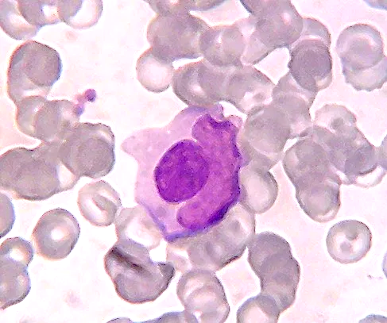
LE (lupus erythematosus) cell
Macrophage (LE cell)
LE body
(denatured nucleus
from another cell)

Slide 12






Fluorescent antinuclear antibody (FANA) test
Fluorescent-tagged antibody (from test kit)
Patient serum (containing ANAs)
Cells with exposed nuclei (from test kit)
View under fluorescent light

Slide 13
Positive FANA test
Cell nuclei with attached ANAs

Slide 14
Lupus Signs and Symptoms
Lupus can present in SO many different ways
that it’s often called “the great imitator.”
Unexplained fever
Fatigue
Butterfly rash
Renal failure
Seizures, psychosis
Arthritis
Endocarditis, pericarditis
Pleuritis

Slide 15
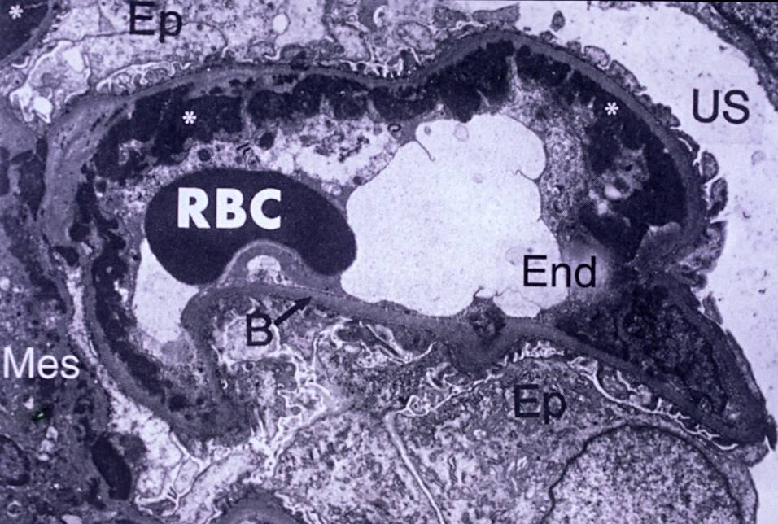
















subendothelial deposits
Renal EM in patient with lupus showing subendothelial deposits

Slide 16
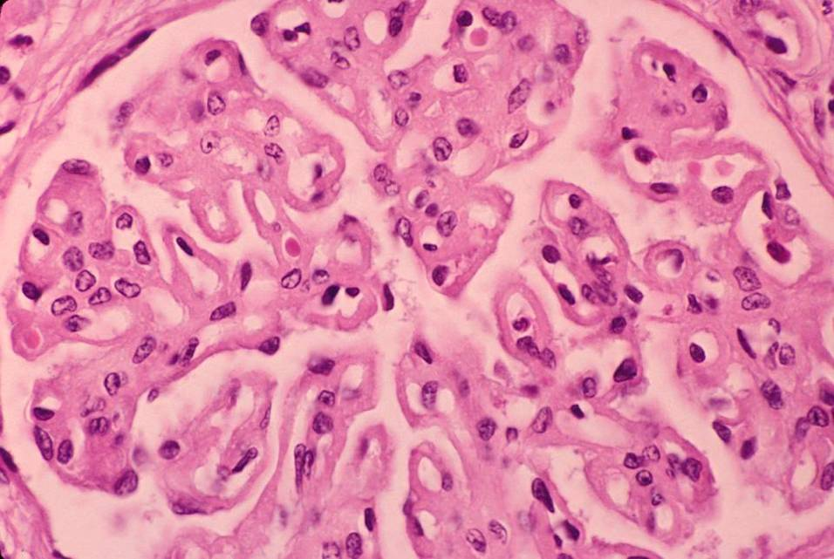

RBC
capillary
“wire loop”
Glomerulus: “wire loop” capillary appearance

Slide 17
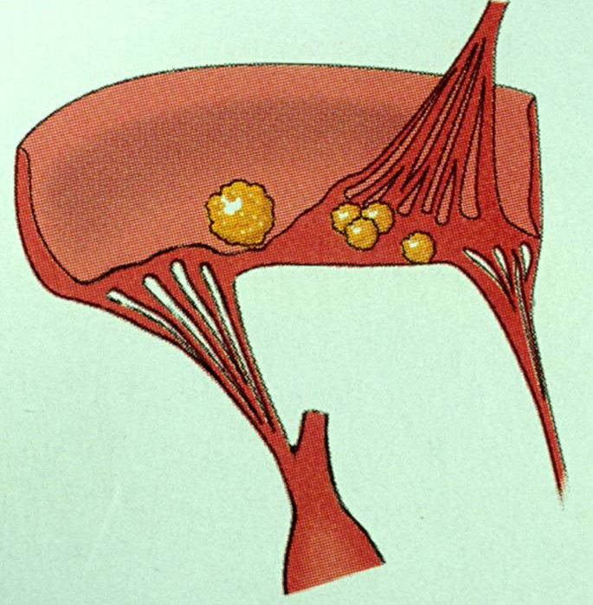
Heart valve: Libman-Sacks lesions

Slide 18
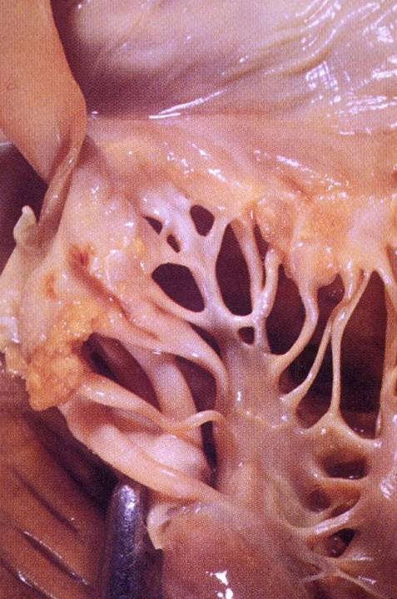

Atrium
Valve
Libman-Sacks lesions
Chordae tendinae
Ventricle
Libman-Sacks lesions

Slide 19
Lupus: Things a Dentist Might See
Young woman with polyarthritis and a butterfly (or other) skin rash
Fatigue
Sensitivity to sunlight
Headaches, seizures, or psychiatric problems
Pleuritic chest pain
Unexplained fever
Oral lesions (not super common though): nonspecific, red-white, erosive

Slide 20
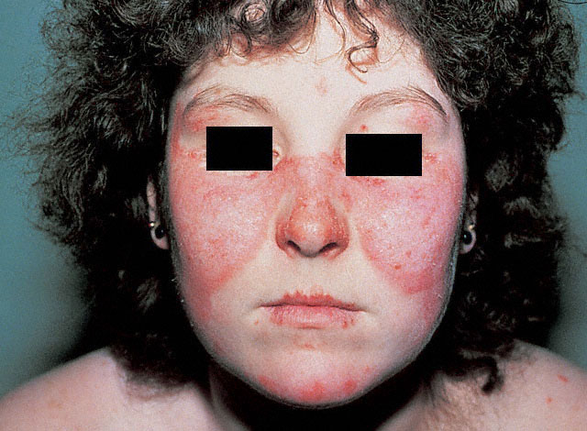

Butterfly rash

Slide 21
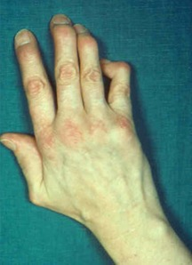
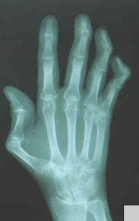

Hitch-hiker’s thumb

Slide 22
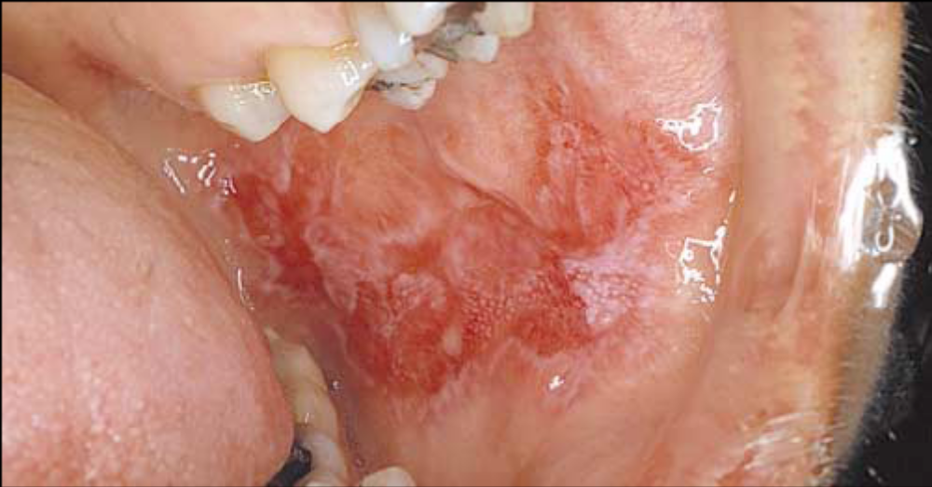
Non-specific buccal lesion

Slide 23

Lupus Prognosis
Variable! Some patients have just one or two episodes, rare patients die within months.
Most patients: relapses/remissions over many years.
Treatment: rituximab, steroids
80% 10-year survival
Most common cause of death: renal failure
anti-inflammatory
kills B cells

Slide 24
Rheumatoid Arthritis
KNOW THIS
Symmetric arthritis starting in small joints
May have systemic manifestations
Rheumatoid factor
Cytokines (especially TNF) cause damage

Slide 25


RA Etiology
Genetically predisposed patient
Something (bug? self-Ag?) activates T cells
T cells release cytokines:
  activate macrophages (causing destruction)
  cause B cells to make antibodies
Damage is mostly related to cytokines, especially TNF
Rheumatoid factor
IgM antibody directed against IgG
Present in 80% of patients

Slide 26
RA Signs and Symptoms
Arthritis
Fever, fatigue
Pericarditis
Pleuritis
Eye changes
Rheumatoid nodules on forearms

Slide 27


Characteristic Features of Arthritis in RA
Mainly small joints (hands), but also knees, elbows, shoulders
Symmetric; characteristic hand features
Chronic synovitis with pannus formation:
  synovial cell proliferation
  inflammation
  granulation tissue

Slide 28
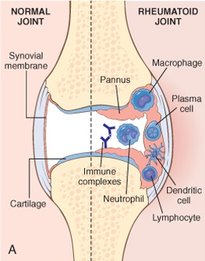


Rheumatoid arthritis joint lesion

Slide 29
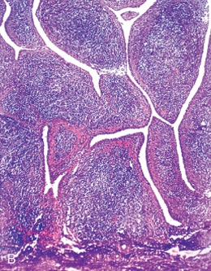
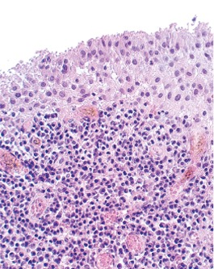


Rheumatoid arthritis: villi (L) and lymphoid aggregates (R)

Slide 30
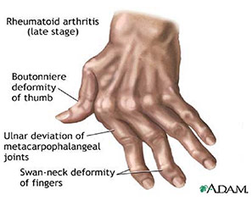

Rheumatoid arthritis joint deformities

Slide 31
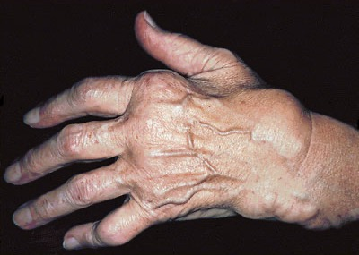






Ulnar deviation
of fingers
Boutonniere deformity
Swelling
Swan-neck deformity
Rheumatoid nodules
Rheumatoid arthritis joint deformities

Slide 32
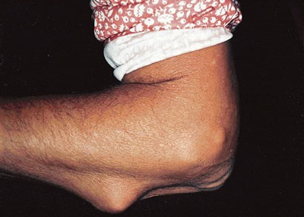


Rheumatoid nodules

Slide 33
RA: Things a Dentist Might See
Female patient with joint pain, swelling
Fingers: ulnar deviation, swan-neck deformities, boutonniere deformity
Rheumatoid nodules

Slide 34
RA: Prognosis
Most patients have chronic disease course with progressive joint destruction and disability
Lifespan shortened by 10-15 years
Treatment: steroids, anti-TNF agents

Slide 35
Sjögren Syndrome
KNOW THIS
Inflammatory disease of salivary and lacrimal glands
Dry eyes, dry mouth
T cells destroy glands
Increased risk of lymphoma

Slide 36
Sjögren Etiology
Genetic predisposition, environmental trigger
CD4+ T cells directed against cells in glands
Autoantibodies
  ANAs
  RF
  Anti-SS-A, anti-SS-B antibodies present in 90% of patients!

Slide 37
Sjögren Signs and Symptoms
Salivary and lacrimal glands
  enlarged, inflamed
  dry eyes, dry mouth
  40x increased risk of lymphoma!
Systemic disease
  fatigue
  arthralgia/myalgia
  Raynaud phenomenon
  vasculitis
  peripheral neuropathy

Slide 38

Sjögren: Things a Dentist Might See
Female between 35-45
Enlarged salivary glands
Raynaud phenomenon
Keratoconjunctivitis sicca (dry eyes)
Oral changes:
  xerostomia (dry mouth)
  mucosal atrophy
  candidiasis
  mucosal ulceration
  caries
  taste dysfunction

Slide 39
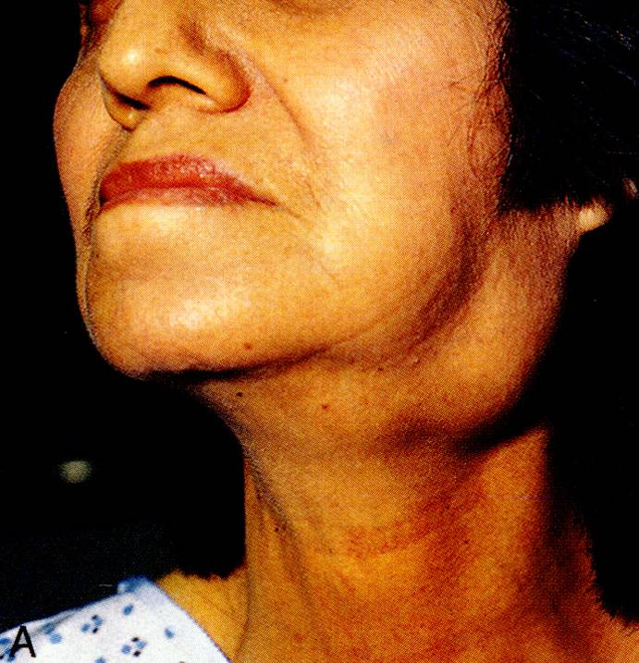
Sjögren syndrome: salivary gland enlargment

Slide 40
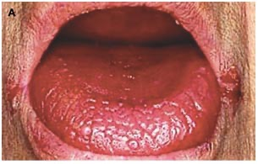
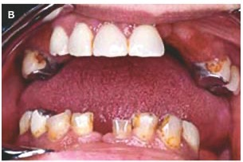
Oral changes in Sjögren Syndrome
atrophic papillae, deeply fissured epithelium
missing teeth and multiple caries
angular cheilitis
Notes:
s.

Slide 41
Sjögren Treatment
Treatment is mostly supportive and symptom-based
Oral treatment: adequate hydration, scrupulous dental hygiene, cholinergic agents (stimulate saliva release), frequent dental exams
Eye treatment: lubricating solutions, surgical procedures
Systemic symptom treatment: steroids, other immunosuppressive drugs

Slide 42
Scleroderma (Systemic Sclerosis)
KNOW THIS
Excessive fibrosis in skin and viscera
Claw hands
Mask-like face
Diffuse and limited types

Slide 43
Scleroderma Etiology
CD4+ T cells accumulate for some reason
T cells release cytokines that activate mast cells and macrophages, which release fibrogenic cytokines
B cell activation also occurs but doesn’t play major role
Autoantibody: anti-Scl 70

Slide 44
Scleroderma Signs and Symptoms
Skin: diffuse, sclerotic atrophy. Fingers first.
GI: “rubber-hose” esophagus
Lungs: fibrosis, pulmonary hypertension
Kidneys: narrowed vessels, hypertension
Heart: myocardial fibrosis

Slide 45
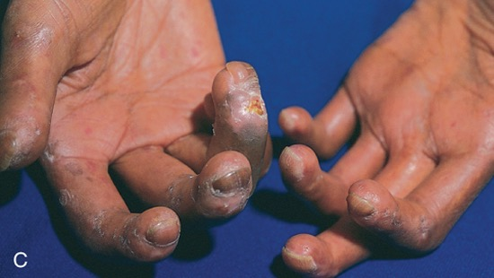

Scleroderma: claw hands

Slide 46
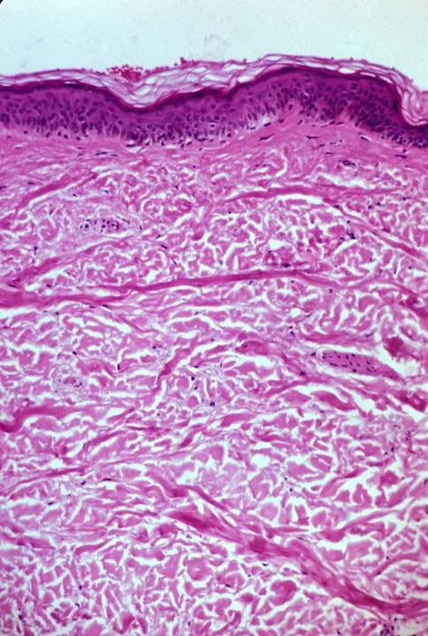

Epidermis
Dermis
Scleroderma: sclerotic skin

Slide 47
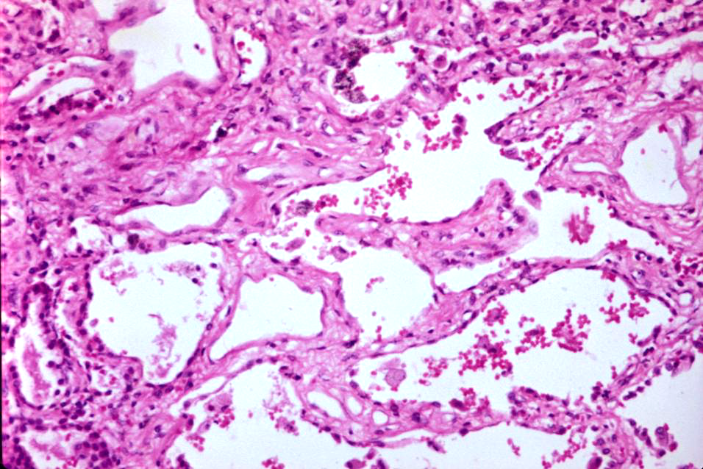


Alveolar wall
Airspace
Airspace
Scleroderma: fibrosis in alveolar walls

Slide 48
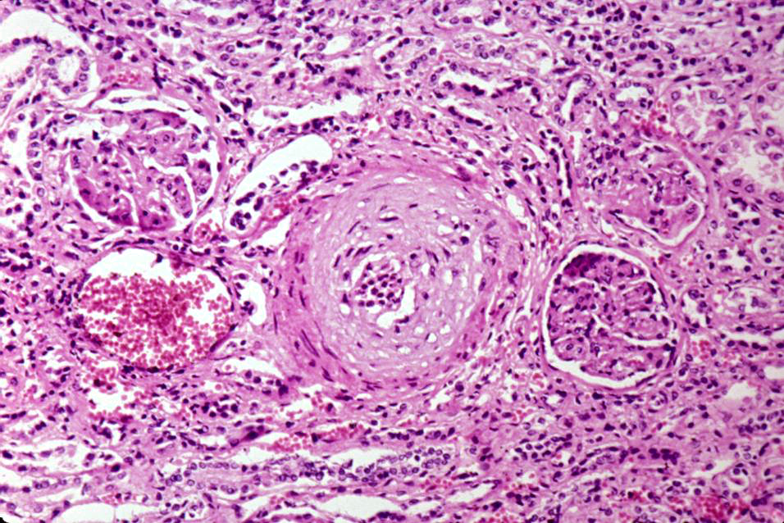





Glomerulus
Arteriole
Glomerulus
Scleroderma: narrowed renal vessel

Slide 49
Limited vs. Diffuse Scleroderma
Limited Scleroderma
Diffuse Scleroderma
Mild skin involvement
Late visceral involvement
Benign course
Widespread skin involvement
Early visceral involvement
Rapid course

Slide 50
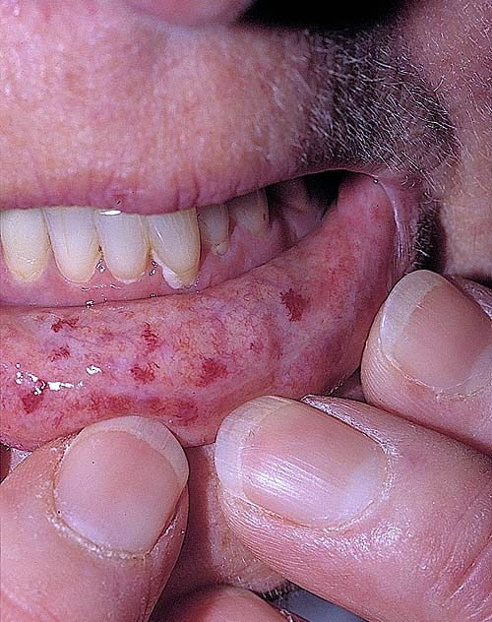
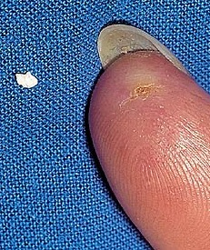

CREST Syndrome
Calcinosis
Raynaud phenomenon
Esophageal dysmotility
Sclerodactyly
Telangiectasia

Slide 51
Scleroderma: Things a Dentist Might See
Female between 50-60
Raynaud phenomenon
Stiff, claw-like fingers
Mask-like face
Difficulty swallowing
Dyspnea, chronic cough
Difficulty getting dentures in

Slide 52
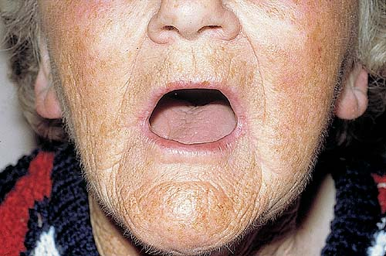
Scleroderma: restricted mouth opening

Slide 53
Scleroderma Prognosis
Steady, slow, downhill course over years
Limited scleroderma may exist for decades without progressing
Diffuse scleroderma is more common and has worse prognosis
Overall 10-year survival = 35-70%

