Slide 1

Hypersensitivity Reactions
Kristine Krafts, M.D.

Slide 2
Hypersensitivity Reactions Objectives
Explain in general how hypersensitivity reactions are different than normal immune reactions.
Explain how T_{H}2 cells, mast cells, IgE, and mediators (like histamine, prostaglandins, and cytokines) are involved in the mechanism of type I hypersensitivity reactions.
Explain the three ways that antibodies mess things up in type II hypersensitivity reactions.

Slide 3
Hypersensitivity Reactions Objectives
Describe how immune complexes lead to tissue damage in type III hypersensitivity reactions.
Describe the mechanisms involved in both kinds of type IV hypersensitivity reactions.
List a few diseases caused by each of the four types of hypersensitivity reactions.

Slide 4
Hypersensitivity Reactions Outline
Introduction and definitions
Type I hypersensitivity
Type II hypersensitivity
Type III hypersensitivity
Type IV hypersensitivity

Slide 5
What are hypersensitivity reactions?
Excessive, harmful immune reactions
Elicited by environmental or endogenous antigens
Often caused by a failure of normal regulatory mechanisms
Often have a genetic basis (HLA or otherwise)
Fall into four categories (type I, II, III, and IV hypersensitivity)

Slide 6
What happens in these reactions?
The immune response is triggered and maintained inappropriately.
Can be hard to eliminate triggers
Can be hard to stop the response
So diseases caused by hypersensitivity responses are often chronic, debilitating, and hard to treat.

Slide 7
The four types of hypersensitivity reactions
Type I hypersensitivity
Type II hypersensitivity
Type III hypersensitivity
Type IV hypersensitivity
“Allergy”
“Antibody”
“Immune complex”
“T-cell”

Slide 8
Type I Hypersensitivity
ALLERGY
“Immediate” hypersensitivity
Antigen (allergen) binds to IgE antibodies on surface of mast cell
Mast cell releases nasty mediators
End result: vessels dilate, smooth muscle contracts, inflammation persists

Slide 9
Sequence of Events
Allergen is inhaled/eaten/injected
Allergen stimulates T_{H}2 production
T_{H}2 cell secretes cytokines:
  IL-4 stimulates B cells to make IgE
  IL-5 recruits eosinophils
  IL-13 stimulates mucous secretion
Mast cell binds IgE
Allergen bridges IgE on mast cell
Mast cell degranulates

Slide 10
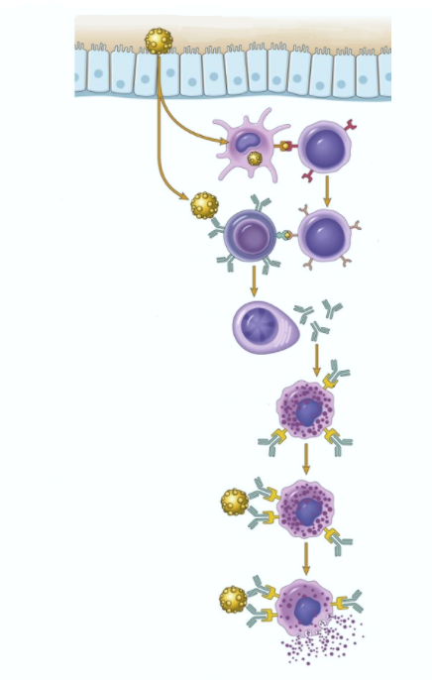
First exposure to allergen
Allergen
Exposure
to allergen
Mucosal lining
Dendritic cell
Naïve T cell
Activation of
B and T cells
B cell
T_{H}2 cell
Production
of IgE
Plasma cell
IgE
F_{c} receptor
Binding of IgE
to mast cells
Mast cell

Slide 11


Repeat exposure to allergen
Allergen
Mast cell
Degranulation
Mediators
Histamine
Prostaglandins
Cytokines
vasodilation
vascular leakage
smooth muscle spasm
Immediate reaction (minutes)
Late reaction
(hours)
inflammation
tissue destruction

Slide 12
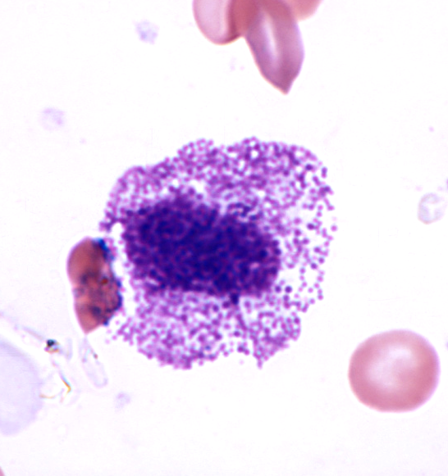
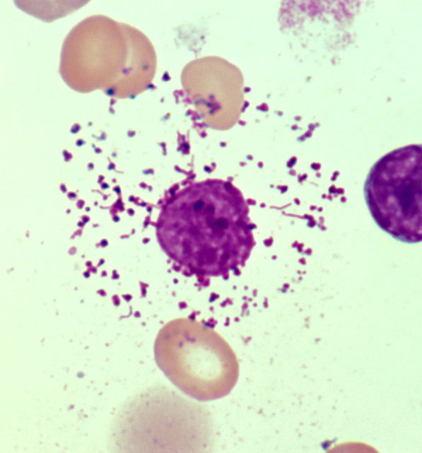
Intact mast cell
Degranulated mast cell

Slide 13
What happens to the patient?
Local reactions
  skin: itching, hives
  GI: diarrhea
  lung: bronchoconstriction
Anaphylaxis
  itching, hives, erythema
  constriction of bronchioles, wheezing
  laryngeal edema, hoarseness, obstruction
  vomiting, cramps, diarrhea
  shock
  DEATH

Slide 14
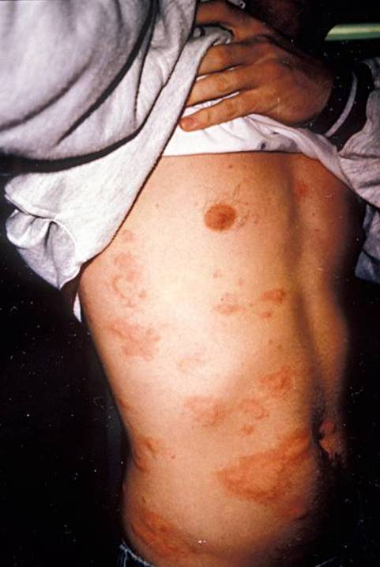

Slide 15
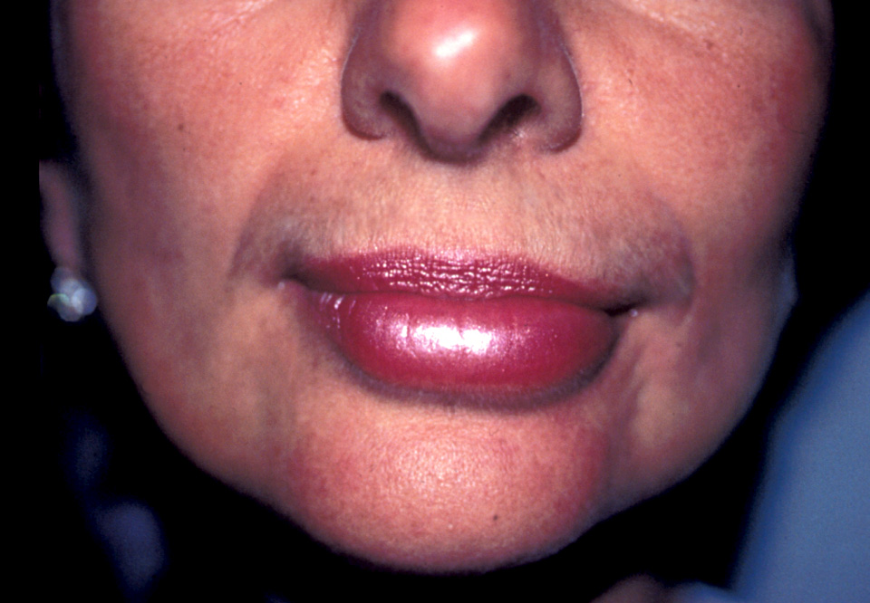

Slide 16
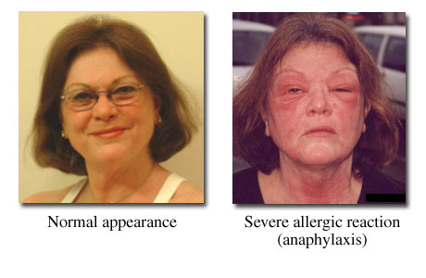

Slide 17
Type II Hypersensitivity
ANTIBODIES
“Antibody-mediated” hypersensitivity
Antibodies bind to antigens on cell surface
One of three things happens:
  Opsonization and phagocytosis
  Inflammation
  Cellular dysfunction
Notes:
A

Slide 18
Diseases caused by type II hypersensitivity
Disease | Antigen | Symptoms
Autoimmune hemolytic anemia | RBC antigens | Hemolysis
Myasthenia gravis | Acetylcholine receptor | Muscle weakness
Graves disease | TSH receptor | Hyperthyroidism

Slide 19
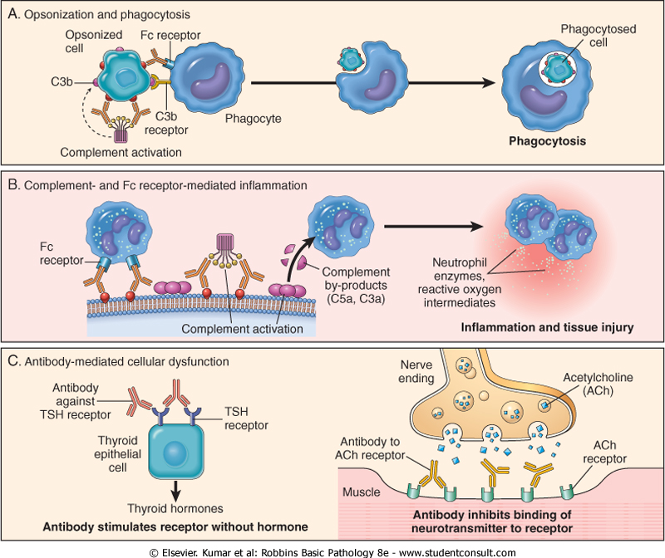

Opsonization and phagocytosis
“opson” = sauce

Slide 20
Inflammation

Slide 21
Cellular dysfunction
Graves disease
Myasthenia gravis

Slide 22
Type III Hypersensitivity
IMMUNE COMPLEXES
“Immune complex-mediated” hypersensitivity
Antibodies bind to antigens, forming complexes
Complexes circulate, get stuck in vessels, stimulate inflammation
End result: bad inflammation, necrotizing vasculitis
Notes:
.

Slide 23
Diseases caused by type III hypersensitivity
Disease | Antigen | Symptoms
Systemic lupus erythematosus | Nuclear antigens | Nephritis, skin lesions, arthritis…
Polyarteritis nodosa | Hepatitis B antigen | Systemic vasculitis

Slide 24
How do the complexes cause inflammation?
Immune complexes activate complement, which:
  attracts and activates neutrophils
  makes vessels leaky
Neutrophils release tissue-dissolving enzymes
Immune complexes also activate clotting, causing microthrombi
Outcomes: vasculitis, glomerulonephritis, arthritis, other -itises

Slide 25
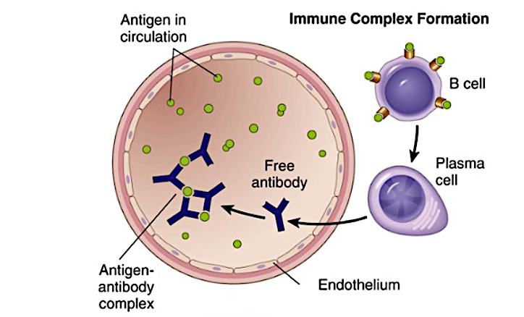

Slide 26
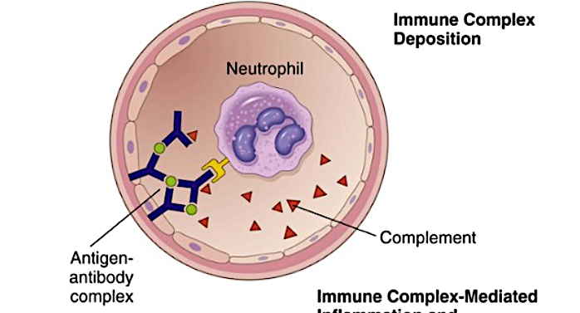


Slide 27
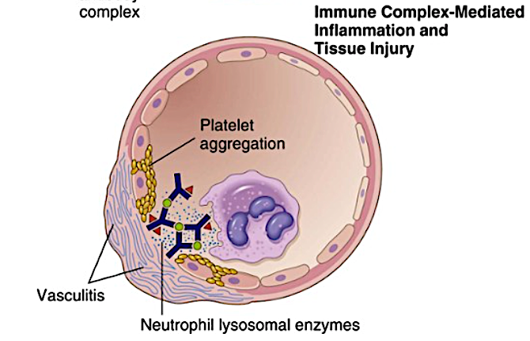



Fibrinoid necrosis

Slide 28
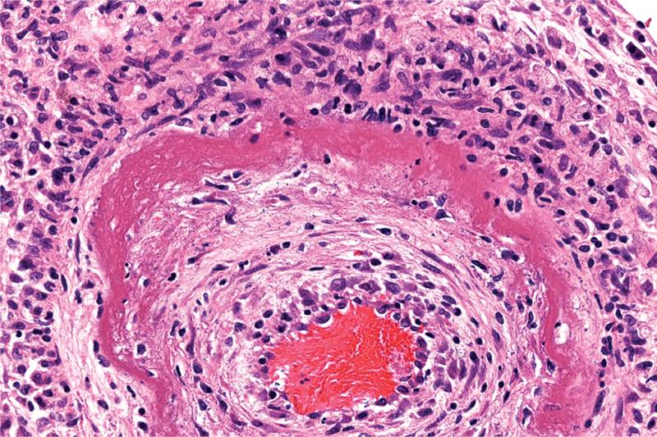
Immune-complex-mediated vasculitis

Slide 29
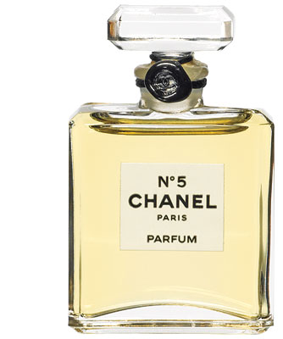
Know these complement fractions
C3b: promotes phagocytosis
C5a: chemotactic for neutrophils
C5-9: membrane damage

Slide 30

Type IV Hypersensitivity
“delayed-type hypersensitivity”
T CELLS
“T-cell-mediated” hypersensitivity
Activated T cells do one of two things:
  release cytokines that activate macrophages, or
  kill cells directly
Results: inflammation, cell destruction
“cell-mediated cytotoxicity”

Slide 31
Delayed-Type Hypersensitivity
Patient exposed to antigen
  APC presents antigen to CD4+ T cell
  T cells differentiate into effector and memory T_{H}1 cells
Patient exposed to antigen again
  T_{H}1 cells come to site of antigen exposure
  Release cytokines that activate macrophages, cause inflammation

Slide 32
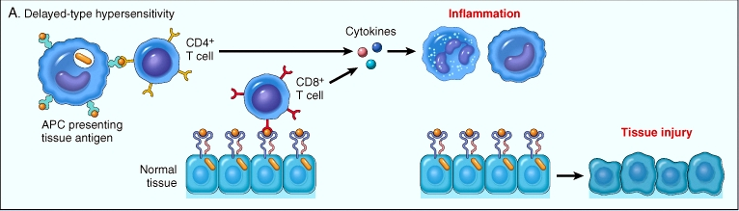

Delayed-Type Hypersensitivity (DTH)

Slide 33
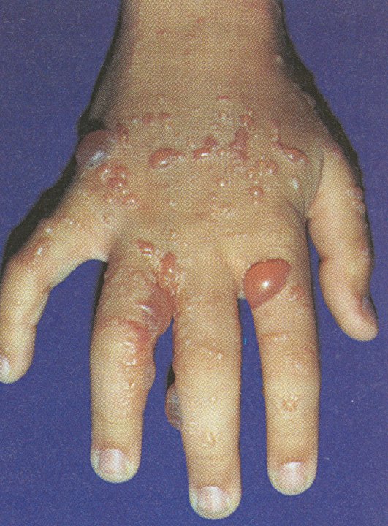
Poison ivy is caused by delayed-type hypersensitivity

Slide 34
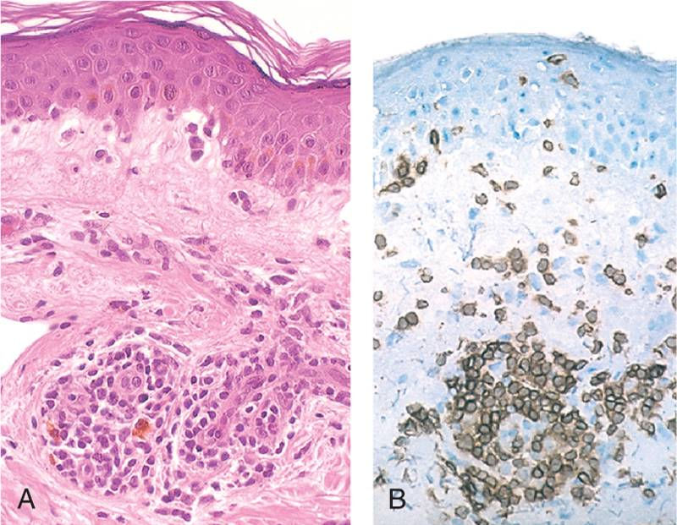
Perivascular cuffing by CD4+ cells

Slide 35
Cell-Mediated Cytotoxicity
CD8+ T cells differentiate into cytotoxic T lymphocytes (CTLs) which kill antigen-bearing cells
In normal immune reactions, CTLs kill infected cells
In cell-mediated cytotoxicity, CTLs kill cells they shouldn’t (e.g., pancreatic islet cells)

Slide 36
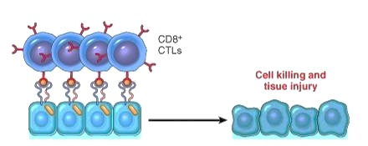
T-Cell-Mediated Cytotoxicity
CD8
MHC I

Slide 37
Diseases caused by type IV hypersensitivity
Disease | Mechanism | Symptoms
Multiple sclerosis | DTH against antigens in myelin | Neurologic symptoms such as paralysis
Type I diabetes | CTLs destroy insulin-producing islet cells | Hyperglycemia

