Slide 1

Neoplasia III: Epidemiology

Slide 2
Epidemiology Lecture Objectives
List the most common type of cancer in men and women, and the cancer responsible for the most deaths.
List the seven most important environmental factors that contribute to the development of carcinoma, and describe a little about each one (e.g., types of associated cancers).
Define, compare and contrast the three types of hereditary cancer.
Briefly describe the genetic mutations in Li-Fraumeni syndrome and xeroderma pigmentosum, and explain how they lead to the development of cancer in each disorder.

Slide 3
Epidemiology Lecture Outline
Cancer facts
Environmental factors
Hereditary cancer

Slide 4
Cancer Facts
Every year there are:
1.5 million new cases of cancer
>500,000 cancer deaths
Cancer is the 2nd leading cause of death (after heart disease)
Most common cancers
Cancers causing the most deaths
  Men: Prostate
  Women: Breast
  Men: Lung
  Women: Lung

Slide 5
= 10 per 100,000

Slide 6
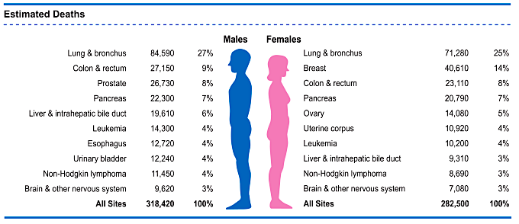
Cancer Deaths

Slide 8

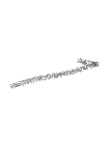






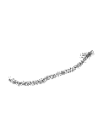

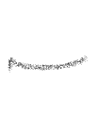



Environmental Factors
HPV (cervical and oropharyngeal cancers)
“The single most important environmental factor contributing to premature death in the US.”
Infectious agents
Smoking
Alcohol
Diet
Obesity
Reproductive history
Environmental carcinogens
Lung, but also oral cavity and pancreatic cancers
Liver, oral cavity, breast
Colon, prostate, breast
“The most overweight people in the US have over 50% higher death rates from cancer”
estrogen exposure
breast and endometrial cancer
UV light (skin)
Arsenic (lung, skin)
Asbestos (mesothelioma)
Benzene (leukemia)
Radon (Lung)

Slide 9
Three Types of Hereditary Cancer
Familial cancers
Inherited cancer syndromes
Syndromes of defective DNA repair

Slide 10
Familial Cancers
Most cases of cancer are sporadic (random)
A small number are familial (related to specific
germline gene mutations)
Example: certain BRCA1 gene mutations increase risk of breast, colon, ovary, and pancreatic cancers
Familial cancers occur earlier and are more aggressive than their sporadic counterparts

Slide 11
Inherited Cancer Syndromes
Usually autosomal dominant
Each has a specific gene mutation that increases risk of getting multiple cancers
Example: Li-Fraumeni syndrome
  mutation in p53 gene
  25x risk of sarcomas, breast cancer, leukemia, and brain tumors
  cancers usually appear before age 50

Slide 12
Syndromes of Defective DNA Repair
Inherited mutations in genes encoding DNA repair systems
Greatly enhance the occurrence of mutations in other genes (“genomic instability”)
Example: xeroderma pigmentosum
  Mutations in genes in “nucleotide excision repair” pathway (fixes UV-damaged DNA)
  Extreme sensitivity to sunlight
  risk of skin cancer (in childhood!)

Slide 13



