Slide 1

Neoplasia IV: Cancer Pathogenesis

Slide 2
Cancer Pathogenesis Lecture Objectives
List the eight characteristics (or hallmarks) of cancer cells that make them different from normal cells.
Explain what proto-oncogenes and oncogenes are.
Describe what the RAS protein normally does, and explain how it causes cancer when it is mutated.
Describe what tumor suppressor genes are.
Describe what the RB protein normally does, and explain how it causes cancer when it is mutated.
Describe the normal functions of p53, and explain why it’s mutated in most tumors.
Describe the normal function of telomeres, and explain how tumor cells exploit this function.

Slide 3
What causes cancer?
Non-lethal genetic damage.

Slide 4
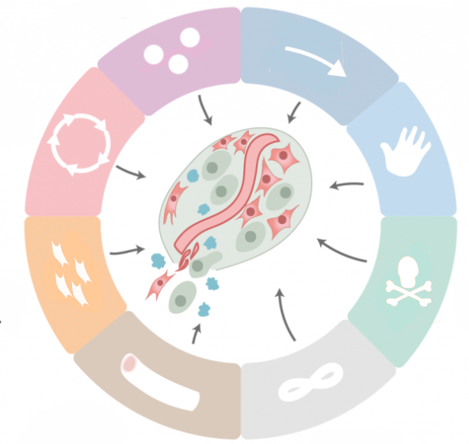
Hallmarks of Cancer
Evasion of
immune detection
Autonomous
cell proliferation
Resistance to
growth-suppressing signals
Altered
metabolism
Ability to invade
and metastasize
Evasion of
apoptosis
Angiogenesis
Immortality

Slide 5
Hallmarks of Cancer
Autonomous
cell proliferation

Slide 6
Autonomous Cell Growth
Proto-oncogene: a normal gene whose product promotes cell growth.
Oncogene: a mutated proto-oncogene.
Causes tumor cell to grow autonomously.
Oncoprotein: the product of an oncogene.

Slide 7
The RAS Gene
RAS is a signal transduction protein
Mutated RAS is always on…
…therefore, always transducing signals…
…therefore, cell is always dividing.

Slide 8
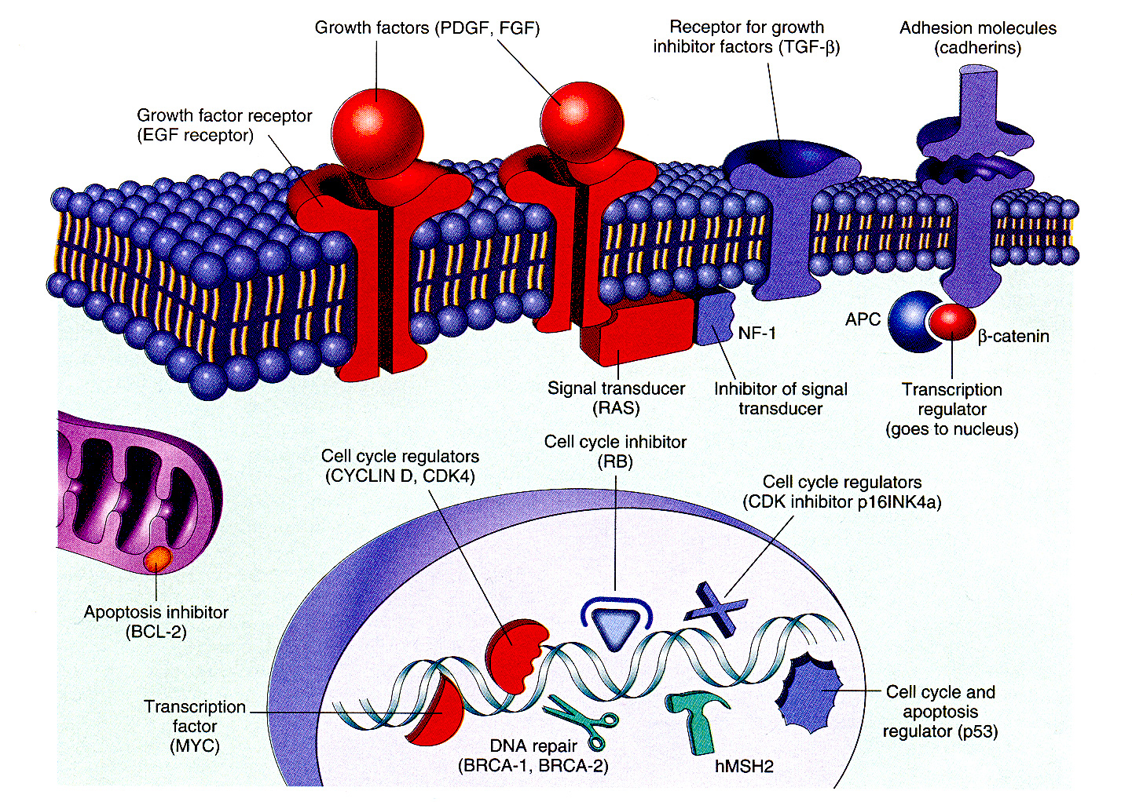


Slide 9
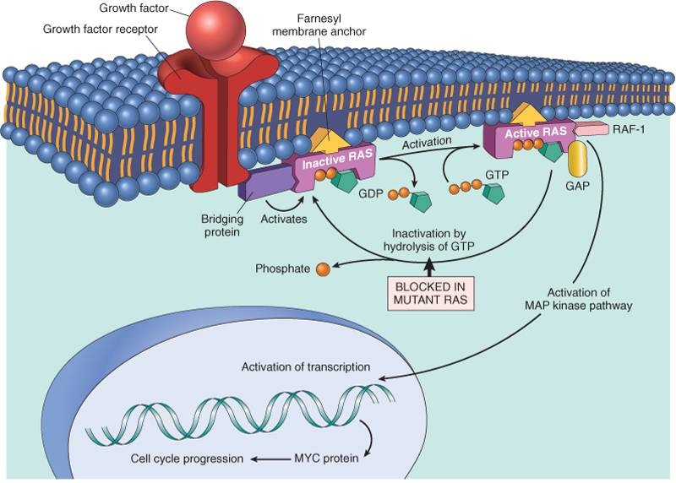





Slide 10
Hallmarks of Cancer
Autonomous
cell proliferation
Resistance to
growth-suppressing signals

Slide 11
Resistance to Growth-Suppressing Signals
Tumor suppressor gene: a normal gene whose product suppresses the cell cycle (like brakes on a car).
Mutate these guys, and you lose the brakes!
Must mutate both copies of the gene to cause tumors.

Slide 12
The Retinoblastoma (RB) Gene
RB gene product stops cell at G₁ checkpoint
Mutant RB is inactive; lets cells pass through G₁!
Patients with two mutated RB genes have very high risk of retinoblastoma (and an increased risk of getting other tumors).

Slide 13


Slide 14
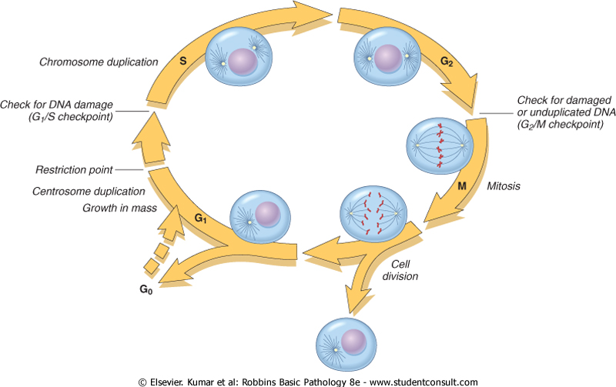
The Cell Cycle
RB pauses cell cycle here

Slide 15
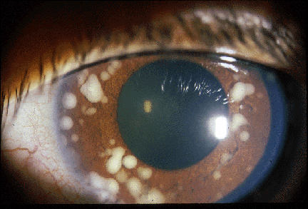
Retinoblastoma

Slide 16
Hallmarks of Cancer
Autonomous
cell proliferation
Resistance to
growth-suppressing signals
Evasion of
apoptosis

Slide 17
Evasion of Apoptosis
Many proteins are involved in apoptosis:
  p53
  Fas (the “death receptor”)
  Executioner caspases
  BCL2 protein family
If genes for these proteins are mutated,
the cell will be able to avoid killing itself.

Slide 18
The p53 Gene
Nickname for p53: “guardian of the genome”
If a cell’s DNA is damaged, p53 causes a pause in the cell cycle (via RB), so DNA can be repaired.
If DNA damage is irreparable, p53 causes the cell to undergo apoptosis.
Most human tumors have p53 mutations!

Slide 19


Slide 20
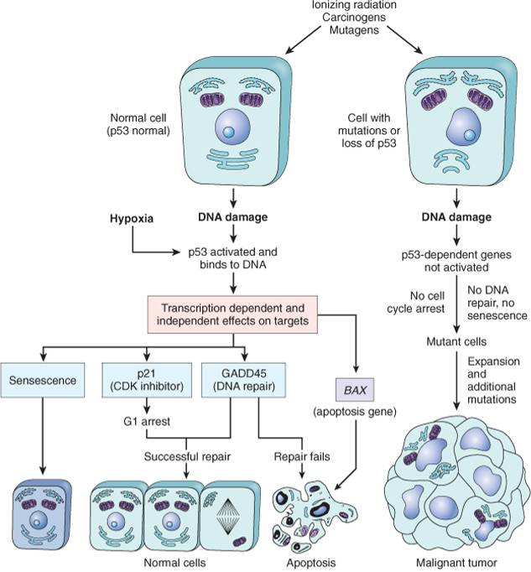











p53 activated
p53 not activated
cell cycle arrest
no cell cycle arrest,
no DNA repair

Slide 21
Hallmarks of Cancer
Autonomous
cell proliferation
Resistance to
growth-suppressing signals
Evasion of
apoptosis
Immortality

Slide 22
Immortality
Normal cells can only undergo 60-70 doublings
Main reason: telomere shortening!
Stem cells and cancer cells use telomerase to maintain telomere length and keep replicating.

Slide 23
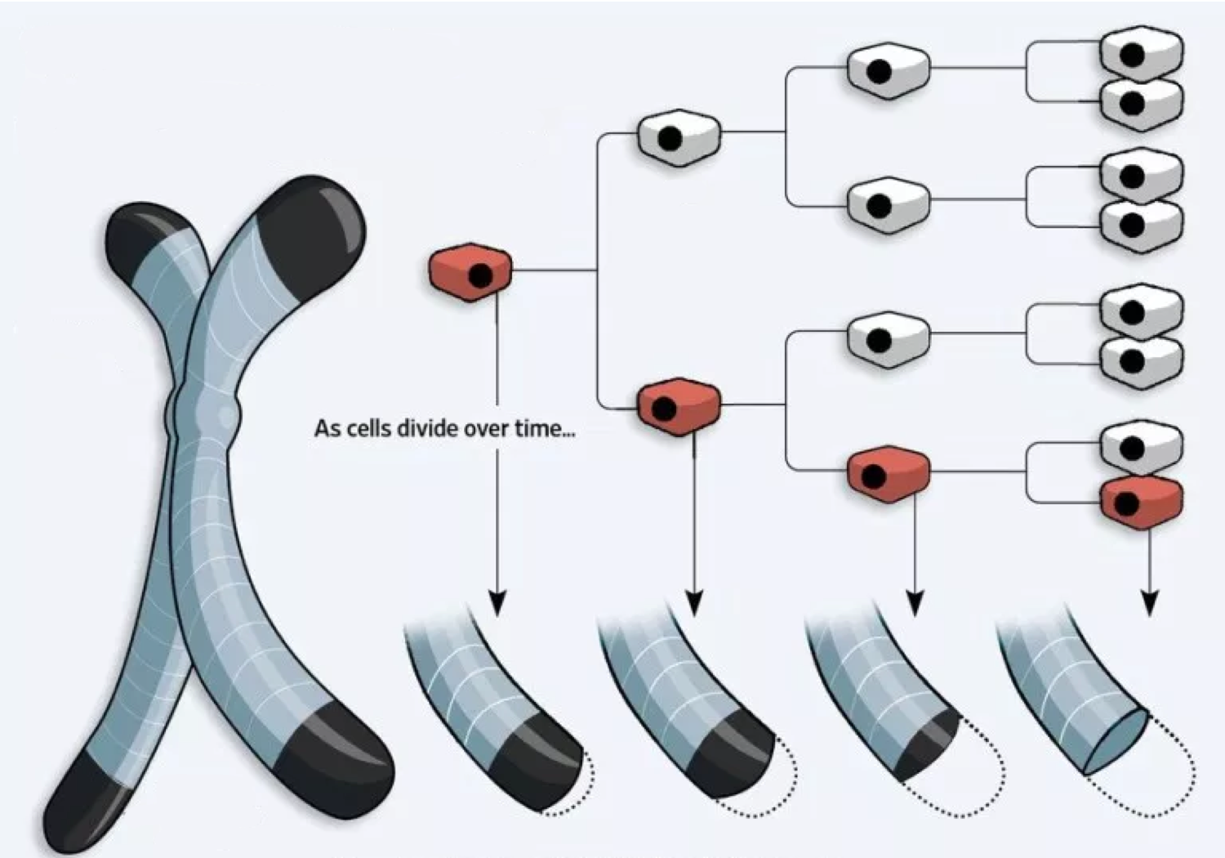


Telomeres
As cells divide over time...

Slide 24
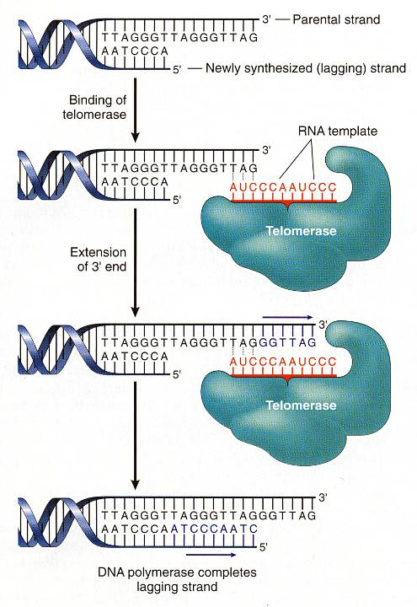


Stem cells and cancer cells use telomerase to replenish telomeres!

Slide 25


Slide 26
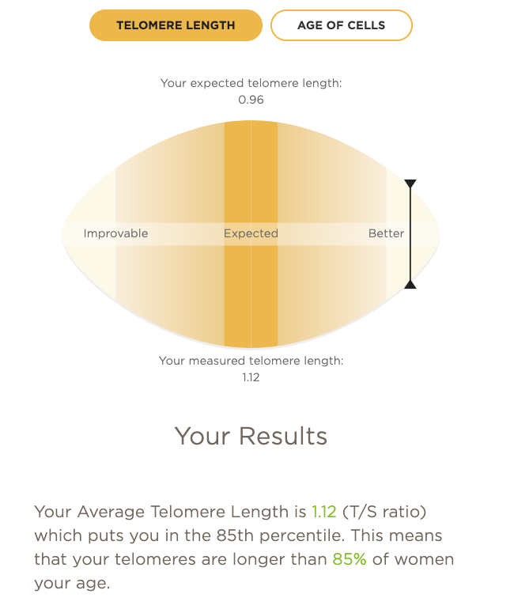

Slide 27
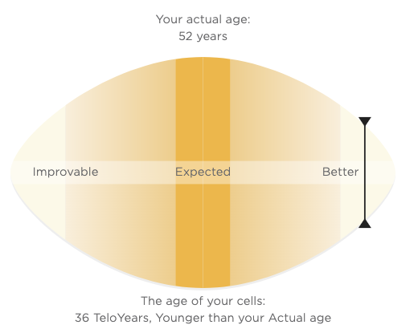
36

Slide 28
Hallmarks of Cancer
Autonomous
cell proliferation
Resistance to
growth-suppressing signals
Evasion of
apoptosis
Angiogenesis
Immortality

Slide 29
Angiogenesis
Tumor cells need blood too!
Can’t grow >1-2 cm without new vessels
Tumor cells eventually learn how to stimulate angiogenesis
Lots of cytokines involved (i.e., VEGF)

Slide 30
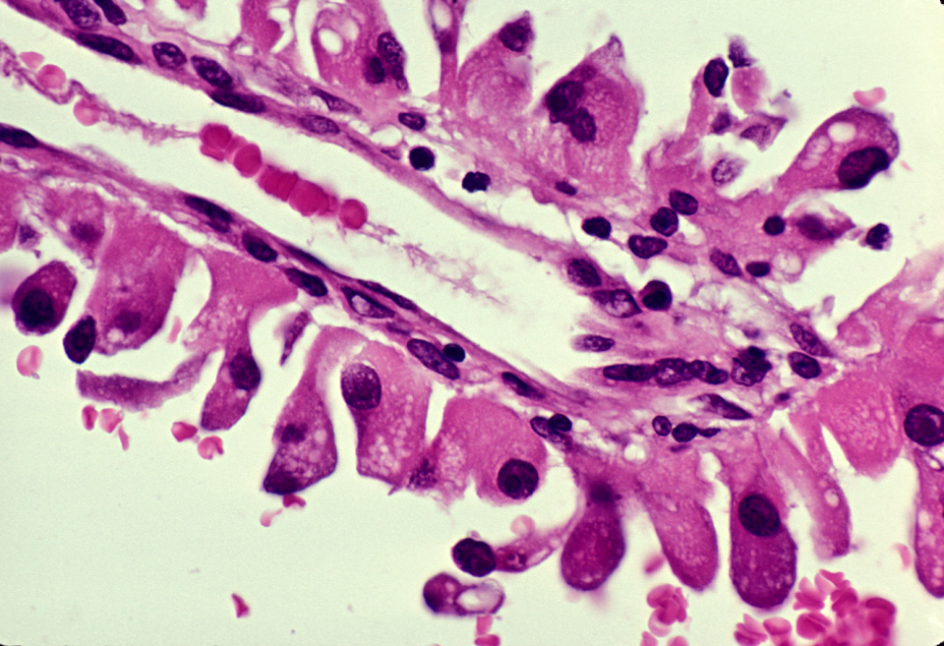
Tumor cells surrounding new vessel

Slide 31
Hallmarks of Cancer
Autonomous
cell proliferation
Resistance to
growth-suppressing signals
Ability to invade
and metastasize
Evasion of
apoptosis
Angiogenesis
Immortality

Slide 32
Ability to Invade and Metastasize
To do this, tumor cells must:
  Loosen contacts between cells
  Degrade extracellular matrix
  Migrate away from the original site
Some tumors lodge in nearest capillary bed; other tumors show tropism.

Slide 33
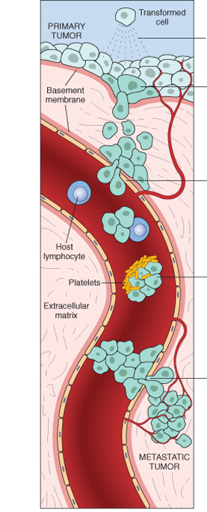
clonal growth
metastatic subclone
intravasation
tumor cell embolus
extravasation

Slide 34
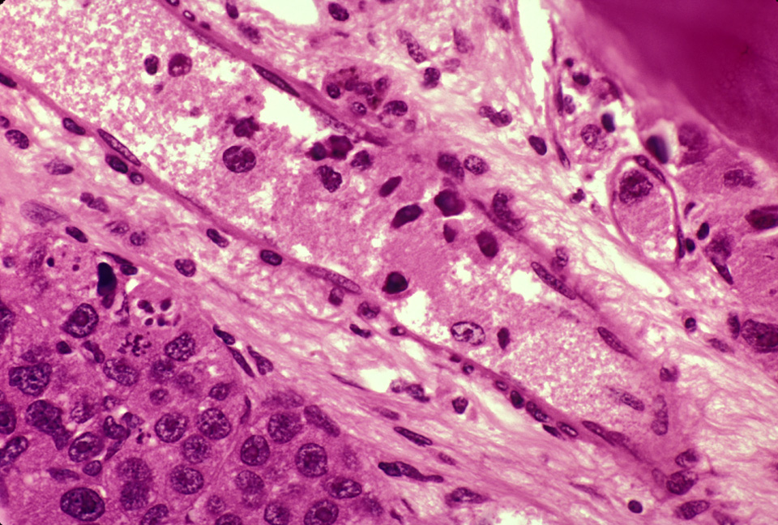
Tumor cells surrounding and invading vessel

Slide 35
Hallmarks of Cancer
Autonomous
cell proliferation
Resistance to
growth-suppressing signals
Altered
metabolism
Ability to invade
and metastasize
Evasion of
apoptosis
Angiogenesis
Immortality

Slide 36





Altered Metabolism
Otto Warburg
Normal cells, when oxygen is around, use oxidative phosphorylation to generate ATP.
Cancer cells are different!
They take up tons of glucose, and convert it to lactate via the glycolytic pathway.
This is called aerobic glycolysis, or the “Warburg effect.”
1931

Slide 37
Hallmarks of Cancer
Evasion of
immune detection
Autonomous
cell proliferation
Resistance to
growth-suppressing signals
Altered
metabolism
Ability to invade
and metastasize
Evasion of
apoptosis
Angiogenesis
Immortality

Slide 38
