Slide 1
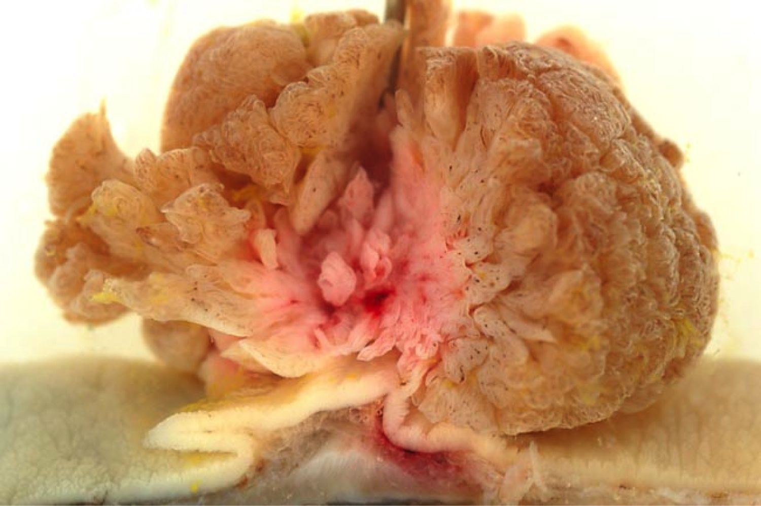
Lower Gastrointestinal Pathology
Kristine Krafts, M.D.

Slide 2
GI Pathology Outline
Esophagus
Stomach
Intestine
  Diverticulosis
  Inflammatory bowel disease
  Adenoma
  Carcinoma

Slide 3
Diverticulosis
Mucosa/submucosa herniates through muscle wall
Older patients, low fiber diet
Sigmoid colon
Asymptomatic unless infected (“diverticulitis”)

Slide 4
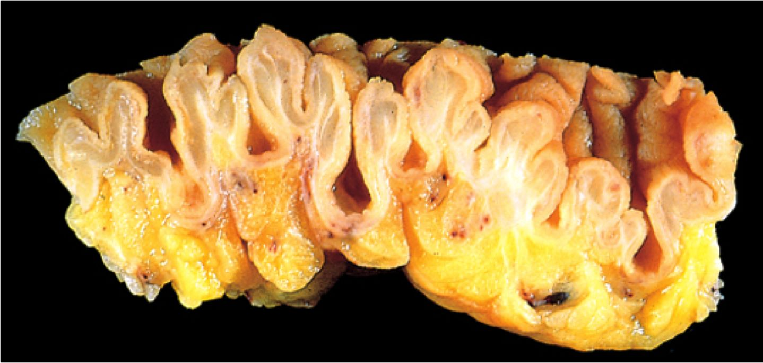
Diverticulosis

Slide 5
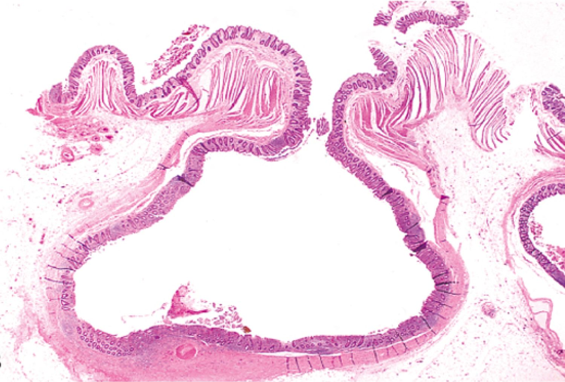
Diverticulosis

Slide 6
Inflammatory Bowel Disease
Crohn Disease
Anywhere
Patchy
Transmural
Poor response to surgery
Increased risk of cancer
Ulcerative Colitis
Colon only
Continuous
Superficial
Good response to surgery
Increased risk of cancer

Slide 7
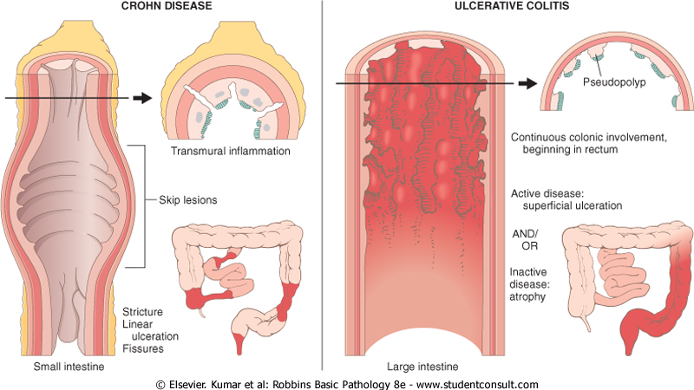
Crohn disease
Ulcerative colitis

Slide 8
Adenoma
Common! 50% of people >60.
Benign glands; may become dysplastic
More dangerous when:
  Large (>1 cm)
  Villous architecture
  Severely dysplastic

Slide 9
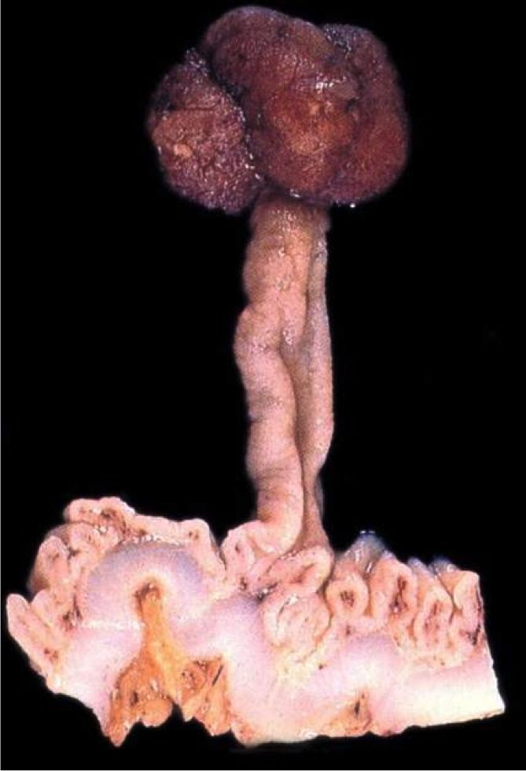
Tubular adenoma of colon

Slide 10
Villous adenoma of colon

Slide 11
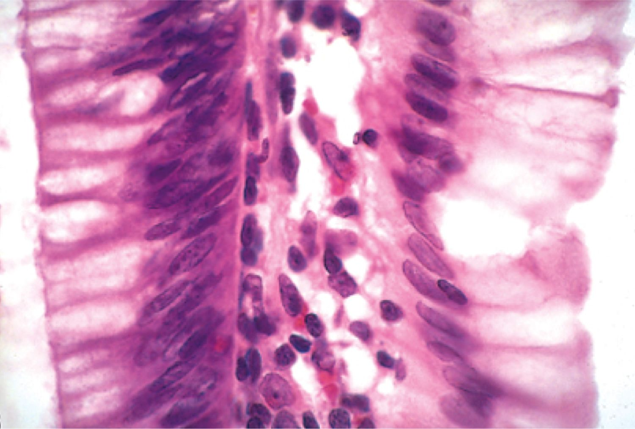
Dysplastic (L) vs. normal (R) epithelium

Slide 12
Colon Carcinoma
Almost always arises in adenomatous polyp
Diet: low fiber, high fat, lots of refined carbs
Symptoms:
  silent for years
  fatigue, weakness, iron-deficiency anemia
  occult bleeding, crampy pain
5 year prognosis: 4% (stage 4) - 90% (stage 1)

Slide 13
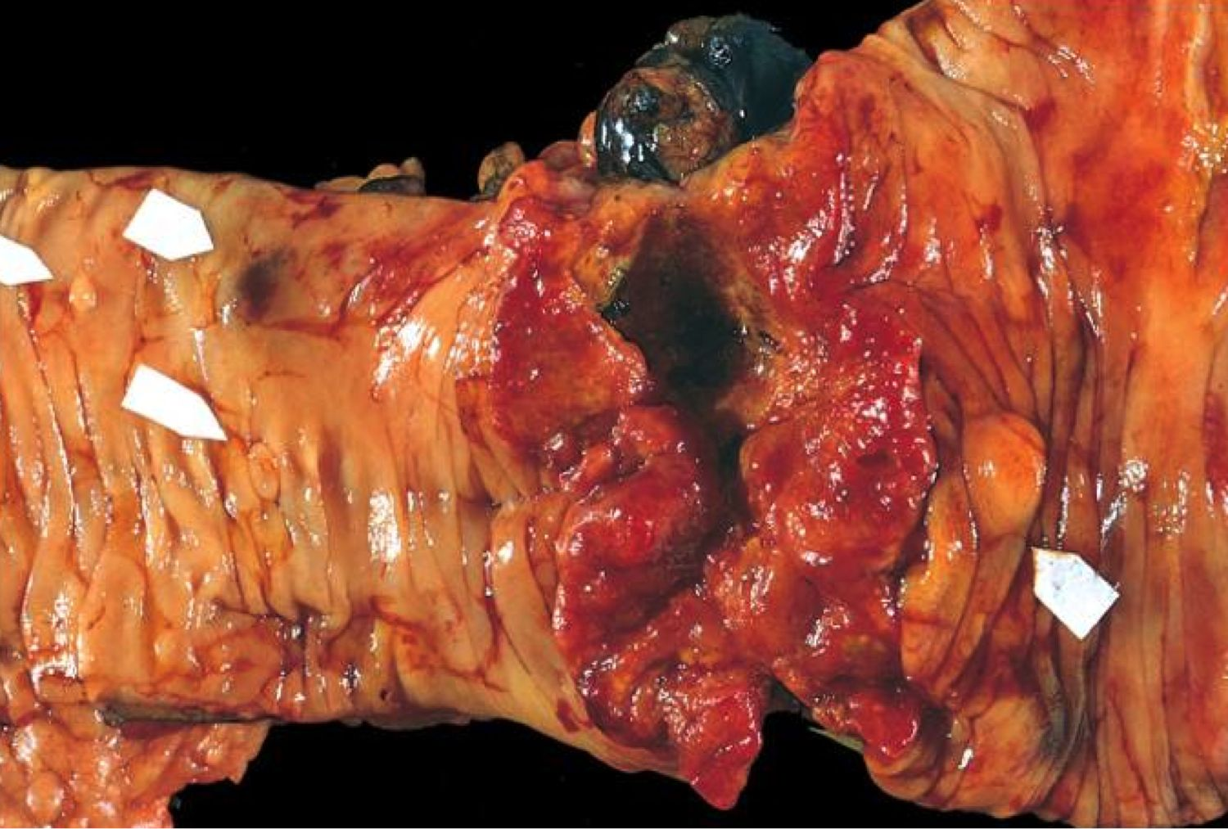
Colon carcinoma

Slide 14
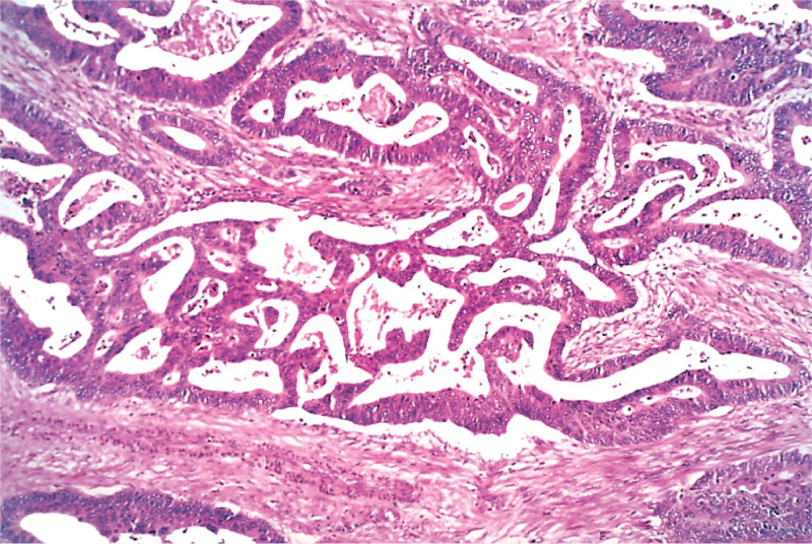
Colon carcinoma

