Slide 1
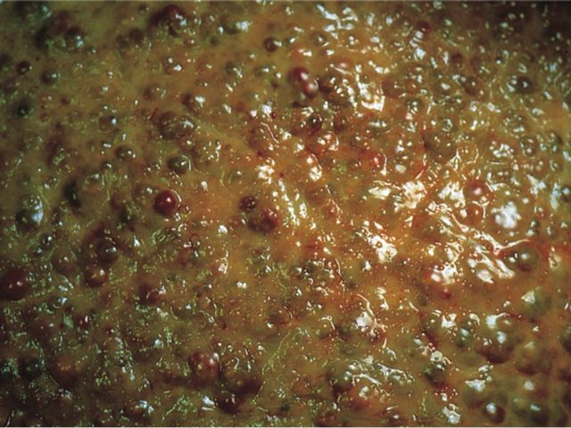
Liver, Gallbladder, and Pancreas Pathology
Kristine Krafts, M.D.

Slide 2
GI Pathology Outline
Esophagus
Stomach
Intestine
Liver
  Hepatitis
  Alcoholic liver disease
  Hemochromatosis
  Wilson disease
  Carcinoma

Slide 3
Viral Hepatitis
Caused by Hepatitis A, B, or C viruses
Some cases asymptomatic
Some cases symptomatic:
  Acute (jaundice)
  Chronic (may lead to cirrhosis and liver failure)
  Fulminant (liver failure)

Slide 4
 | Hepatitis A | Hepatitis B | Hepatitis C
Transmission | Fecal-oral | Body fluids Needles | Body fluids Needles
Chronic Hepatitis | None | 5% | >85%
Carcinoma | No | Yes | Yes
Other stuff | 50% of people > 50 are + | Vaccine effective | New drugs are promising
Bottom line | Benign, self-limited disease | Most recover; small % die | Nasty! Almost 10% die

Slide 5
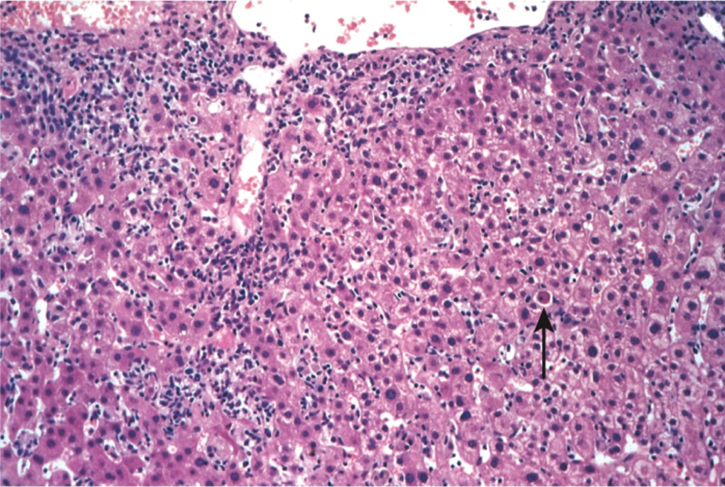
Acute viral hepatitis

Slide 6
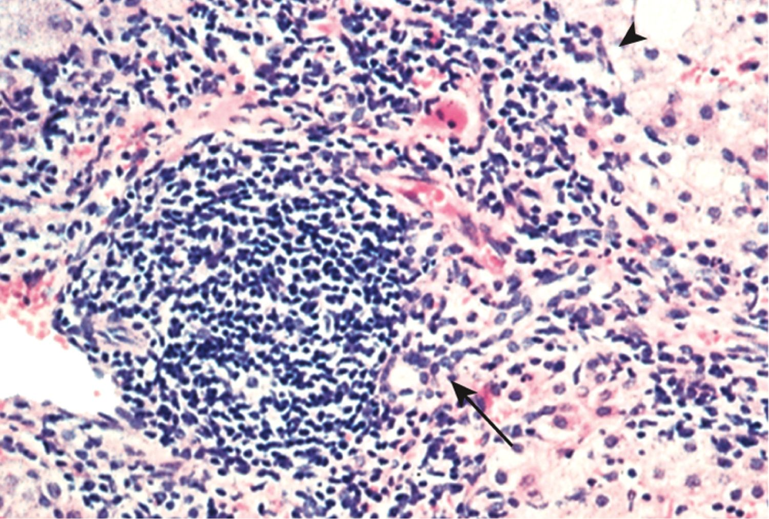
Chronic viral hepatitis

Slide 7
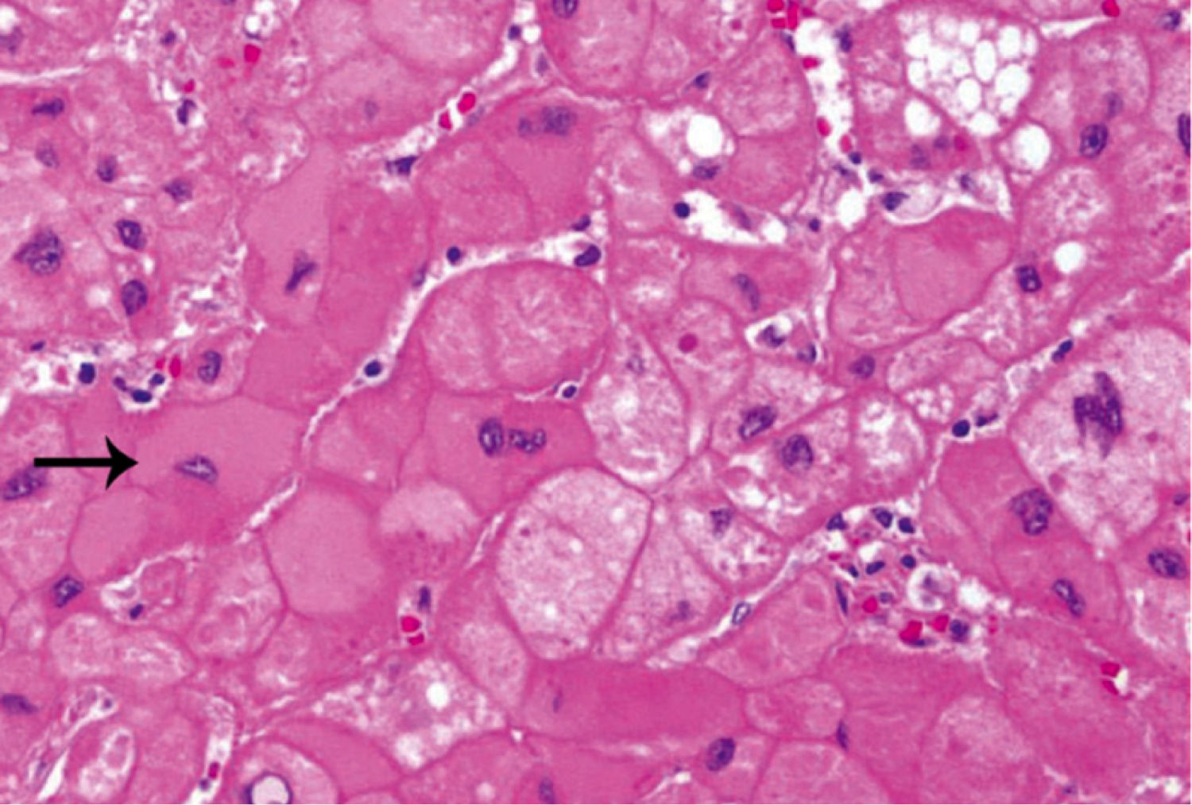
Chronic viral hepatitis: ground-glass hepatocytes

Slide 8
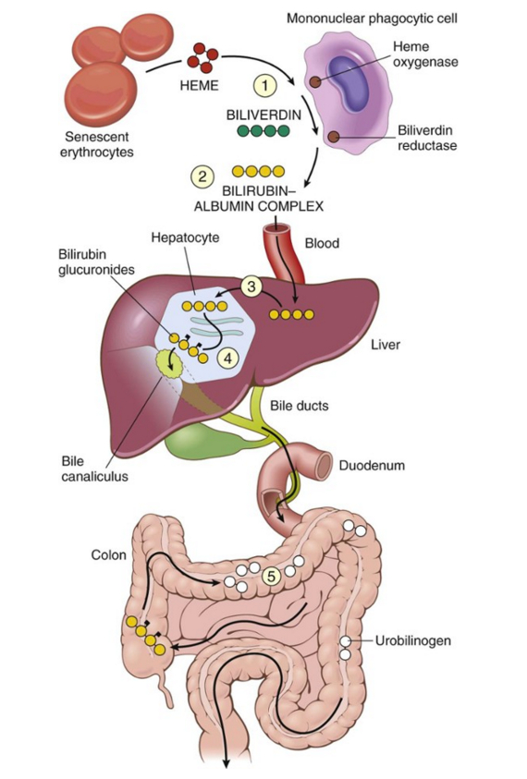
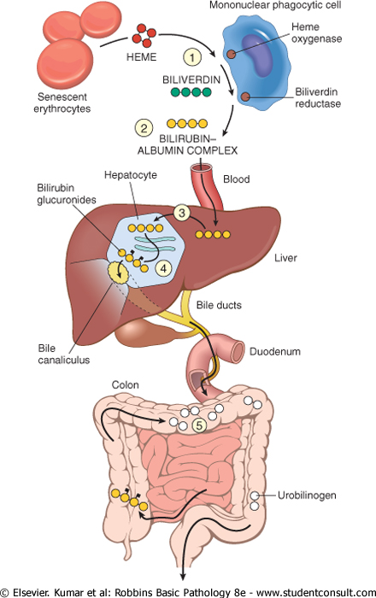
Bilirubin metabolism and elimination

Slide 9
Jaundice
Yellow discoloration of the skin due to hyperbilirubinemia (excess bilirubin in the blood)
The amount of bilirubin in the blood depends on the rate of:
  bilirubin production (from breakdown of red cells)
  bilirubin uptake by the liver
  bilirubin conjugation by the liver
  bilirubin excretion into bile ducts

Slide 10
Hyperbilirubinemia
Conjugated bilirubin = water-soluble (excreted in urine)
Unconjugated bilirubin = insoluble (toxic to tissues!)
Causes of conjugated hyperbilirubinemia:
  blockage in bile flow (e.g., tumor near bile duct)
  congenital disorders affecting bile excretion
Causes of unconjugated hyperbilirubinemia:
  excess bilirubin production (e.g., massive hemolysis)
  impaired bilirubin uptake by liver
  Impaired bilirubin conjugation

Slide 11
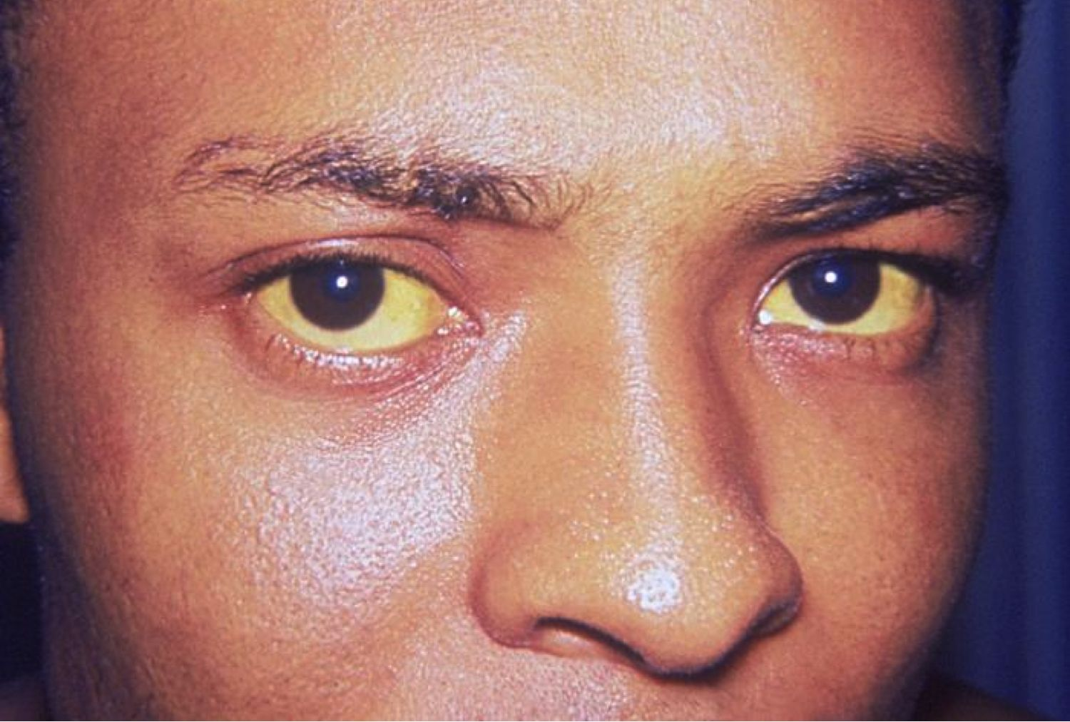
Icterus (only eyes are yellow; may precede jaundice)

Slide 12
Jaundice (yellow skin, eyes, mucous membranes)

Slide 13
Laboratory Tests
Hepatocyte integrity | Serum aspartate aminotransferase (AST)
 | Serum alanine aminotransferase (ALT)
Biliary function | Serum bilirubin (total and direct)
 | Serum alkaline phosphatase
Hepatocyte function | Serum albumin
 | Prothrombin time

Slide 14
Cirrhosis
Fibrotic, nodular liver
Causes: alcoholism, hepatitis
Leads to portal hypertension and liver failure
Increased risk of liver carcinoma

Slide 15
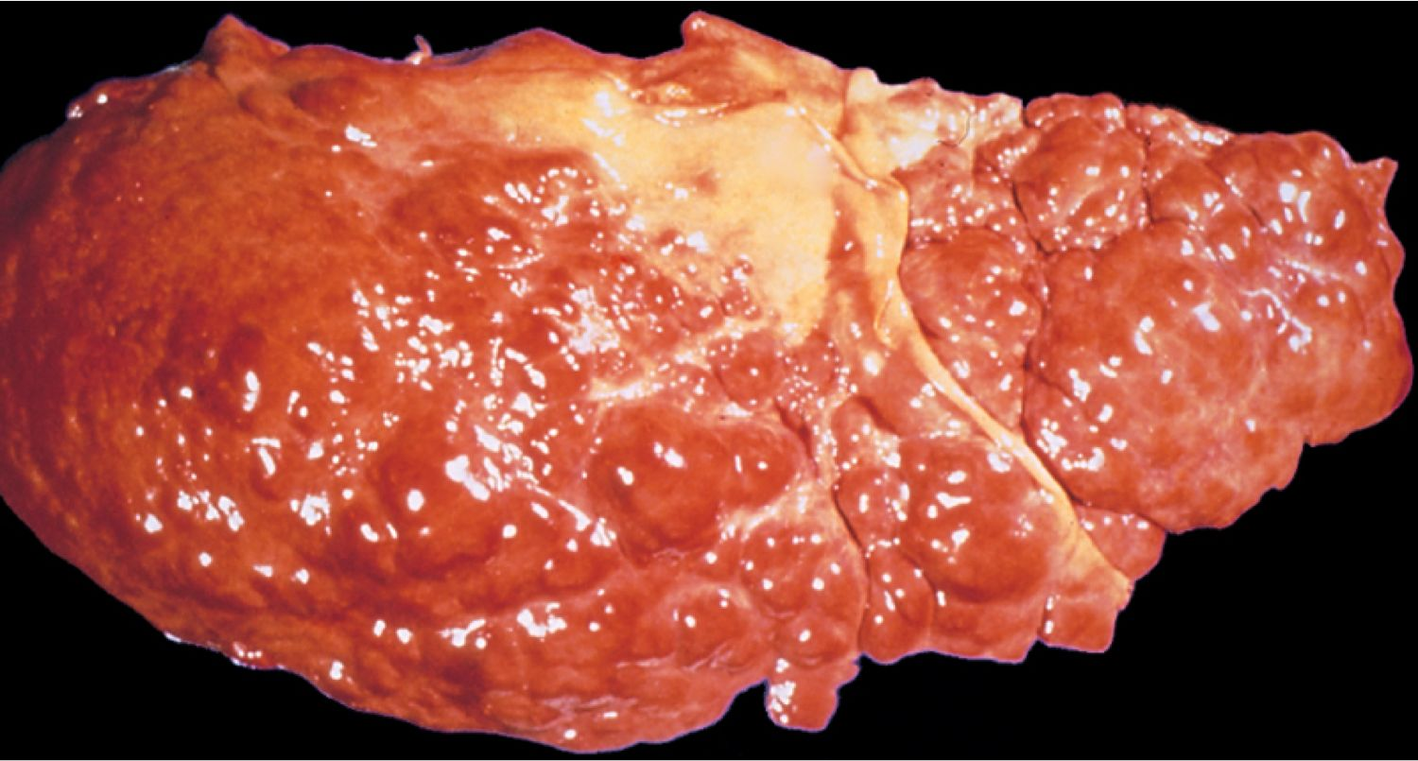
Cirrhosis

Slide 16
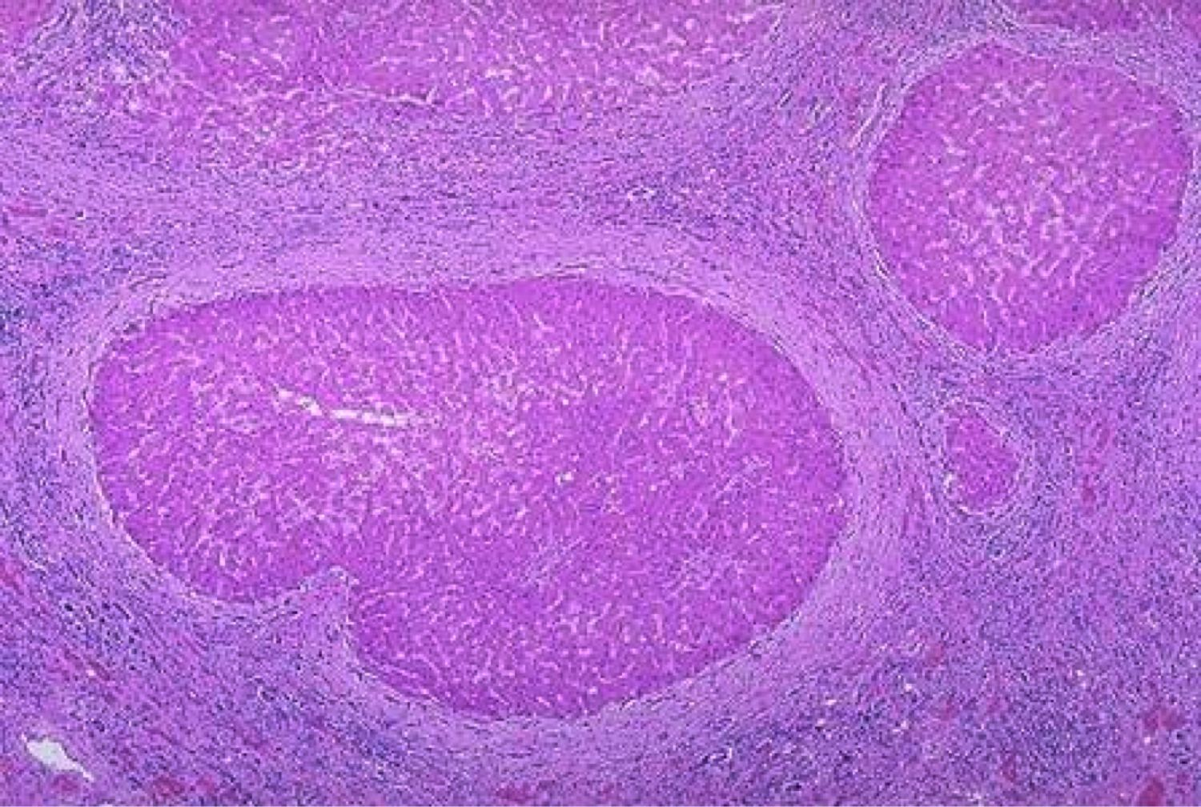
Cirrhosis

Slide 17
Portal Hypertension
Impaired flow of blood through liver
Blood backs up in portal system
Most common cause: cirrhosis
Four main clinical consequences
  ascites (↑ fluid in peritoneal cavity)
  esophageal varices (dilated esophageal veins)
  congestive splenomegaly
  hepatic encephalopathy

Slide 18
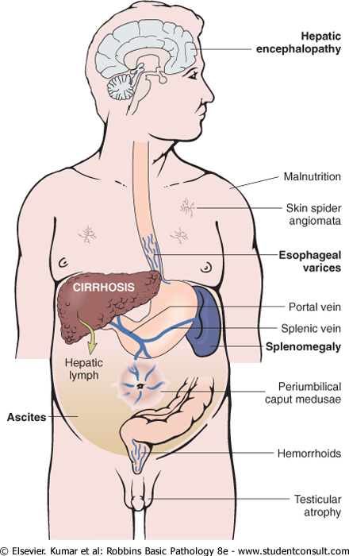
Consequences of portal hypertension

Slide 19
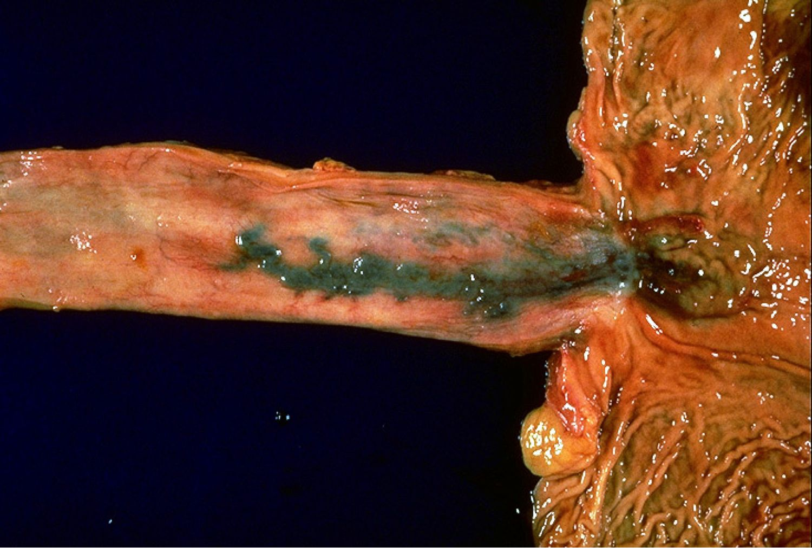
Esophageal varices

Slide 20
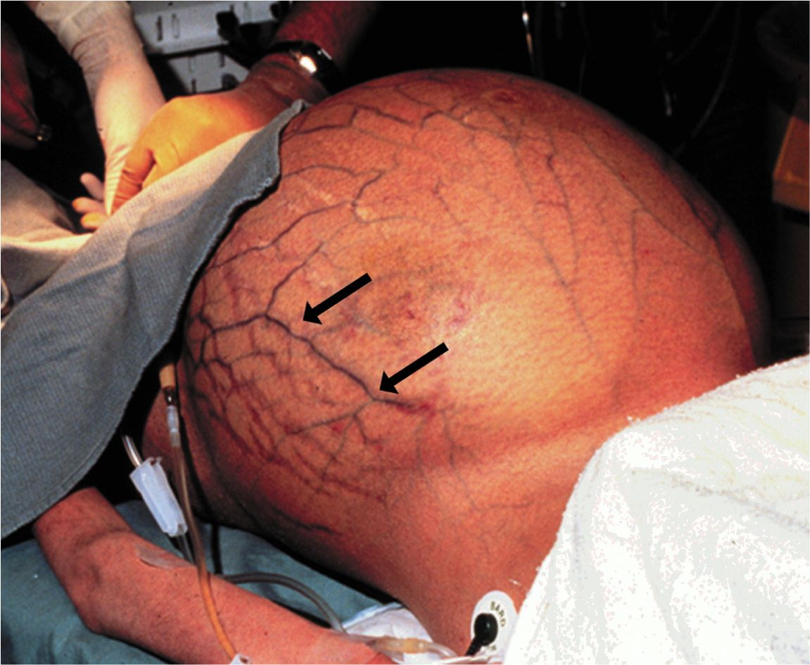
Caput medusae (dilated periumbilical veins)

Slide 21
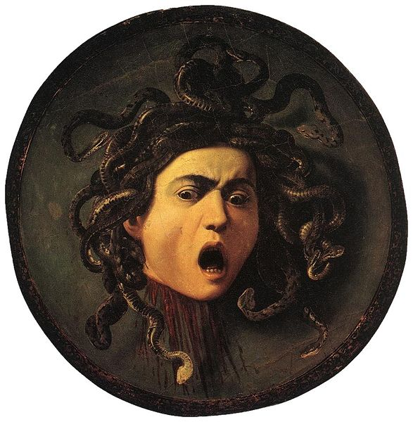
Medusa

Slide 22
Liver Failure
End point of severe liver disease
Causes: fulminant hepatitis, cirrhosis, drug overdose
Symptoms: jaundice, edema, bleeding, hyperammonemia
Multiple organ-system failure
  Hepatic encephalopathy
  Hepatorenal syndrome

Slide 23
Oral Manifestations of Liver Injury
Hematomas, gingival bleeding
Jaundiced mucosa
Glossitis (in alcoholic hepatitis)
Reduced healing after surgery

Slide 24
Alcoholic Liver Disease
100,000 -200,000 deaths/year
Effects on liver: steatosis, hepatitis, cirrhosis
How much do you need to drink?
  Short-term ingestion of 8 beers/day → reversible steatosis
  Long-term ingestion of 5 beers/day → severe injury

Slide 25
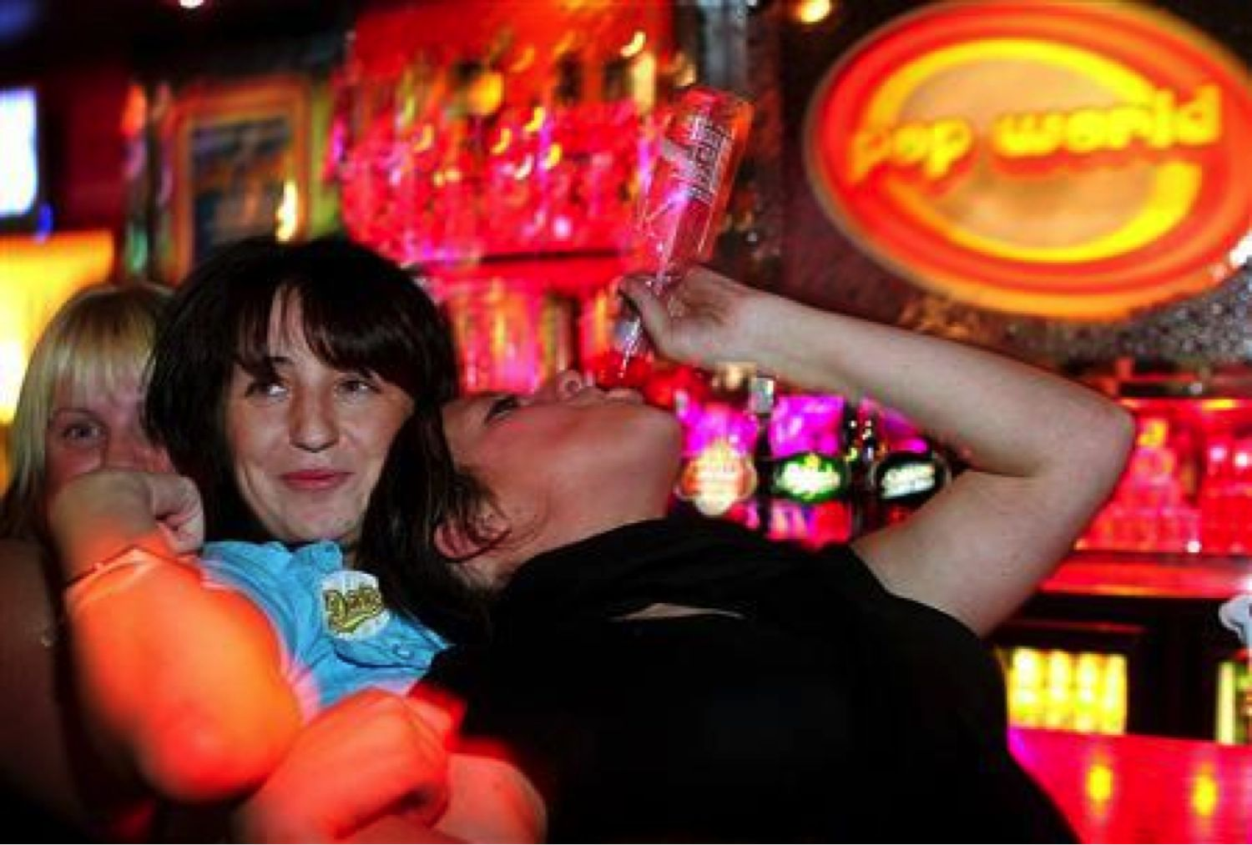
More youth with irreversible liver disease now

Slide 26
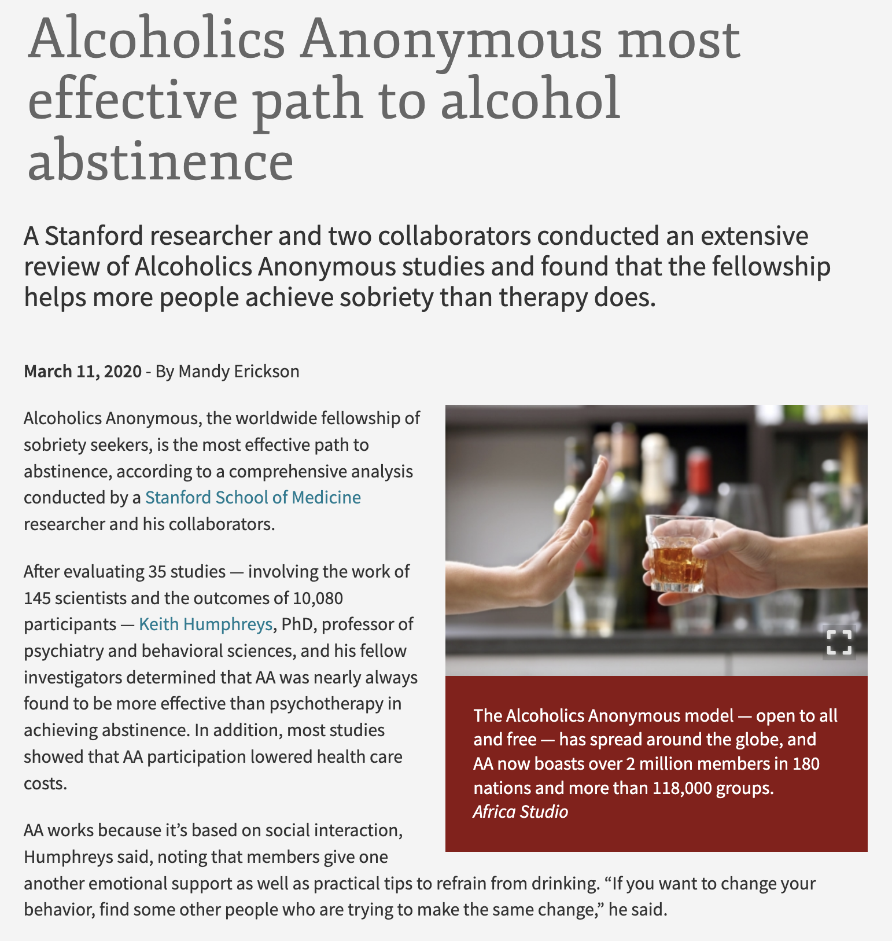

Slide 27
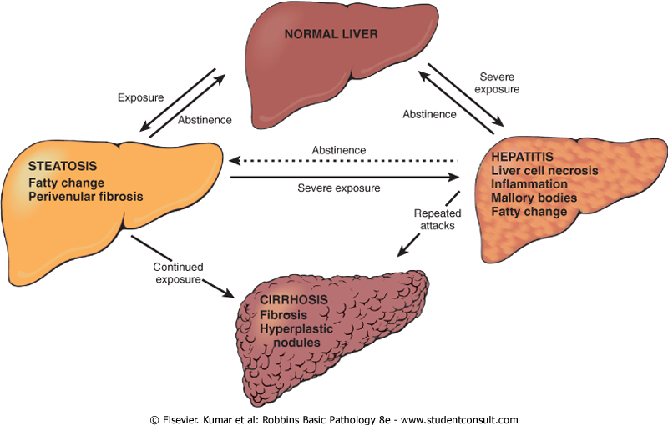
Alcoholic liver disease

Slide 28
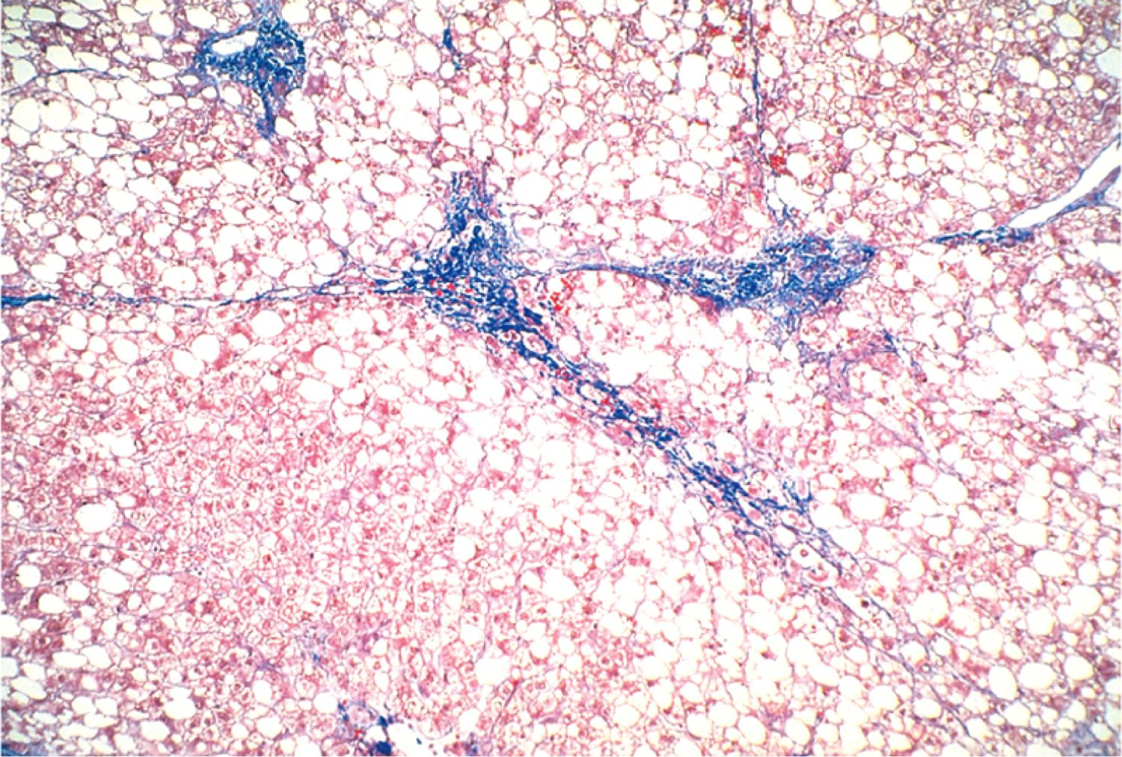
Alcoholic steatosis

Slide 29
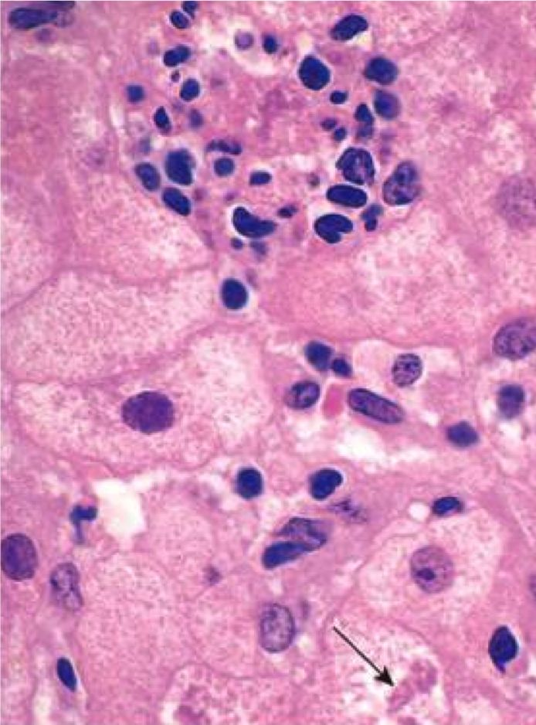
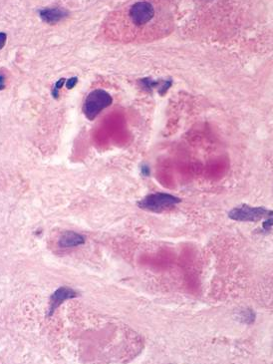
Alcoholic hepatitis: inflammation and Mallory bodies

Slide 30
Alcoholic Liver Disease
Abstinence: 5ys is 90%
Continued drinking: 5ys drops to 50-60%
Causes of death in end-stage alcoholism:
  Liver failure
  Massive GI bleed
  Infection
  Hepatorenal syndrome
  Hepatocellular carcinoma

Slide 31
Hereditary Hemochromatosis
Autosomal recessive disease: ↑ body iron
Cause: mutations in hemochromatosis gene (regulates iron absorption)
Cirrhosis, skin discoloration, liver carcinoma
Early detection and treatment (phlebotomy, iron chelators) = normal life expectancy

Slide 32
Grey-brown skin discoloration in hemochromatosis

Slide 33
Wilson Disease
Autosomal recessive disease: ↑ body copper
Cause: mutation in gene regulating copper excretion
Symptoms: acute and chronic liver disease, neuropsychiatric manifestations, Kayser-Fleisher rings in cornea
Treatment: copper chelation therapy

Slide 34
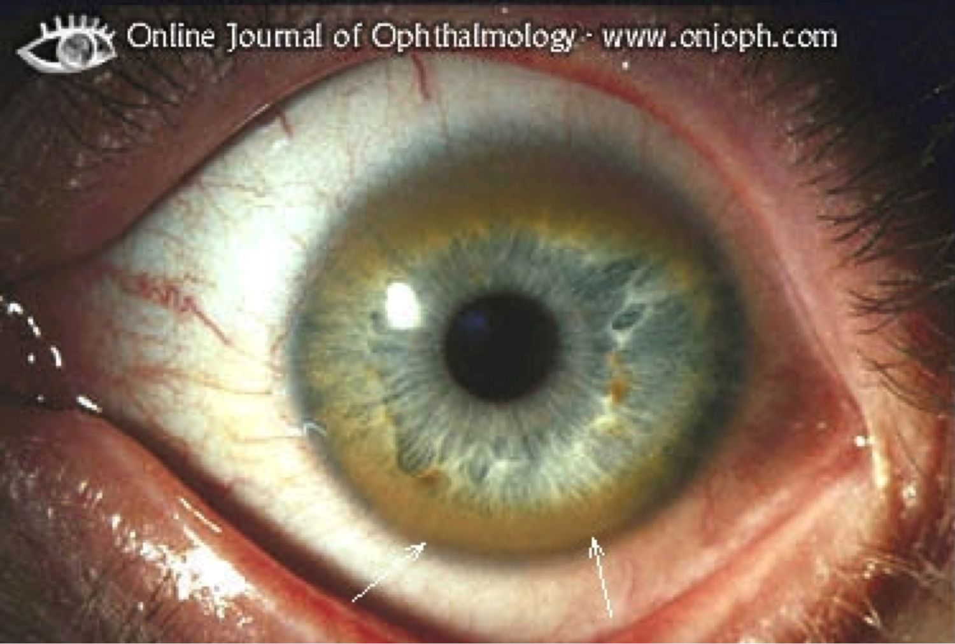
Kayser-Fleischer Rings

Slide 35
Hepatocellular Carcinoma
Strongly associated with hepatitis B and C, chronic liver disease, and aflatoxins
Rapid increase in liver size, worsening ascites, fever and pain
↑↑↑ alpha fetoprotein level
Median survival 7 months (death from bleeding, liver failure, cachexia)

Slide 36
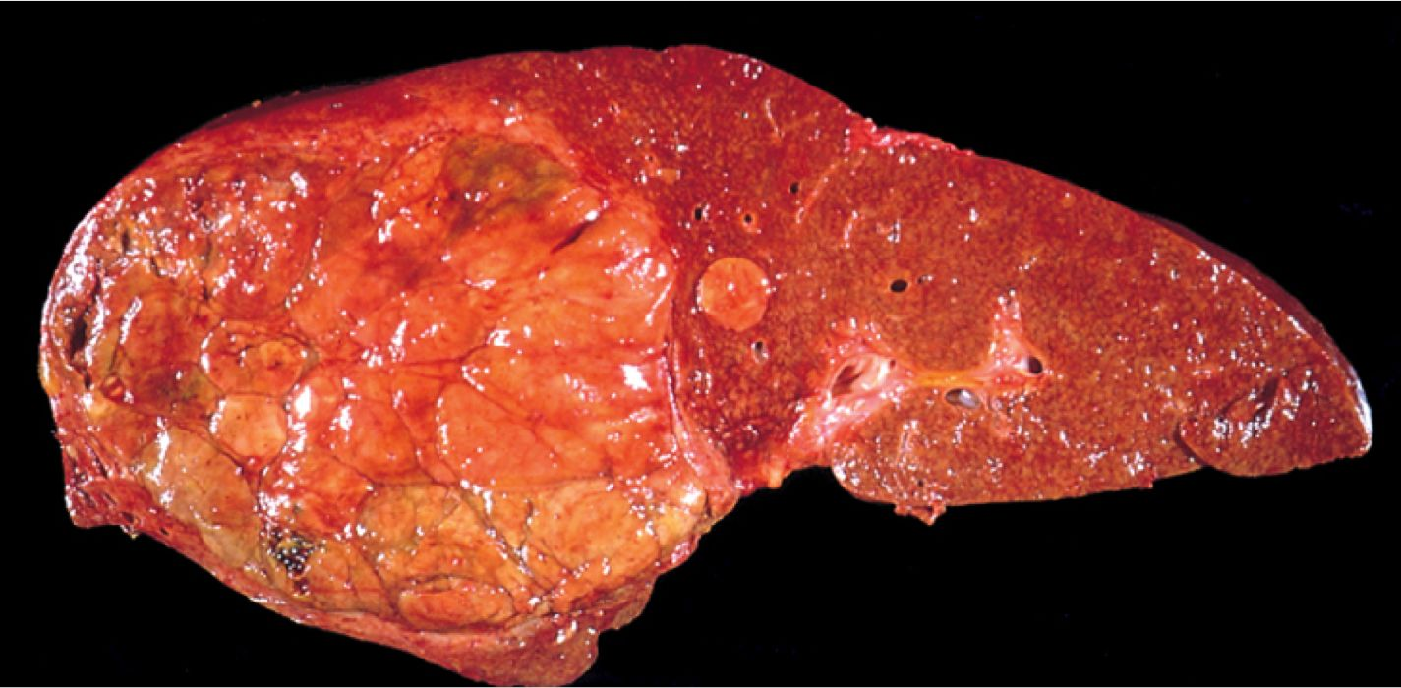
Hepatocellular carcinoma

Slide 37
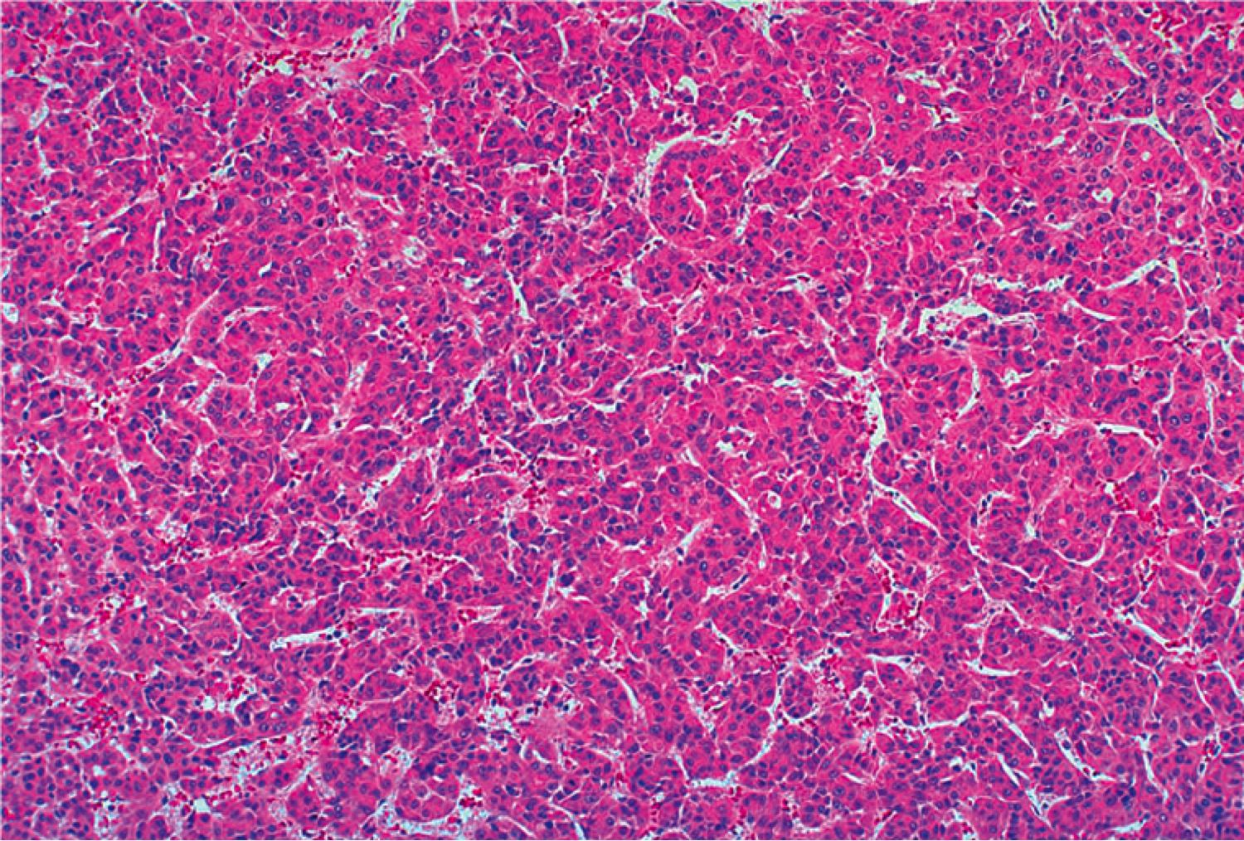
Hepatocellular carcinoma

Slide 38
Metastatic Carcinoma
Most common malignancy in the liver
Usually multiple lesions
Most common primaries: colon, lung, breast, pancreas, stomach.

Slide 39
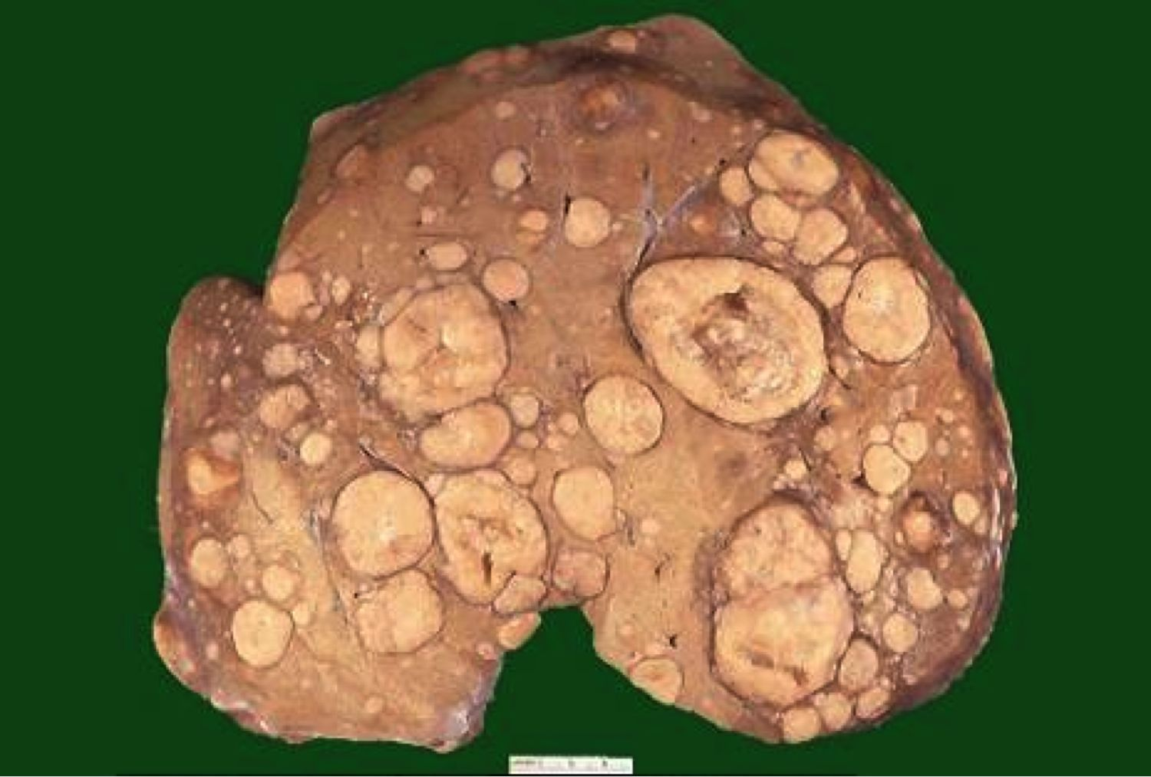
Metastatic carcinoma

Slide 40
GI Pathology Outline
Esophagus
Stomach
Intestine
Liver
Gallbladder
  Cholelithiasis
  Cholecystitis

Slide 41
Cholelithiasis
Common! (10% of adults in US)
Cholesterol stones: Female, Fat, Fertile, Forty
Pigment (bilirubin) stones: Asian countries, hemolytic anemia and biliary infections
Symptoms: None, or excruciating pain
Complications: cholecystitis (inflamed gallbladder), perforation, obstruction, pancreatitis

Slide 42
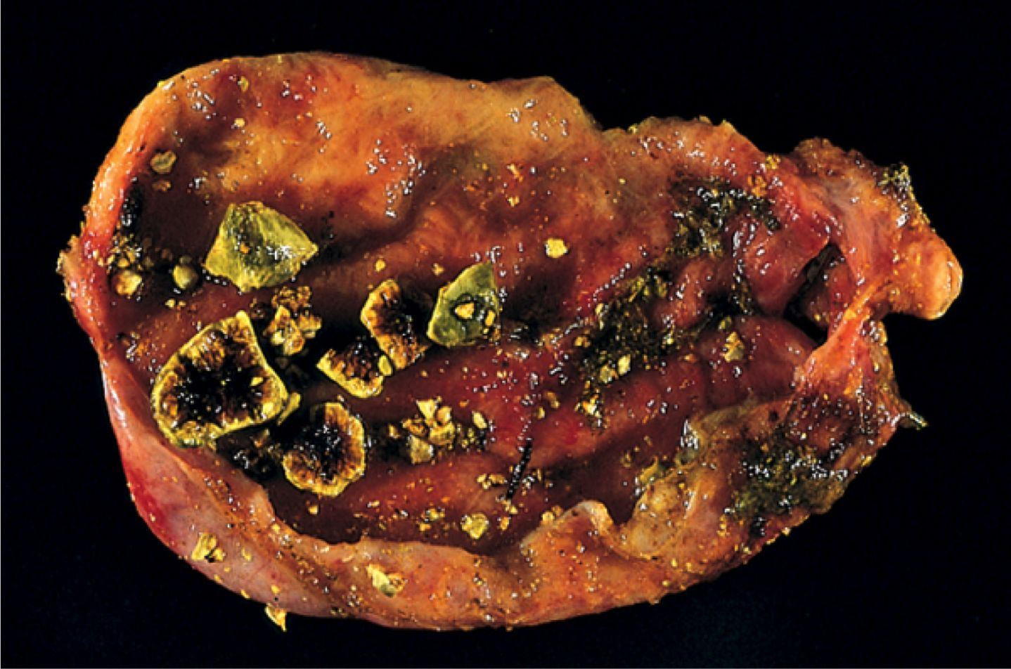
Cholesterol gallstones

Slide 43
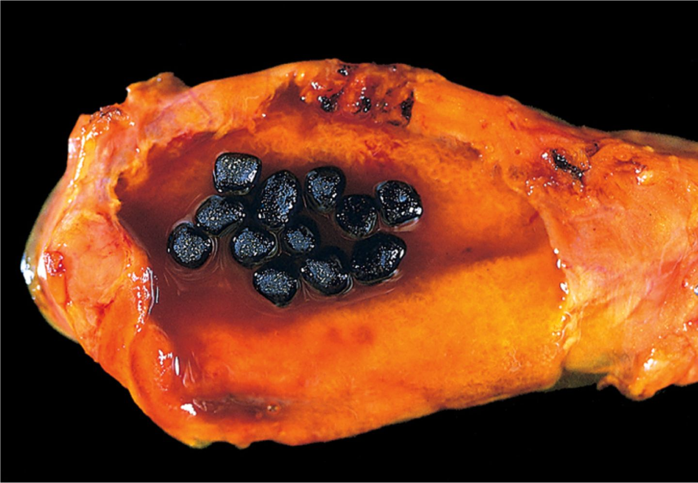
Pigmented gallstones

Slide 44
GI Pathology Outline
Esophagus
Stomach
Intestine
Liver
Gallbladder
Pancreas
  Pancreatitis
  Carcinoma

Slide 45
Normal Pancreas
Exocrine pancreas
  Makes enzymes for digestion
  Diseases: pancreatitis, cystic fibrosis, tumors
Endocrine pancreas
  Makes insulin, glucagon, other hormones
  Diseases: diabetes, tumors

Slide 46
Acute Pancreatitis
Acute inflammation and reversible destruction of pancreas
Symptoms: abdominal pain radiating to back
Main causes: alcoholism, gallstones
Labs: elevated serum amylase and lipase
Prognosis: Most recover, but 5% die in first week

Slide 47
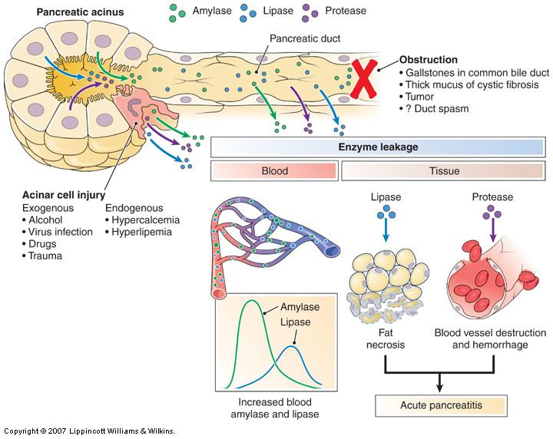
Obstruction
(gallstones)
Cell injury
(alcohol)

Slide 48
Chronic Pancreatitis
Longstanding, irreversible pancreatic destruction
Most are alcohol related, some idiopathic
Symptoms: silent, or bouts of jaundice and pain
Prognosis: poor (50% mortality over 20 years)

Slide 49
Pancreatic Carcinoma
4th leading cause of cancer death in US
Biggest risk factor: smoking
Highly invasive
Silent until late; then pain, jaundice
Very high mortality: 5ys <5%

Slide 50
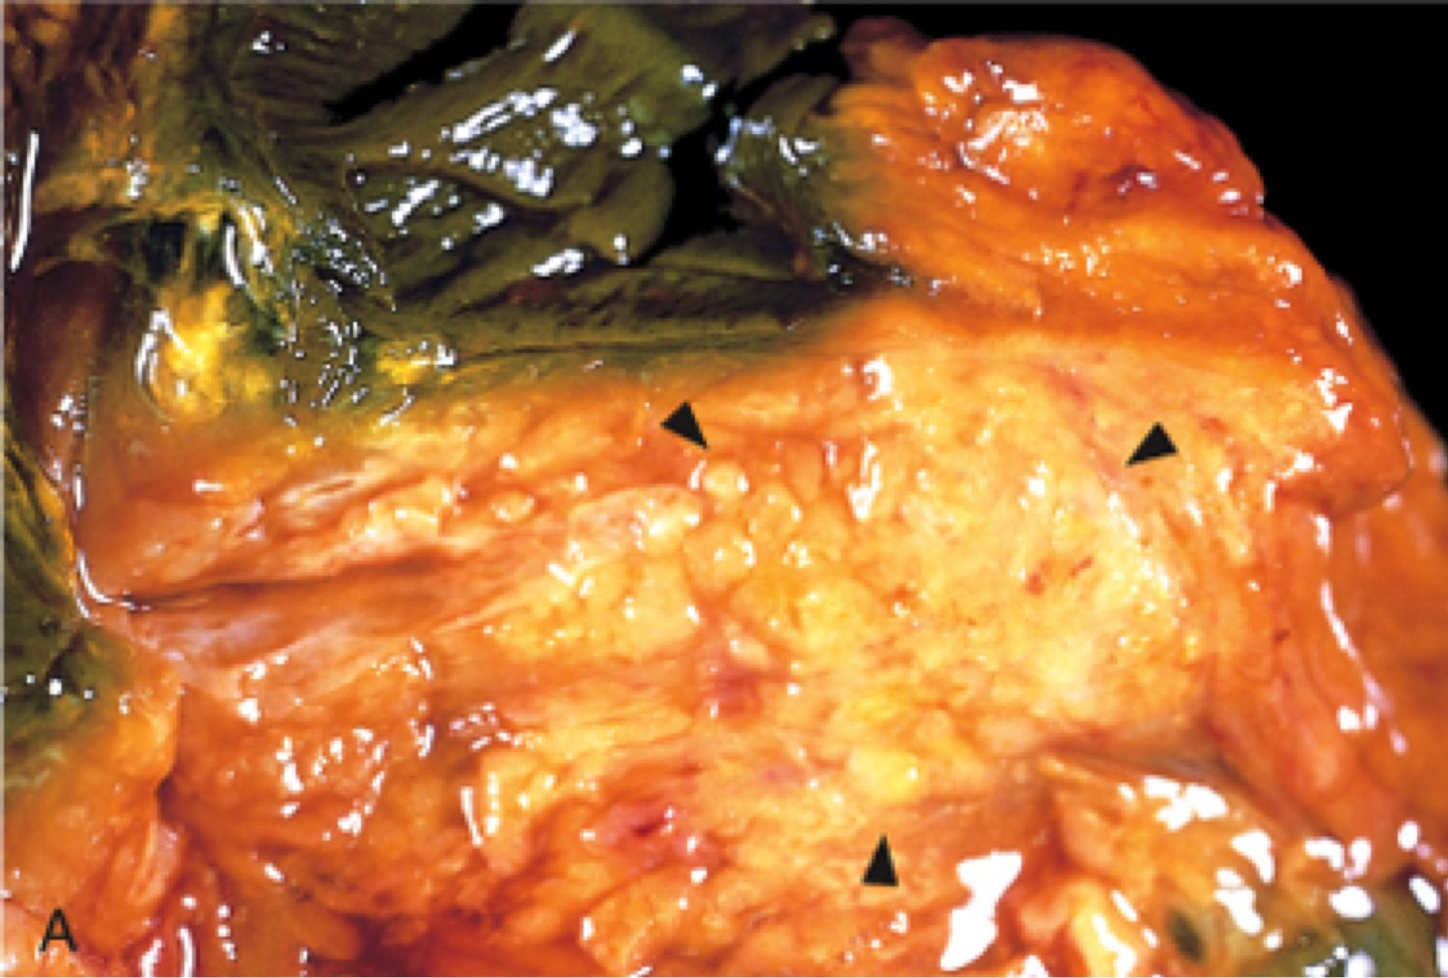
Pancreatic carcinoma

Slide 51
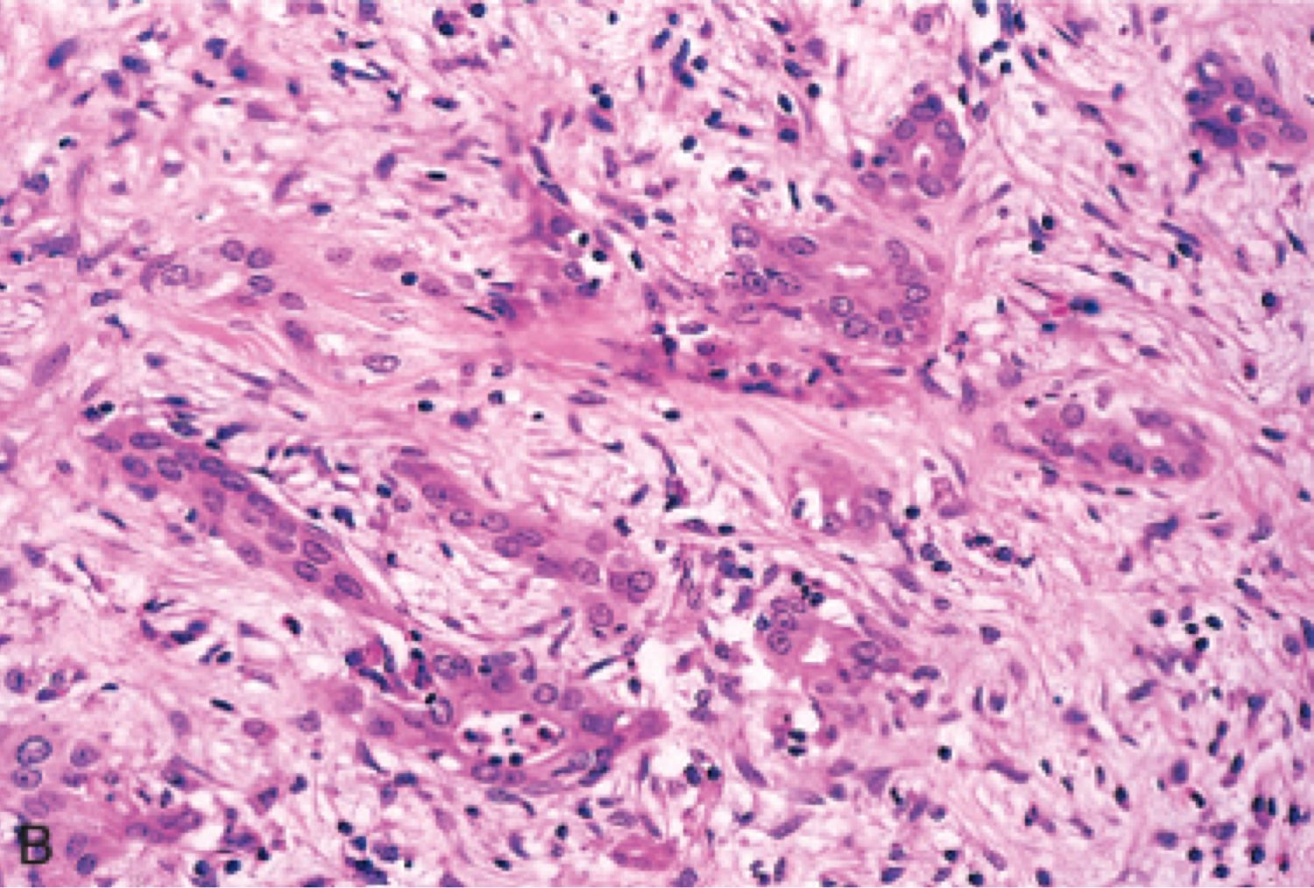
Pancreatic carcinoma

