Slide 1
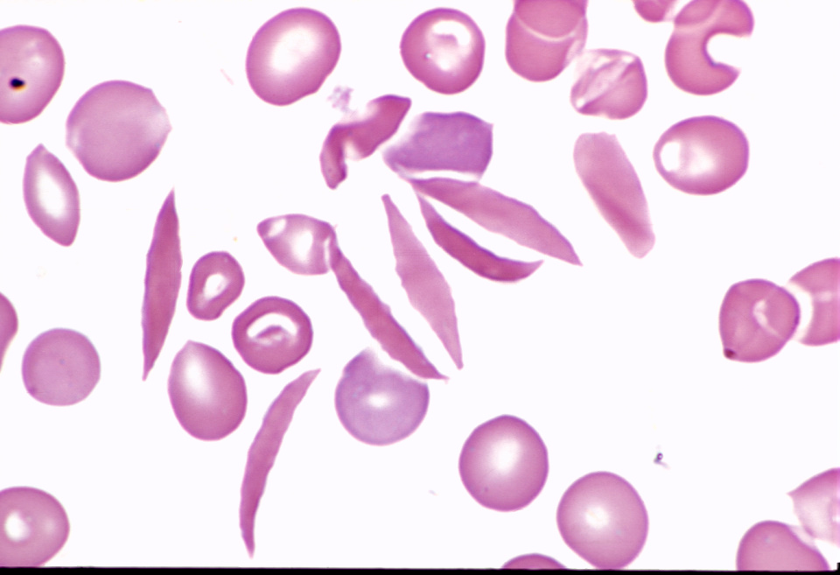
Anemia
Kristine Krafts, M.D.

Slide 2
Anemia Outline
Background facts about blood
Anemia: general information
Anemia: specific types

Slide 3
Anemia Outline
Background facts about blood

Slide 4
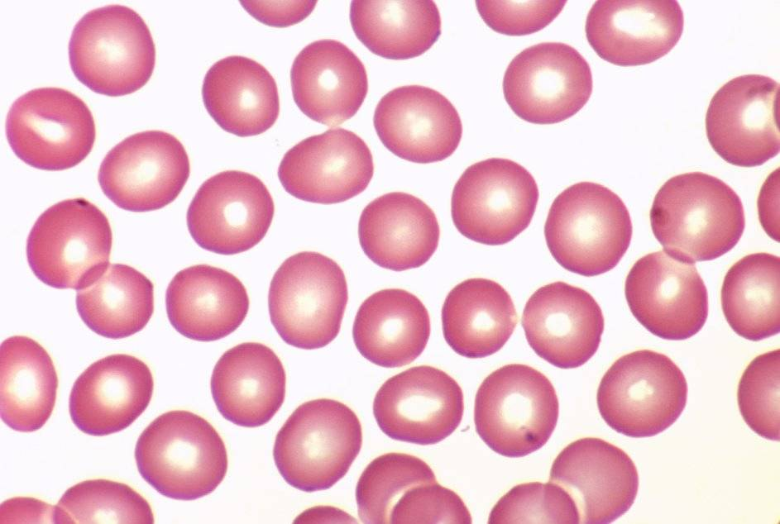
Normal red blood cells

Slide 5
Complete Blood Count (CBC)
RBC
Hemoglobin
Hematocrit

Slide 6
Complete Blood Count (CBC)
MCV
MCHC
microcytic
normocytic
macrocytic
hypochromic
normochromic

Slide 7
Additional Red Blood Cell Properties
Size variation
Shape
anisocytosis
poikilocytosis

Slide 8
Anemia Outline
Background facts about blood
Anemia: general information

Slide 9
An (without) -emia (blood):
a reduction below normal
in hemoglobin or red blood cell number.
Decreased oxygen supply to tissues!

Slide 10

General Symptoms of Anemia
Pale skin, mucous membranes
Breathlessness
Tachycardia
Dizziness
Fatigue
Pallor

Slide 11





New RBCs made in the bone marrow
Fun facts:
RBCs circulate throughout the body
100 billion RBCs are
made and lost every day!
Each RBC travels around the body about 150,000 times (100 miles!) in its 4 months of life.
Old RBCs removed by the spleen

Slide 12
Three Ways to Get Anemic
Lose blood
Destroy too much blood
  Extracorpuscular reasons
  Intracorpuscular reasons
Make too little blood
  Too few building blocks
  Too few erythroblasts
  Not enough room

Slide 13
Anemia Outline
Background facts about blood
Anemia: general information
Anemia: specific types

Slide 14
Three Ways to Get Anemic
Lose blood

Slide 15
Anemia of Blood Loss
Things you must know
Cause: traumatic, acute blood loss
At first, hemoglobin is normal!
After 2-3 days, see reticulocytes
Chronic blood loss is different (it causes iron deficiency anemia).

Slide 16
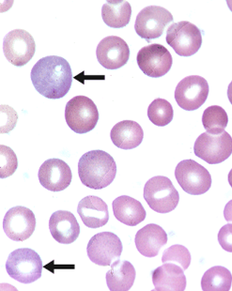
Reticulocytes

Slide 17
Three Ways to Get Anemic
Lose blood
Destroy too much blood

Slide 18
Hemolytic Anemias
Hemolysis = destruction (-lysis) of blood (heme-)
Cause can be Intracorpuscular or extracorpuscular
Clinical sign: jaundice (yellow skin due to excess bilirubin in blood)

Slide 19
How do you know if an anemia is hemolytic?
Look for signs of RBC destruction:
↑ bilirubin, ↑ LDH, ↓ haptoglobin
Look for signs of ↑ RBC production:
↑ reticulocytes, nucleated red cells in blood

Slide 20
Three Ways to Get Anemic
Lose blood
Destroy too much blood
  Extracorpuscular reasons

Slide 21
Microangiopathic Hemolytic Anemia
Things You Must Know
Physical trauma to red cells
Schistocytes
Find out why!

Slide 22
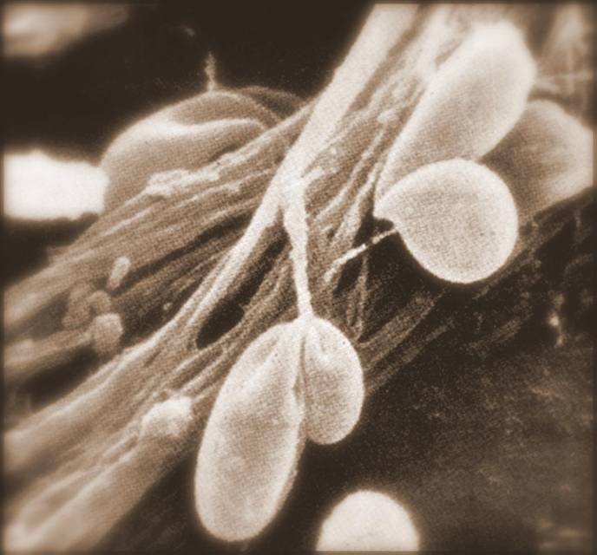
Red cells snagged on fibrin strand

Slide 23
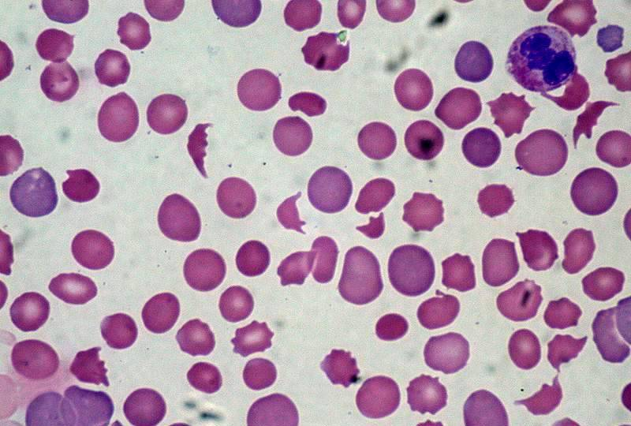
Schistocytes

Slide 24
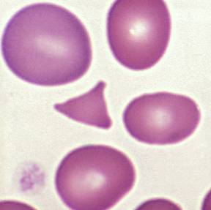
Triangulocyte

Slide 25

Causes of MAHA
MOST cases are caused by one of these four things!
Malignancy
Obstetric complications
Sepsis
Trauma
Abnormal/prosthetic heart valve
Excessive running/marching

Slide 26
Autoimmune Hemolytic Anemia
Things You Must Know
Warm AIHA
  IgG
  Spleen
  Spherocytes
Cold AIHA
  IgM, complement
  Intravascular hemolysis
  Agglutination

Slide 27
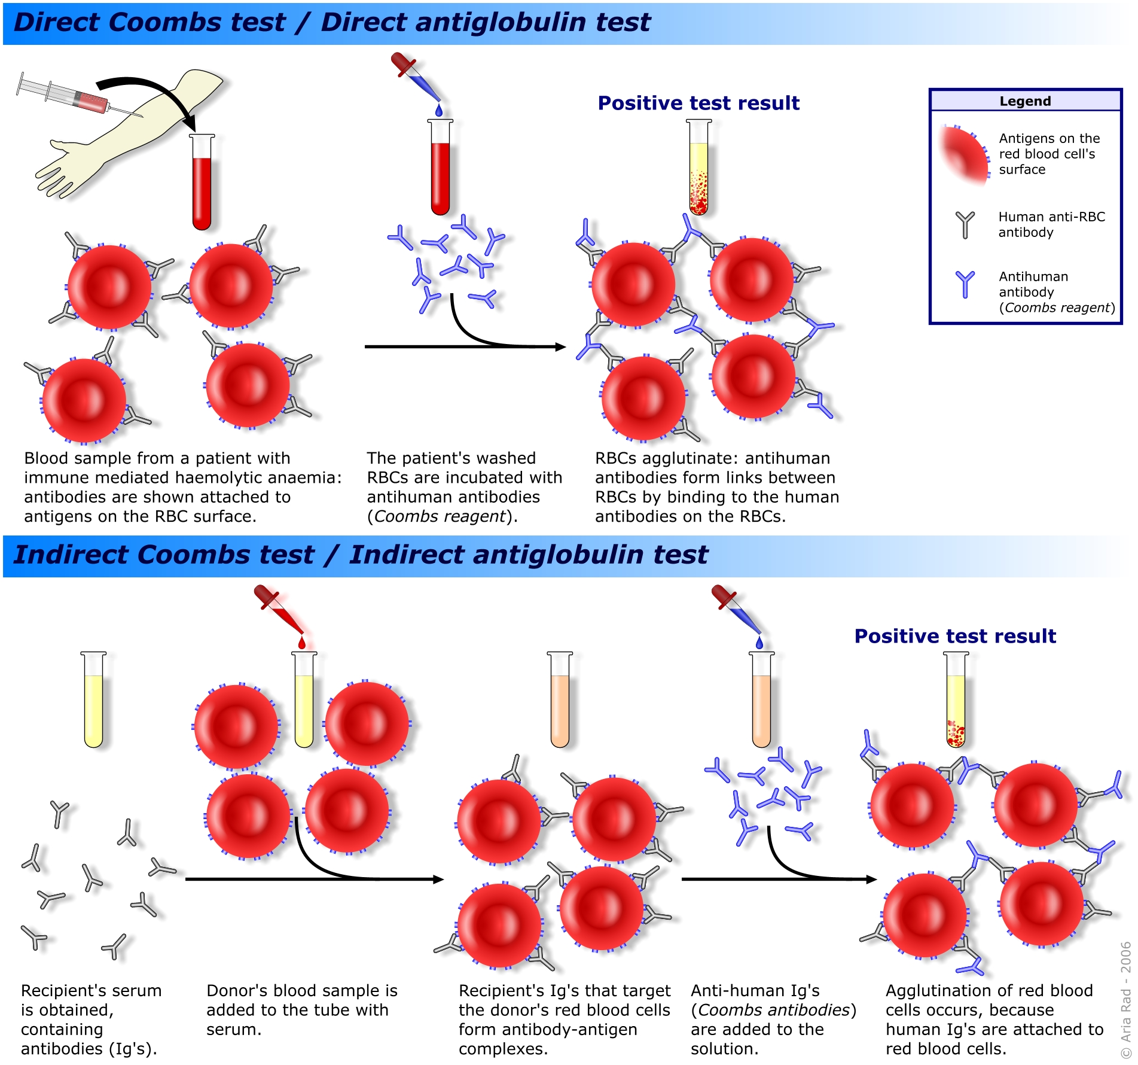
Warm AIHA

Slide 28
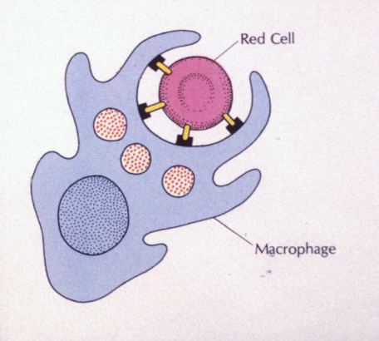
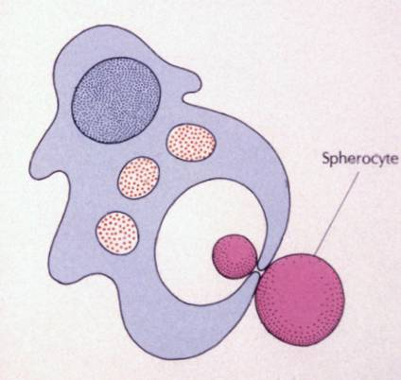
Warm AIHA

Slide 29
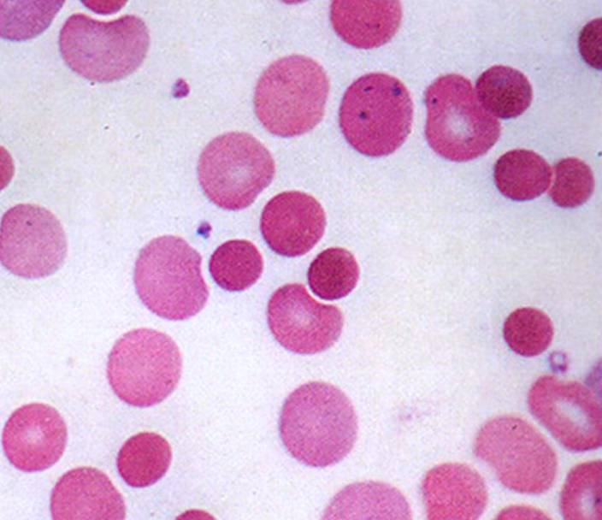
Warm AIHA

Slide 30
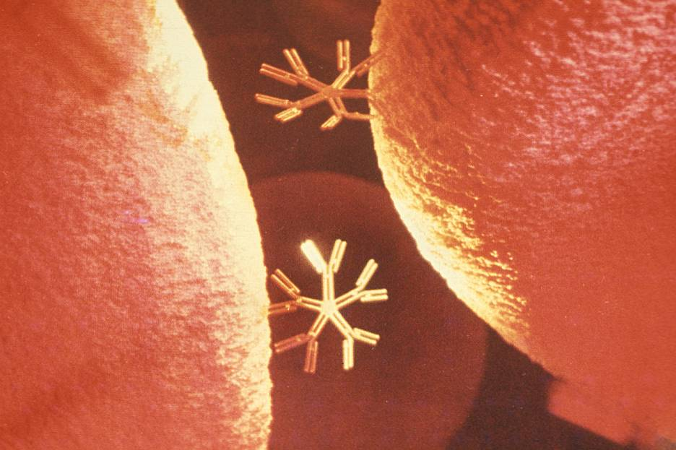
Cold AIHA

Slide 31
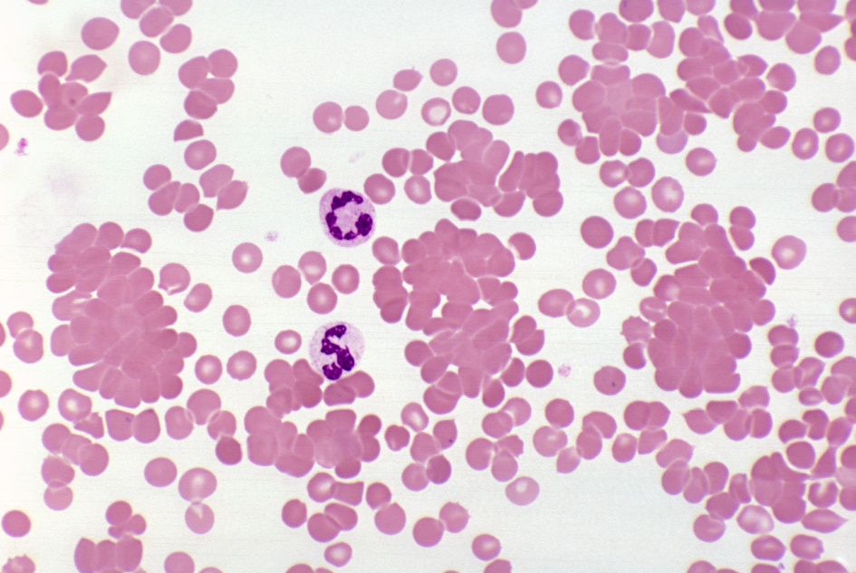
Cold AIHA

Slide 32
patient red cells
+
AHG
=
agglutination
Direct antiglobulin test (DAT)

Slide 33
Three Ways to Get Anemic
Lose blood
Destroy too much blood
  Extracorpuscular reasons
  Intracorpuscular reasons

Slide 34
Sickle Cell Anemia
Things You Must Know
Hemoglobinopathy (qualitative defect in hemoglobin)
Single amino acid substitution in beta chain of hemoglobin
Can be heterozygous or homozygous
Sickle cells are nasty:
  Fragile (burst easily)
  Get stuck in vessels

Slide 35
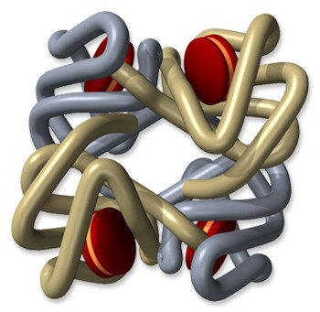
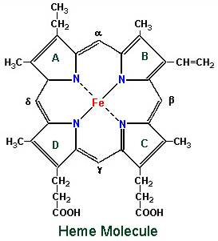
Hemoglobin

Slide 36
Point mutation in β chain gene
abnormal β chains
(substitution of valine for glutamate)
Hgb S
Nasty!
Aggregates and polymerizes on deoxygenation
Red cell becomes sickle shaped
Sickles clog up vessels…
…plus, they are fragile

Slide 37
Sickle cell anemia

Slide 38
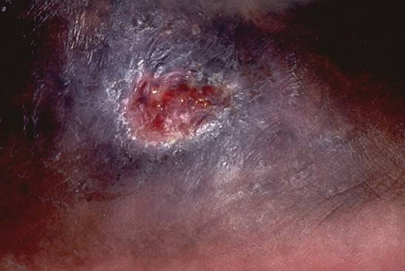
Sickle cell anemia: foot lesion

Slide 39
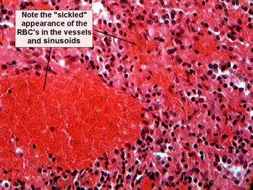
Sickle cell anemia: spleen

Slide 40
Clinical Findings in Sickle Cell Anemia
Most patients are black
Severity of disease is variable
Chronic hemolysis, vaso-occlusive disease, and ↑ infections (autosplenectomy)
Treatment: prevent triggers, vaccinate, transfuse

Slide 41
Thalassemia
Things You Must Know
Quantitative defect in hemoglobin
Can’t make enough α or β chains
Variable disease severity
Hypochromic, microcytic anemia with increased RBC and target cells

Slide 42
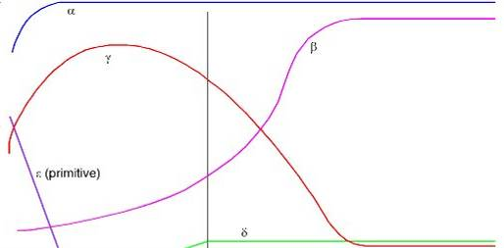
α
β
γ
δ
birth
Hgb F = α₂γ₂
Hgb A₂ = α₂δ₂
Hgb A = α₂β₂
Hemoglobin chain development

Slide 43
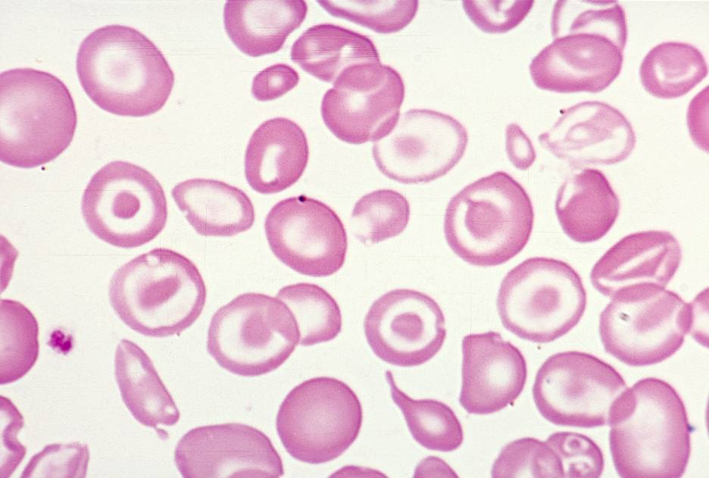
Thalassemia

Slide 44
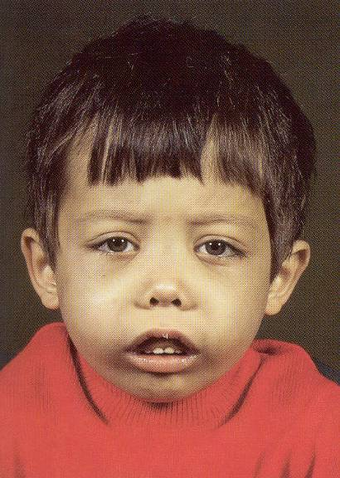
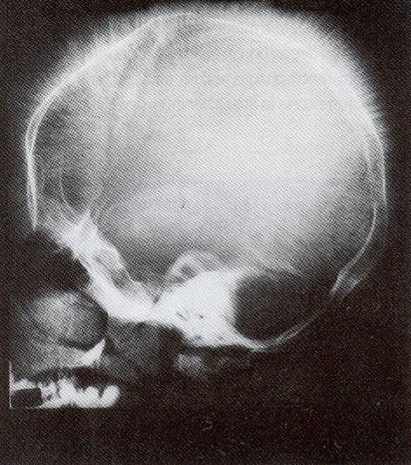
Thalassemia: Medullary expansion

Slide 45
Hereditary Spherocytosis
Things You Must Know
Tons of spherocytes
Spectrin defect
Splenectomy is curative

Slide 46
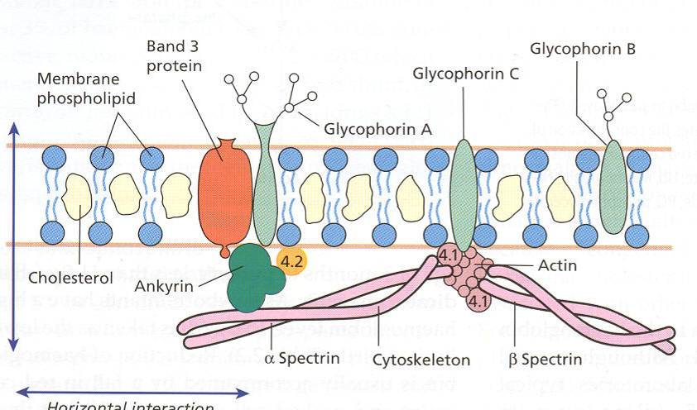
z

Slide 47
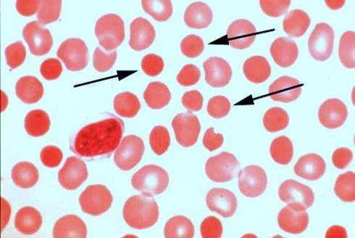
Hereditary spherocytosis

Slide 48
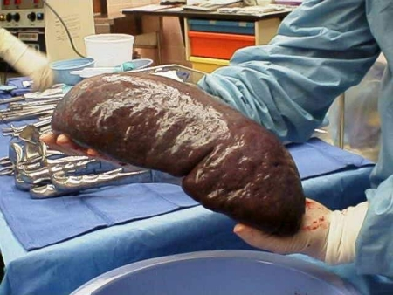
Splenomegaly in hereditary spherocytosis

Slide 49
Glucose-6-Phosphate Dehydrogenase Deficiency
Things You Must Know
↓ G6PD → ↑ peroxides → cell lysis
Oxidant exposure
Bite cells (removal of Heinz bodies)
Self-limiting

Slide 50
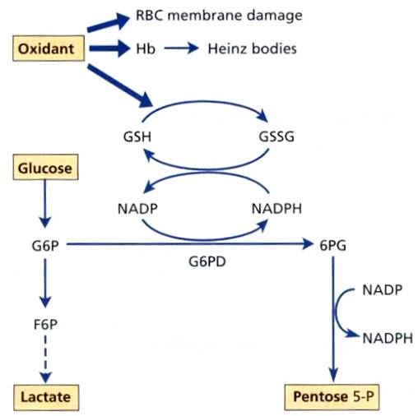

Slide 51
Clinical Findings in G6PD Deficiency
Some patients asymptomatic
Others have episodic hemolysis
Triggers: broad beans (favism), drugs (antibiotics, aspirin)
Spontaneous resolution

Slide 52
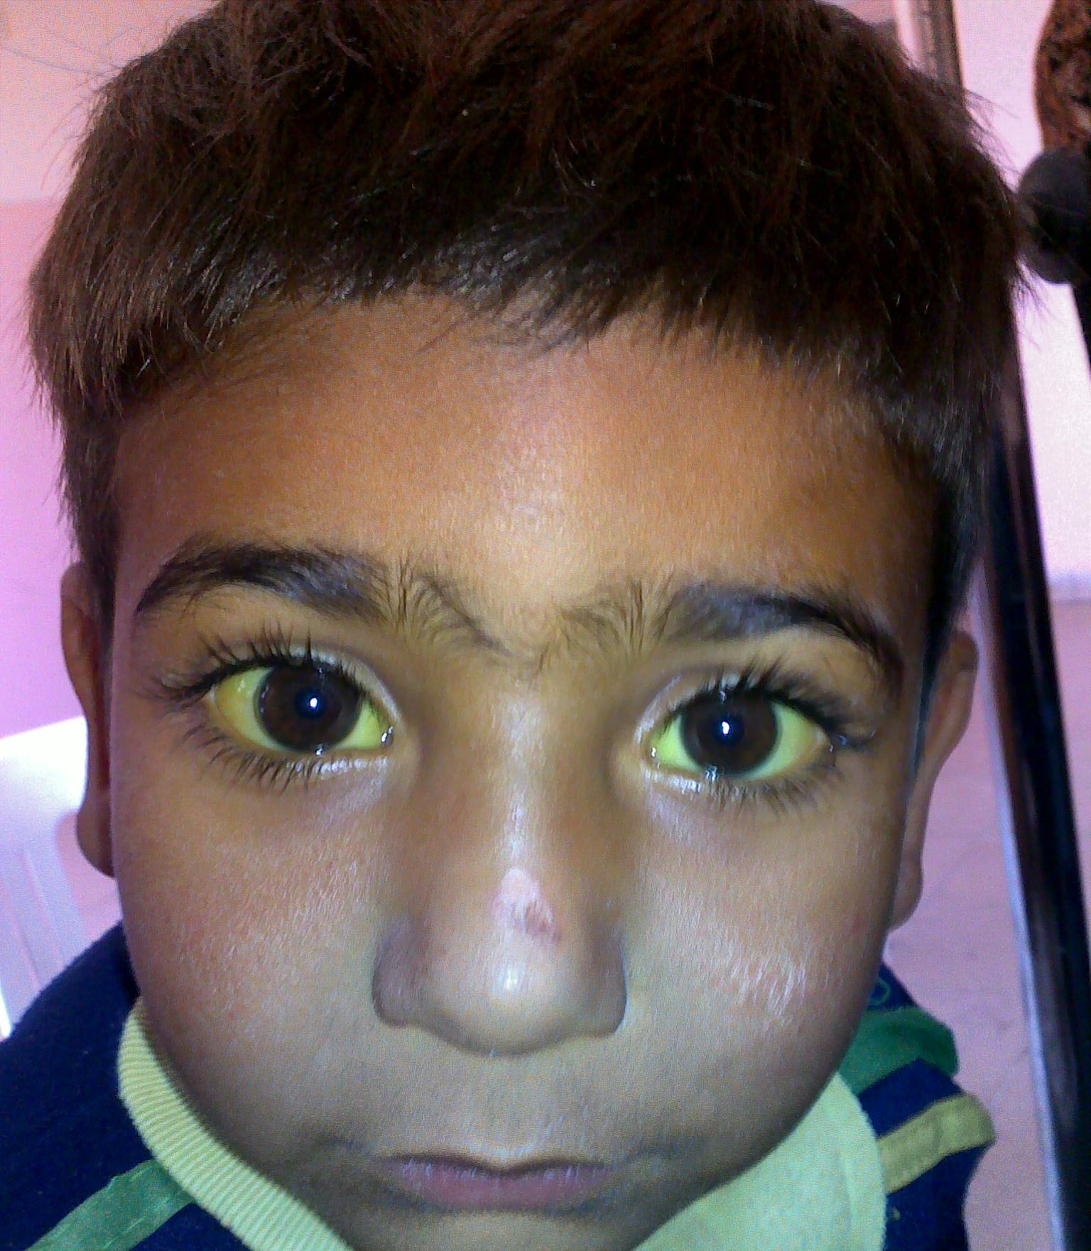
Child with G6PD deficiency: jaundiced sclera

Slide 53
Why Do G6PD-Deficient Red Cells Die?
They can’t reduce nasties
Nasties attack hemoglobin bonds
Heme breaks away from globin
Globin denatures, sticks to red cell membrane (“Heinz body”)
Spleen bites out Heinz bodies

Slide 54
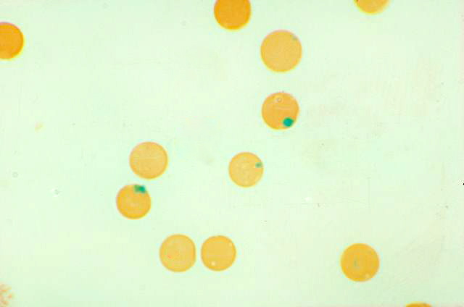
G6PD deficiency: Heinz bodies

Slide 55
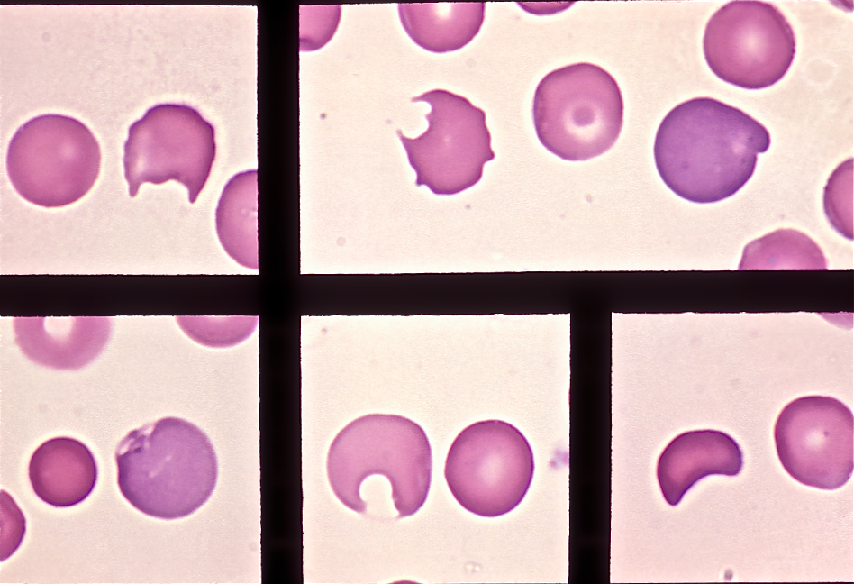
G6PD deficiency: bite cells

Slide 56
Three Ways to Get Anemic
Lose blood
Destroy too much blood
  Extracorpuscular reasons
  Intracorpuscular reasons
Make too little blood
  Too few building blocks

Slide 57
Iron-Deficiency Anemia
Things You Must Know
Most important cause: GI bleeding
Microcytic, hypochromic anemia
Must find out why patient is iron deficient!

Slide 58
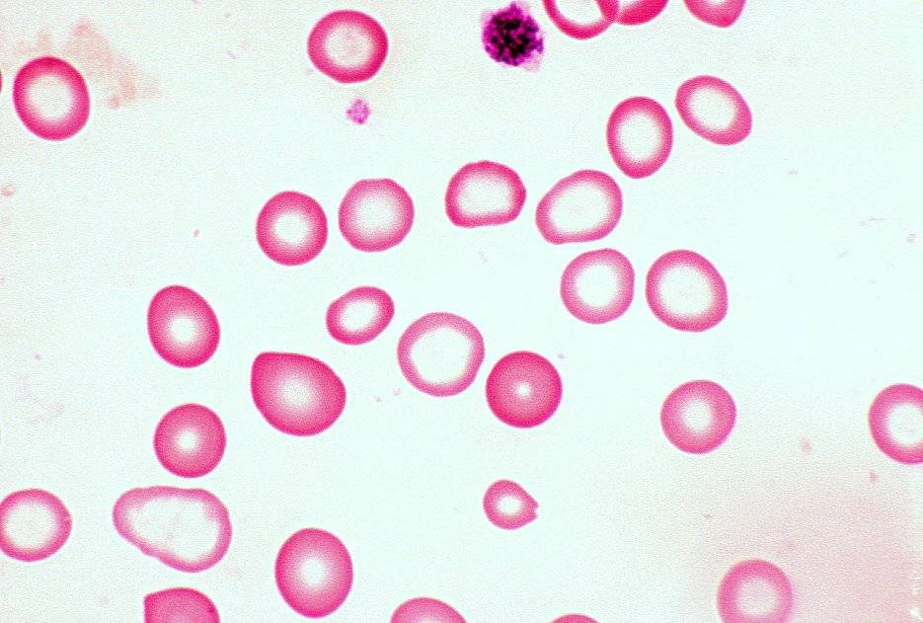
Iron-deficiency anemia

Slide 59
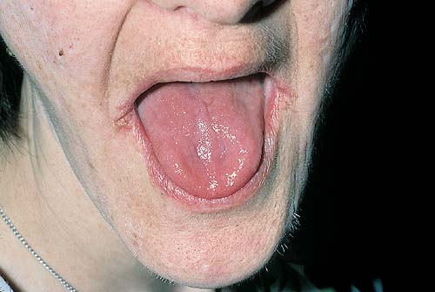
Atrophic glossitis in iron-deficiency anemia

Slide 60
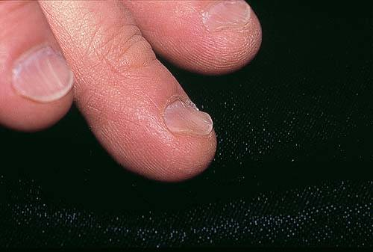
Koilonychia in iron-deficiency anemia

Slide 61
Causes of Iron Deficiency
Decreased iron intake
  bad diet
  bad absorption
Increased iron loss
  GI bleed
  menses
  hemorrhage
Increased iron requirement
  pregnancy

Slide 62
Anemia of Chronic Disease
Things You Must Know
Infections, inflammation, malignancy
Iron metabolism disturbed
Normochromic, normocytic anemia
Anemia usually mild

Slide 63
Megaloblastic Anemia
Things You Must Know
Defective DNA synthesis
Nuclear/cytoplasmic asynchrony
Cause: ↓ B12 and/or folate
Macrocytic anemia with oval macrocytes and hypersegmented neutrophils

Slide 64
methyl FH₄
B12
FH₄
methylene FH₄
FH₂
dUMP
dTMP
DNA
Need B12 to make DNA!

Slide 65
Megaloblastic Anemia
retarded DNA synthesis
unimpaired RNA synthesis
BIG cells!
immature nucleus
mature cytoplasm

Slide 66
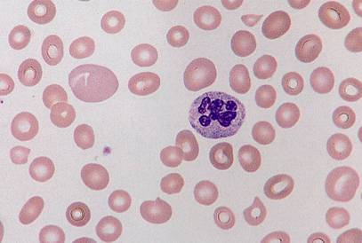
Megaloblastic anemia

Slide 67
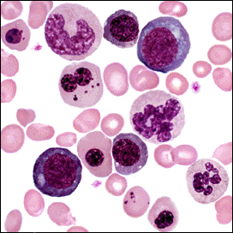
Megaloblastic anemia

Slide 68
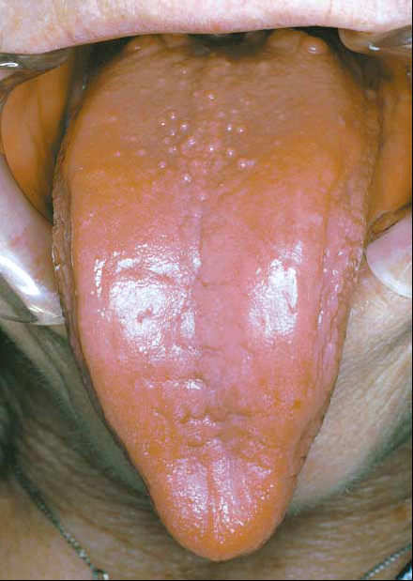
Atrophic glossitis in megaloblastic anemia

Slide 69
What else is B12 good for?
B12
homocysteine
methionine
↑↑ homocysteine
endothelial damage
atherosclerosis
thrombosis
↓↓ methionine
myelin damage
subacute combined degeneration

Slide 70
Three Ways to Get Anemic
Lose blood
Destroy too much blood
  Extracorpuscular reasons
  Intracorpuscular reasons
Make too little blood
  Too few building blocks
  Too few erythroblasts

Slide 71
Aplastic Anemia
Things You Must Know
Pancytopenia
Empty marrow
Most are idiopathic

Slide 72
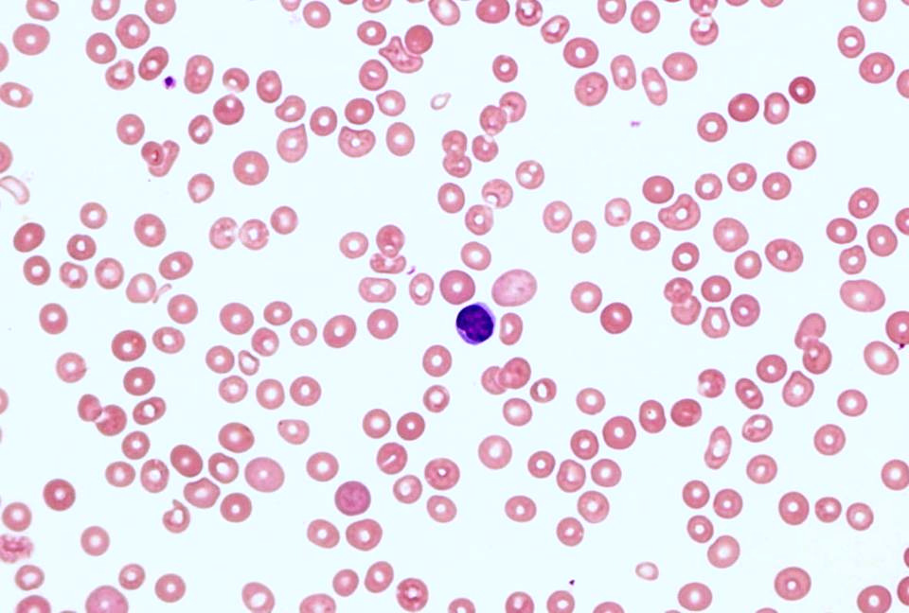
Blood smear in aplastic anemia

Slide 73
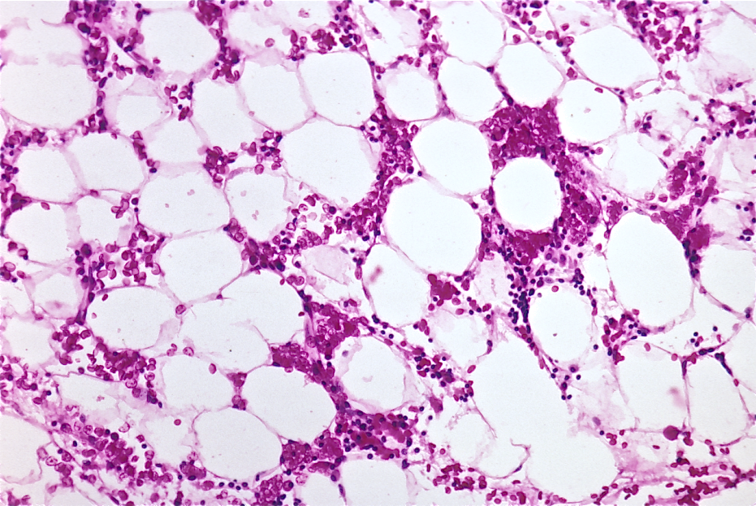
Bone marrow biopsy in aplastic anemia

Slide 74
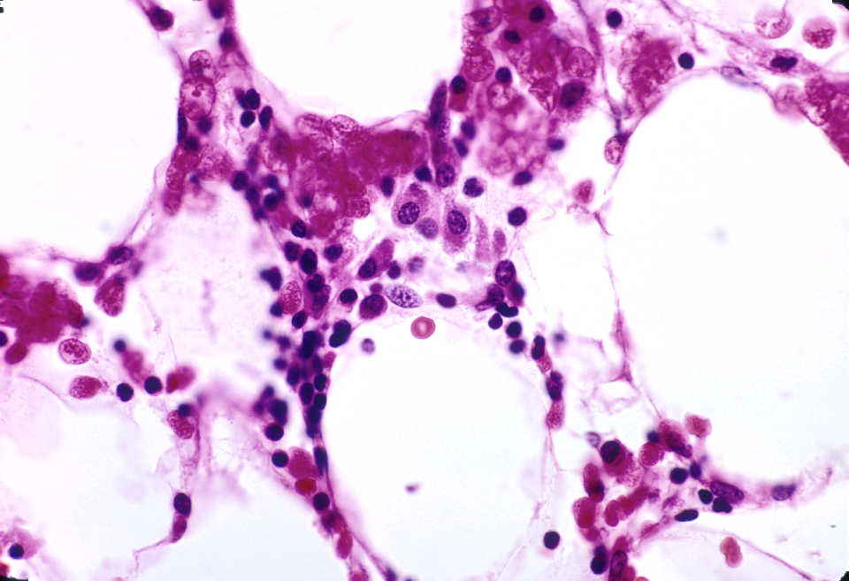
Empty bone marrow in aplastic anemia

Slide 75
Causes of Aplastic Anemia
Idiopathic
Drugs
Viruses
Pregnancy

Slide 76
Three Ways to Get Anemic
Lose blood
Destroy too much blood
  Extracorpuscular reasons
  Intracorpuscular reasons
Make too little blood
  Too few building blocks
  Too few erythroblasts
  Not enough room

Slide 77
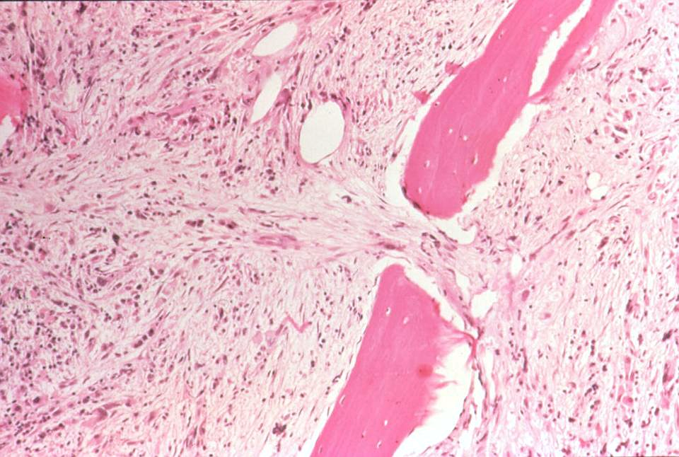
Bone marrow full of fibrosis

