Slide 1
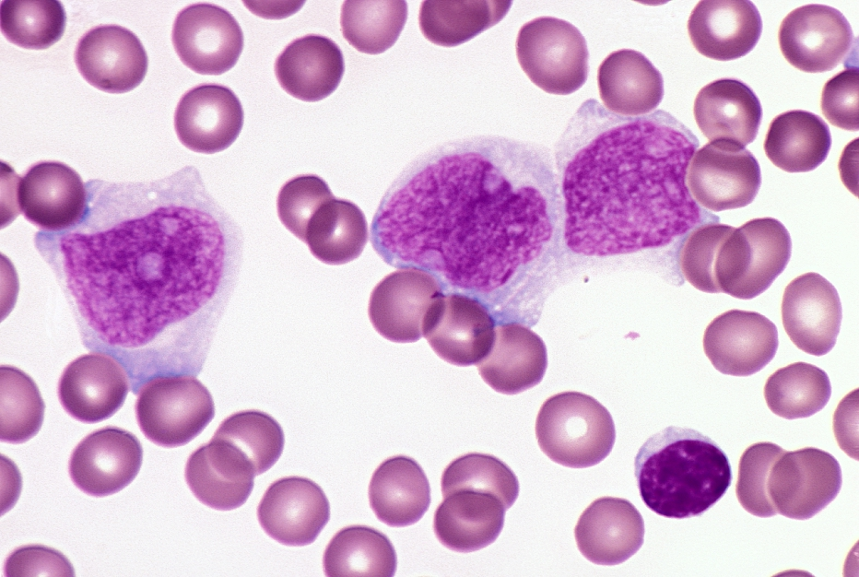
Acute Leukemia
Kristine Krafts, M.D.

Slide 2
Acute Leukemia Outline
Big-picture look at hematologic malignancies
What is acute leukemia?
Acute myeloid leukemia
Acute lymphoblastic leukemia

Slide 3
Acute Leukemia Outline
Big-picture look at hematologic malignancies

Slide 4
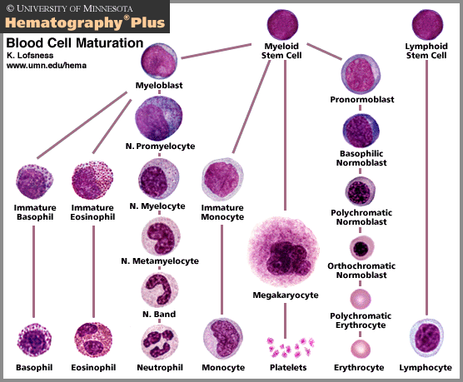

Slide 5

Three Groups of Hematologic Malignancies
Leukemias
Acute leukemias
Chronic leukemias
Most heme malignancies fall into these two groups
Lymphomas
Hodgkin lymphoma
Non-Hodgkin lymphoma
Plasma cell disorders
Multiple myeloma

Slide 6
Leukemia vs. Lymphoma
Leukemias and lymphomas are both malignancies of hematopoietic cells. What’s the difference?
Leukemia
Lymphoma
Starts in lymph nodes
Can spread to other places
Lymphoid only
Hodgkin or non-Hodgkin
Starts in bone marrow, spills into blood
Can spread to other places
Myeloid or lymphoid
Acute or chronic

Slide 7
How is a diagnosis made?
Clinical setting
Morphology
Immunophenotyping
Molecular studies
Cytogenetics

Slide 8
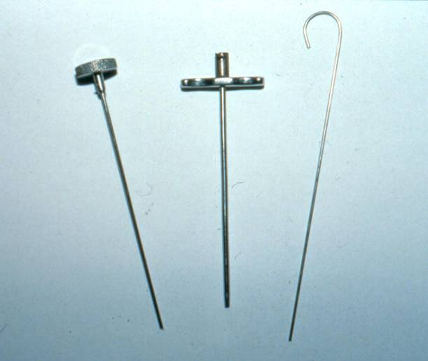
Bone marrow biopsy needle

Slide 9
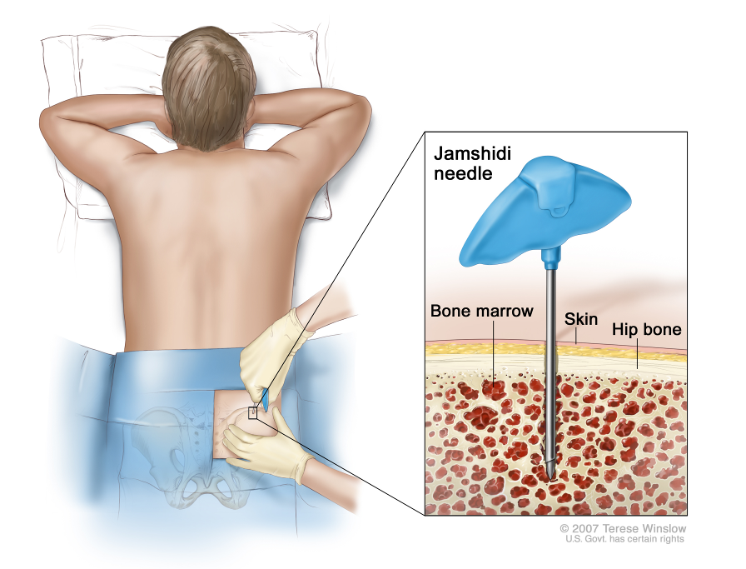

Slide 10
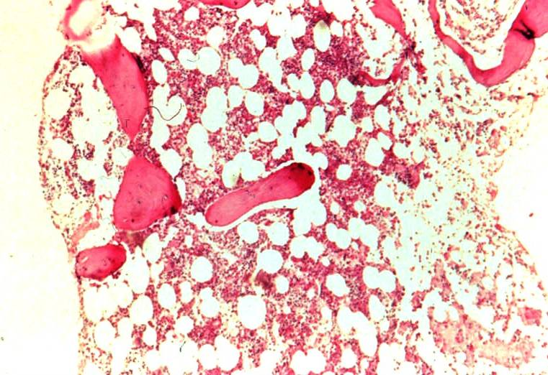
Normal bone marrow biopsy

Slide 11
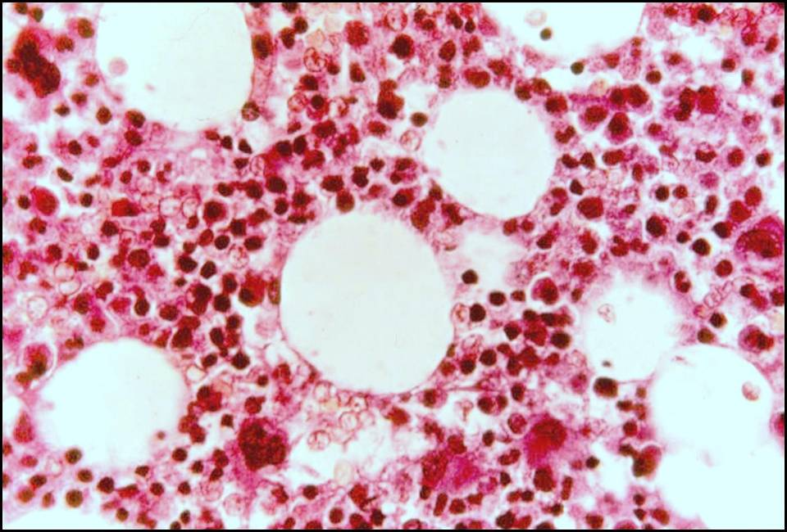
Normal bone marrow biopsy

Slide 12
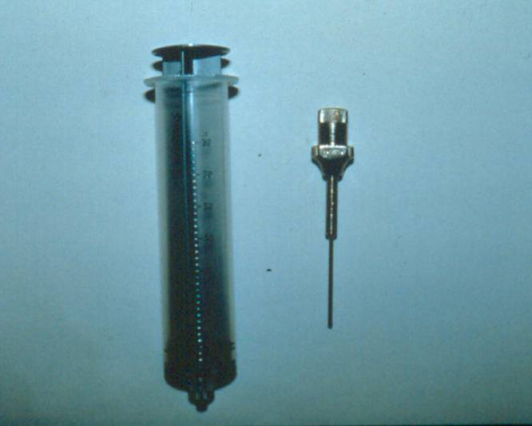
Bone marrow aspiration needle

Slide 13
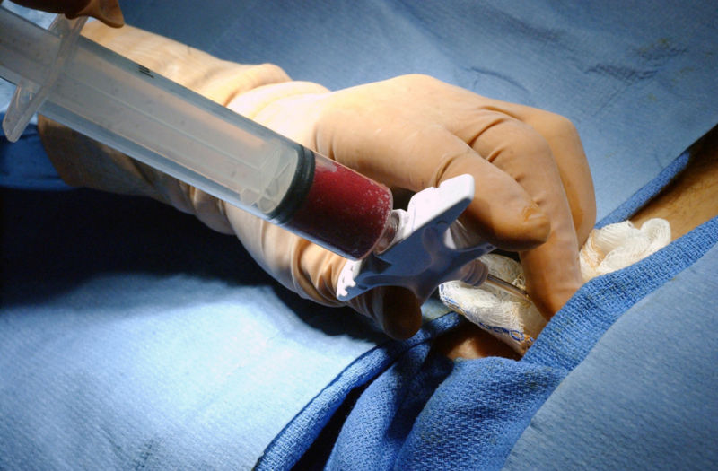
Bone marrow aspiration

Slide 14
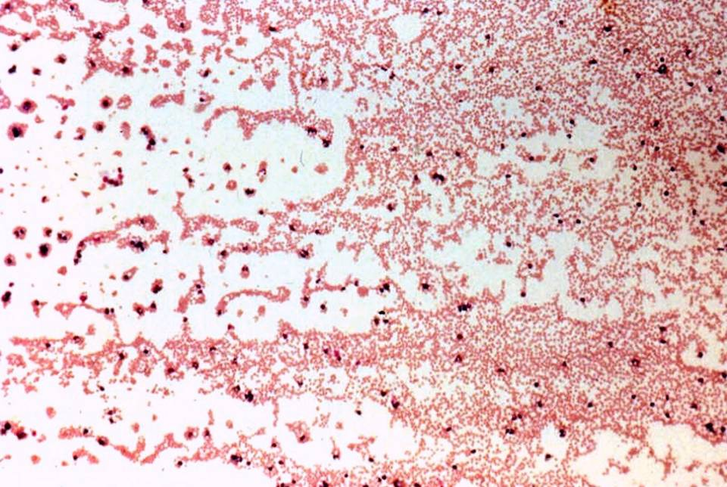
Normal bone marrow aspirate

Slide 15
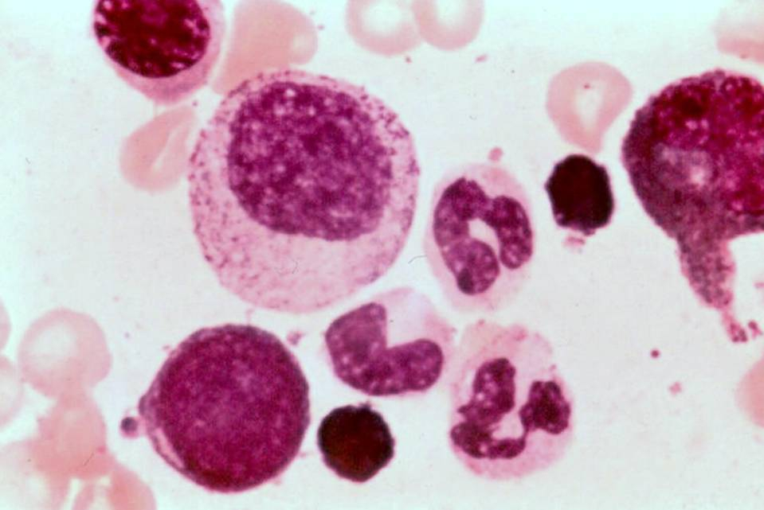
  Normal bone marrow aspirate

Slide 16
Immunophenotyping
CD3
CD4
CD3
CD8
CD19
CD21
Helper T cell
Cytotoxic T cell
B cell

Slide 17
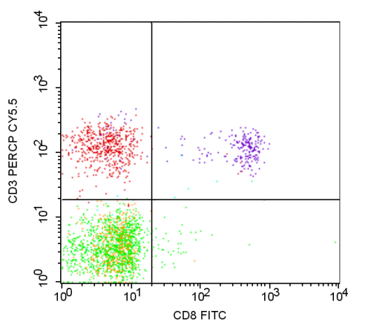



Immunophenotyping
CD3
CD4
CD3
CD8
CD19
CD21

Slide 18
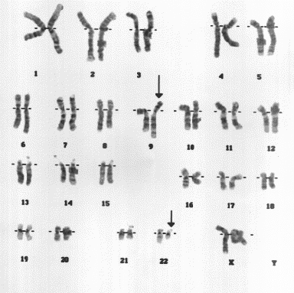
Cytogenetics

Slide 19
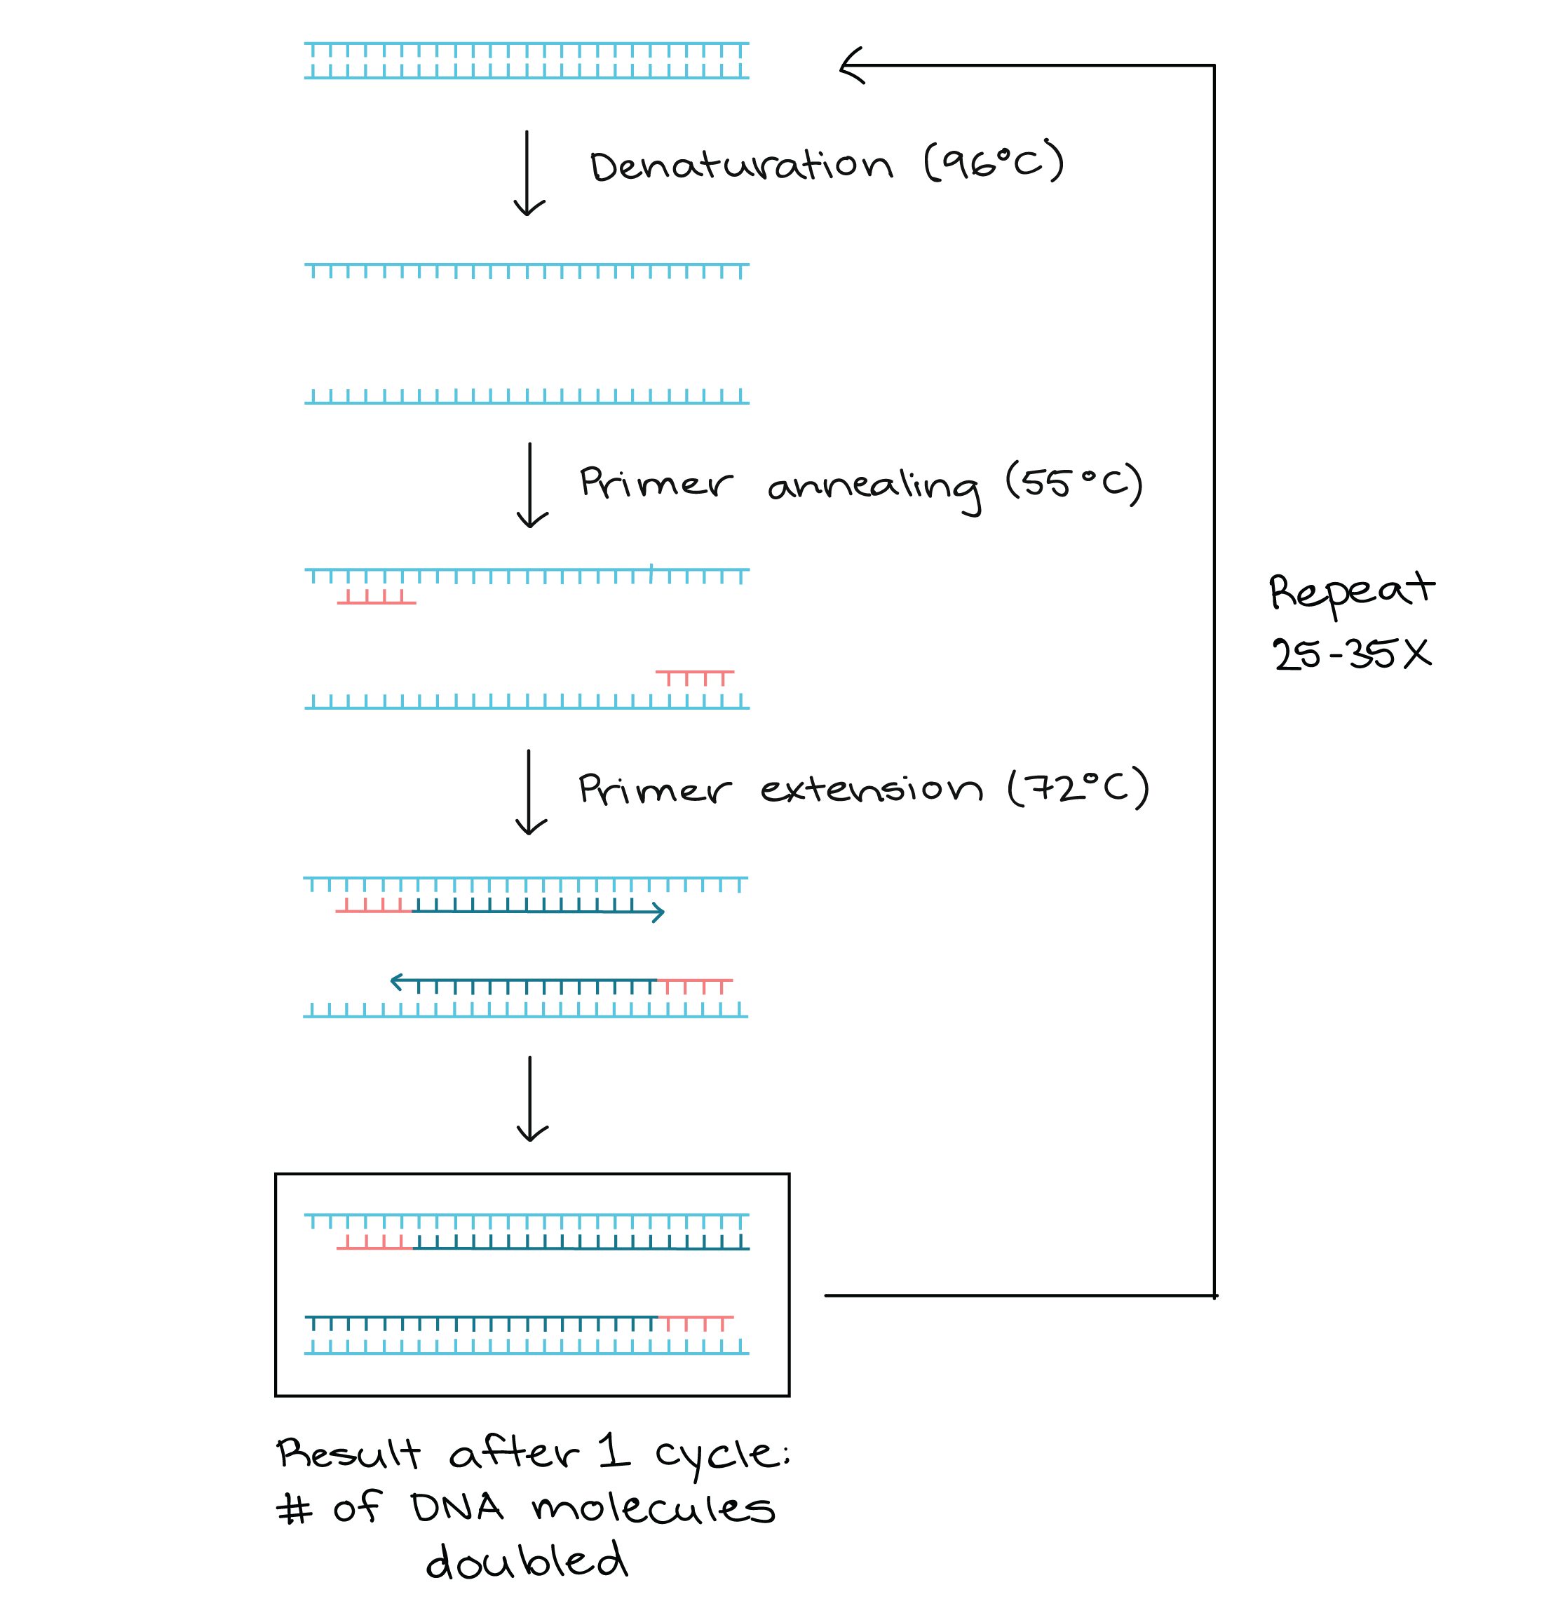
One Type of Molecular Study: Polymerase Chain Reaction

Slide 20
Acute Leukemia Outline
Big-picture look at hematologic malignancies
What is acute leukemia?

Slide 21
Acute Leukemia
Malignant proliferation of immature myeloid or lymphoid cells in the bone marrow
Cause
  Clonal expansion
  Maturation failure
Why is it so bad to have these malignant cells filling up the bone marrow?
  Crowd out normal cells
  Inhibit normal cell function
  May leave and infiltrate other organs

Slide 23
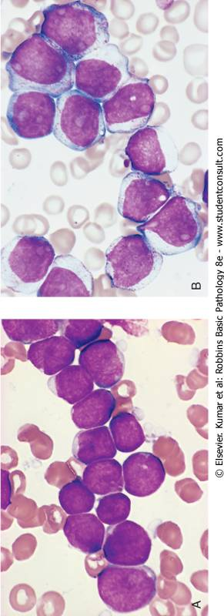
Acute myeloid leukemia
Acute lymphoblastic leukemia

Slide 24
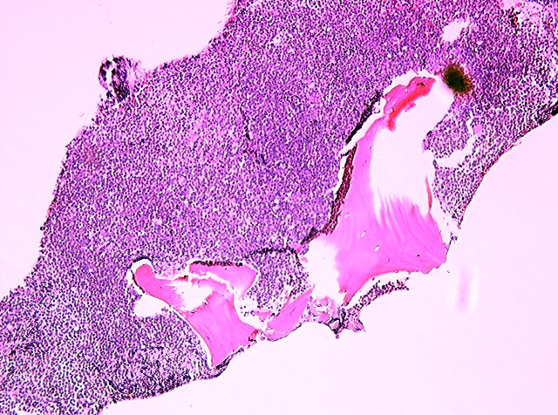
Acute leukemia: bone marrow biopsy

Slide 25
Clinical Features of Acute Leukemia
Sudden onset (days)
Symptoms of “bone marrow failure”
  Fatigue
  Infections
  Bleeding
Bone pain (expanding marrow)
Organ infiltration (liver, spleen, brain)

Slide 26
Acute Leukemia Outline
Big-picture look at hematologic malignancies
What is acute leukemia?
Acute myeloid leukemia

Slide 27
Acute Myeloid Leukemia
Things you must know
Malignant proliferation of myeloblasts (or other early myeloid precursor cells)
in blood and bone marrow
20% cutoff for diagnosis
Many subtypes
Bad prognosis

Slide 29
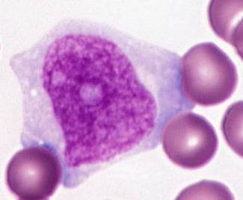
20%
need at least
blasts

Slide 30
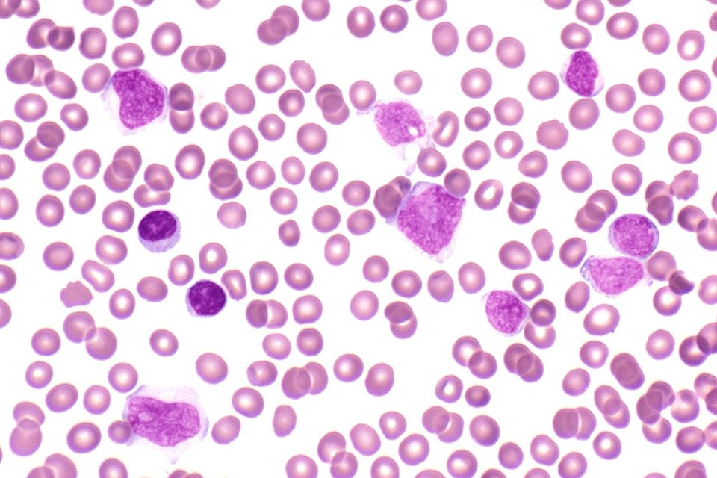
Acute myeloid leukemia with >20% blasts

Slide 31
Q. Why do you need 20% blasts to call it AML?
A. To make sure it’s really AML, and not MDS.

Slide 32
Myelodysplasia (MDS)
Group of disorders characterized by defective (“dysplastic”) maturation of hematopoietic cells
Myeloblasts may be increased in number
(but not over 20%!)
Typically affects older patients
May transform into AML - or may not!
Treatment way less aggressive than AML treatment

Slide 33
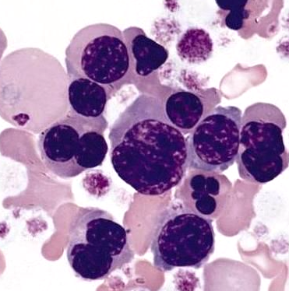
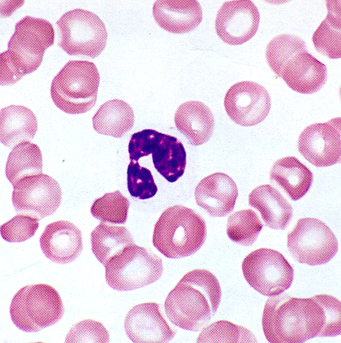
Dyserythropoiesis
Dysmyelopoiesis
(weird changes in red cells)
(weird changes in neutrophils)

Slide 34
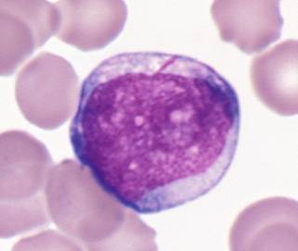
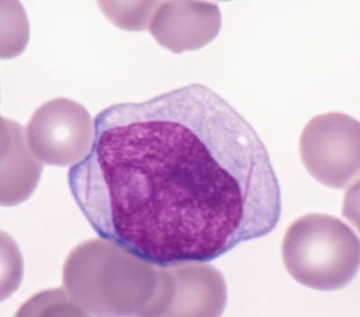
Auer rods

Slide 35
Subtypes of AML
There are LOTS!
Classified using morphology + genetics
We’ll just talk about two:
  Acute promyelocytic leukemia
  Acute monoblastic leukemia

Slide 36
Acute Promyelocytic Leukemia
Malignant proliferation of promyelocytes
Promyelocyte granules contain stuff that stimulates coagulation (BAD!)
t(15;17) results in a new fusion protein that blocks maturation at the promyelocyte stage
ATRA (all trans-retinoic acid) degrades the fusion protein, allowing cells to mature!

Slide 37
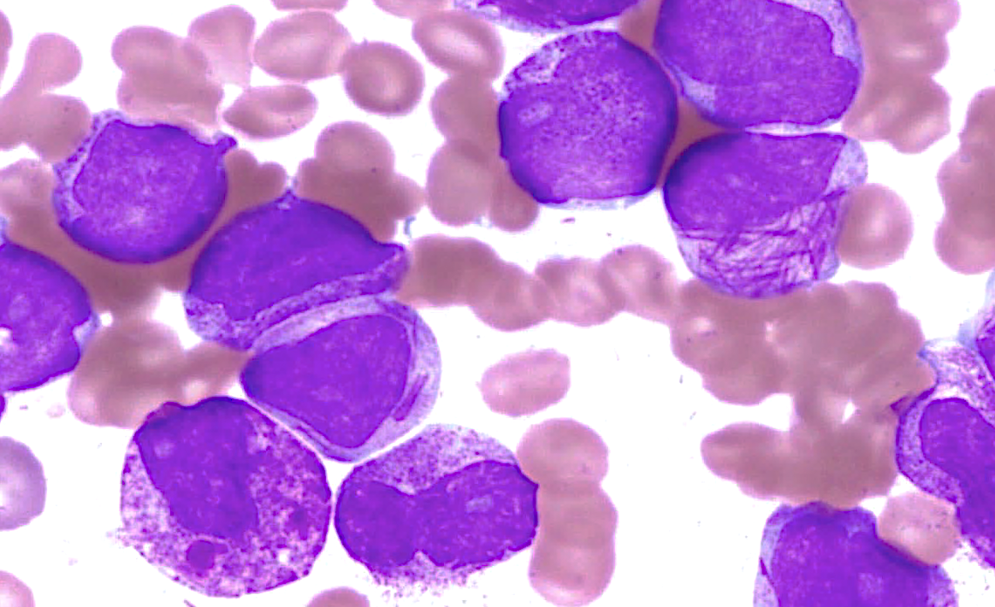
Faggot cell
Acute promyelocytic leukemia

Slide 38


Slide 39
Acute Monoblastic Leukemia
Malignant proliferation of monoblasts
Extramedullary involvement (gums, CNS) is common

Slide 40
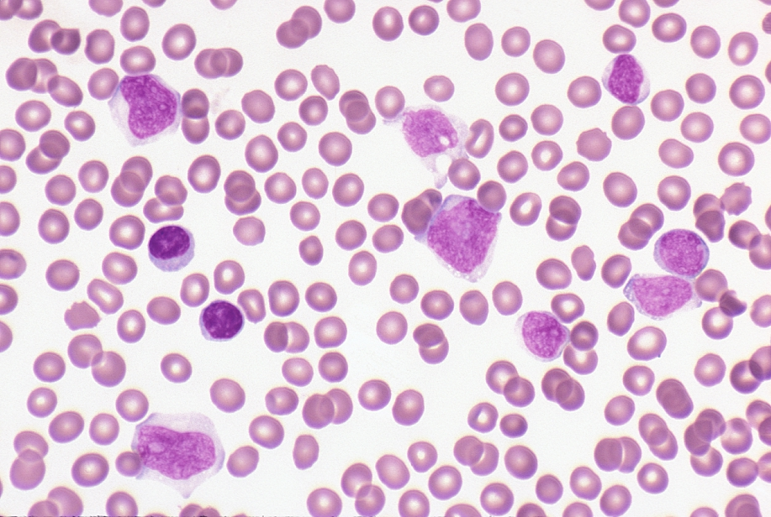
Acute monoblastic leukemia

Slide 41
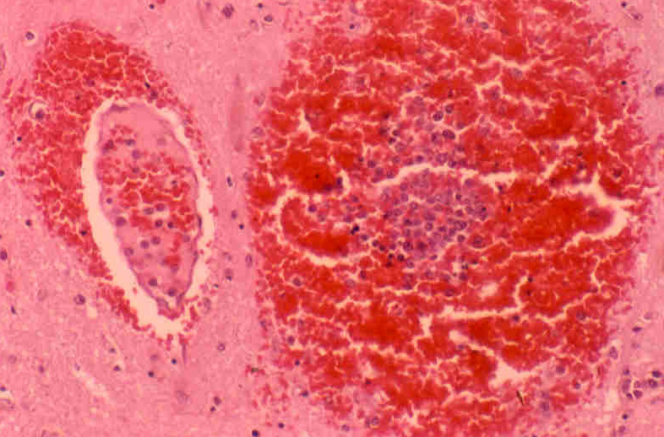
Acute monoblastic leukemia: brain involvement

Slide 42
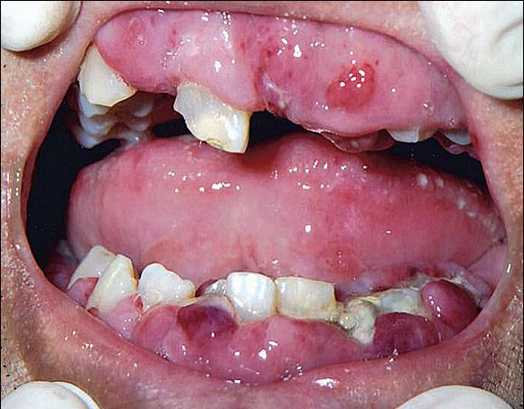
Acute monoblastic leukemia: gum involvement

Slide 43
Treatment and Prognosis of AML
Treatment
Chemo
Bone marrow transplant
Prognosis
Dismal
Except AMLs with certain genetic abnormalities (e.g., APL)

Slide 44
Acute Leukemia Outline
Big-picture look at hematologic malignancies
What is acute leukemia?
Acute myeloid leukemia
Acute lymphoblastic leukemia

Slide 45
Acute Lymphoblastic Leukemia
Things You Must Know
Malignant proliferation of lymphoid blasts in blood, bone marrow
Classified by immunophenotype (B vs. T)
More common in children
Prognosis often good!

Slide 47
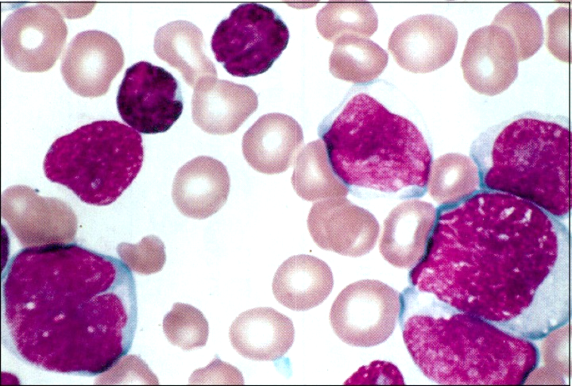
Acute lymphoblastic leukemia

Slide 48
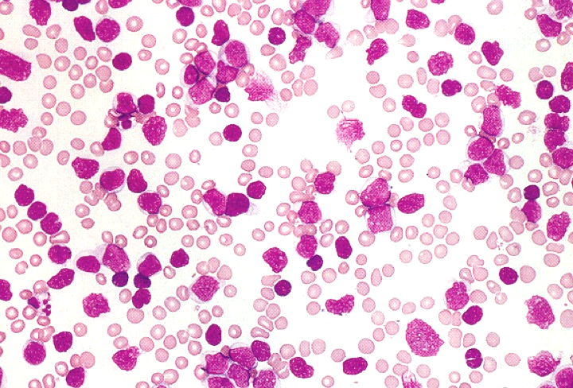
Acute lymphoblastic leukemia

Slide 49
Treatment and Prognosis of ALL
Treatment
Chemo ± bone marrow transplant
Many children are cured!
Prognosis
Immunophenotype (B is better)
Age (1-10 better)
WBC (<10,000 better)
Cytogenetics (hyperdiploidy better!)

