Slide 1

General Principles of
Hemostasis
Kristine Krafts, M.D.

Slide 2
Hemostasis Lecture Outline
The big picture
Laboratory tests

Slide 3
Hemostasis Lecture Outline
The big picture

Slide 4
Hemostasis is a balancing act!
pro-clotting
anti-clotting
plugs up holes in blood vessels
keeps clotting under control

Slide 5
How to make a clot
clot
Constrict vessel
Form platelet plug
Seal plug with fibrin

Slide 6
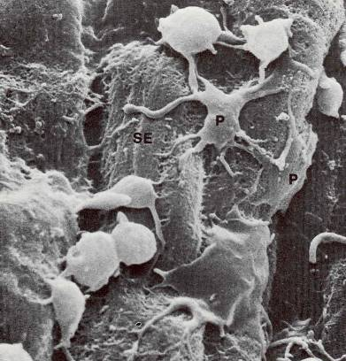
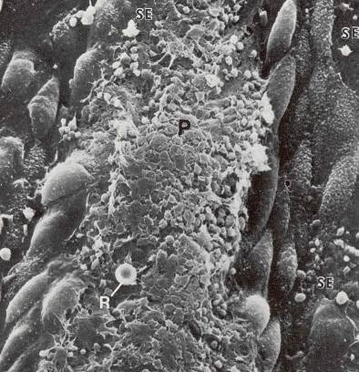
Platelet adhesion and aggregation

Slide 7
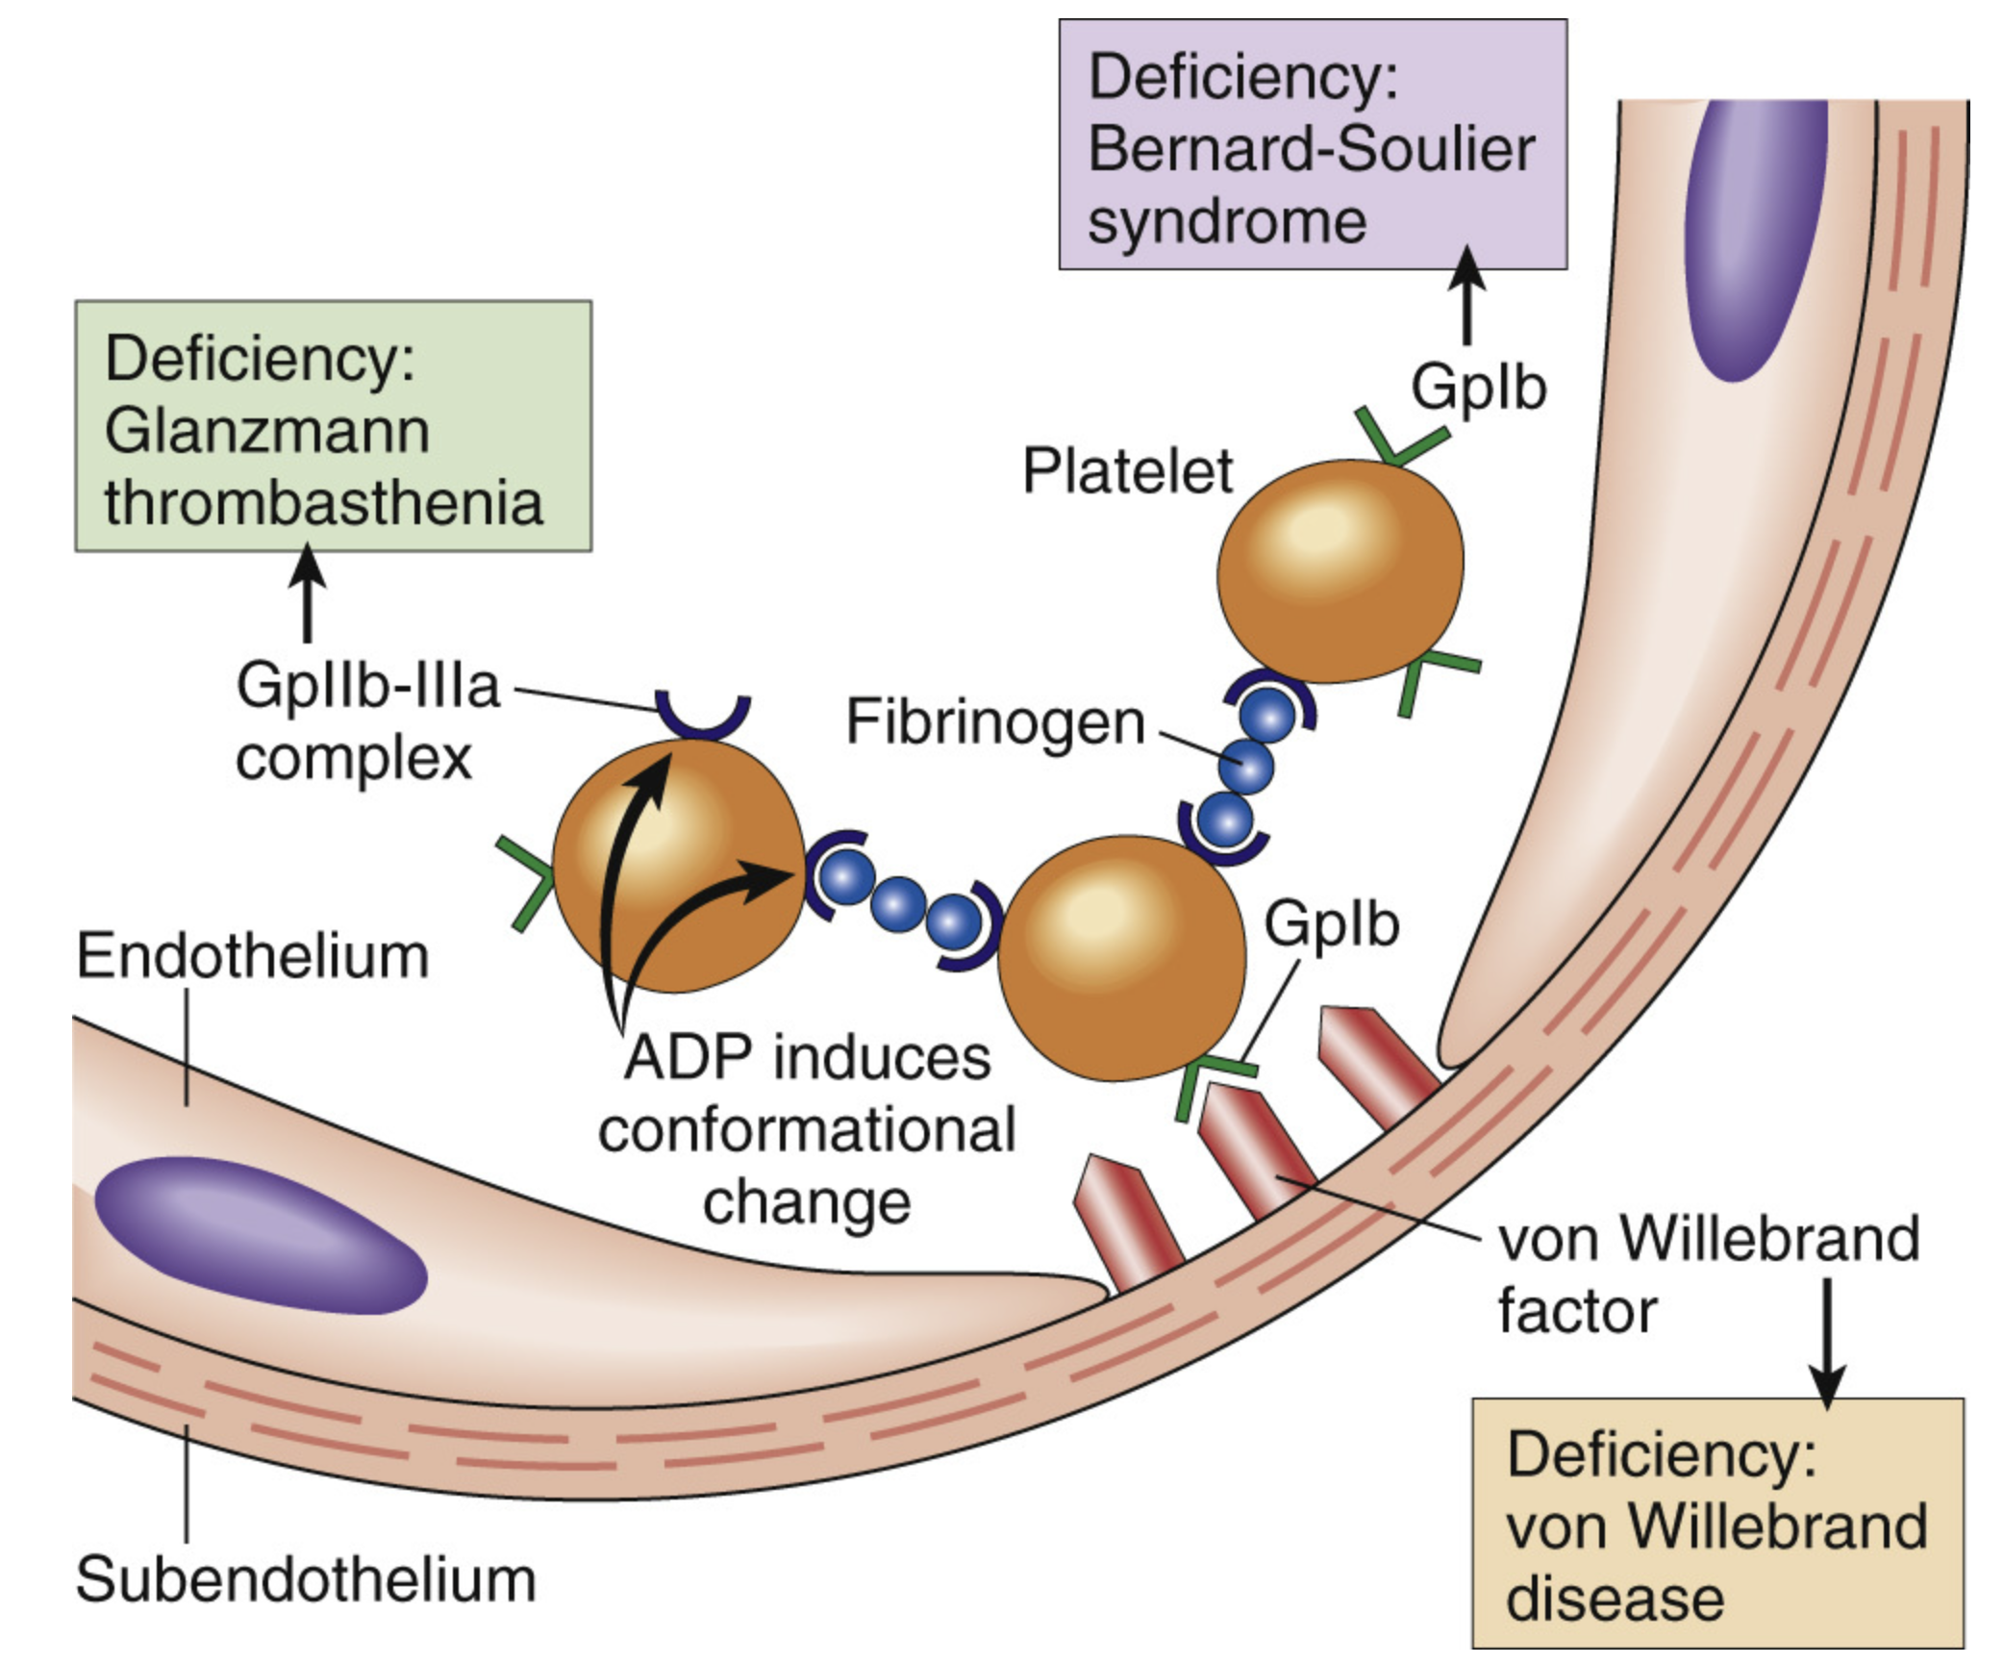









Slide 8
Coagulation Cascade
Intrinsic Pathway
Extrinsic Pathway
thrombin
exposed TF
XI
XIa
TF
VIIa
IX
IXa
VII
VIII
VIIIa
Final common pathway
X
V
Va
Xa
prothrombin
thrombin
fibrinogen
FIBRIN

Slide 9
Q. Do you need to use both pathways in vivo?
A. Yes!
Q. So…where’s the starting point?
A. It all starts when tissue factor shows up!

Slide 10
Where does tissue factor come from?
“Hidden” cells exposed during injury
Microparticles floating in blood
Endothelial cells and monocytes (during inflammation)

Slide 11
Tissue factor is what starts the cascade in vivo
Intrinsic Pathway
Extrinsic Pathway
thrombin
exposed TF
XI
XIa
TF
VIIa
IX
IXa
VII
VIII
VIIIa
Final common pathway
X
V
Va
Xa
prothrombin
thrombin
fibrinogen
FIBRIN

Slide 12
TF binds to VII, which becomes VIIa
Intrinsic Pathway
Extrinsic Pathway
thrombin
exposed TF
XI
XIa
TF
VIIa
IX
IXa
VII
VIII
VIIIa
Final common pathway
X
V
Va
Xa
prothrombin
thrombin
fibrinogen
FIBRIN

Slide 13
TF/VIIa complex converts X to Xa, and FCP makes fibrin.
Intrinsic Pathway
Extrinsic Pathway
thrombin
exposed TF
XI
XIa
TF
VIIa
IX
IXa
VII
VIII
VIIIa
Final common pathway
X
V
Va
Xa
prothrombin
thrombin
fibrinogen
FIBRIN

Slide 14
But then the whole extrinsic pathway is shut down!
Intrinsic Pathway
Extrinsic Pathway
thrombin
exposed TF
XI
XIa
TF
VIIa
IX
IXa
VII
VIII
VIIIa
Final common pathway
X
TFPI
(tissue factor pathway inhibitor)
V
Va
Xa
prothrombin
thrombin
fibrinogen
FIBRIN

Slide 15
So then what?
Intrinsic Pathway
XI
XIa
IX
IXa
VIII
VIIIa
Final common pathway
X
V
Va
Xa
prothrombin
thrombin
fibrinogen
FIBRIN

Slide 16
Thrombin kicks of the intrinsic pathway!
The cascade continues this way until it’s time to stop.
Intrinsic Pathway
thrombin
XI
XIa
IX
IXa
VIII
VIIIa
Final common pathway
X
V
Va
Xa
prothrombin
thrombin
fibrinogen
FIBRIN

Slide 17
A little simplified
Intrinsic
Extrinsic
TF
VIIa
IX
VIII
X
V
thrombin
FIBRIN

Slide 18
A lot simplified
tissue factor
fibrin

Slide 19
How to remember which pathway is which?
Intrinsic Pathway
Extrinsic Pathway
thrombin
exposed TF
XI
XIa
TF
VIIa
IX
IXa
VII
VIII
VIIIa
Final common pathway
X
V
Va
Xa
prothrombin
thrombin
fibrinogen
FIBRIN

Slide 20


busy
simple
sinful
sexy

Slide 21
Coagulation Cascade
SINtrinsic Pathway
Intrinsic Pathway
Extrinsic Pathway
thrombin
exposed TF
XI
XIa
TF
VIIa
IX
IXa
VII
VIII
VIIIa
Final common pathway
X
V
Va
Xa
busy
prothrombin
thrombin
sinful
fibrinogen
FIBRIN

Slide 22
Coagulation Cascade
SINtrinsic Pathway
SEXtrinsic Pathway
Extrinsic Pathway
thrombin
exposed TF
XI
XIa
TF
VIIa
IX
IXa
VII
VIII
VIIIa
Final common pathway
X
V
Va
Xa
busy
prothrombin
thrombin
simple
sinful
sexy
fibrinogen
FIBRIN

Slide 23
How to keep clotting under control
clot
Constrict vessel
Form platelet plug
Seal plug with fibrin
inhibit the cascade

Slide 24
Cascade Inhibitors
Intrinsic Pathway
Extrinsic Pathway
thrombin
exposed TF
XI
XIa
TF
VIIa
IX
IXa
VII
VIII
VIIIa
Final common pathway
X
ATIII
protein
C
V
Va
Xa
prothrombin
thrombin
fibrinogen
FIBRIN

Slide 25
How to keep clotting under control
clot
Constrict vessel
Form platelet plug
Seal plug with fibrin
lyse the clot

Slide 26
Lysing the clot
Tissue plasminogen activator (t-PA)
plasminogen
plasmin
clot
fibrin degradation products (FDPs)

Slide 27
Hemostasis Lecture Outline
The big picture
Laboratory tests

Slide 28
Platelet Lab Tests
Count
  Done by particle counter
  150 – 450 x 10⁹/L
Morphology
  Size
  Granulation

Slide 29
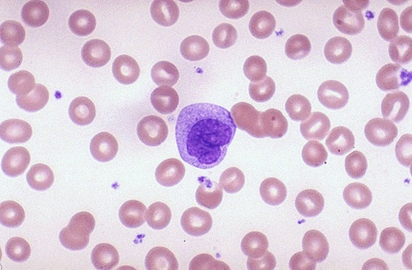
Platelets

Slide 30
Bleeding Time
Evaluates how the platelets function in vivo
Make incision, wait for bleeding to stop
If abnormal, means something’s wrong with platelets (or patient is taking aspirin)
Many factors can affect the results
Slowly being replaced by the “closure time”

Slide 31
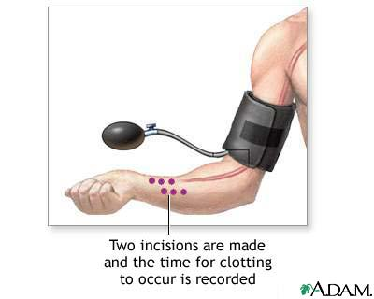

Slide 32
Coagulation Lab Tests
Draw blood into citrate tube
Spin tube, decant plasma
Add reagents to plasma
Watch for formation of fibrin

Slide 33
Prothrombin Time (PT)
This test evaluates the extrinsic pathway.
Extrinsic Pathway
exposed TF
Method: Add thromboplastin to patient’s plasma, measure the time it takes to make fibrin.
TF
VIIa
VII
Final common pathway
X
V
Va
Xa
prothrombin
thrombin
fibrinogen
FIBRIN

Slide 34
Q. How can the PT just measure the extrinsic pathway?
A. Because thromboplastin is made of phospholipid
and something that acts just like tissue factor.
So it kicks off the extrinsic pathway in the test
tube (just like TF does in vivo)!
Q. Doesn’t the intrinsic pathway interfere?
A. No! The test ends when fibrin is detected.
So any further fibrin formation along the
intrinsic pathway doesn’t matter.

Slide 35
International normalized ratio (INR)
Just a “corrected” PT.
Thromboplastin activity varies with manufacturer!
PT results very different depending on which
brand of thromboplastin used.
INR was created to correct this inconsistency.
INR = PT with some mathematical calculations
that take into account the brand of thromboplastin.

Slide 36
Partial Thromboplastin Time (PTT)
Intrinsic Pathway
This test evaluates the intrinsic pathway.
thrombin
Method: Add phospholipid (plus a little activator to mimic thrombin) to patient’s plasma, measure the time it takes to make fibrin.
XI
XIa
IX
IXa
VIII
VIIIa
Final common pathway
X
V
Va
Xa
prothrombin
thrombin
fibrinogen
FIBRIN

Slide 37
Q. How can the PTT measure just the intrinsic pathway?
A. Because you just add phospholipid and a little
thrombin-like activator. You don’t add any
tissue factor!
Q. So the extrinsic pathway doesn’t interfere?
A. No! It never gets activated, because there’s no
tissue factor around.

Slide 38
Fibrin Degradation Product Assay
Measures FDPs
VERY, VERY sensitive test
Best used to rule OUT a thrombus!
clot
fibrin degradation products (FDPs)

