Slide 1
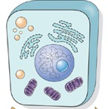
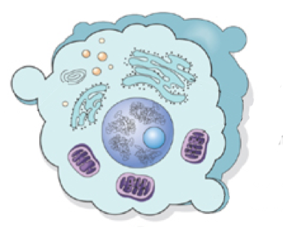
Cell Injury
Kristine Krafts, MD

Slide 2
Cell Injury Lecture Objectives
Outline the basic process of cell injury, including the concepts of homeostasis, adaptation, injury, and cell death.
List and define the four adaptations cells undergo in response to stress.
List and describe the two main causes of cell injury.
Describe the basic steps that occur during cell injury.
List cellular changes that occur in reversible vs. irreversible injury.
Compare and contrast the two types of cell death.
List the five types of necrosis, and describe their causes, their gross and microscopic appearances, and the situations in which they commonly occur.

Slide 3
Cell Injury Outline
What is cell injury, exactly?
The four adaptations
The two causes of cell injury
The mechanisms of cell injury
Cell death

Slide 4
Cell Injury Outline
What is cell injury, exactly?

Slide 5
Cell injury, super-simplified
Normal cells keep themselves in a “steady state” called homeostasis.
Excess stress can force cells to develop a new steady state; this process is called adaptation.
If there’s so much stress that the cell can’t adapt, then the cell will become injured.
Mild cell injury is reversible; severe cell injury is irreversible and leads to cell death.

Slide 6
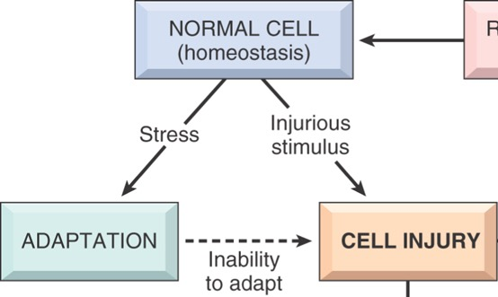

Slide 8
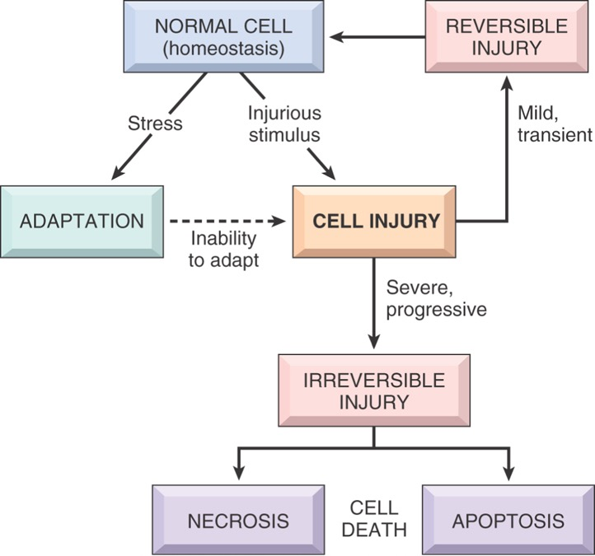

Slide 11
Cell Injury Outline
What is cell injury, exactly?
The four adaptations

Slide 12

How do cells adapt
when they are stressed?
There are four types of adaptations:
1. Hypertrophy
2. Hyperplasia
3. Atrophy
4. Metaplasia

Slide 13
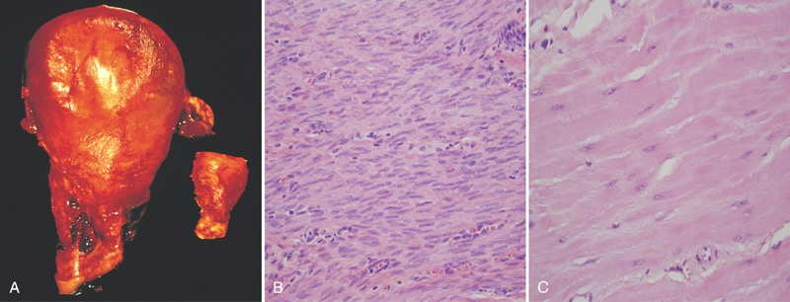
Hypertrophy = an increase in cell size
In pregnancy, the uterus undergoes hypertrophy.
Smooth muscle cells in normal uterus
Smooth muscle cells
in uterus during pregnancy (BIG!)

Slide 14
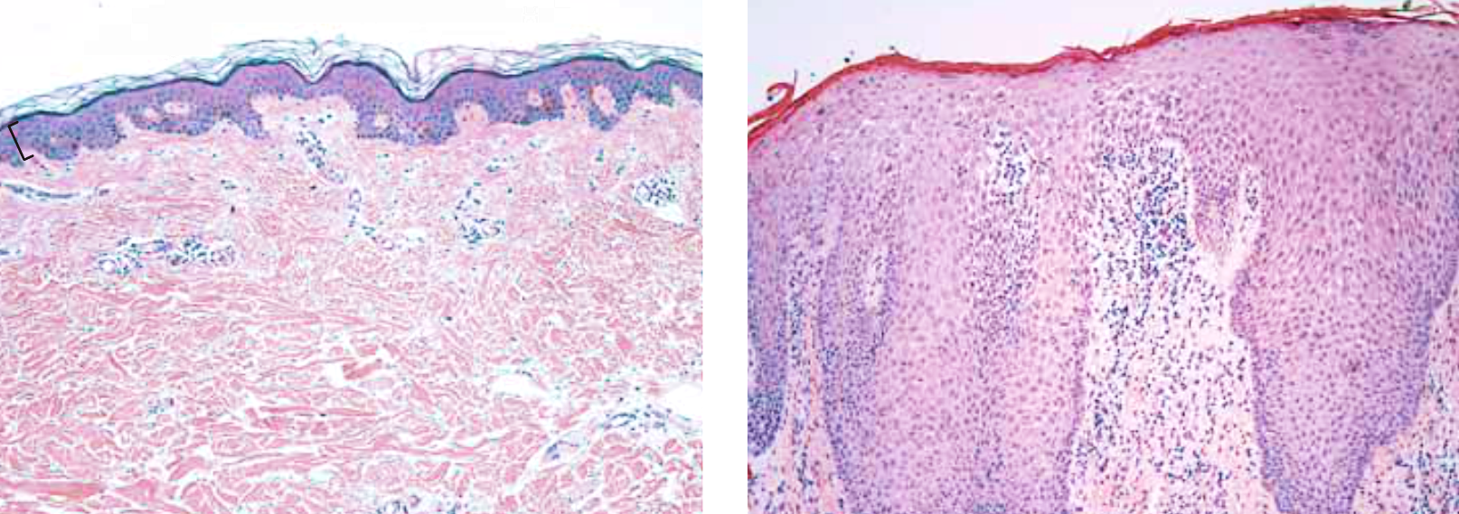
Hyperplasia = an increase in cell number
Normal epidermis
Hyperplastic epidermis

Slide 15
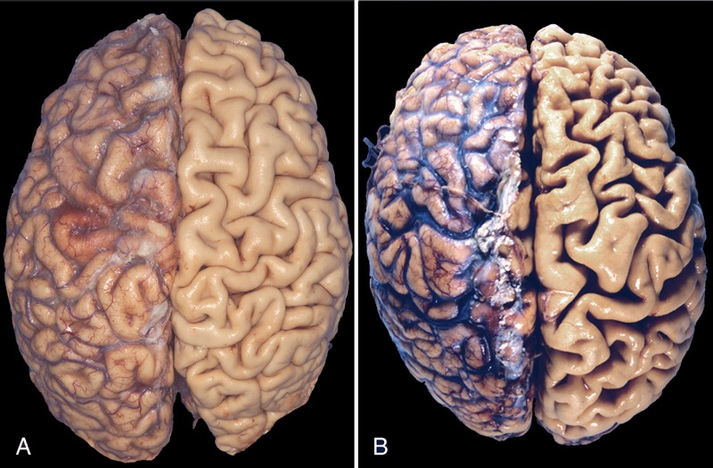
Atrophy = an decrease in cell size
Normal brain
Atrophic brain

Slide 16
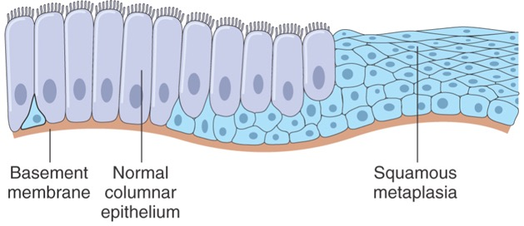
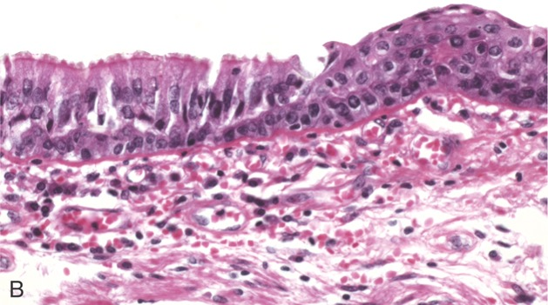
Metaplasia = a change from one cell type to another

Slide 17
Cell Injury Outline
What is cell injury, exactly?
The four adaptations
The two causes of cell injury

Slide 18

What causes cell injury?

Slide 19


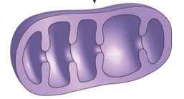
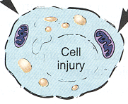
What causes cell injury?
Basically, two things!
1. Ischemia (lack of blood flow)
Not enough oxygen
Mitochondria can’t make ATP
Membrane pumps fail, calcium accumulates...

Slide 20
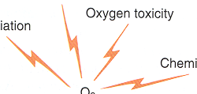
What causes cell injury?
Basically, two things!
1. Ischemia (lack of blood flow)
2. Things that form free radicals
c
Inflammation
Chemicals
Radiation
Toxins
Not enough oxygen
O₂
c
c
Mitochondria can’t make ATP
Free radicals
(like H₂O₂)
Membrane pumps fail, calcium accumulates...
Cell membrane is damaged

Slide 21
Cell Injury Outline
What is cell injury, exactly?
The four adaptations
The two causes of cell injury
The mechanisms of cell injury

Slide 22

What happens when cells get injured?

Slide 23

So what happens during cell injury?
Cell injury often starts with ATP depletion.

Slide 24

So what happens during cell injury?
Without enough ATP, cell membrane pumps fail, and calcium accumulates in the cell.

Slide 25




So what happens during cell injury?
Too much cytoplasmic calcium is bad for three reasons:
1. It poisons mitochondria.
3. It activates nasty enzymes which damage cell membranes.
2. It damages
proteins and DNA.

Slide 26

If the injury is mild,
the cell will go back to normal.

Slide 27
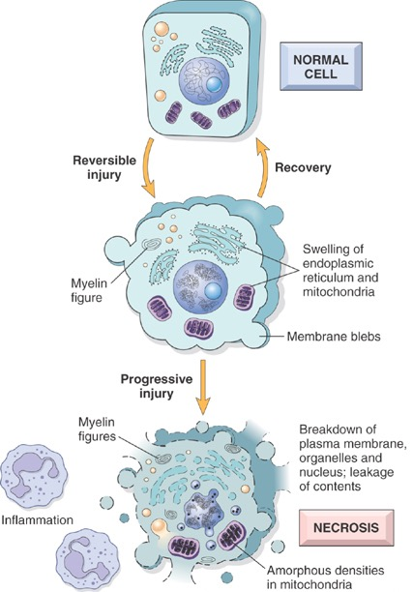
Signs of reversible injury:
  Membrane blebs
  Swollen ER and mitochondria
  Myelin figures (phospholipids from damaged cell membrane)

Slide 28

If the injury is severe, the cell will become irreversibly injured!

Slide 29
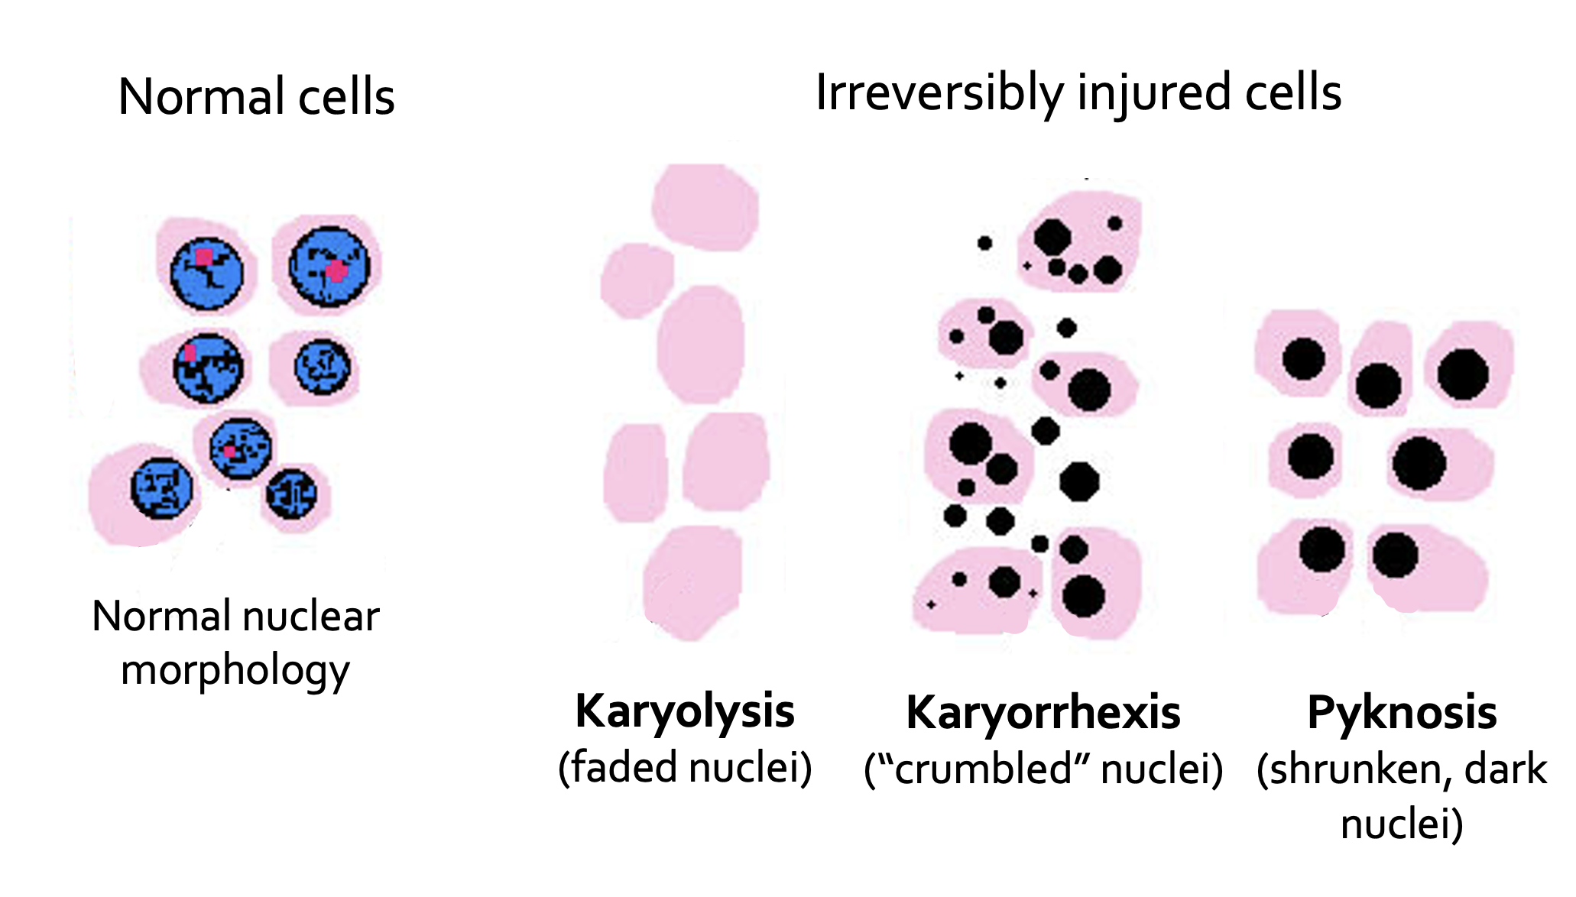

Nuclear hallmarks of irreversible cell injury

Slide 30

Then…
the cell dies!

Slide 31
Cell Injury Outline
What is cell injury, exactly?
The four adaptations
The two causes of cell injury
The mechanisms of cell injury
Cell death

Slide 32
Necrosis is a type of cell death in which the cell bursts open, releasing its contents and attracting inflammatory cells (which clean up the mess).

Slide 33
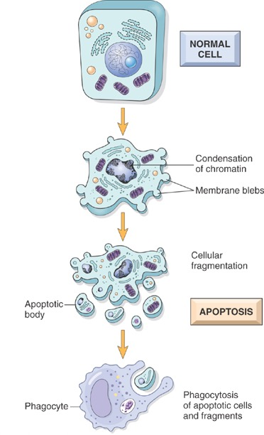
Apoptosis is a type of cell death in which the cell quietly dies. Instructions for apoptosis are programmed into the cell’s DNA!

Slide 34
The five types of necrosis
1. Coagulative necrosis
  Seen in infarcts* in any tissue (except brain)
  Caused by lack of blood supply
  Gross: firm tissue often in a triangle shape
  Micro: ghostly, pink cells
* Infarct = an area of dead tissue caused by lack of blood flow

Slide 35
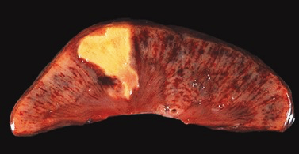
Wedge-shaped infarct
Cross-section of kidney

Slide 36
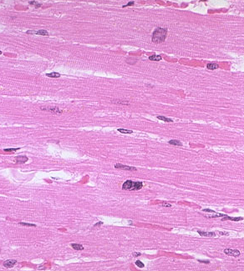
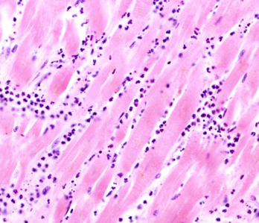
Normal heart cells
Heart cells undergoing coagulative necrosis

Slide 37
The five types of necrosis
1. Coagulative necrosis
2. Liquefactive necrosis
  Seen in infections and in brain infarcts
  Caused by neutrophils releasing their toxic contents and “liquefying” tissue
  Gross: creamy yellow-green liquid (pus)
  Micro: lots of neutrophils and cell debris

Slide 38
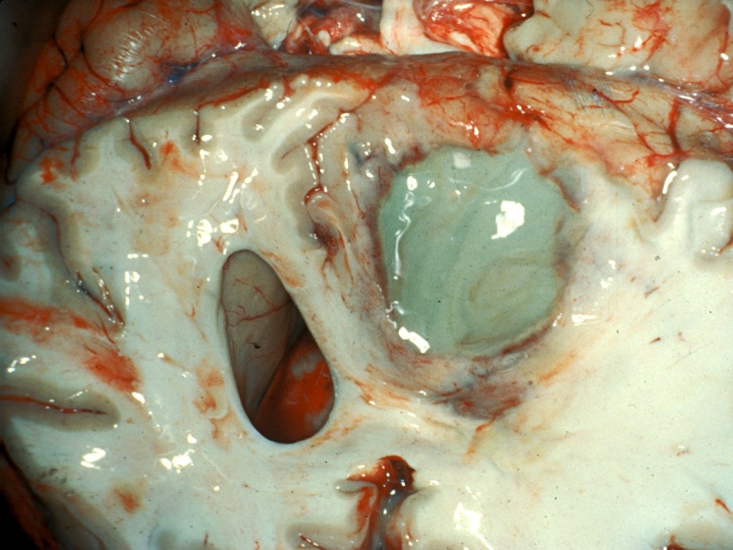
Liquefactive necrosis in the brain

Slide 39
The five types of necrosis
1. Coagulative necrosis
2. Liquefactive necrosis
3. Caseous necrosis
  Seen in tuberculosis infections
  Caused by the body’s attempt to wall off and kill tuberculosis bugs
  Gross: soft, cheesy-looking (“caseous”) tissue
  Micro: caseating granulomas

Slide 40
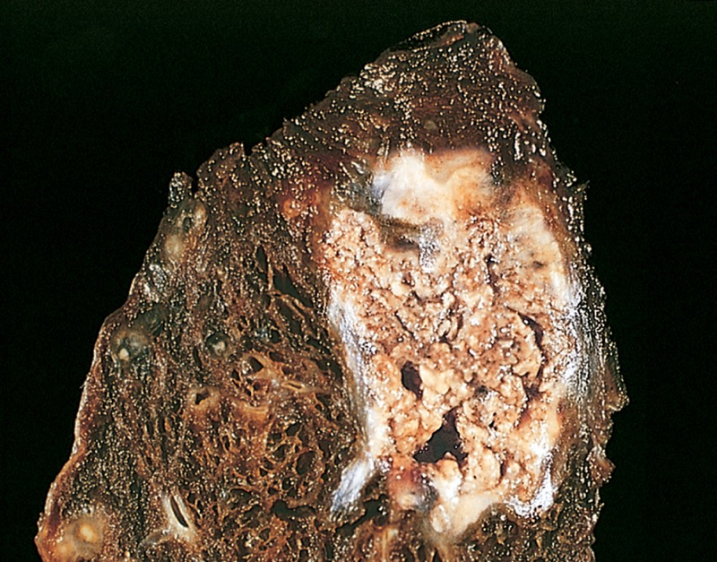
Cheesy-looking caseous necrosis
Portion of lung from a patient with tuberculosis

Slide 41
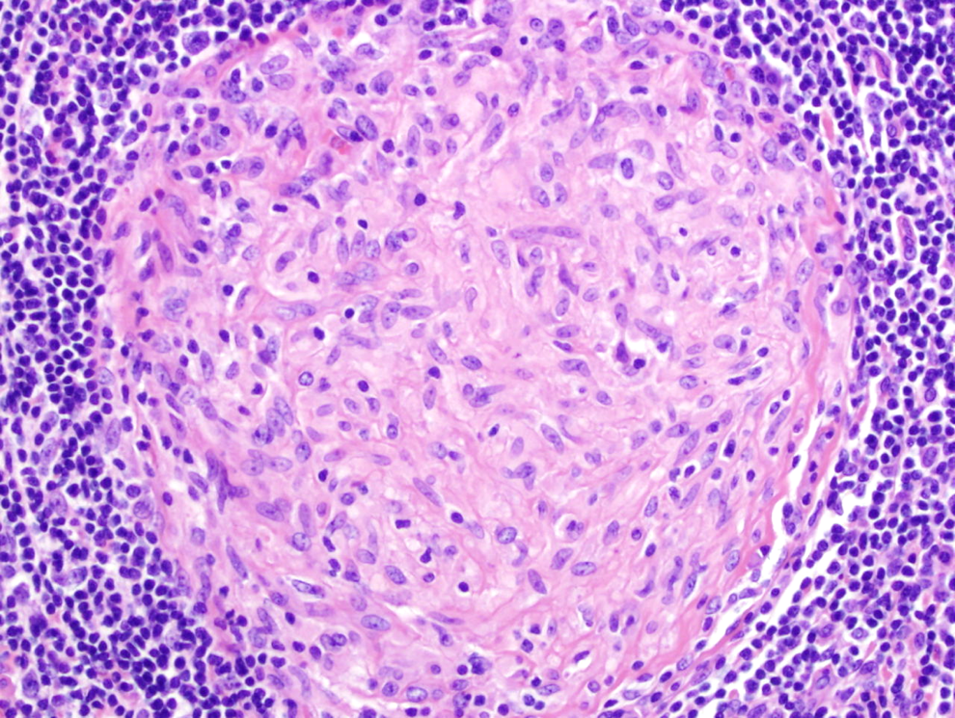
What’s a granuloma?
  It’s a group of macrophages surrounding something and trying to phagocytize (eat) it.
macrophages
Sometimes
there are lymphocytes
surrounding the macrophages.

Slide 42
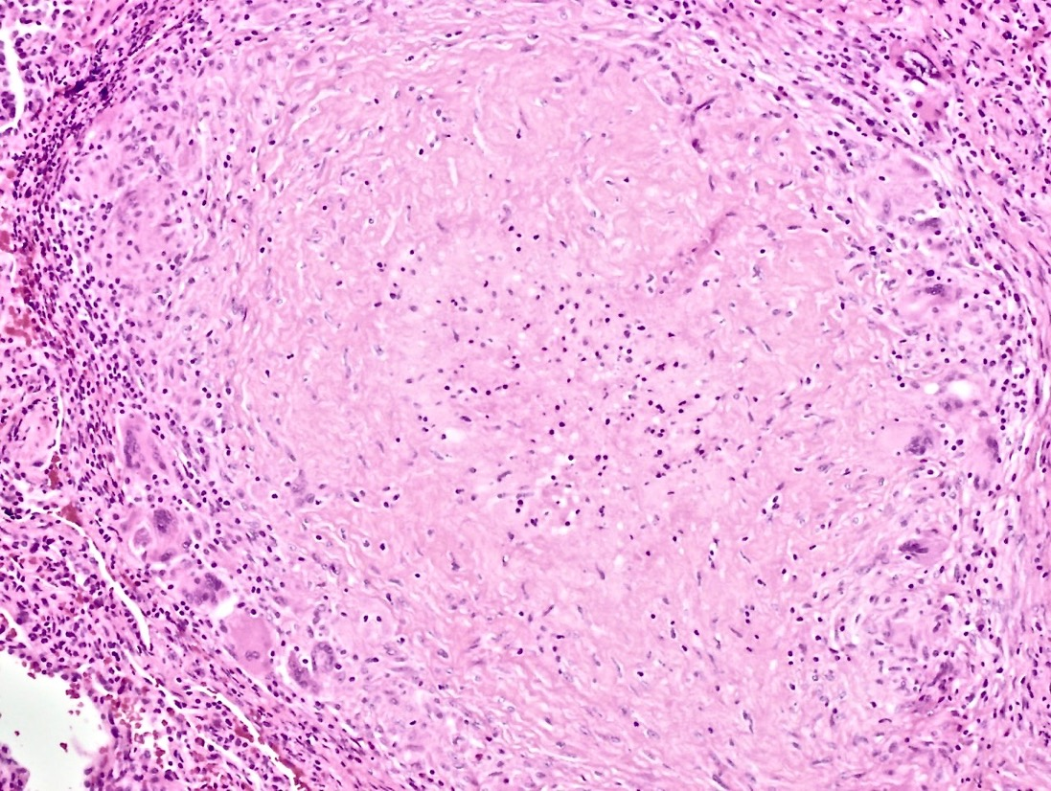
What’s a caseating granuloma?
  It’s a granuloma with a bunch of necrotic debris in the middle.
necrotic debris
lymphocytes
macrophages

Slide 43
The five types of necrosis
1. Coagulative necrosis
2. Liquefactive necrosis
3. Caseous necrosis
4. Fat necrosis
  Seen in pancreatitis*
  Cause: lipase (from damaged pancreas cells) breaks down fat cells, then calcium accumulates.
  Gross: chalky white deposits in fat
  Micro: shadowy outlines of dead fat cells.
* Pancreatitis = inflammation of the pancreas

Slide 44
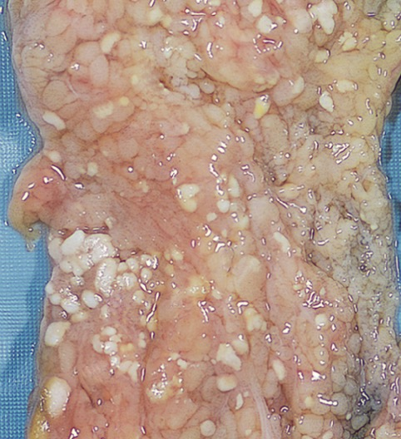
Chalky, white areas of fat necrosis
Portion of pancreas from patient with pancreatitis

Slide 45
Dead fat cells
Fat necrosis

Slide 46
The five types of necrosis
1. Coagulative necrosis
2. Liquefactive necrosis
3. Caseous necrosis
4. Fat necrosis
5. Gangrenous necrosis
  Seen in limbs that lose blood supply
  Isn’t really a different type of necrosis (but people use the term, so you should know it)
  Gross: black, dead skin and decomposing tissue
  Micro: coagulative necrosis

Slide 47
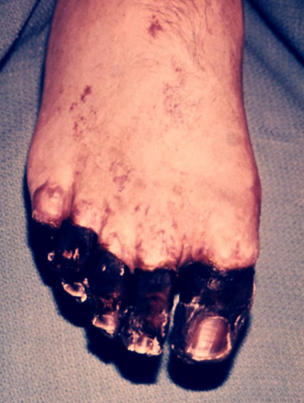
Gangrenous necrosis

