Slide 1
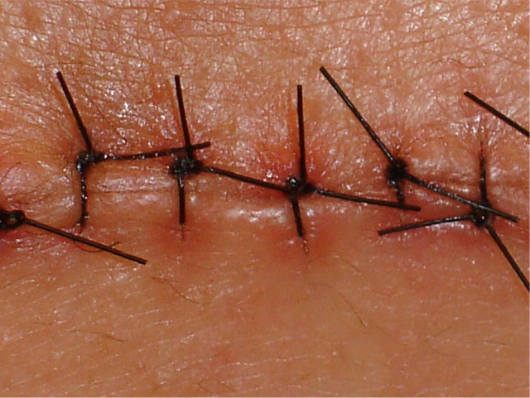
Tissue Repair
Kristine Krafts, M.D.

Slide 2
Tissue Repair Lecture Objectives
Define tissue repair, regeneration, and scarring.
Explain the difference between labile, stable, and permanent tissues, and give examples of each.
Explain the importance of stem cells in regeneration, and list the two types of tissues in which regeneration can occur.
Outline the main steps involved in scarring, and be sure you know what granulation tissue is.

Slide 3
Tissue Repair Lecture Objectives
Describe what you’d need to know in order to predict whether a wound will heal by regeneration or scarring.
Compare and contrast first-intention and second-intention healing, and know the rough timeline for first-intention healing of small wounds.
Describe in general how strong a wound is at suture removal, and explain how that wound strength changes over time.
Explain how the wound healing process is abnormal in keloid scars and proud flesh.

Slide 4
Tissue Repair Lecture Outline
Introduction and definitions
Three types of tissues
Repair by regeneration
Repair by scarring
A couple things about skin wounds
Abnormal wound healing

Slide 5
Tissue Repair Lecture Outline
Introduction and definitions

Slide 6
Tissue Repair
Tissue repair is defined as the restoration of tissue architecture and function after an injury.
It involves two processes:
  Regeneration (full restoration to normal)
  Connective tissue deposition (scarring)

Slide 7
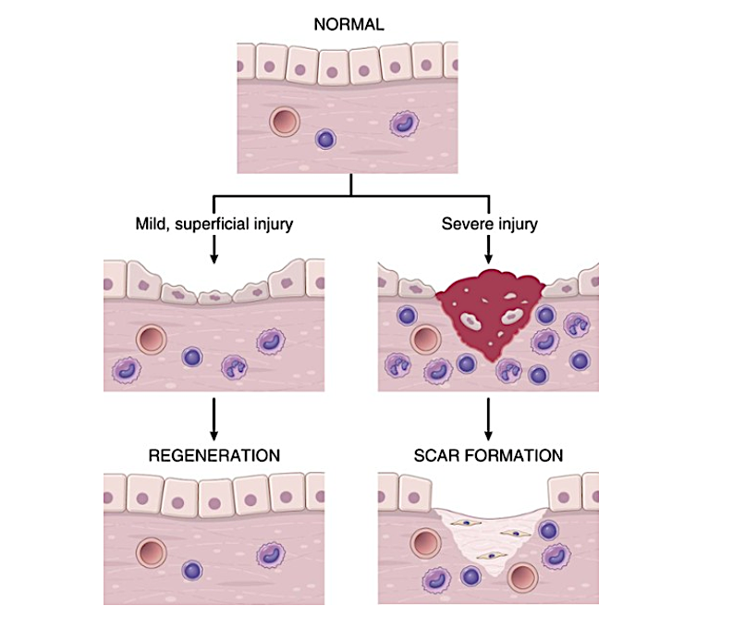

Slide 8
Tissue Repair Lecture Outline
Introduction and definitions
Three types of tissues

Slide 9
Three Types of Tissues
Labile (continuously proliferating) tissues
  Composed of cells that are constantly being lost and replaced
  Replacement comes from stem cells and also from proliferation of some mature cells
  Can easily regenerate after injury
  Examples: skin, bone marrow, GI epithelium

Slide 10
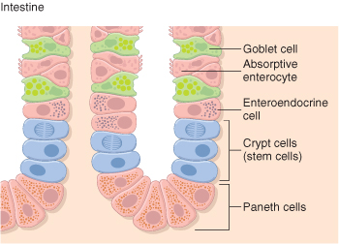
Stem cells in GI epithelium

Slide 11
Three Types of Tissues
Labile tissues
Stable (quiescent) tissues
  Composed of cells that have a minimal ability to proliferate
  Can undergo some regeneration after injury
  Examples: liver, kidney, pancreas

Slide 12
Three Types of Tissues
Labile tissues
Stable tissues
Permanent tissues
  Composed of cells that cannot proliferate
  Cannot regenerate in response to injury
  Injury always results in scarring
  Examples: brain, heart

Slide 13
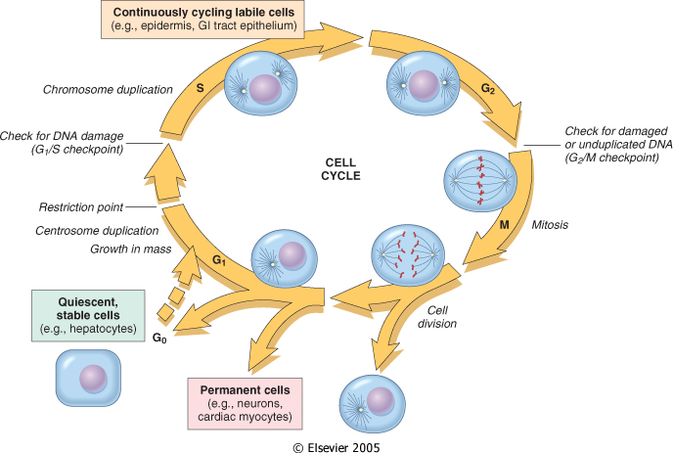

Slide 14
Tissue Repair Lecture Outline
Introduction and definitions
Three types of tissues
Repair by regeneration

Slide 15
Regeneration
Occurs all the time in labile tissues!
Occurs in limited form in stable tissues
  Remove one kidney: the other one undergoes hypertrophy and hyperplasia
  Remove half of the liver: it will grow back
Doesn’t occur at all in permanent tissues.

Slide 16
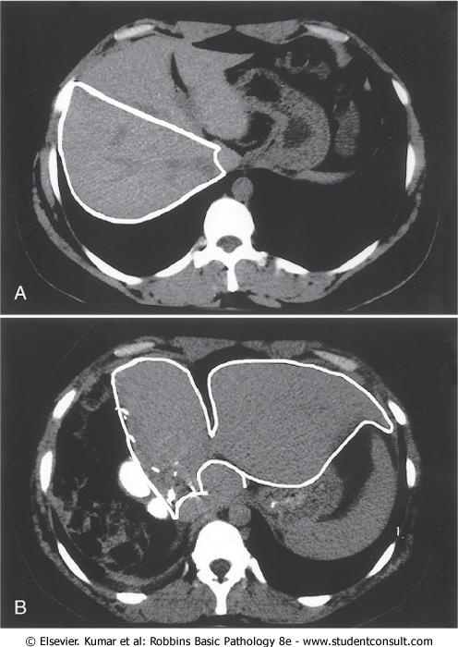
Liver before resection
right lobe to be resected
left lobe
now
enlarged
Liver
1 week after resection

Slide 17
Tissue Repair Lecture Outline
Introduction and definitions
Three types of tissues
Repair by regeneration
Repair by scarring

Slide 18
Scarring
If full regeneration isn’t possible, then you need to make a scar.
What determines whether regeneration is possible?
  Type of tissue
  Extent of extracellular matrix damage
Scarring involves creating new blood vessels (angiogenesis), laying down collagen (which is made by fibroblasts), and eventually remodeling the collagen so the scar is just right.

Slide 19
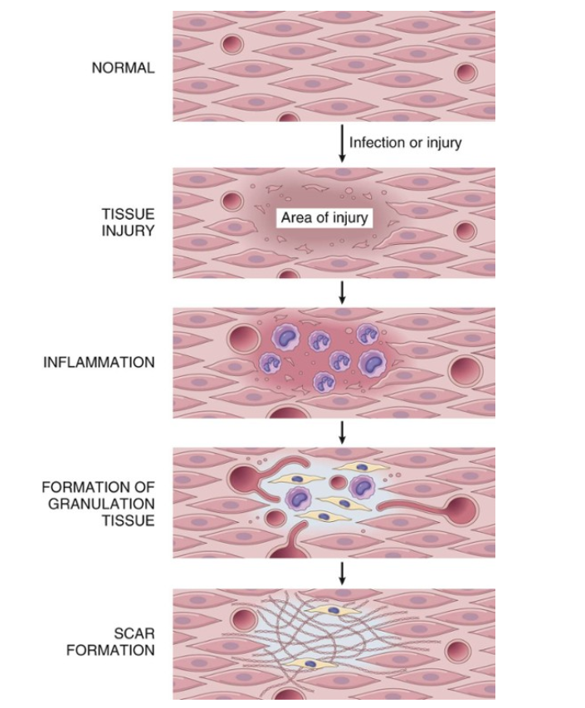
1. New blood vessels
2. Fibroblasts
3. Extracellular matrix
collagen

Slide 20
Scarring
Summary:
1. Make granulation tissue
2. Turn it into a chunk of collagen

Slide 21
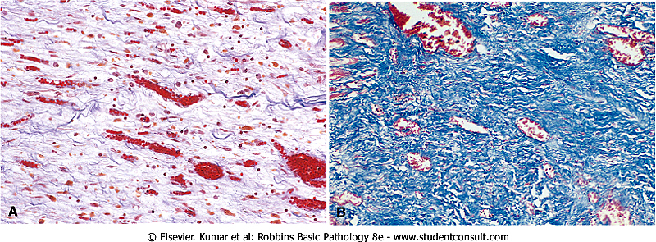
Fibroblasts
New blood vessels
Collagen
Extracellular matrix
Granulation tissue

Slide 22
Blood vessels
Collagen
Scar

Slide 23
Q. Is “granulation tissue” the same thing as
“granuloma”?

Slide 24
Q. Is “granulation tissue” the same thing as
“granuloma”?
A. No!

Slide 25
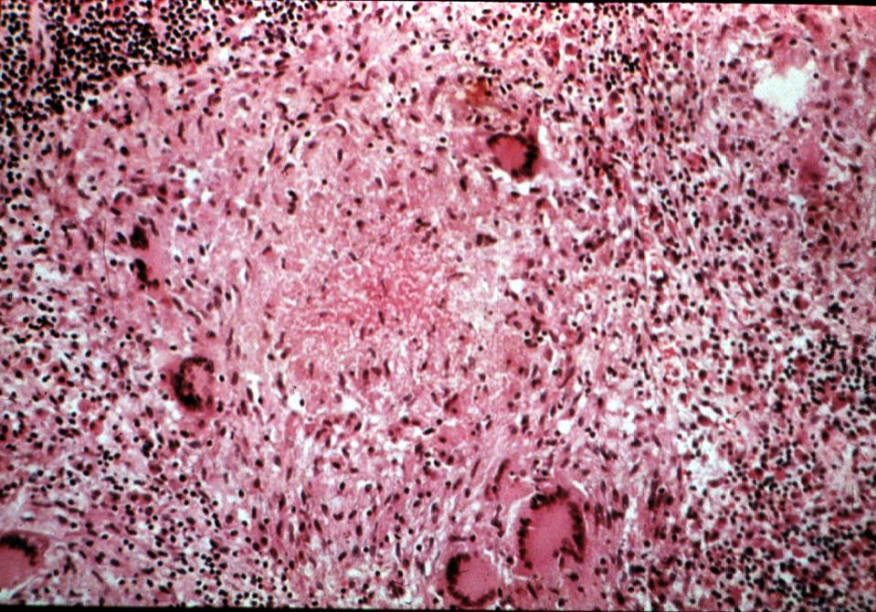
Granuloma

Slide 26
Tissue Repair Lecture Outline
Introduction and definitions
Three types of tissues
Repair by regeneration
Repair by scarring
A couple things about skin wounds

Slide 27
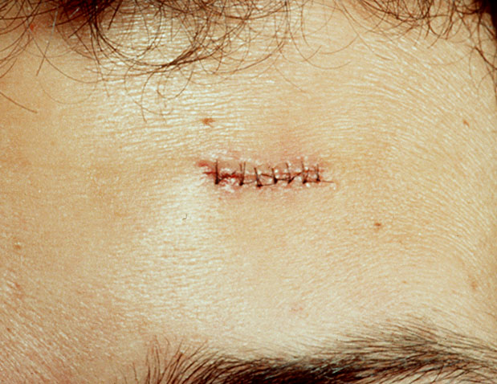
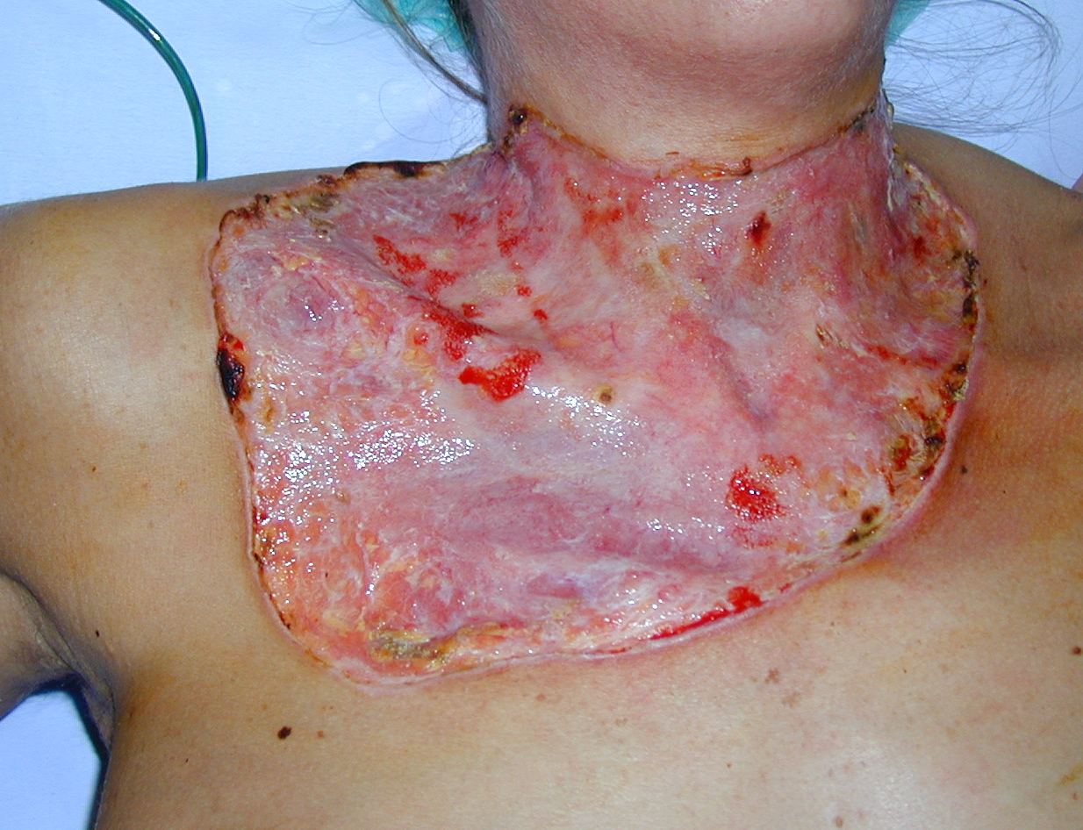
Skin Wounds: Two Types of Healing
First intention healing
Second intention healing

Slide 28
First Intention Healing
Second Intention Healing
Small wounds that close easily
Regeneration > scarring
Healing is fast
Minimal inflammation and scarring
Examples:
  Paper cuts
  Well-approximated surgical incisions
  Replaced periodontal flaps
Large open wounds
Scarring > regeneration
Healing is slower
More inflammation and scarring,
greater risk of infection
Examples:
  Burns
  External-bevel gingivectomies
  Extraction sockets

Slide 29
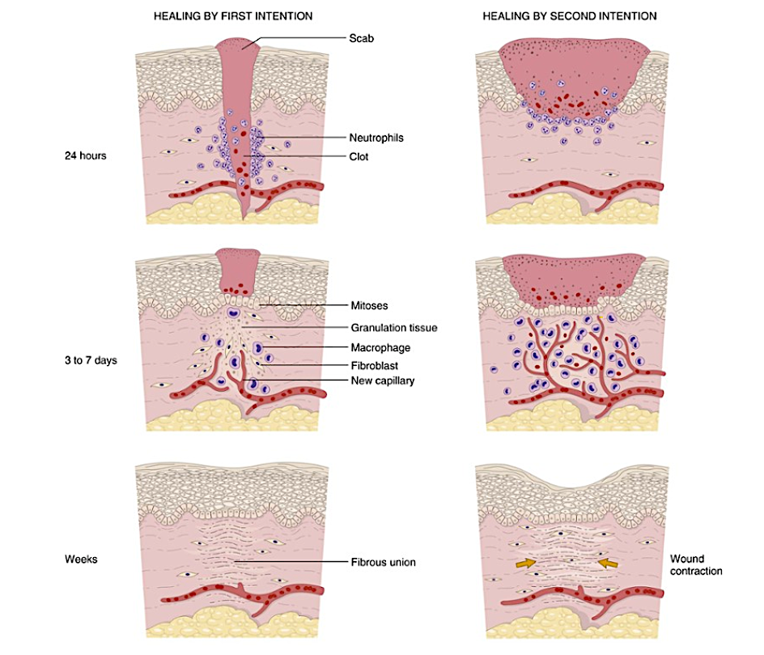
Rough timeline for first intention
healing of small wounds
(scar)
Notes:
Fi

Slide 30
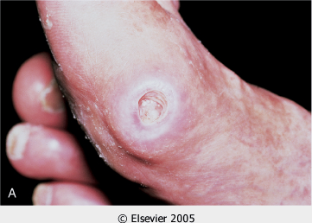
Pressure ulcer of skin

Slide 31
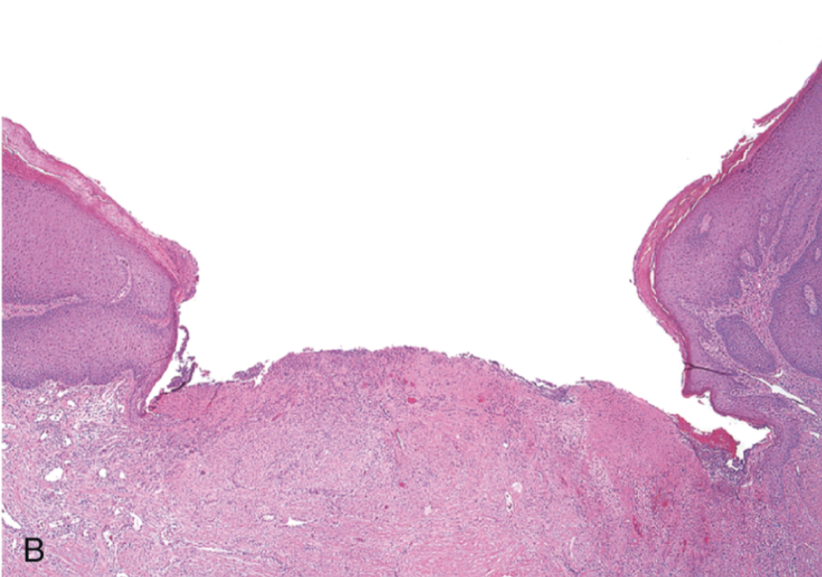
Skin ulcer: large gap between edges

Slide 32
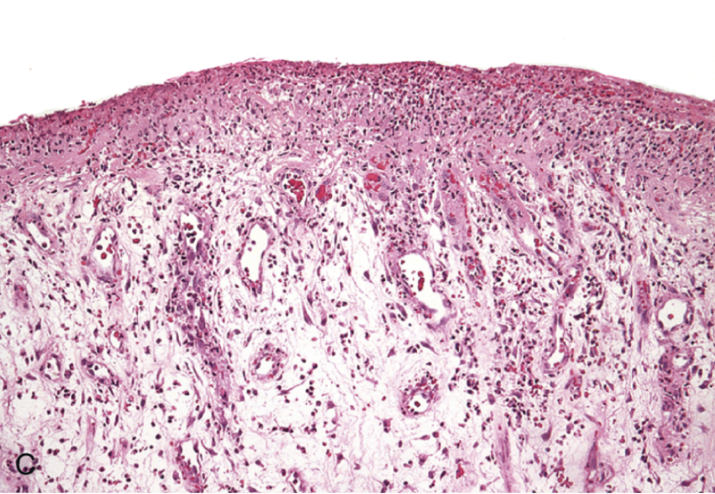
Skin ulcer: granulation tissue

Slide 33
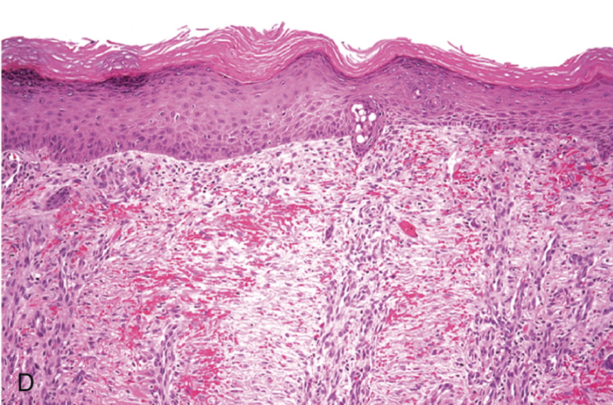
Skin ulcer: re-epithelialization

Slide 34
Skin Wound Strength
100%
75%
50%
25%
Suture
removal
3 months
Years
At suture removal: 10%
Rapid increase over next 4 weeks
At third month: 70-80%

Slide 35
Tissue Repair Lecture Outline
Introduction and definitions
Three types of tissues
Repair by regeneration
Repair by scarring
A couple things about skin wounds
Abnormalities in tissue repair

Slide 36
Abnormalities in Tissue Repair
Not enough granulation tissue/scarring
Too much scarring (keloid scar)
Too much granulation tissue (proud flesh)

Slide 37
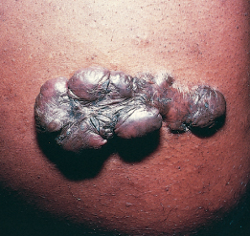
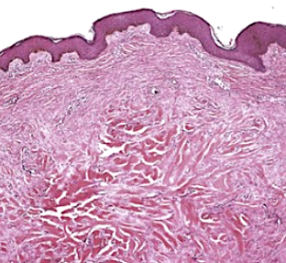
Keloid Scar

Slide 38
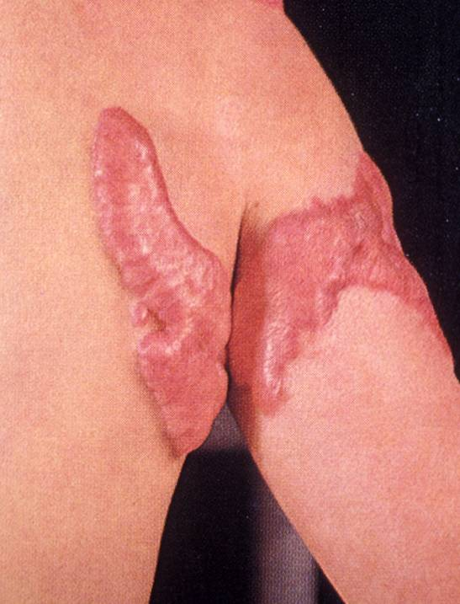
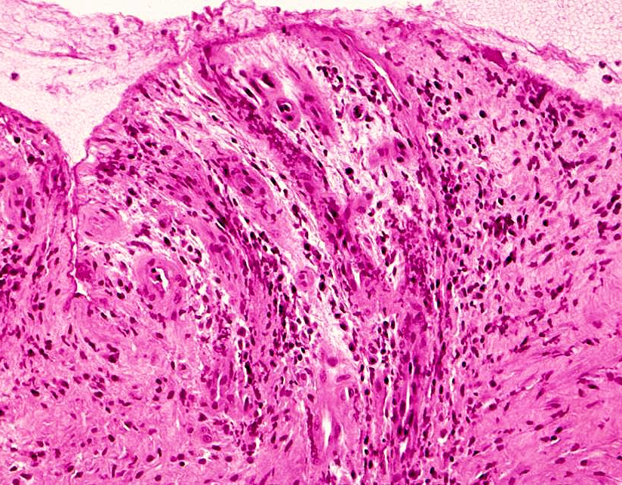
Proud Flesh

