Slide 1
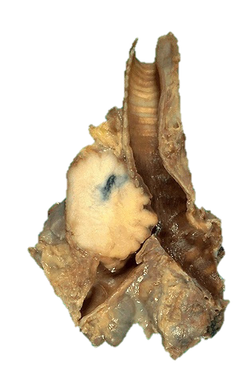
Respiratory Pathology
Kristine Krafts, M.D.

Slide 2
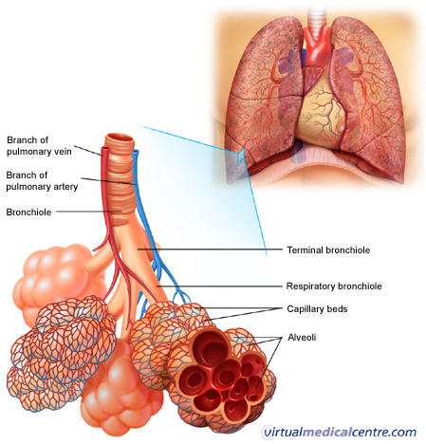

Slide 3
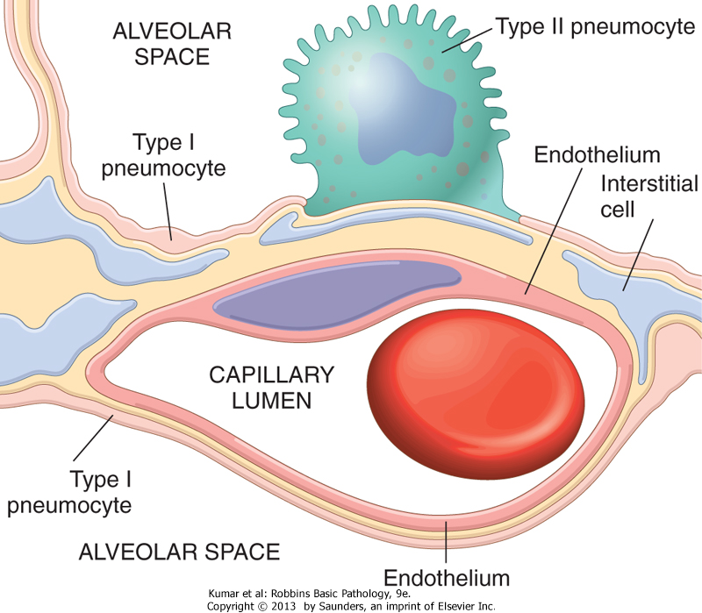

Slide 4
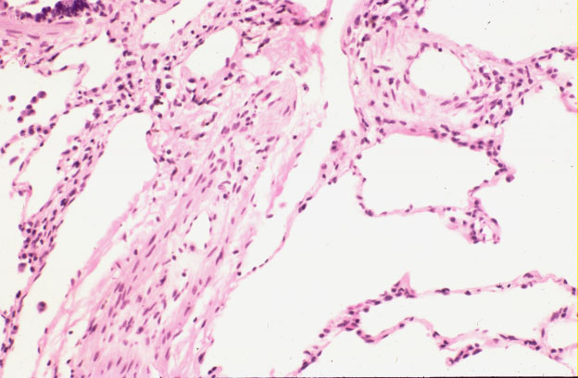
Normal lung: alveolar spaces

Slide 5
Respiratory Pathology Outline
Acute respiratory distress syndrome
Obstructive lung diseases
Restrictive lung diseases
Vascular diseases
Infections
Carcinoma

Slide 6
Respiratory Pathology Outline
Acute respiratory distress syndrome

Slide 7
Acute respiratory distress syndrome
Symptoms: rapid onset respiratory insufficiency that doesn’t respond to oxygen
Associated with pneumonia, aspiration of gastric contents, sepsis, severe trauma
Pathogenesis: Damage to alveolar capillary membrane; neutrophils play a big role
Morphology: “diffuse alveolar damage” with hyaline membranes

Slide 8
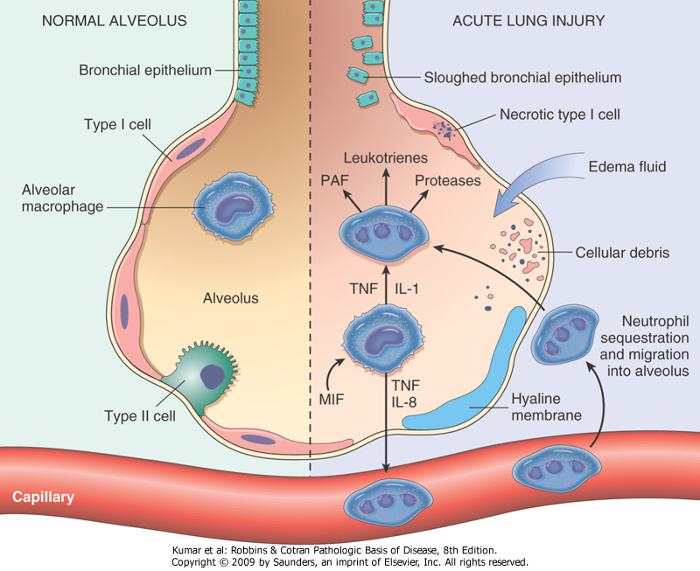

Slide 9
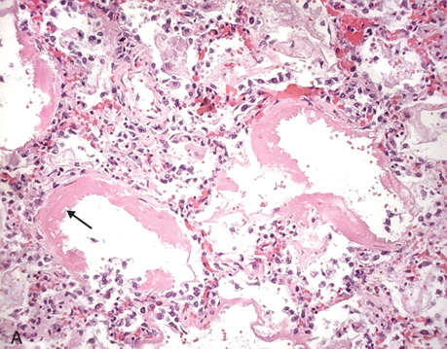
Diffuse alveolar damage: hyaline membranes

Slide 10
Respiratory Pathology Outline
Acute respiratory distress syndrome
Obstructive lung diseases

Slide 11
Respiratory Pathology Outline
Acute respiratory distress syndrome
Obstructive lung diseases
  Emphysema
  Chronic bronchitis
  Asthma
  Bronchiectasis

Slide 12
Emphysema
Destruction/enlargement of airspaces
Centriacinar emphysema
  Destruction of proximal acinus
  Worse in upper lobes of lung
  Smoking
Panacinar emphysema
  Destruction of entire acinus
  Worse in lower lobes of lung
  Alpha-1-antitrypsin deficiency

Slide 13
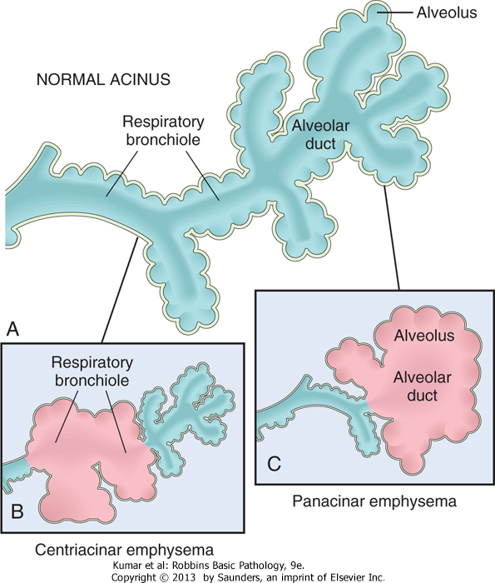

Slide 14


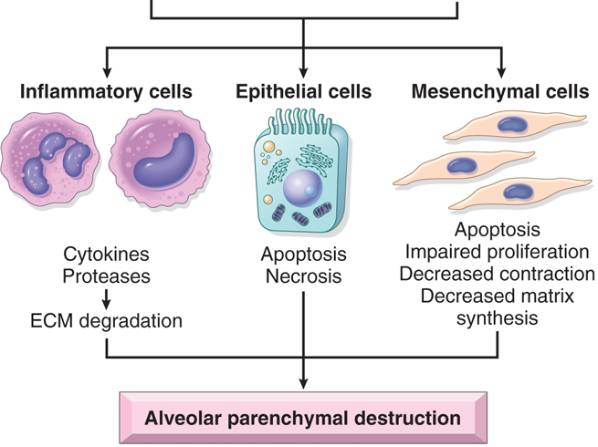
Pathogenesis of emphysema
Smoking
α-1 antitrypsin deficiency

Slide 15
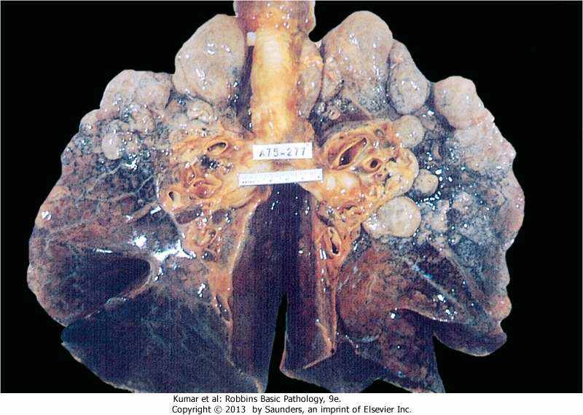
Emphysema: dilated air spaces

Slide 16
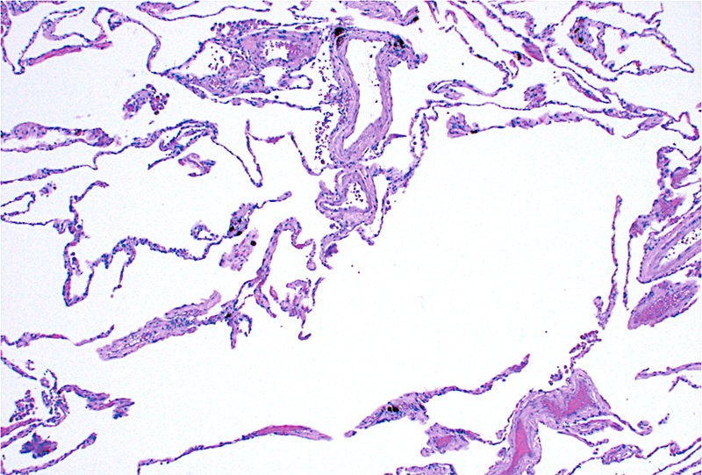
Emphysema: dilated air spaces

Slide 17
Chronic Bronchitis
Definition: persistent, productive cough for ≥ 3 months in ≥ 2 consecutive years
Pathogenesis: hypersecretion of mucous
Cause: smoking (mostly) and pollution

Slide 18
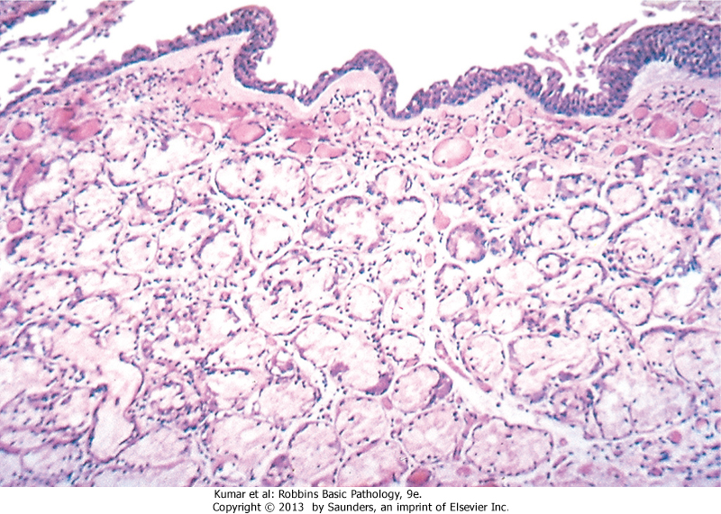
Chronic bronchitis: mucous gland hyperplasia

Slide 19
Asthma
Chronic inflammatory disease of airways leading to bronchial constriction
Symptoms: wheezing, breathlessness
Hallmarks: intermittent, reversible airway obstruction, chronic inflammation, increased mucus.
Atopic (allergic) vs. non-atopic
Triggers: allergens, infection, smoke, cold, exercise

Slide 20
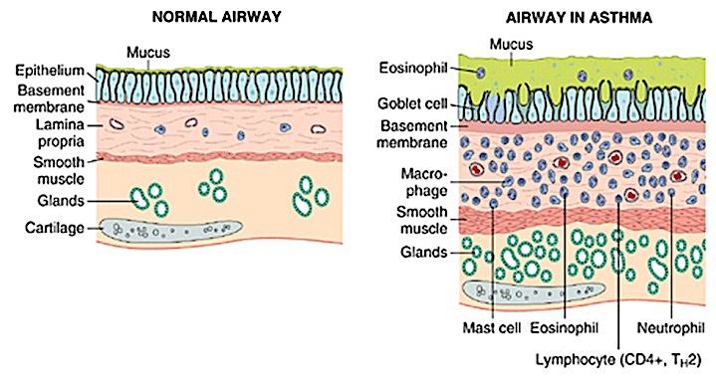

Slide 21
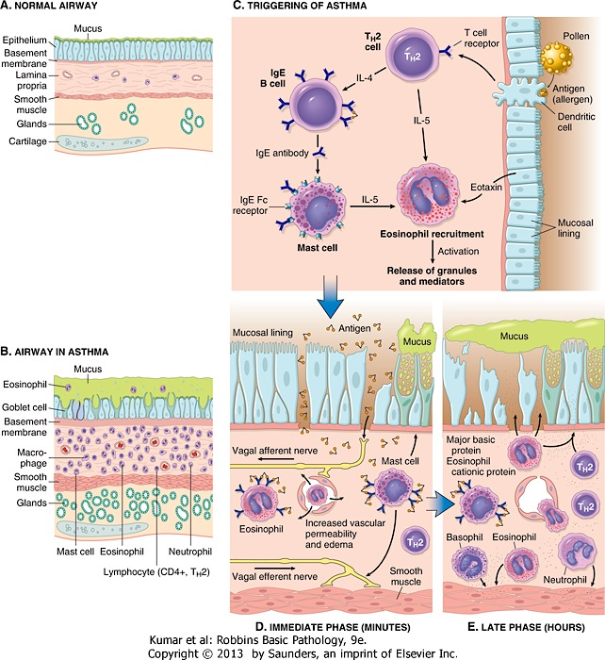
How is asthma triggered?

Slide 22
Then what happens?

Slide 23
Bronchiectasis
Permanent dilation of bronchi and bronchioles due to chronic inflammation
Secondary to:
  obstruction (tumor)
  congenital conditions (cystic fibrosis)
  bad pneumonia

Slide 24
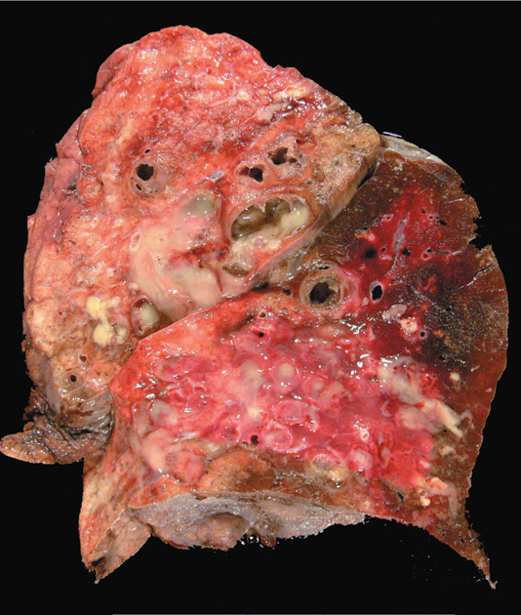
Bronchiectasis

Slide 25
Respiratory Pathology Outline
Acute respiratory distress syndrome
Obstructive lung diseases
Restrictive lung diseases

Slide 26
Idiopathic pulmonary fibrosis
Patchy, progressive lung fibrosis
Symptoms: gradual onset cough, dyspnea. Respiratory failure and cor pulmonale within about 3 years
Radiologic and histologic term: “usual interstitial pneumonia”

Slide 27
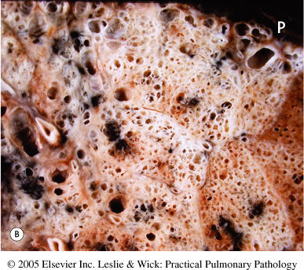
IPF: fibrotic lung

Slide 28
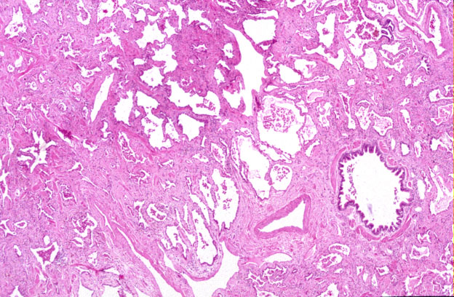
IPF: tons of fibrosis

Slide 29
Pneumoconioses
Disorders caused by inhalation of mineral dusts
Size matters (1-5 μm particles are worst)
Three main dust particles:
  Carbon (coal workers)
  Silica (sandblasting, mining, ceramics)
  Asbestos (mining, insulation removal)

Slide 30
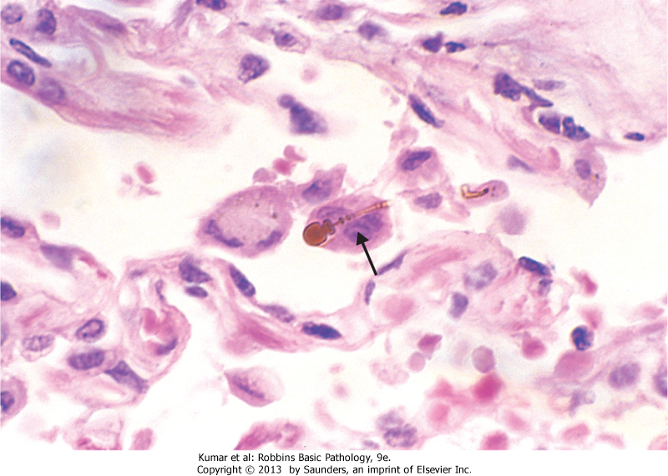
Asbestos fibers

Slide 31
Respiratory Pathology Outline
Acute respiratory distress syndrome
Obstructive lung diseases
Restrictive lung diseases
Vascular diseases

Slide 32
Pulmonary embolism
Most arise from leg veins
Small emboli may be asymptomatic, cause infarction, or cause hemoptysis
Medium-sized emboli (less common) cause shortness of breath and infarction
Large emboli (even less common) can cause sudden death

Slide 33
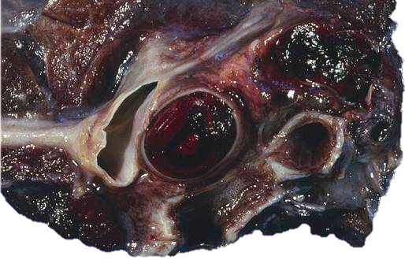
Pulmonary embolism

Slide 34
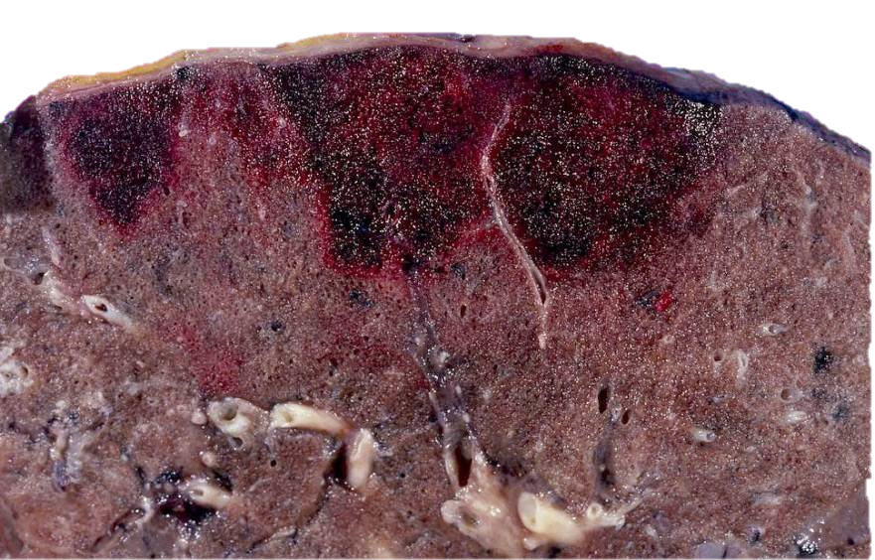
Pulmonary infarcts

Slide 35
Respiratory Pathology Outline
Acute respiratory distress syndrome
Obstructive lung diseases
Restrictive lung diseases
Vascular diseases
Infections

Slide 36
Pneumonia
1/6 of all deaths in the US!
Can be acute or chronic
Causes: bacteria, viruses
Different anatomic patterns
Different clinical settings

Slide 37
Typical bugs in different clinical settings
Community-acquired
Streptococcus pneumoniae
Haemophilus influenzae
Mycoplasma pneumoniae
viruses
Immunocompromised
Cytomegalovirus
Pneumocystis jiroveci
Aspergillus
Nosocomial
gram-negative rods
Staphylococcus aureus
Chronic
Mycobacterium tuberculosis
Histoplasma capsulatum
Aspiration
Anaerobic bacteria

Slide 38
Most community-acquired pneumonias are one of these:
Alveolar
Streptococcus pneumoniae*
Staphylococcus aureus
Hemophilus influenzae
Interstitial
viruses
Mycoplasma pneumoniae
* Most common

Slide 39
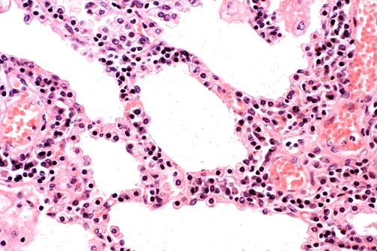
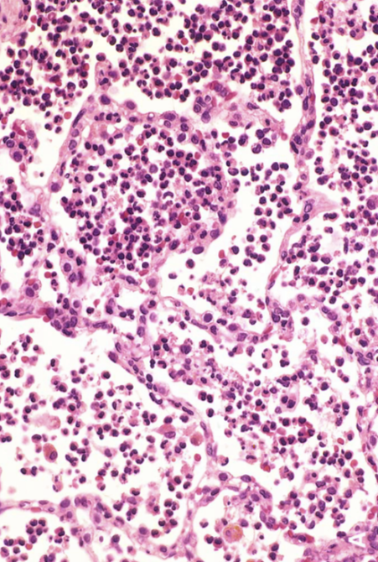
interstitial inflammation
alveolar inflammation
Viral pneumonia
Bacterial pneumonia

Slide 40
Lung abscess
Localized collection of pus
Bugs: Staph, Strep, gram-negative bugs, anaerobes, or mixture
Pathogenesis: aspiration of infected material (from teeth, sinuses), aspiration of gastric contents, as complication of nasty bacterial pneumonia

Slide 41
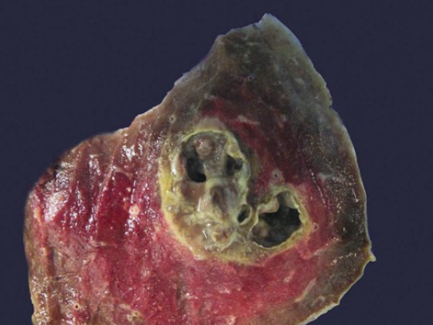
Lung abscess

Slide 42
Tuberculosis
Cause: Mycobacterium tuberculosis
Chronic, granulomatous disease that can involve any organ but often involves lungs
Spread by respiratory droplet
Primary (initial) TB: Ghon complex.
Secondary (reactivation) TB: Cavitating granulomas.

Slide 43
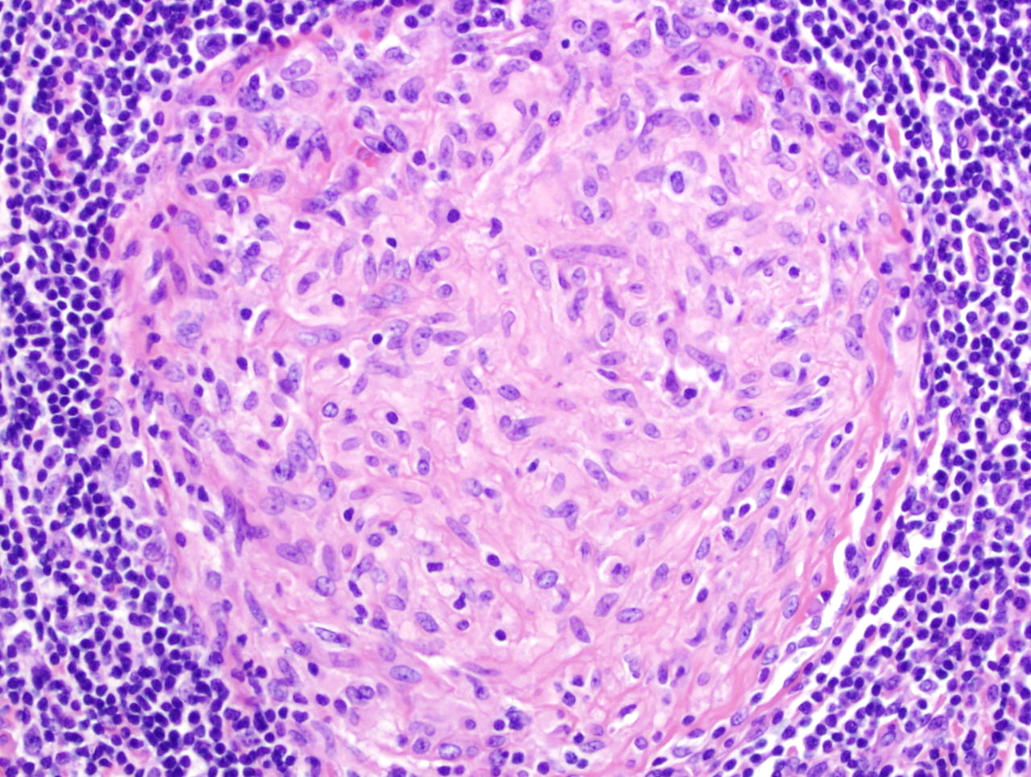
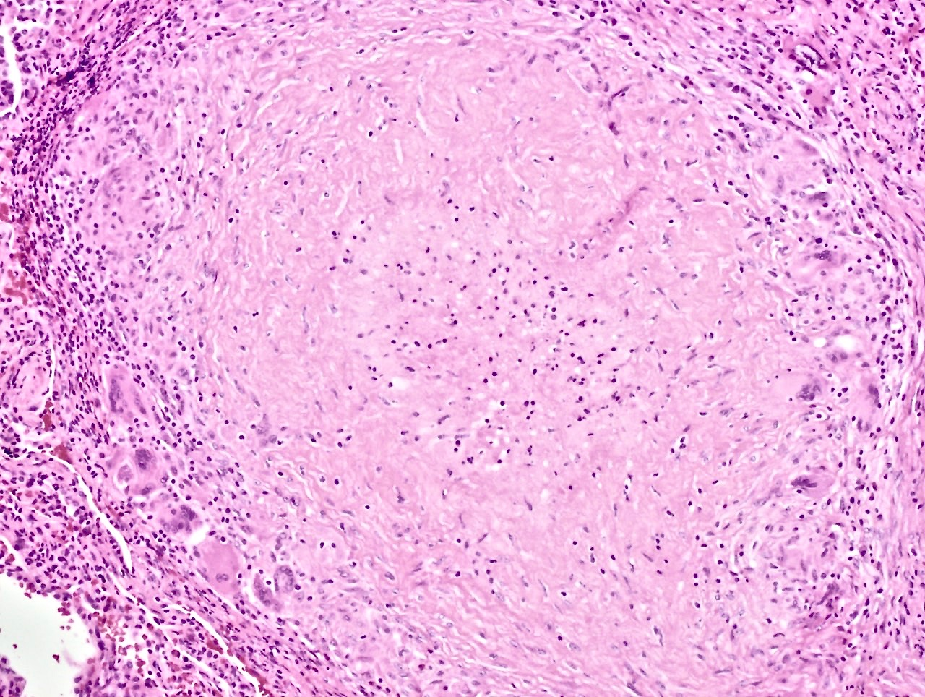
necrotic debris
just macrophages (no necrotic debris)
lymphocytes
macrophages
Regular (non-caseating) granuloma
Caseating granuloma

Slide 44
regular macrophages
necrotic debris
foreign-body giant cells
Caseating granuloma

Slide 45
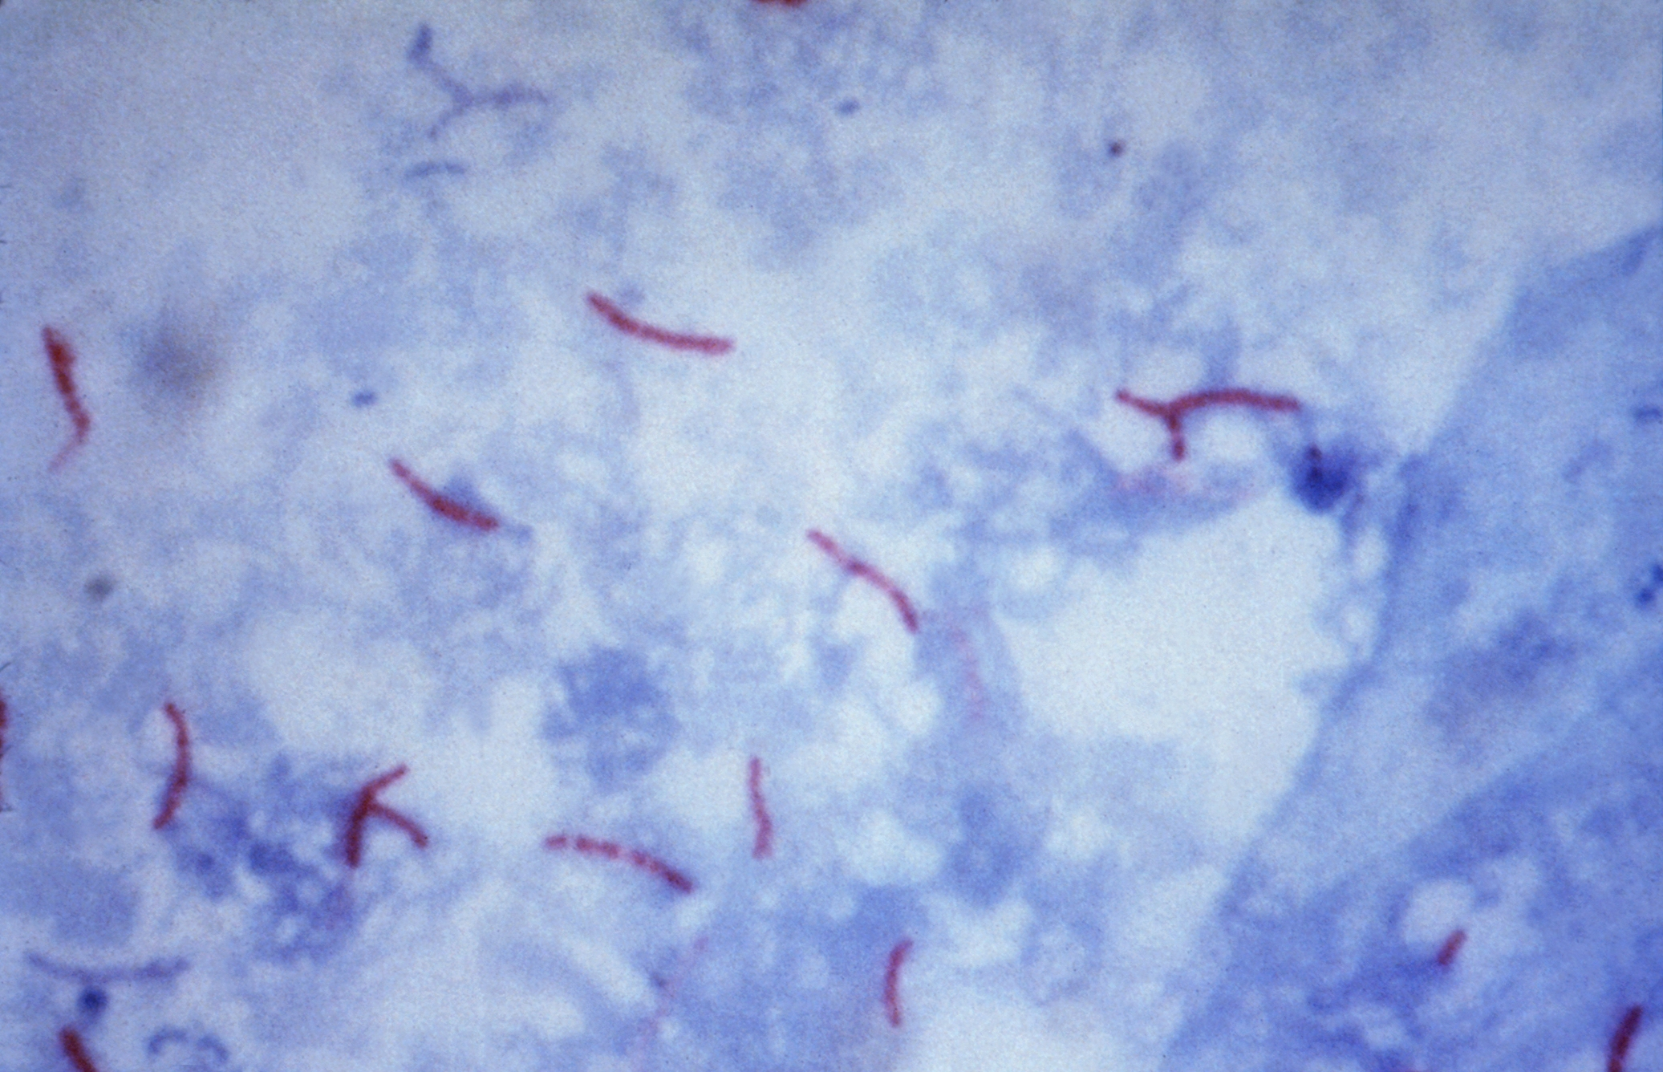
TB organisms (acid-fast stain)

Slide 46
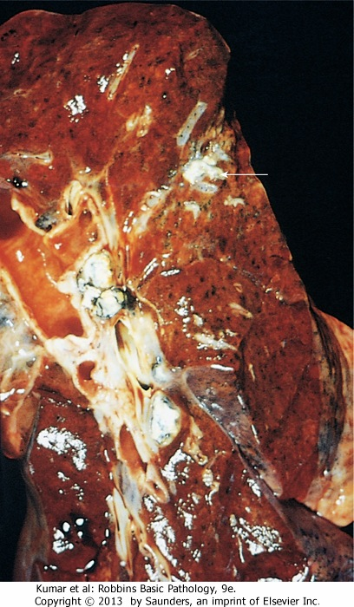
lung lesion
involved
lymph nodes
Ghon complex: lung lesion + involved nodes

Slide 47
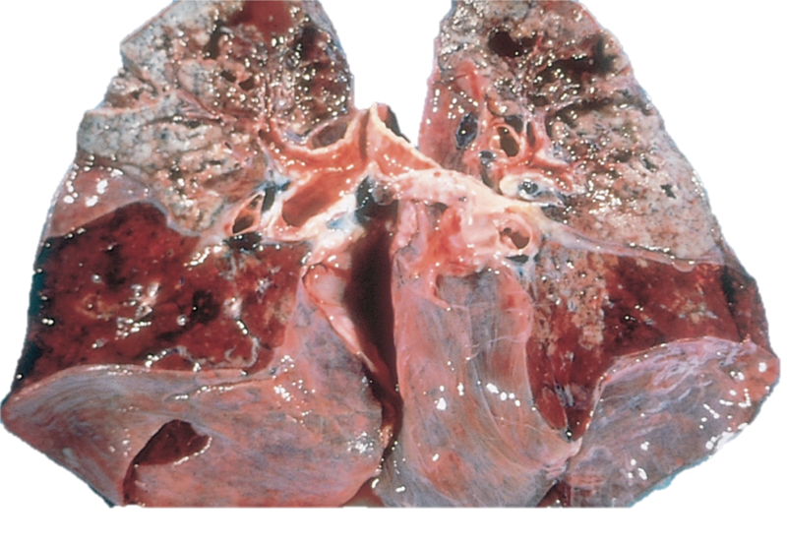
Secondary TB: tons of caseating, cavitating necrosis

Slide 48
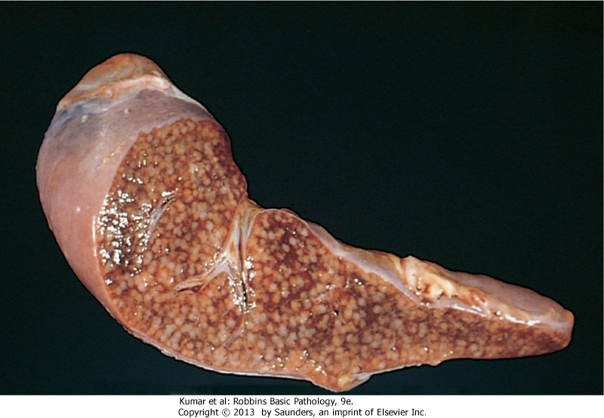
Spleen: miliary TB

Slide 49
Opportunistic pneumonias
Affect immunosuppressed patients (patients with AIDS, cancer, post-transplant)
Unusual organisms:
  Pneumocystis jiroveci
  Aspergillus
  Cytomegalovirus

Slide 50
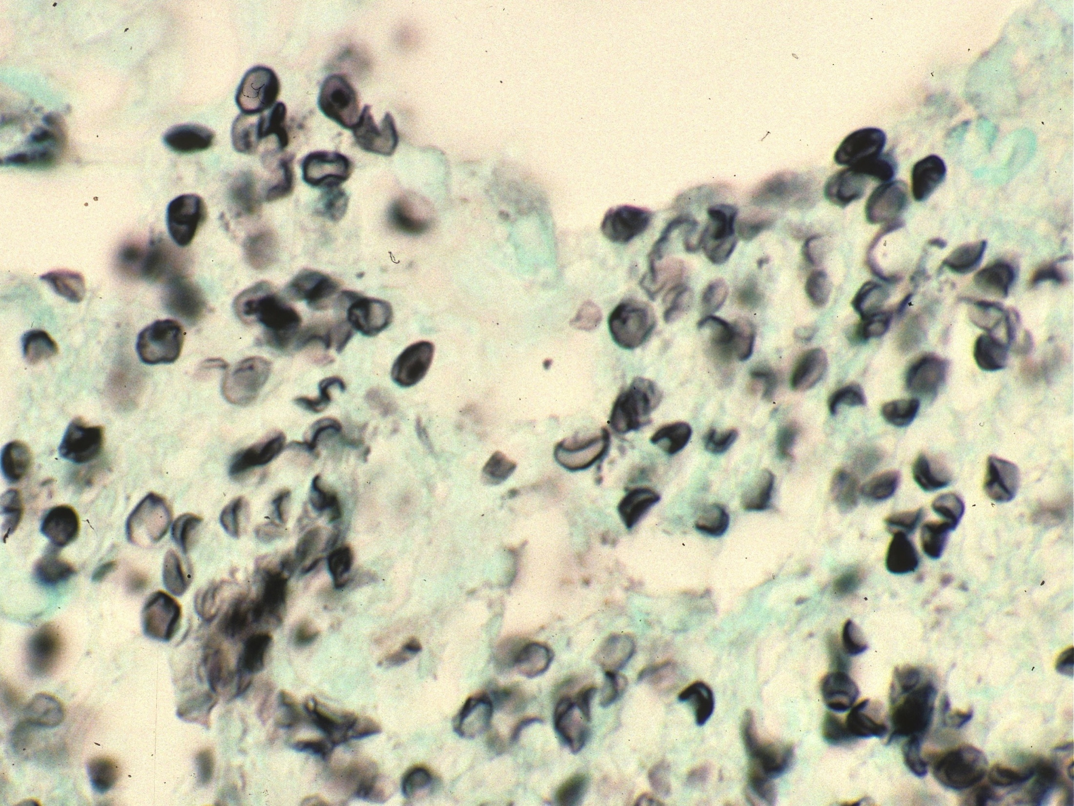
Crushed Ping-Pong ball shaped organisms
Crescent shaped organisms
Pneumocystis

Slide 51
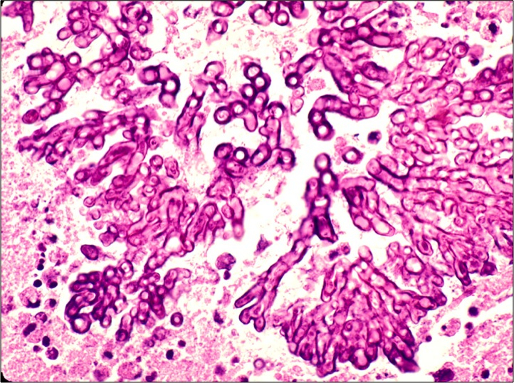
Aspergillus

Slide 52
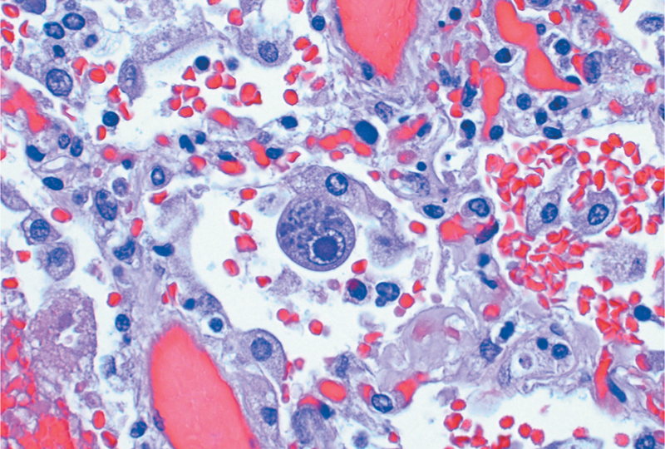
Cytomegalovirus (two kinds of inclusions)

Slide 53
Respiratory Pathology Outline
Acute respiratory distress syndrome
Obstructive lung diseases
Restrictive lung diseases
Vascular diseases
Infections
Carcinoma

Slide 54
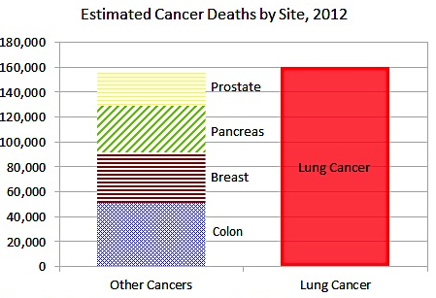

Slide 55
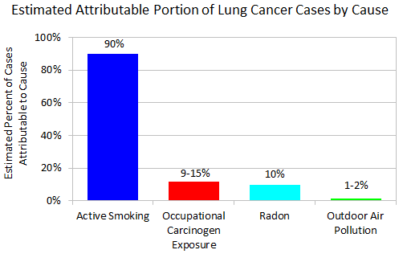

Slide 56
Types of lung cancer
Adenocarcinoma
Squamous cell carcinoma
Large cell carcinoma
Small cell carcinoma

Slide 57
Types of lung cancer
Adenocarcinoma
Squamous cell carcinoma
Large cell carcinoma
Small cell carcinoma
NSCLC
SCLC

Slide 58
Presenting symptoms
Potentially curable
asymptomatic
cough
hemoptysis
Usually incurable
dyspnea
chest pain
anorexia & weight loss
hoarseness
bone pain

Slide 59
Survival statistics…bad.
At diagnosis, >50% have metastases
Overall (all stages) 5ys = 16%
Localized disease 5ys = 45%

Slide 60
Adenocarcinoma
Most common type, especially in women and non-smokers
Usually peripherally located
Adenocarcinoma in situ is a rare form of adenocarcinoma with a better prognosis (5ys = 40%)

Slide 61
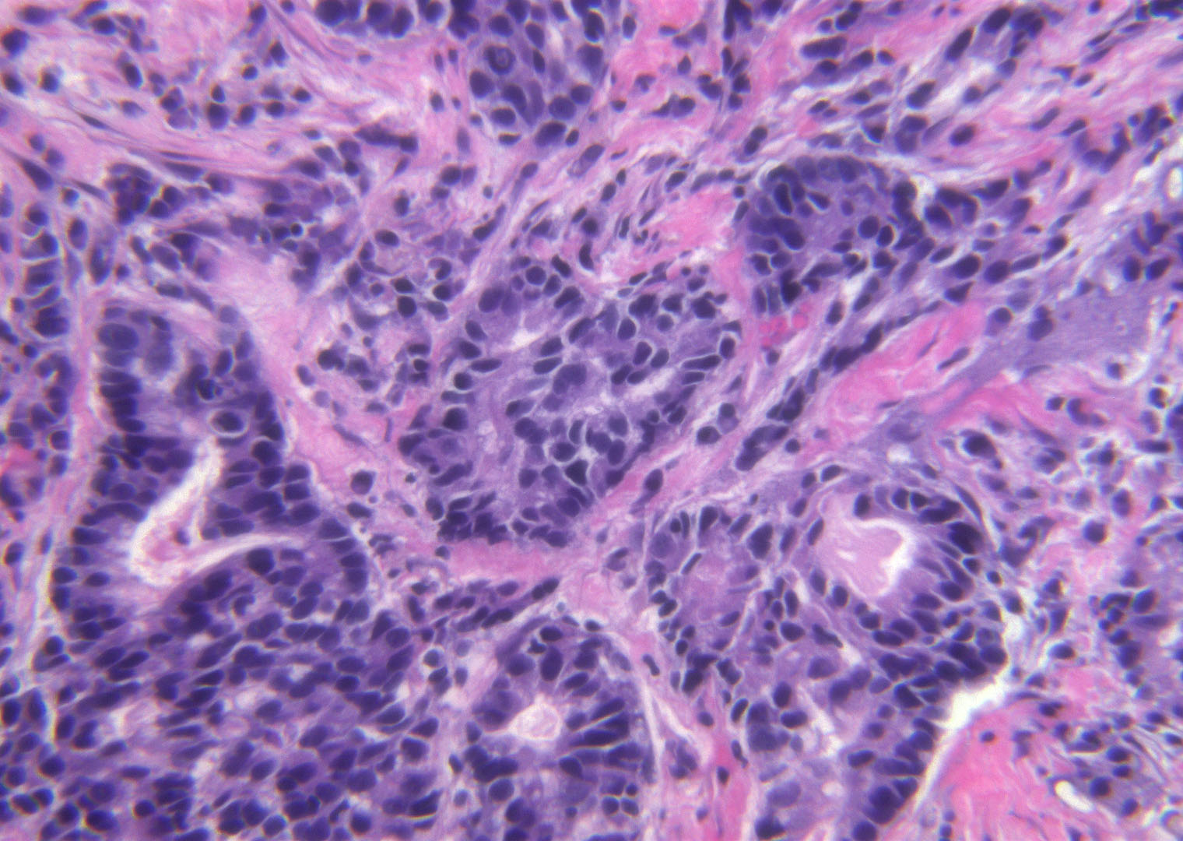
Adenocarcinoma

Slide 62
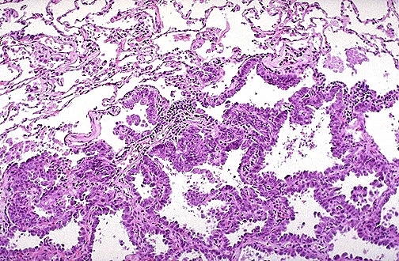
Adenocarcinoma in situ

Slide 63
Squamous cell carcinoma
Malignant tumor of squamous cells
Usually centrally located
Usually preceded by distinct lesions

Slide 64
Squamous cell carcinoma

Slide 65
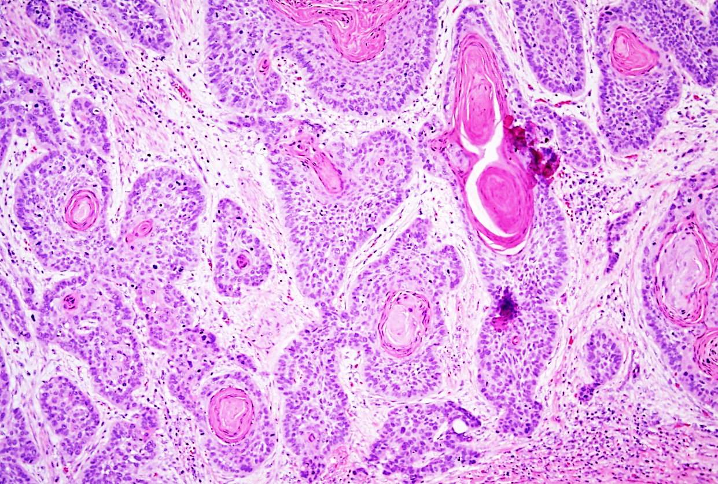
Squamous cell carcinoma

Slide 66
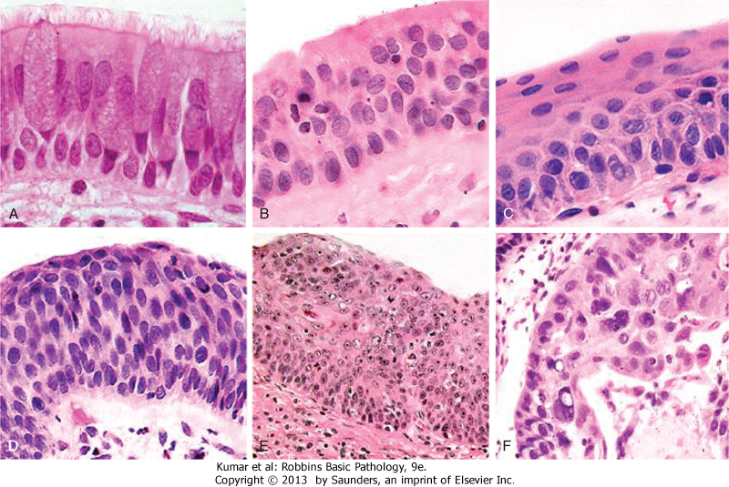
Squamous cell carcinoma precursor lesions
squamous metaplasia
dysplasia
carcinoma in situ

Slide 67
Small cell carcinoma
VERY high mortality
Small cells, minimal cytoplasm, “molding”
High growth fraction yet treatment ineffective
Median survival (with treatment) = 1 year

Slide 68
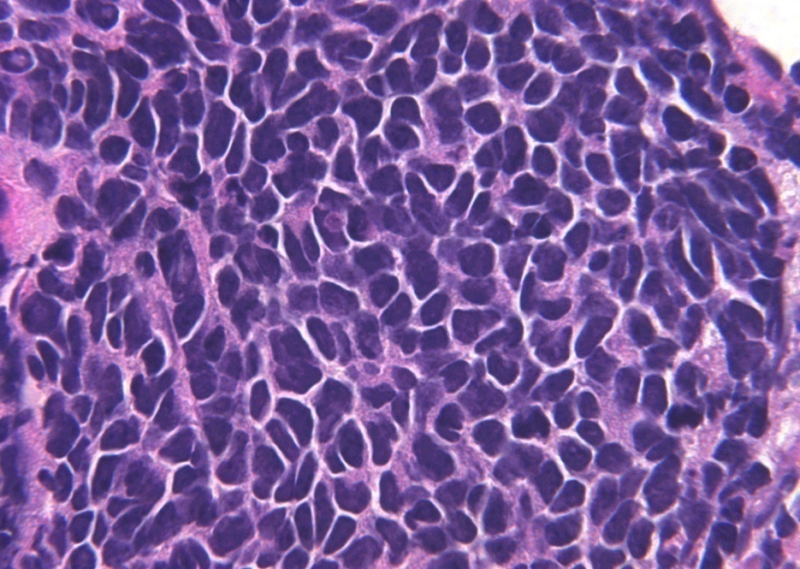
Small cell carcinoma

Slide 69
Mesothelioma
Malignant tumor of mesothelial cells
Most patients have had asbestos exposure
Not related to smoking
Highly malignant; short survival.

Slide 70
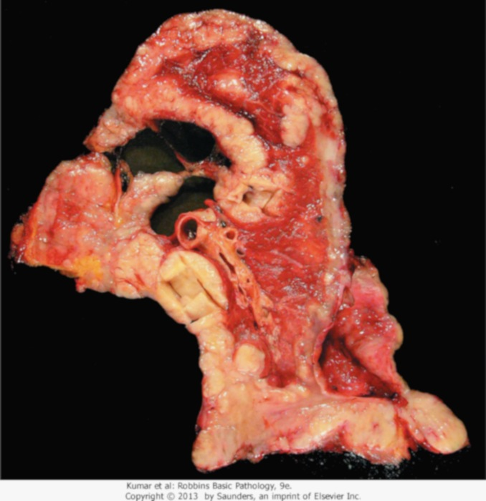
Mesothelioma

