Slide 1

Female Reproductive System
Kristine Krafts, M.D.

Slide 2
Female Reproductive Learning Objectives
Explain what cervical dysplasia is and why it matters. Describe the incidence, peak age, cause, and most important prognostic factor for cervical carcinoma.
Describe what endometriosis is, how it presents, and how it affects fertility.
Explain what endometrial hyperplasia is and how it is related to endometrial carcinoma.
Describe the clinical features, risk factors, histologic features, and prognosis of leiomyoma, leiomyosarcoma, and endometrial carcinoma.

Slide 3
More Female Reproductive Learning Objectives
Compare and contrast the general incidence and mortality rate of ovarian vs. breast cancer (don’t memorize numbers though).
Describe the typical age, risk factors, symptoms, and prognosis of ovarian carcinoma. What type of carcinoma accounts for most cases?
Describe why and how breast lumps are evaluated, and know in general how likely a lump is to be cancerous.

Slide 4
Yet More Female Repro Learning Objectives
Describe the incidence, peak age, risk factors, clinical features, and histology of fibroadenoma.
Describe the clinical presentation and risk factors for breast cancer.
Describe how prognosis is determined for patients with breast cancer. Explain what the T, N, and M stand for in the TNM staging system, and explain how they are used to determine the stage and relative prognosis of breast cancer (but don’t memorize specific numbers from slide 58!).

Slide 5
Female Reproductive System Outline
Cervix
Uterus
Ovaries
Breast

Slide 6
Female Reproductive System Outline
Cervix
  Cervical carcinoma

Slide 7
Cervical Carcinoma
Most are squamous cell carcinomas;
a few are adenocarcinomas
Caused by high-risk HPV (mostly 16, 18)
Low-risk HPV (6, 11) causes condylomas
Preceded by dysplastic epithelial changes
Pap smears catch most cases before they become invasive

Slide 8
Squamous Intraepithelial Lesion (SIL)
Used to call the dysplastic precursor lesions “cervical intraepithelial neoplasia” (CIN)
Current term is “SIL”
Low-grade SIL (LSIL): mild dysplasia
High-grade SIL (HSIL): mod-severe dysplasia
LSIL usually reverts to normal, but HSIL usually progresses to carcinoma

Slide 9
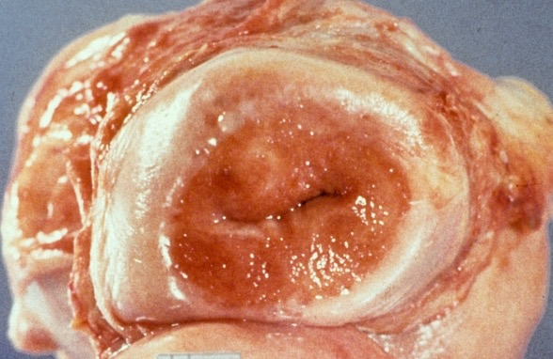
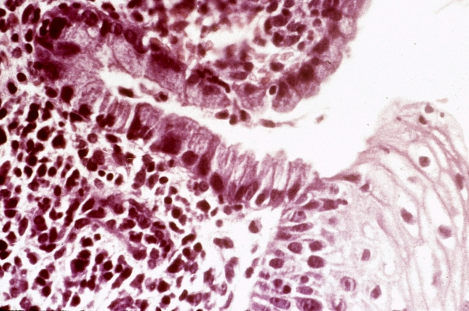
Cervical carcinoma usually arises in the transformation zone
Transformation zone

Slide 10
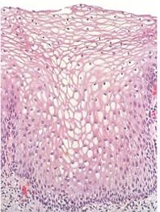
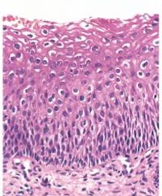
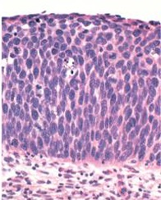
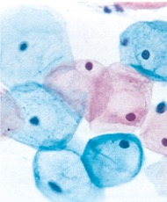
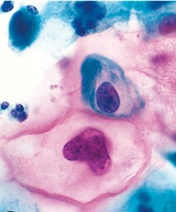
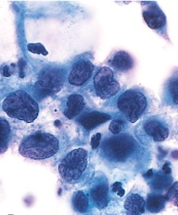
Tissue
biopsy
Pap
smear
Normal
LSIL
HSIL

Slide 11
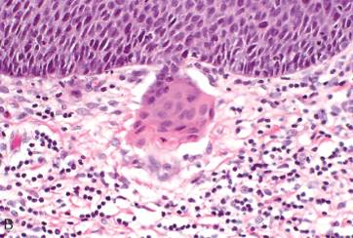
Invasive cervical carcinoma

Slide 12
Invasive Cervical Carcinoma
Peak age: 45 (10-15 years after SIL develops)
Spreads slowly
Staging is super important for prognosis
  Localized disease: 90% 5-year survival
  Regional mets: 50% 5-year survival
  Distant mets: 15% 5-year survival

Slide 13
Female Reproductive System Outline
Cervix
Uterus
  Endometriosis
  Endometrial hyperplasia
  Tumors

Slide 14
Endometriosis
Ectopic endometrial glands (outside uterus)
Ectopic endometrium undergoes cyclic bleeding
Can cause pain, scarring, infertility

Slide 15
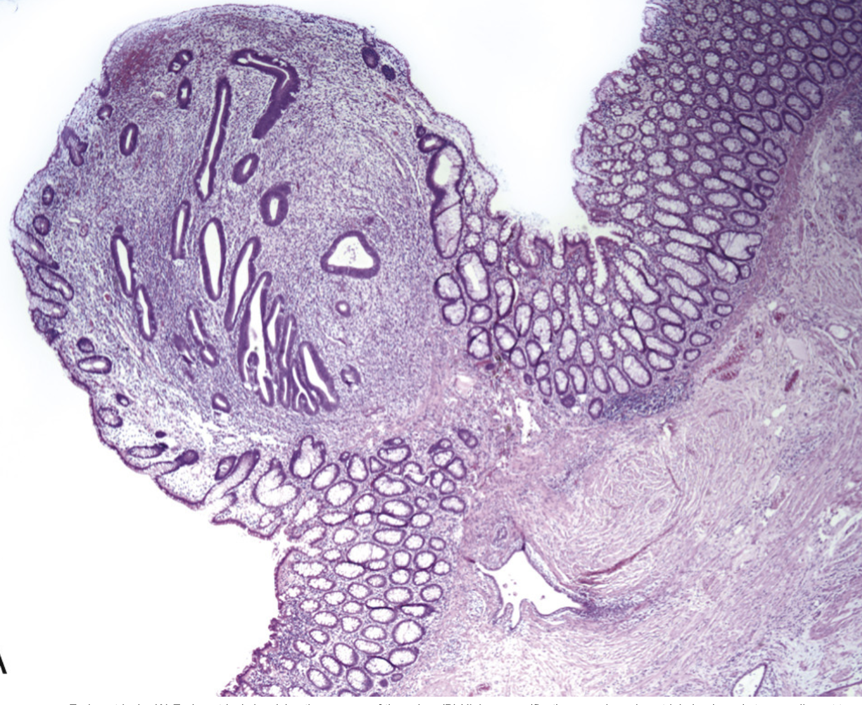

Mucosa of colon
Endometrial glands and stroma
Endometriosis in colon

Slide 16
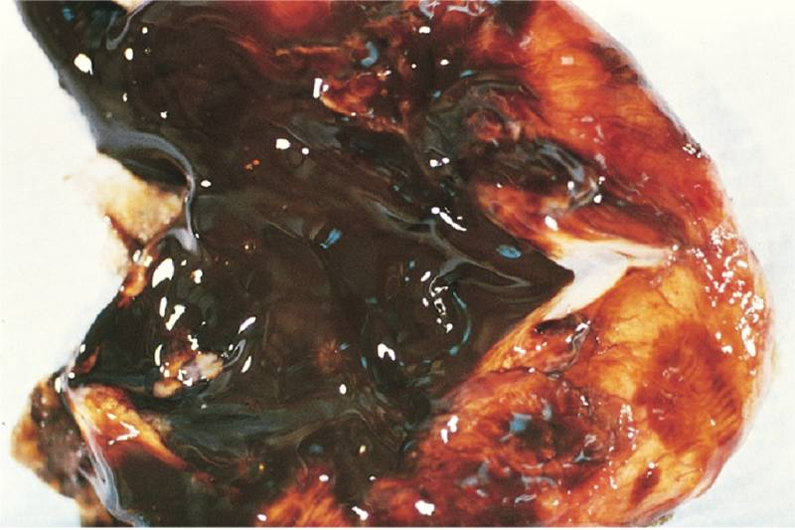
Endometriosis in ovary (“chocolate cyst”)

Slide 17
Endometrial Hyperplasia
Proliferation of endometrial glands and stroma
Risk factors involve estrogen excess (obesity, nulliparity, estrogen replacement therapy)
Presents with abnormal bleeding
“Atypical hyperplasia” = increased risk of transformation into adenocarcinoma

Slide 18
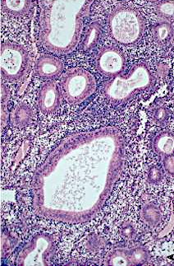
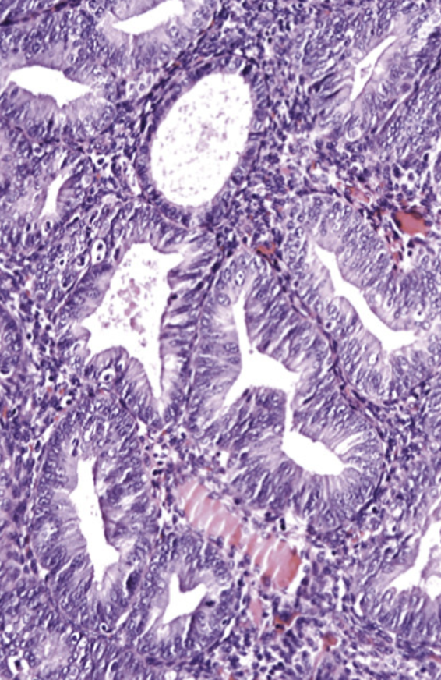
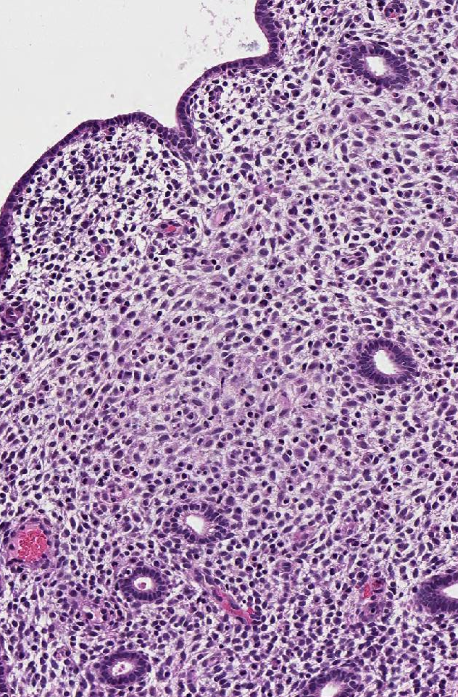
Back-to-back glands containing atypical cells
Cute little glands
Crowded, dilated glands
Normal
endometrium
Typical
endometrial hyperplasia
Atypical
endometrial hyperplasia

Slide 19
Leiomyoma (“Fibroid”)
Benign tumor of smooth muscle
Very common!
Stimulated by estrogen
Can cause pain and abnormal bleeding

Slide 20
Leiomyosarcoma
Malignant tumor of smooth muscle
Necrotic, with atypical cells and lots of mitoses
Metastasizes early, often to lungs
5-year survival = 40%

Slide 21
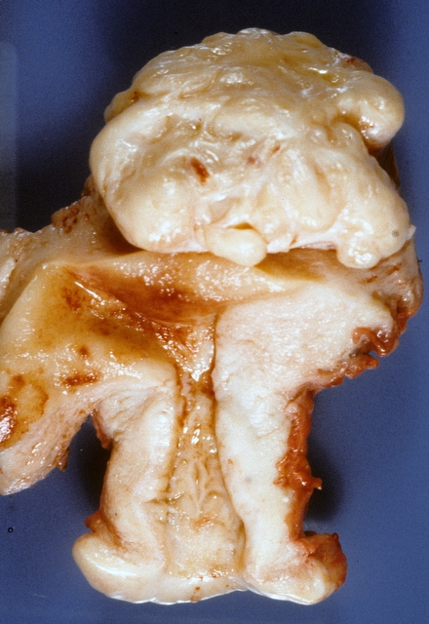
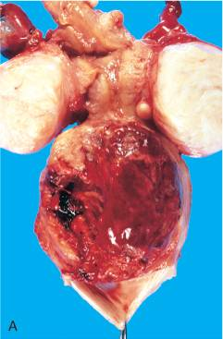
Leiomyoma
Leiomyosarcoma

Slide 22
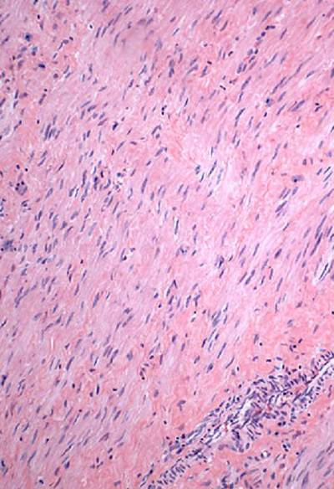
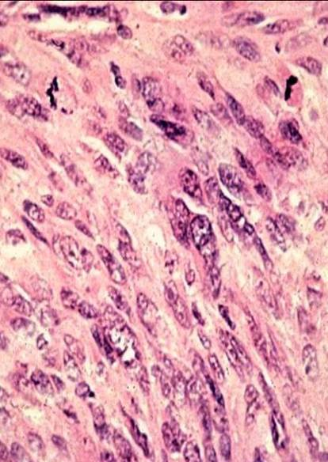
Leiomyoma
Leiomyosarcoma

Slide 23
Endometrial Carcinoma
Peak age: 55-65 (not before 40)
Frequently preceded by atypical endometrial hyperplasia
Risk factors involve estrogen excess
Presents with abnormal bleeding
Metastasizes late

Slide 24
Female Reproductive System Outline
Cervix
Uterus
Ovaries
  Tumors

Slide 25
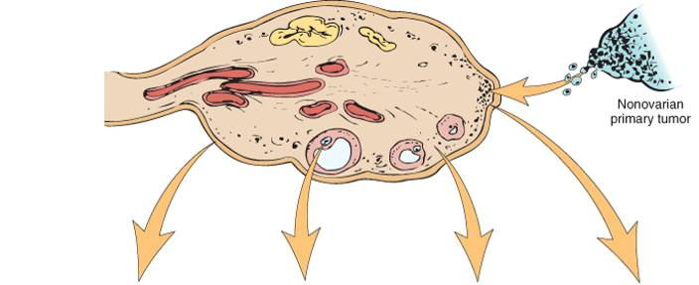
Origin of Ovarian Tumors
Most common!
Surface epithelial tumors
Germ cell tumors
Sex cord-stromal tumors
Cystadenoma
Cystadenocarcinoma
Teratoma
Dysgerminoma
Yolk sac tumor
Choriocarcinoma
Granulosa-theca cell tumor
Sertoli-Leydig cell tumor

Slide 26
Cystadenoma
Benign tumor derived from surface epithelium of the ovary
Contains cystic spaces filled with fluid
Typically large, occasionally bilateral

Slide 27
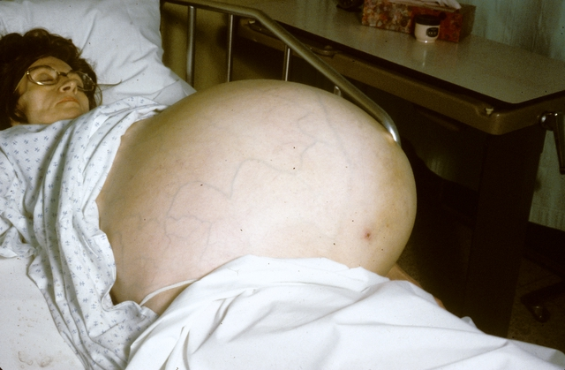
Patient with ovarian cystadenoma

Slide 28
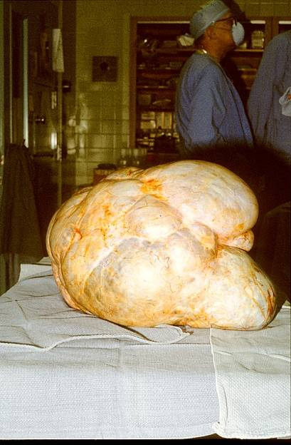
Ovarian cystadenoma

Slide 29
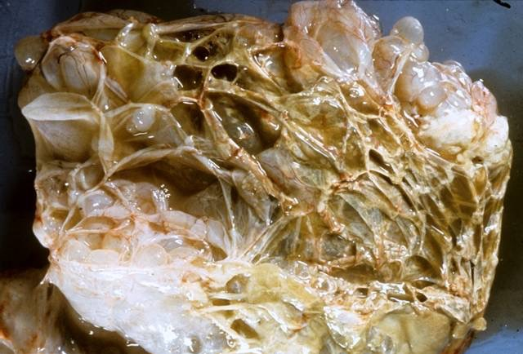
Ovarian cystadenoma

Slide 30
Teratoma
Benign tumor arising from germ cells
Sometimes called “dermoid cyst” because it’s usually cystic and lined by skin
Usually presents as an abdominal mass
Often contains many types of tissue such as cartilage, bone, neural tissue
Rare cases become malignant

Slide 31
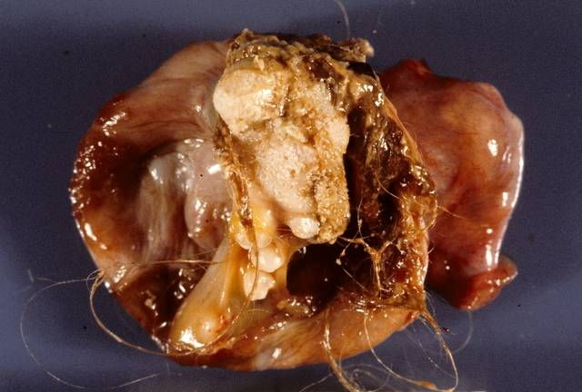
Teratoma

Slide 32
Ovarian Cancer
2023 estimates: 20,000 new cases / 13,000 deaths
Peak age: 50
Risk factors: estrogen excess, family history
Symptoms: bloating, pain, more frequent/urgent urination
Often metastatic at diagnosis
Most are cystadenocarcinomas

Slide 33
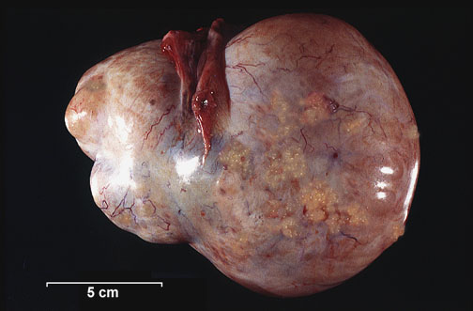
Papillary cystadenocarcinoma

Slide 34
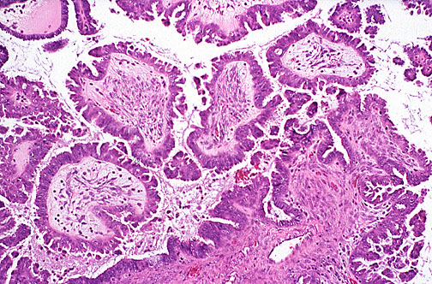
Papillary cystadenocarcinoma

Slide 35
Ovarian Cancer
Treatment: surgery, radiation, chemotherapy
Prognosis depends on stage
  Cancer inside ovary: 5y survival 70%
  Cancer outside ovary: 5y survival 13%

Slide 36
Female Reproductive System Outline
Cervix
Uterus
Ovaries
Breast
  Fibrocystic change
  Tumors

Slide 37
Breast
Many breast diseases present as lumps
Most lumps are NOT cancerous…
…but a lump always needs to be evaluated
Ultrasound, mammography, fine needle aspiration, and biopsy are the usual methods

Slide 38
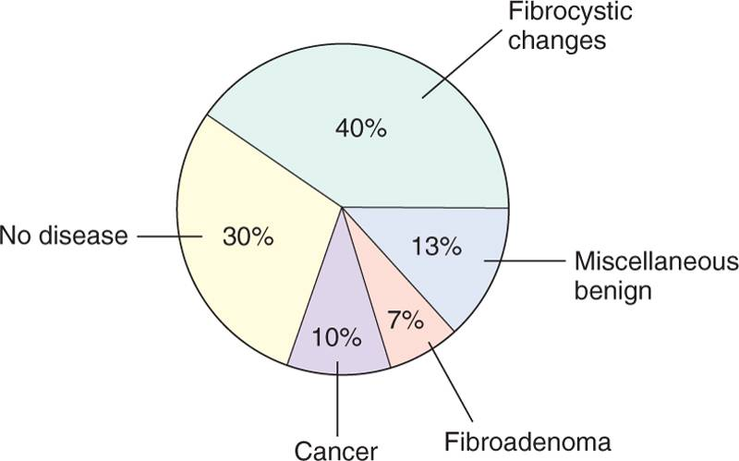
Most breast lumps are not cancerous

Slide 39
Fibrocystic Change
“Lumpy bumpy” breast tissue containing cysts and fibrous tissue
Very common
Most cases are NOT associated with increased cancer risk

Slide 40
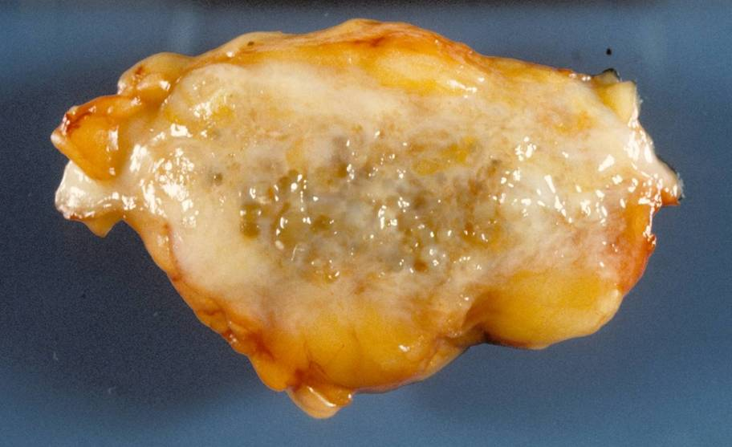
Fibrocystic change

Slide 41
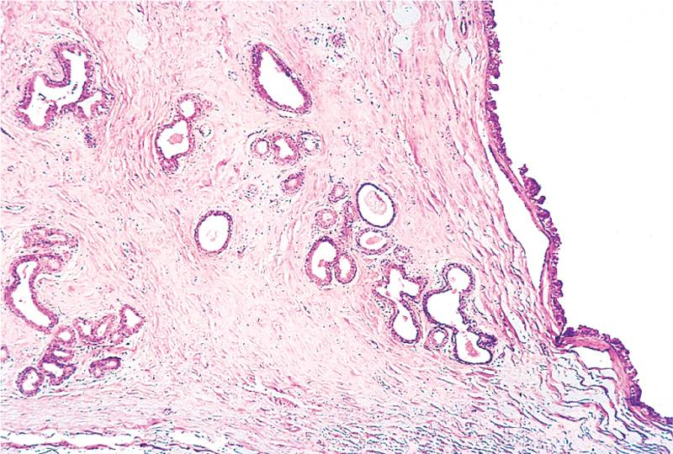
Fibrocystic change

Slide 42
Fibroadenoma
Most common benign breast tumor
Stimulated by estrogen
Peak incidence: 20s
Solitary, discrete, moveable mass
Fibrous tissue with compressed ducts and lobules

Slide 43
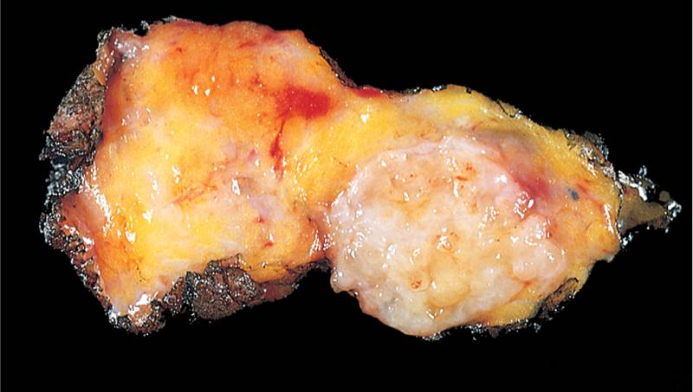
Fibroadenoma

Slide 44
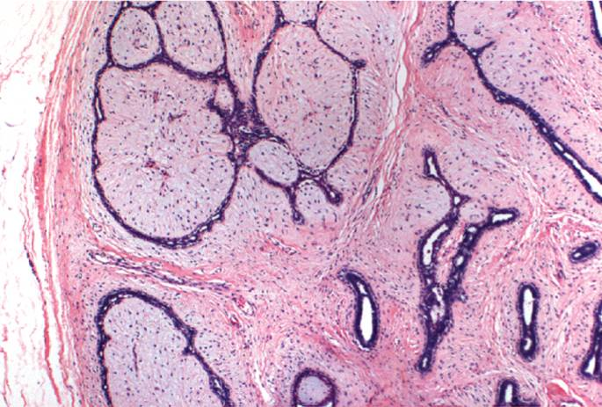
Fibroadenoma

Slide 45
Breast Carcinoma
2023 estimates: 300,000 new cases / 44,000 deaths
Really common! Incidence: 1 in 8 women!
Usually presents as a lump
Risk factors: age (75% of patients are >50), estrogen excess, alcohol consumption, high-fat diet, family history (less than 10% of all cases)

Slide 46
Breast Carcinoma Family History
Worry if first degree relative with breast cancer
Most have BRCA-1 or BRCA-2 mutations
Tumor suppressor genes; help repair DNA
Genetic testing difficult
Most carriers get cancer by age 70

Slide 47
Breast Carcinoma Clinical Findings
If discovered by palpation:
Solitary, painless, moveable mass
2-3 cm in diameter
Axillary nodes positive in 50% of patients
If discovered by mammography:
1 cm in diameter
Axillary nodes positive in 15% of patients
As disease progresses:
Fixation to chest wall
Adherence to overlying skin
Peau d’orange

Slide 48
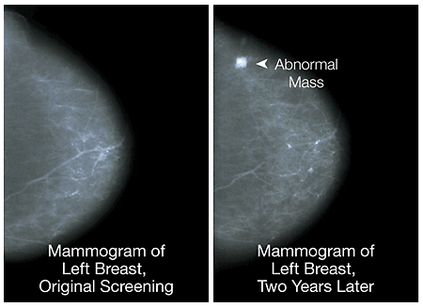

Slide 49
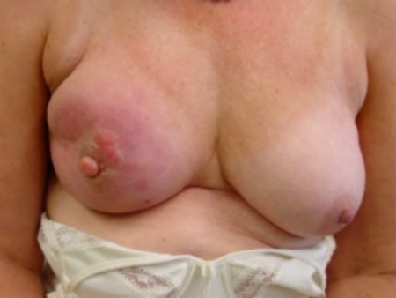
Advanced breast carcinoma: fixation to skin

Slide 50
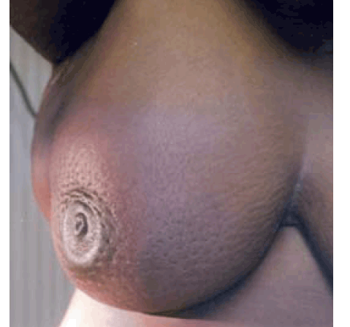
Peau d’orange

Slide 51
Breast Carcinoma Histologic Types
Non-invasive
Ductal carcinoma in situ (DCIS)
Lobular carcinoma in situ (LCIS)
Invasive
Ductal
Lobular
Inflammatory
…and a bunch of other rare types

Slide 52
Breast Carcinoma Prognostic Factors
Stage
Grade
Type (inflammatory is worst)

Slide 53
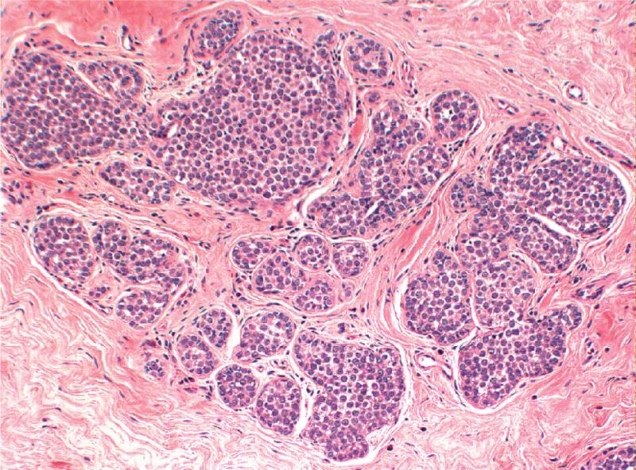
Lobular carcinoma in situ

Slide 54
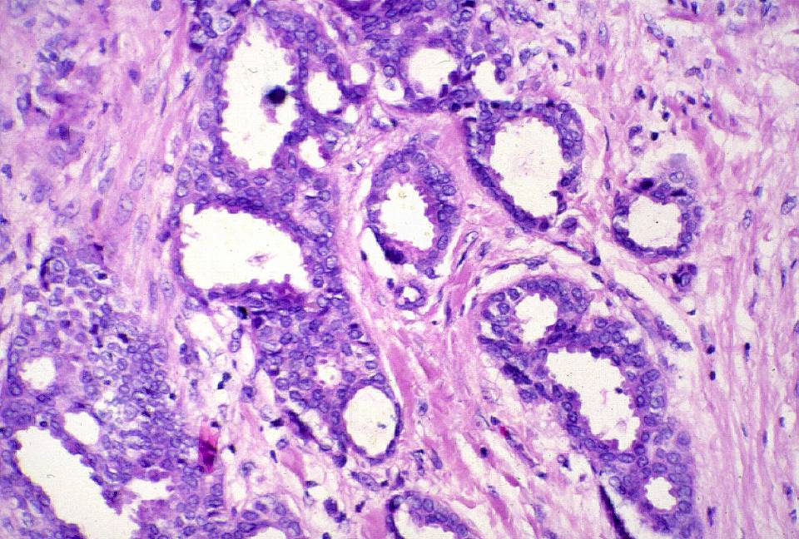
Low-grade invasive ductal carcinoma

Slide 55
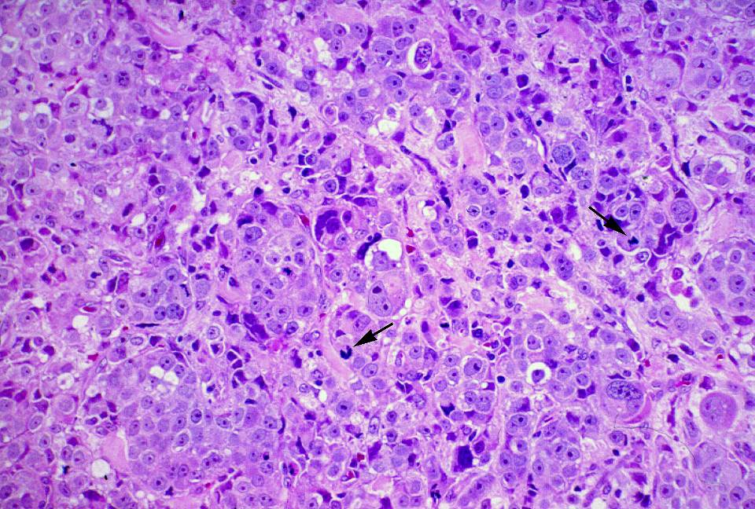
High-grade invasive ductal carcinoma

Slide 56
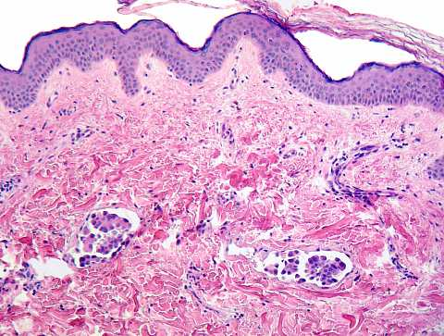
Inflammatory breast carcinoma

Slide 57
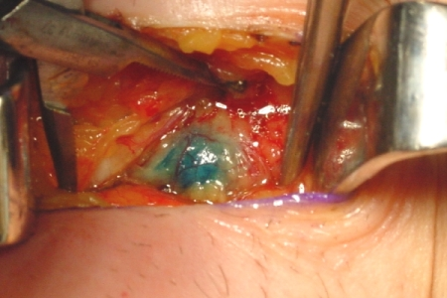
Sentinel node biopsy

Slide 58
TNM* staging system for breast cancer
Stage
T
N
M
5-year survival
Stage 0
Stage I
Stage II
Stage III
Stage IV
DCIS
<2 cm
<5 cm
>5 cm
<5 cm
>5 cm
Any T
Any T
Any T
0
0
<3
0
4+
1+
10+
Any N
Any N
M0
M0
M0
M0
M0
M0
M0
skin or chest wall
M1
92%
87%
75%
46%
13%
* Tumor (size), nodes (# positive), metastases
Don’t memorize the numbers in this table! See learning objectives!

