Slide 1
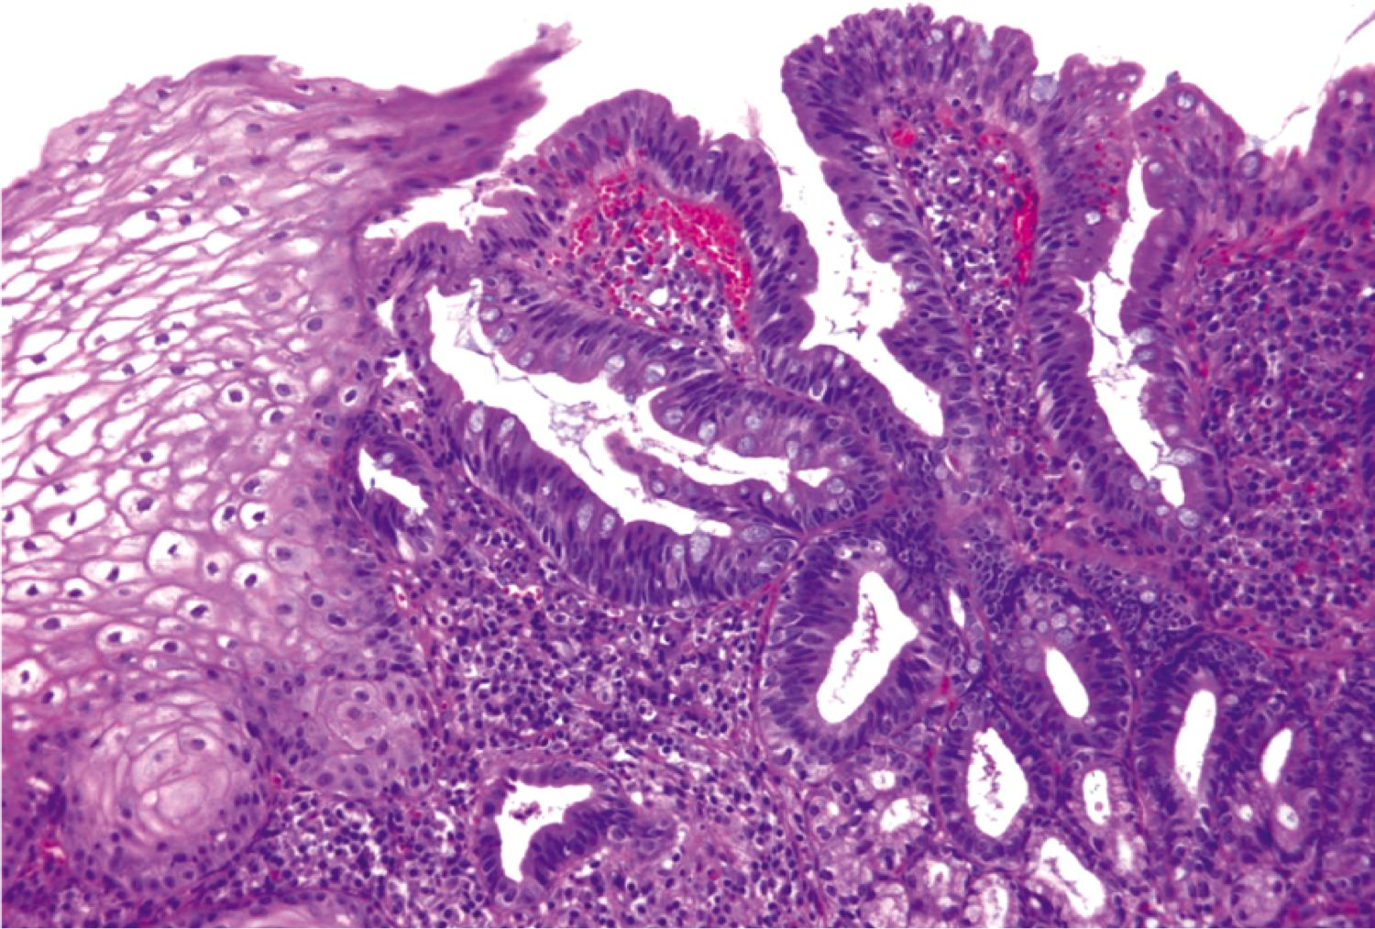
Upper Gastrointestinal Pathology
Kristine Krafts, M.D.

Slide 2
GI Pathology Outline
Esophagus
Stomach
Intestine
Liver
Gallbladder
Pancreas
Upper GI
Lower GI
Accessory
organs

Slide 3
Upper GI Lecture Objectives
Explain what a hiatal hernia is.
Explain what is going on in Barrett esophagus; describe the morphologic appearance of the epithelium, and know why it is important to monitor patients who have this condition.
Define what “gastritis” and “ulcer” mean. Describe the causes and morphologic changes seen in each disorder.
Compare and contrast intestinal-type and diffuse-type gastric carcinoma.

Slide 4
GI Pathology Outline
Esophagus
  Hiatal hernia
  Mallory-Weiss syndrome
  Barrett esophagus
  Carcinoma

Slide 5
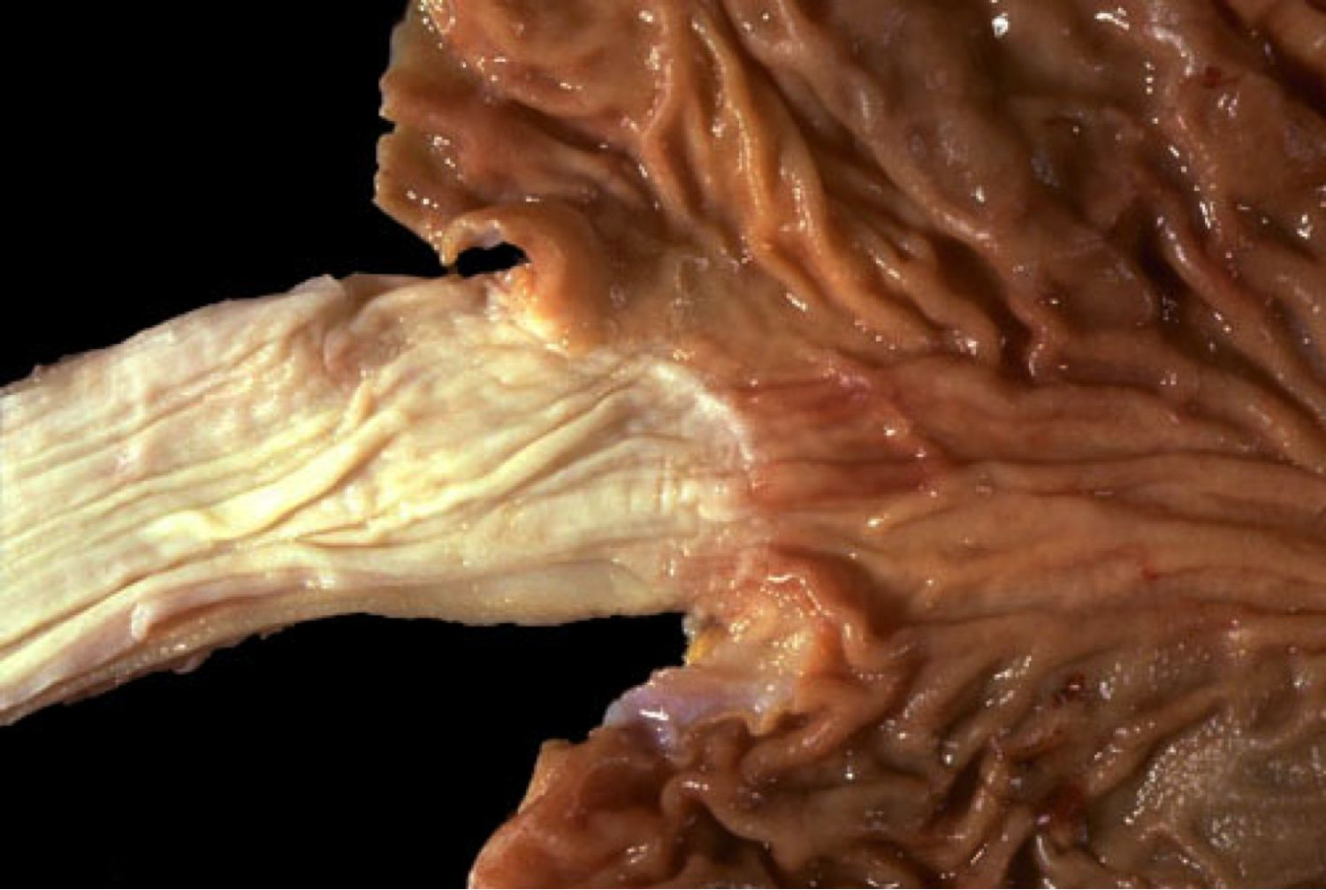
Normal esophageal-gastric junction

Slide 6
Hiatal Hernia
Dilated portion of stomach protrudes above diaphragm
Common! Usually asymptomatic.
Heartburn, reflux esophagitis
Danger: ulceration, bleeding

Slide 7
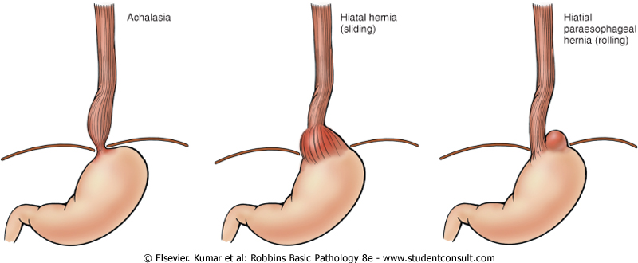
Sliding (L) and rolling (R) hiatal hernias

Slide 8
Mallory-Weiss Syndrome
GE junction tears
Severe vomiting (chronic alcoholics)
Symptoms: bleeding, pain, infection
Treatment: cauterization
Prognosis: usually heals; sometimes fatal

Slide 9
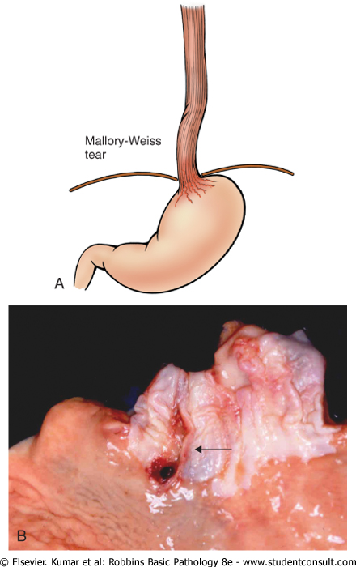
Mallory-Weiss tears

Slide 10
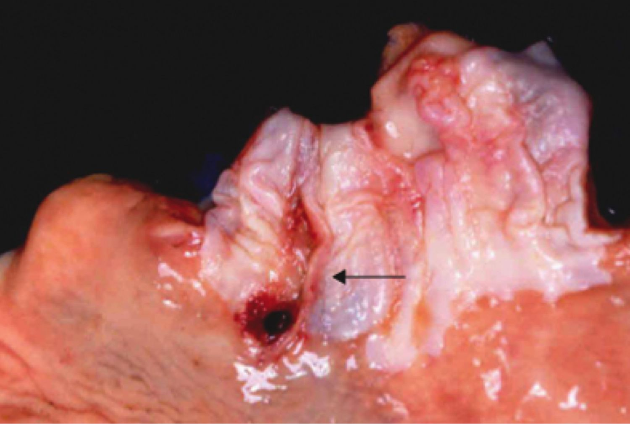
Mallory-Weiss tears

Slide 11
Barrett Esophagus
Replacement of squamous epithelium by columnar epithelium with goblet cells
Complication of long-standing reflux esophagitis
Danger: 30-100x risk of adenocarcinoma
Treatment: screen for high-grade dysplasia

Slide 12
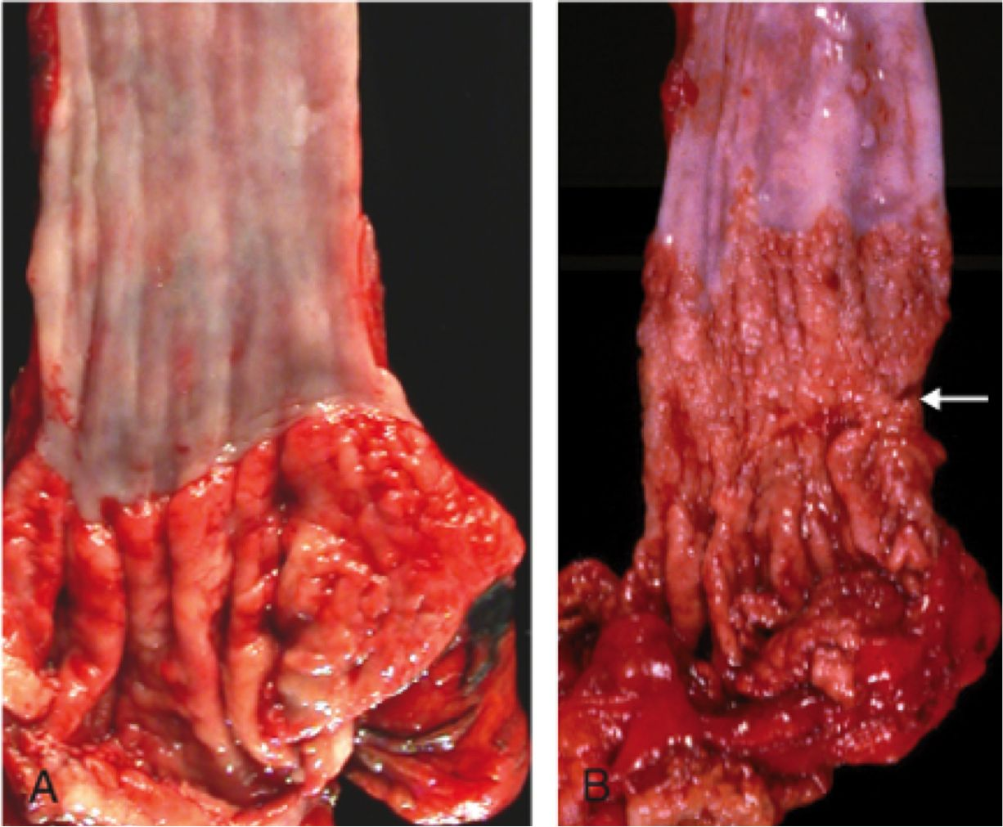
Normal esophagus (L) and Barrett esophagus (R)

Slide 13
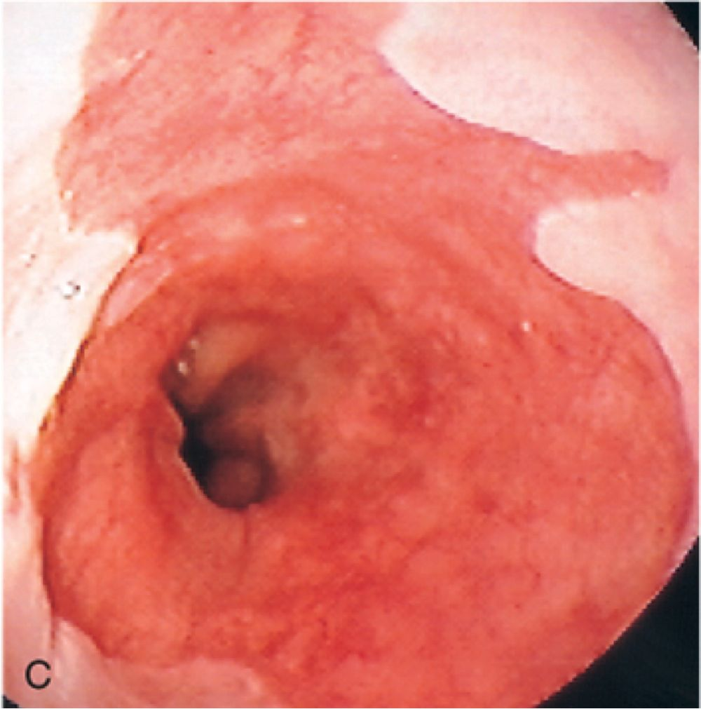
Barrett esophagus

Slide 14
Normal squamous
epithelium
Columnar epithelium with goblet cells
Barrett esophagus

Slide 15
Esophageal Carcinoma
Adenocarcinoma
Commonest type in US
Risk factor: Barrett esophagus
Distal 1/3 of esophagus
Symptoms: insidious onset; late obstruction
Squamous cell carcinoma
Commonest type worldwide
Risk factors: esophagitis, smoking, alcohol, genetics
Middle 1/3 of esophagus
Symptoms: insidious onset; late obstruction

Slide 16
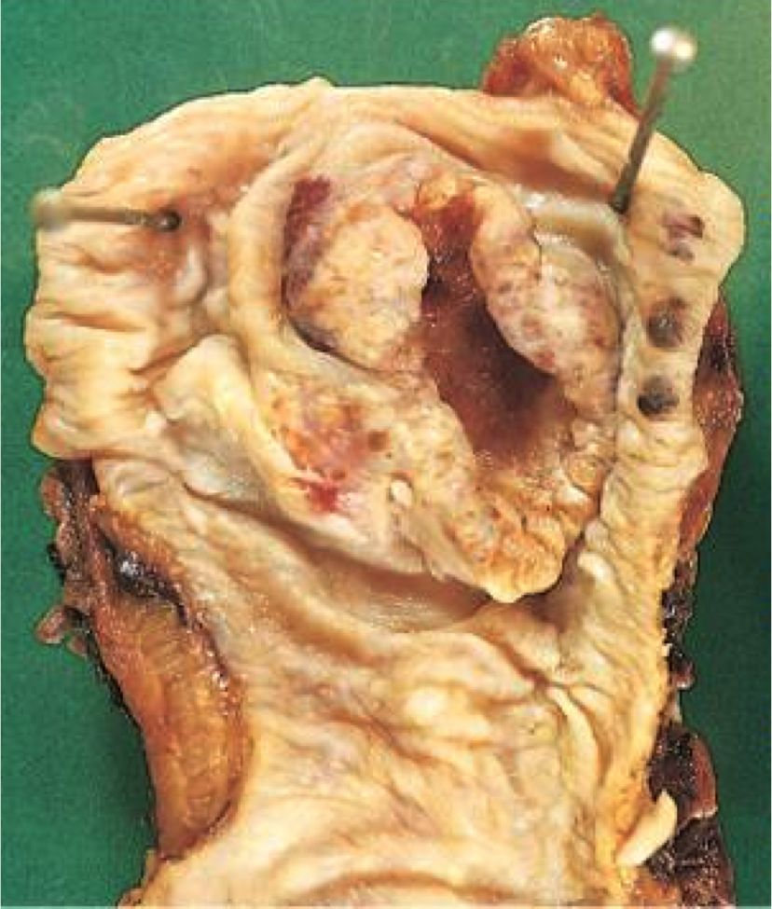
Adenocarcinoma of esophagus

Slide 17
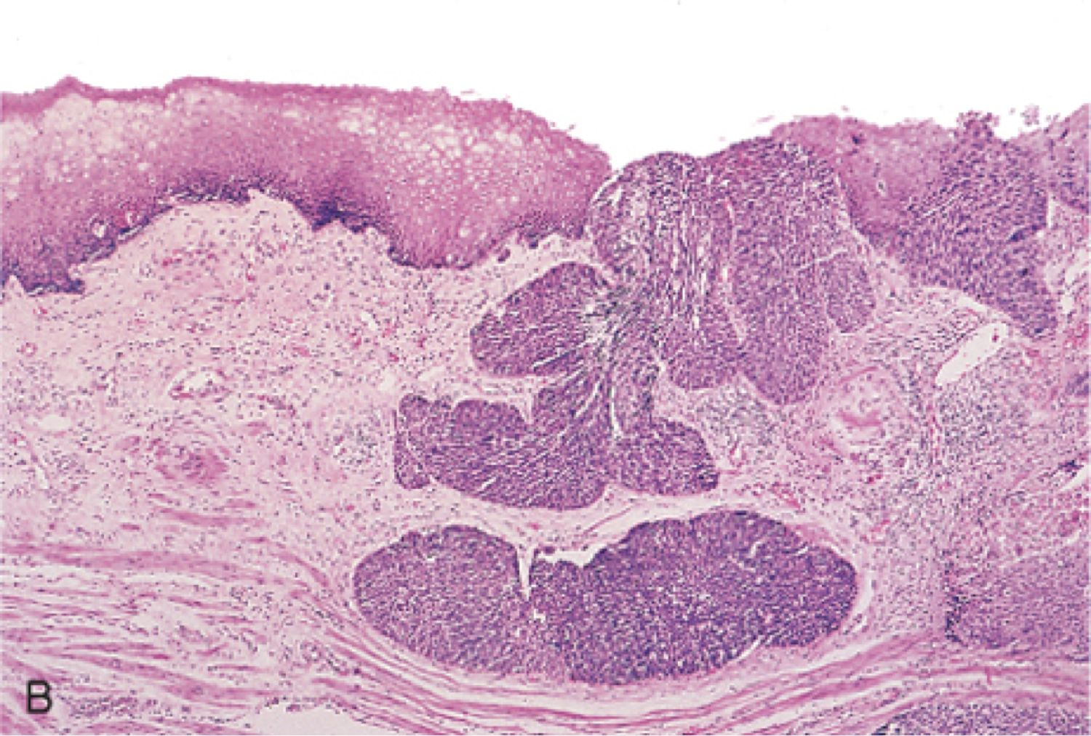
Squamous cell carcinoma of esophagus

Slide 18
GI Pathology Outline
Esophagus
Stomach
  Gastritis
  Ulcers
  Carcinoma

Slide 19
Gastritis
Mucosal inflammation
Asymptomatic, or epigastric pain
Causes: H. pylori, autoimmune, NSAIDs
Danger: intestinal metaplasia (sometimes turns into gastric cancer)

Slide 20
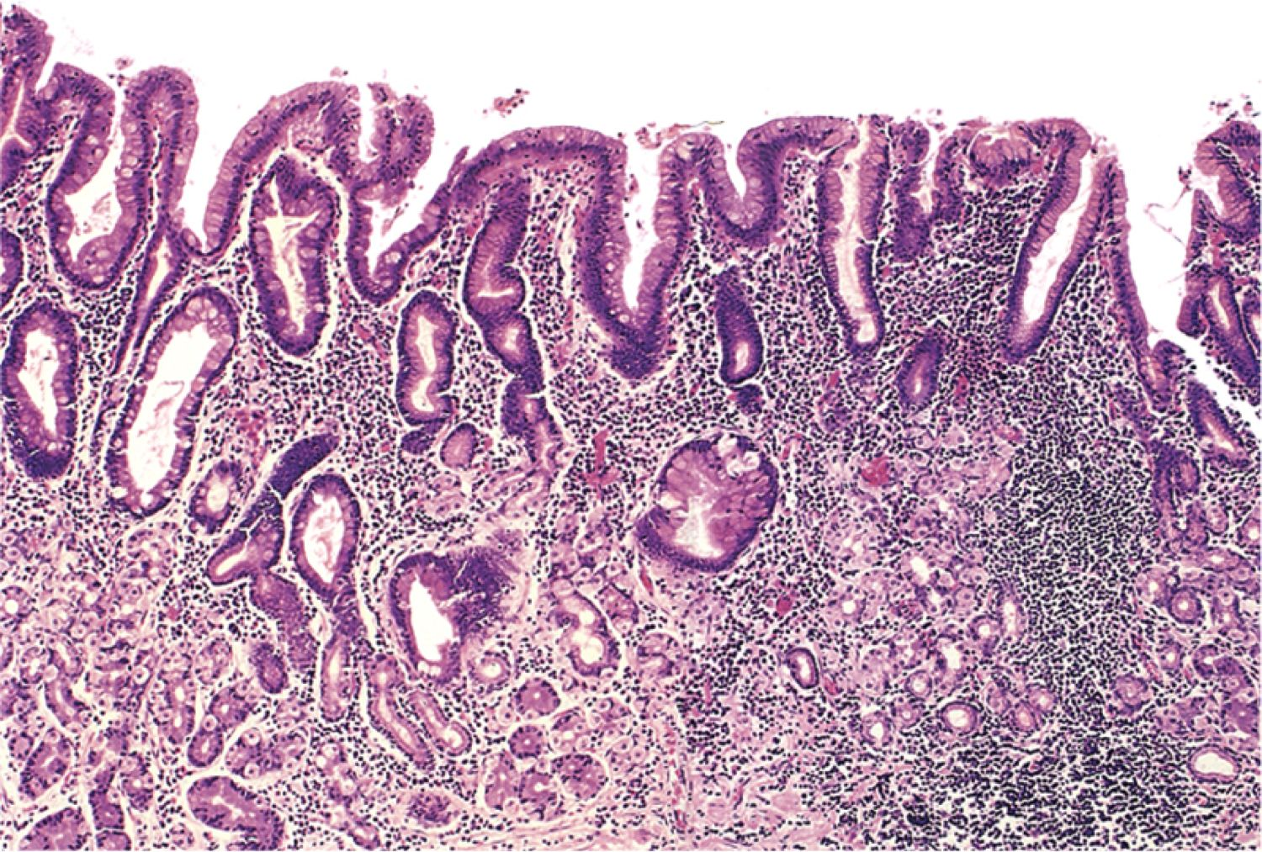
Gastritis

Slide 21
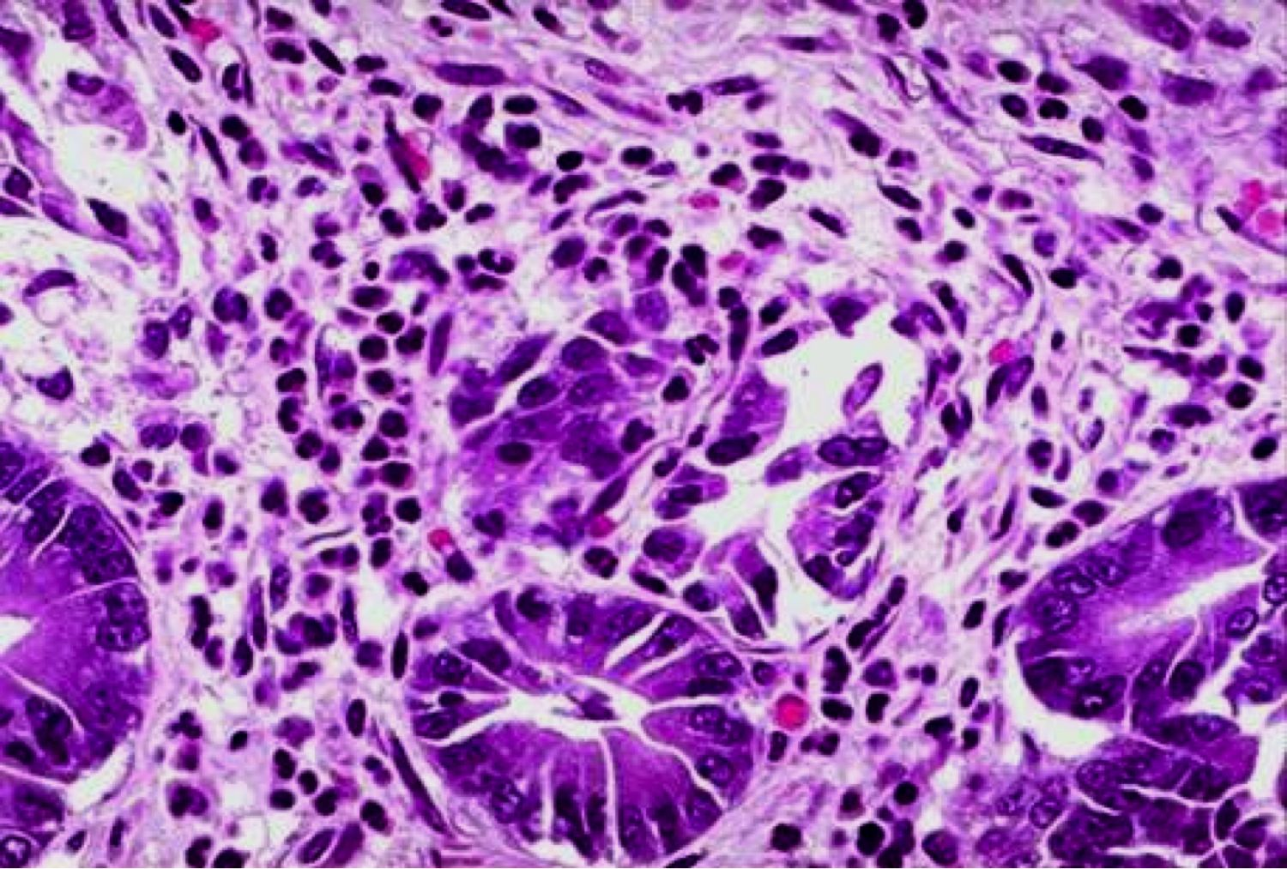
Chronic gastritis

Slide 22
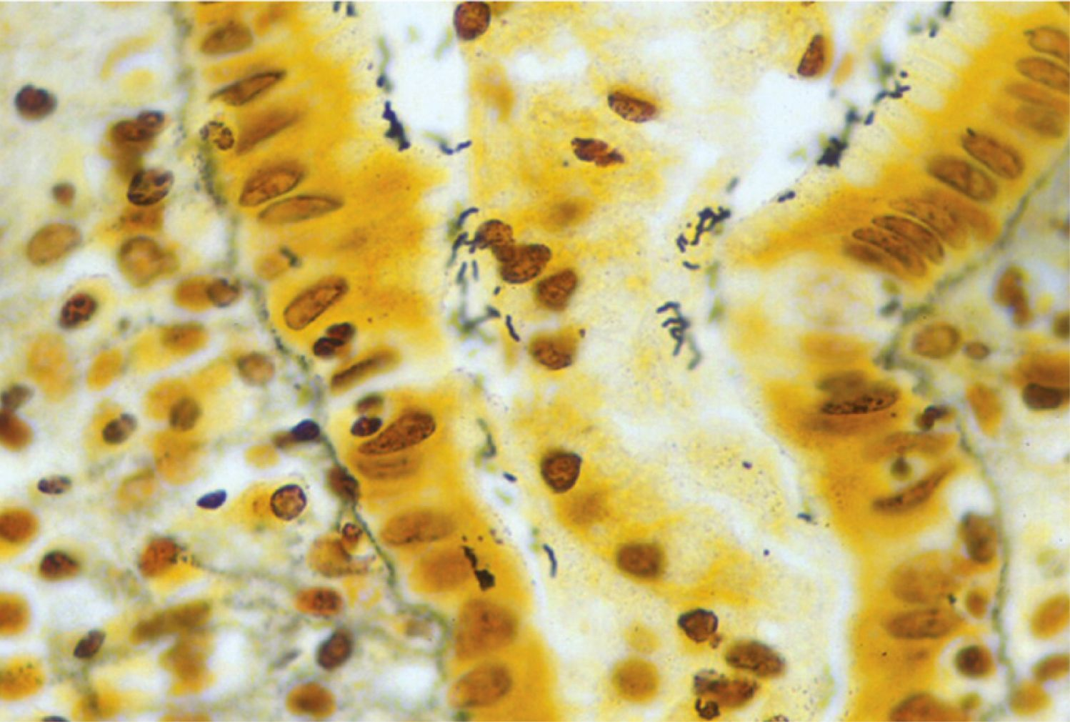
Helicobacter pylori organisms

Slide 23
Ulcer
Erosion of mucosa into submucosa
Causes: H. pylori, NSAIDs
Symptoms: epigastric pain
Danger: bleeding, perforation

Slide 24
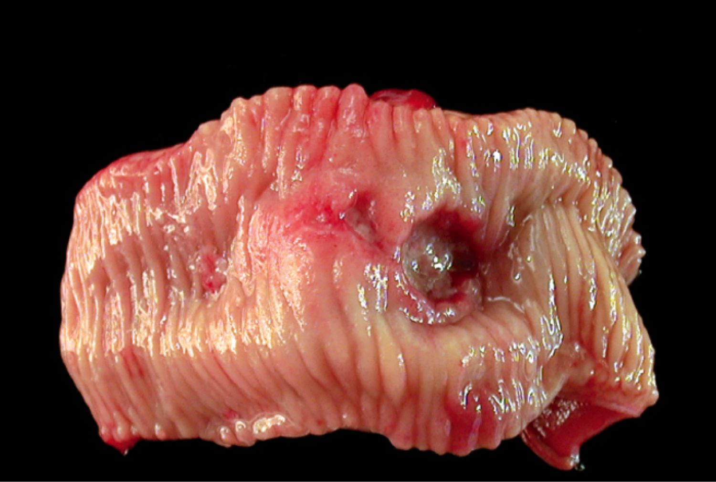
Ulcer

Slide 25
Gastric Carcinoma
Intestinal type
Bulky mass
Risk factors: H. pylori infection, dietary carcinogens (smoked,
salted food)
Morphology: glands composed of columnar cells
Diffuse type
Thickened stomach wall
(“linitis plastica”)
Risk factors: undefined
Morphology: “signet ring” cells

Slide 26

Virchow’s node
Enlarged left supraclavicular lymph node (metastatic gastric carcinoma)
Notes:
26

Slide 27
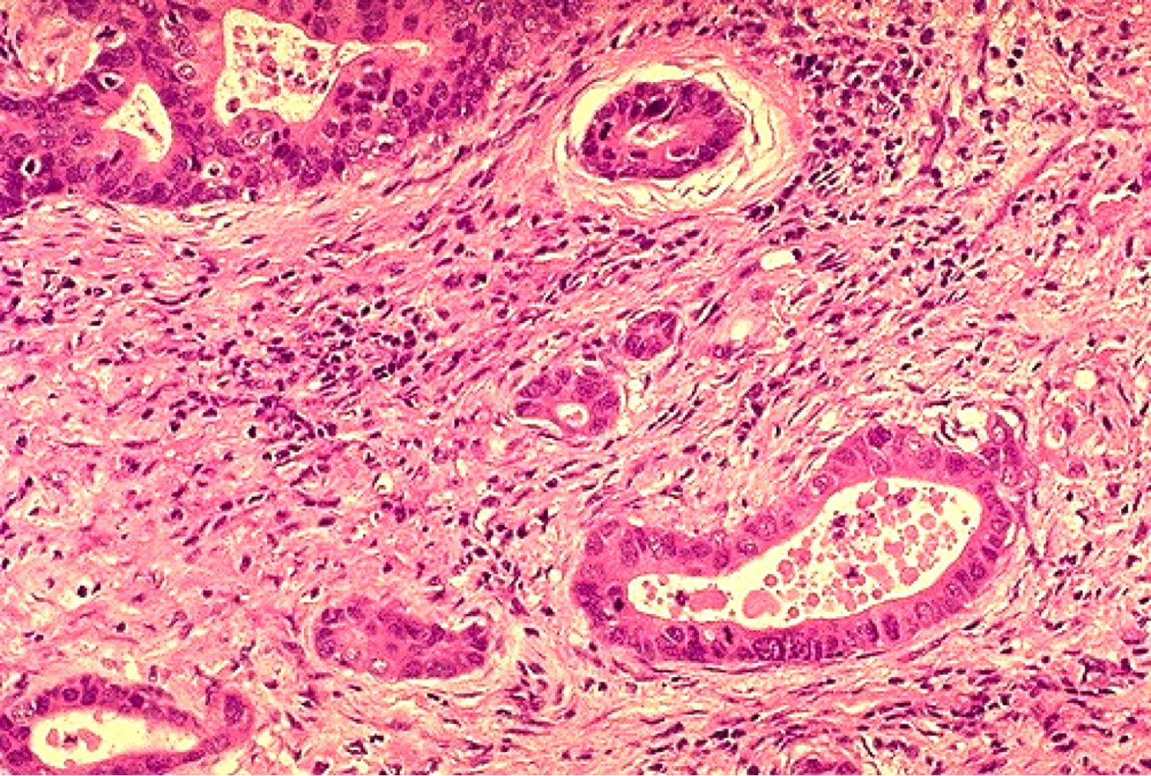
Intestinal-type gastric carcinoma: glands

Slide 28
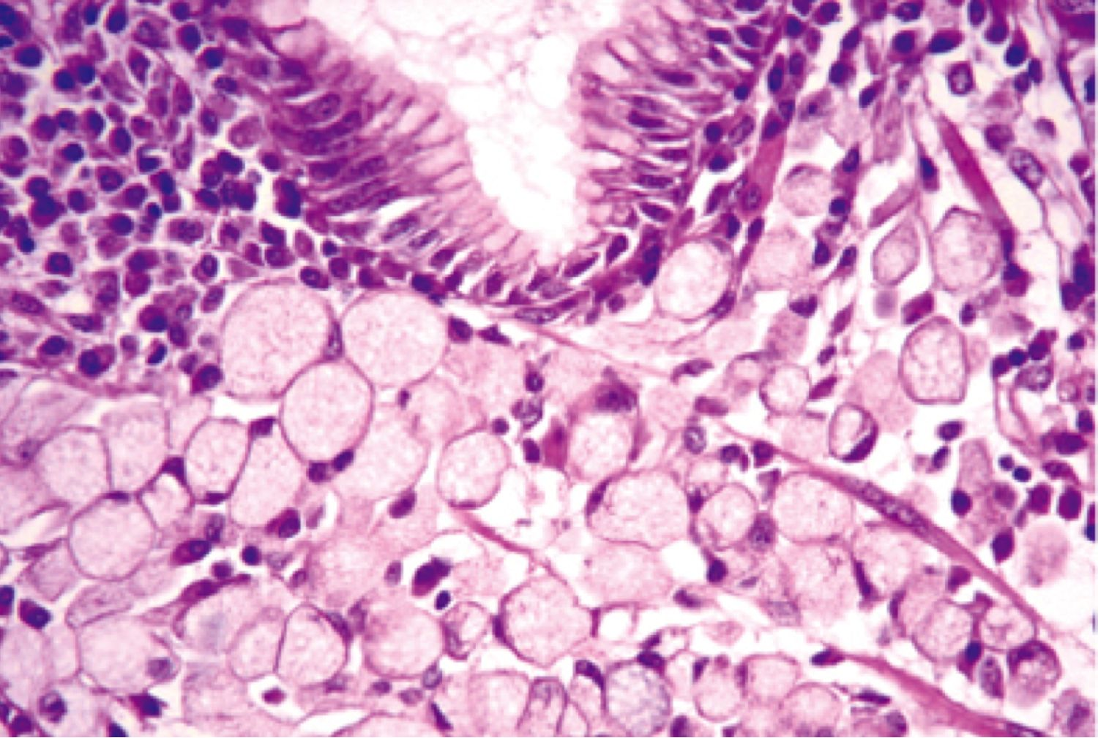
Diffuse gastric carcinoma: signet ring cells

Slide 29
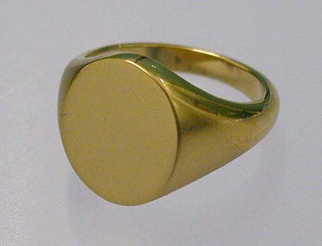
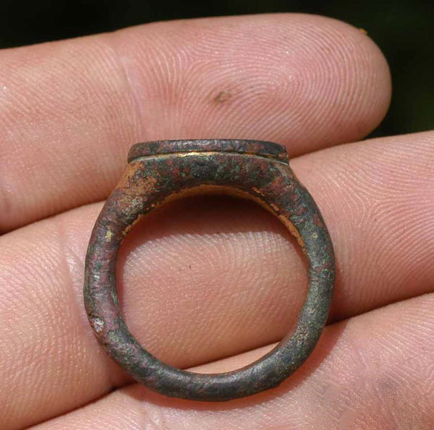
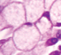
Signet ring cell

Slide 30
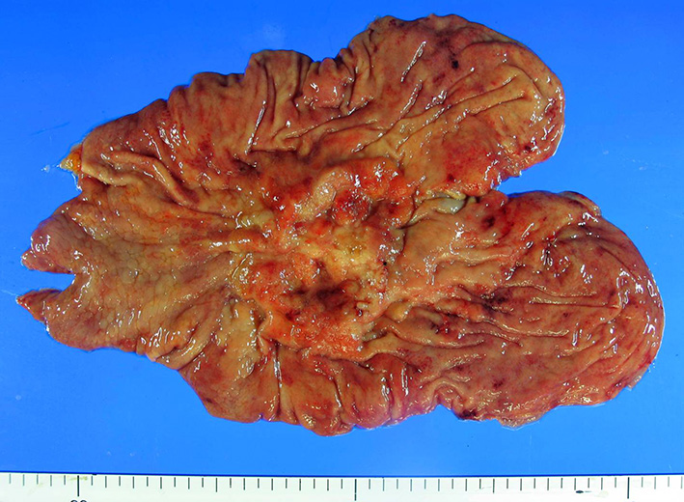
Intestinal-type gastric carcinoma: bulky mass

Slide 31
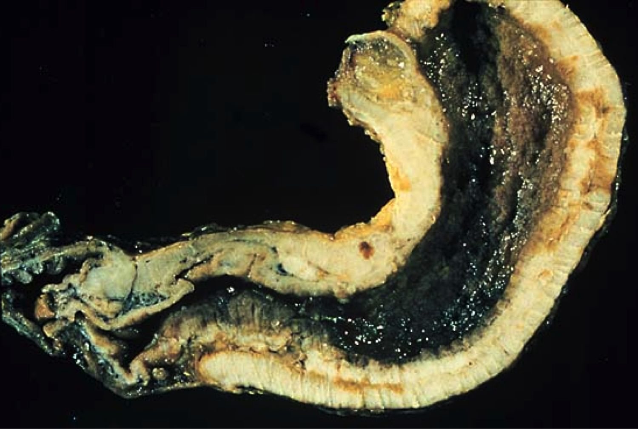
Diffuse-type gastric carcinoma: linitis plastica

