Slide 1

Hypersensitivity Reactions
Kristine Krafts, M.D.

Slide 2
Hypersensitivity Reactions Objectives
Explain in general how hypersensitivity reactions are different than normal immune reactions.
Explain how T_{H}2 cells, mast cells, IgE, and mediators (like histamine, prostaglandins, and cytokines) are involved in the mechanism of type I hypersensitivity reactions.
Describe the local and systemic symptoms that can occur as a result of type I hypersensitivity reactions.
Explain the three ways that antibodies mess things up in type II hypersensitivity reactions.

Slide 3
Hypersensitivity Reactions Objectives
Describe how immune complexes lead to tissue damage in type III hypersensitivity reactions.
Describe the mechanisms involved in both kinds of type IV hypersensitivity reactions.
Know that type I hypersensitivity is the underlying mechanism for most allergies.

Slide 4
Hypersensitivity Reactions Outline
Introduction and definitions
Type I hypersensitivity
Type II hypersensitivity
Type III hypersensitivity
Type IV hypersensitivity

Slide 5
What are hypersensitivity reactions?
Excessive, harmful immune reactions
Elicited by environmental or endogenous antigens
Often caused by a failure of normal regulatory mechanisms
Often have a genetic basis (HLA or otherwise)
Fall into four categories (type I, II, III, and IV hypersensitivity)

Slide 6
What happens in these reactions?
The immune response is triggered and maintained inappropriately.
Can be hard to eliminate triggers
Can be hard to stop the response
Diseases caused by hypersensitivity responses are often chronic, debilitating, and hard to treat.

Slide 7

The four types of hypersensitivity reactions
Might be a good idea to try to associate the types with a word or two, like this – just to make them easier to remember.
Type I hypersensitivity (“allergy”)
Type II hypersensitivity (“antibody”)
Type III hypersensitivity (“immune complex”)
Type IV hypersensitivity (“T-cell”)

Slide 8
Type I Hypersensitivity
ALLERGY
“Immediate” hypersensitivity
Antigen (allergen) binds to IgE antibodies on surface of mast cell
Mast cell releases nasty mediators
End results: vessels dilate, smooth muscle contracts, inflammation begins and persists

Slide 9
Sequence of Events
First exposure to allergen:
Allergen is inhaled/eaten/injected
Allergen stimulates T_{H}2 and IgE production
IgE coats mast cells
That’s it – no symptoms occur!
Subsequent exposures to allergen:
Allergen bridges IgE on mast cell
Mast cell degranulates
SYMPTOMS!

Slide 10
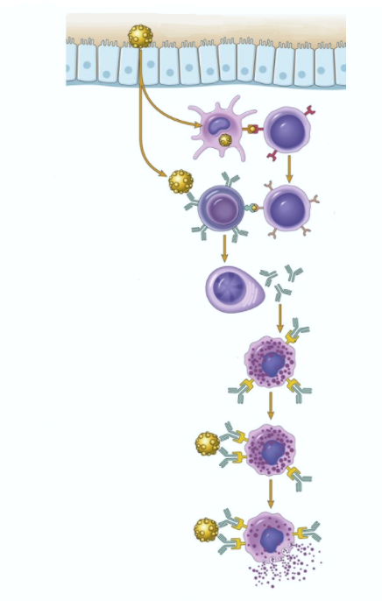
First exposure to allergen
Allergen
Exposure
to allergen
Mucosal lining
Dendritic cell
Naïve T cell
Activation of
B and T cells
B cell
T_{H}2 cell
Production
of IgE
Plasma cell
IgE
F_{c} receptor
Binding of IgE
to mast cells
Mast cell

Slide 11


Repeat exposure to allergen
Allergen
Mast cell
Degranulation
Mediators
Histamine
Prostaglandins
Cytokines
vasodilation
vascular leakage
smooth muscle spasm
Immediate reaction (minutes)
Late reaction
(hours)
inflammation
tissue destruction

Slide 12
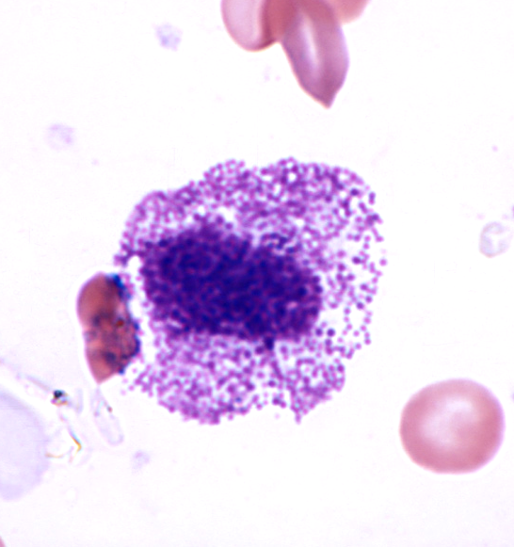
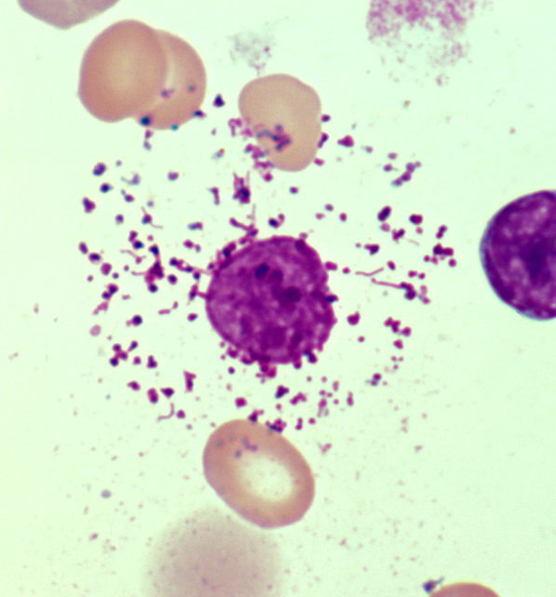
Intact mast cell
Degranulated mast cell

Slide 13
What happens to the patient?
Local reactions
  skin: itching, hives
  GI: diarrhea
  lung: bronchoconstriction
Anaphylaxis
  itching, hives, erythema
  constriction of bronchioles, wheezing
  laryngeal edema, hoarseness, obstruction
  vomiting, cramps, diarrhea
  shock
  DEATH

Slide 14
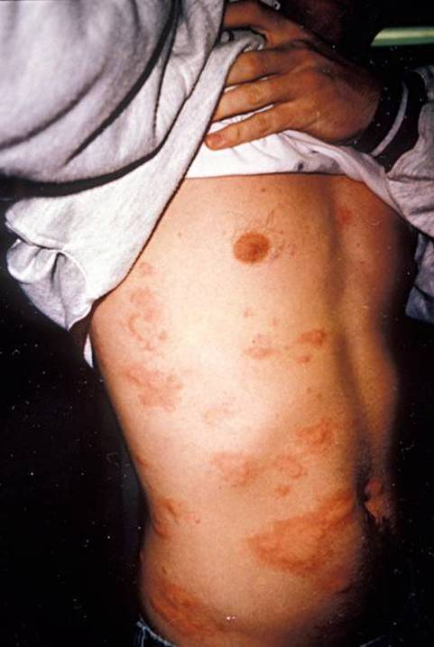
Hives

Slide 15
Type II Hypersensitivity
ANTIBODIES
“Antibody-mediated” hypersensitivity
Antibodies bind to antigens on cell surfaces
So what? What do these bound antibodies do that’s so bad? Three things can result:
  Opsonization (and then phagocytosis)
  Inflammation
  Cellular dysfunction
Notes:
A

Slide 16
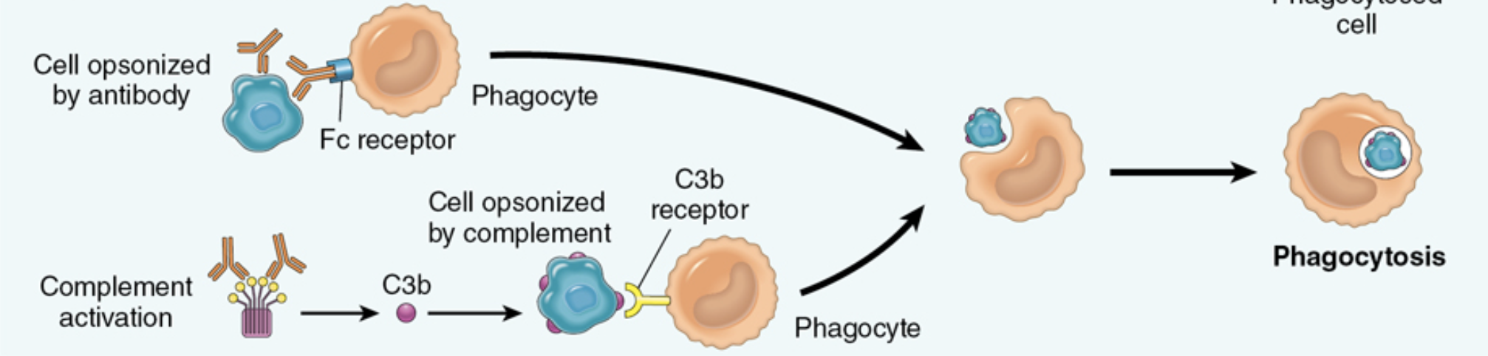

Opsonization and phagocytosis
“opson” = Greek for “super yummy sauce”

Slide 17
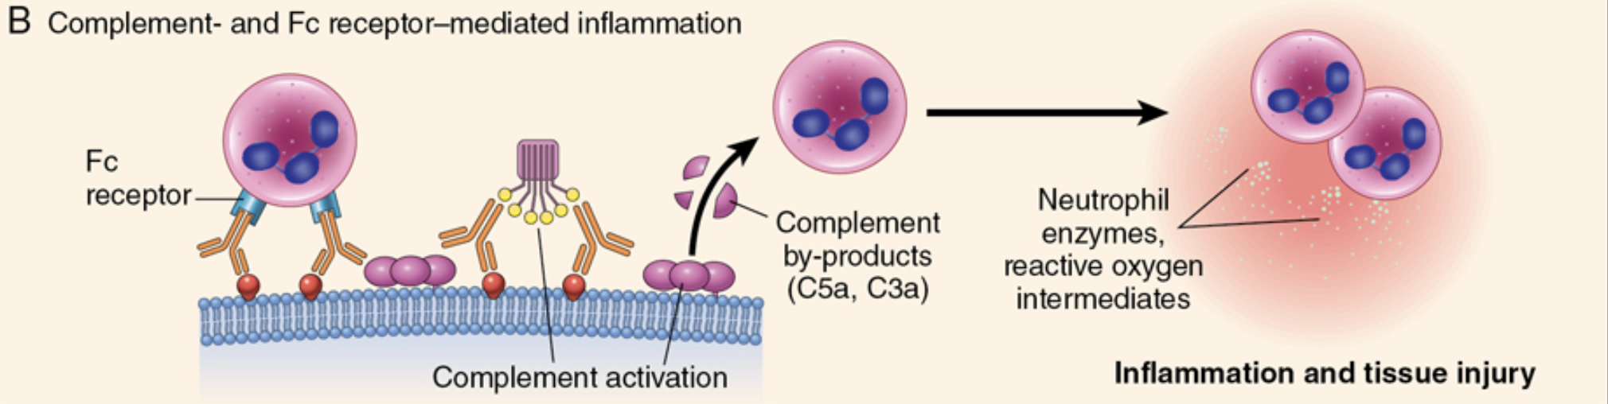
Inflammation

Slide 18
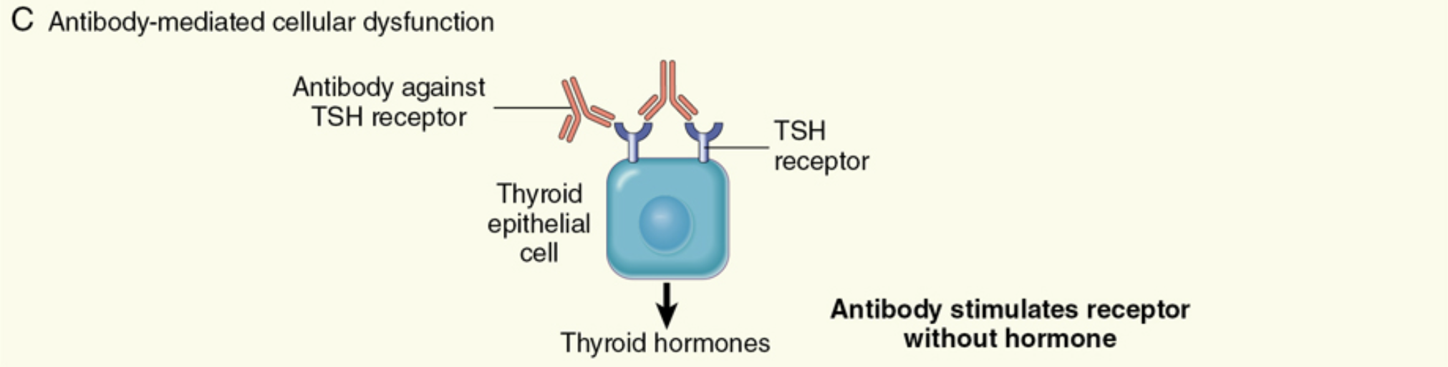
Cellular Dysfunction

Slide 19
Diseases caused by type II hypersensitivity
Don’t memorize these now! We’ll talk about these diseases later.
Disease | Antigen | Symptoms
Autoimmune hemolytic anemia | RBC antigens | Hemolysis
Myasthenia gravis | Acetylcholine receptor | Muscle weakness
Graves disease | TSH receptor | Hyperthyroidism

Slide 20
Type III Hypersensitivity
IMMUNE COMPLEX
“Immune complex-mediated” hypersensitivity
Antibodies bind to antigens, forming complexes
Complexes circulate, get stuck in vessel walls, stimulate inflammation
Results: bad inflammation, necrotizing vasculitis
Notes:
.

Slide 21
Why are immune complexes damaging?
Immune complexes activate complement, which:
  attracts and activates neutrophils
  makes vessels leaky
Neutrophils release tissue-dissolving enzymes
Immune complexes also activate clotting, causing microthrombi
Outcomes: vasculitis, glomerulonephritis, arthritis, other –itises
Vessel walls can become so damaged that they undergo necrosis!

Slide 22
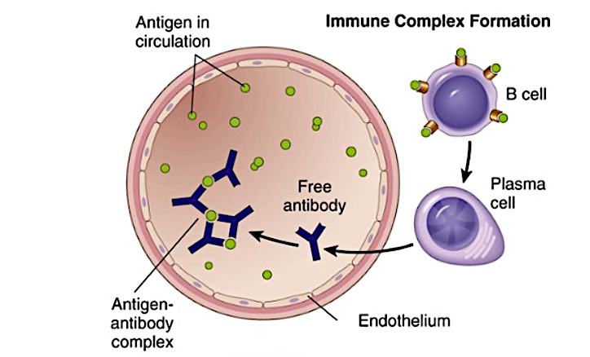

Immune complex formation

Slide 23
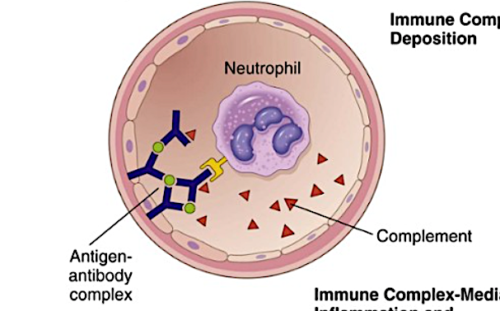



Immune complex deposition

Slide 24
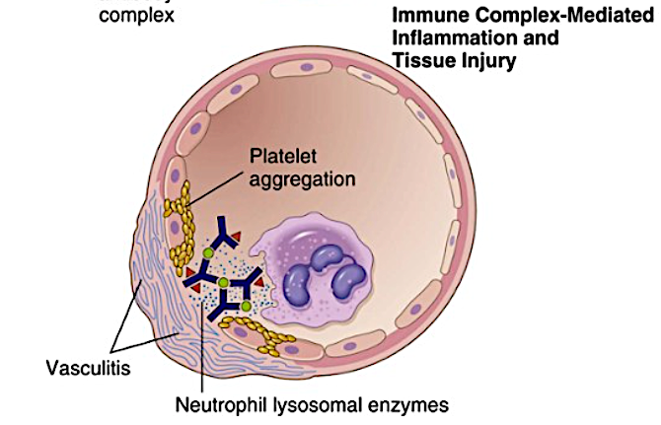




Inflammation and tissue damage
“Fibrinoid necrosis”

Slide 25
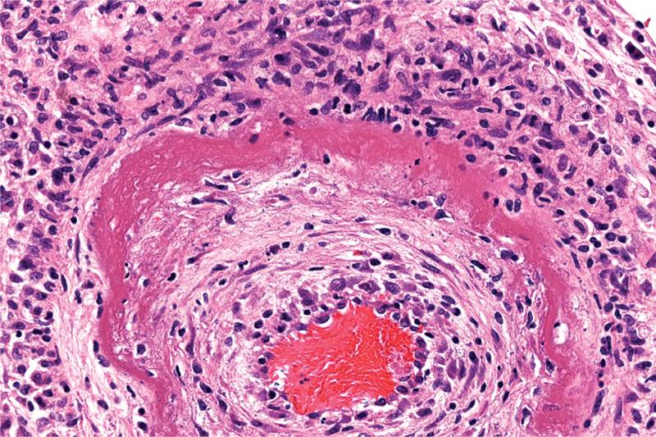



Fibrinoid necrosis
Thick vessel wall
Inflammation
RBCs
Immune-complex-mediated vasculitis

Slide 26
Diseases caused by type III hypersensitivity
Don’t memorize these now! We’ll talk about these diseases later.
Disease | Antigen | Symptoms
Systemic lupus erythematosus | Nuclear antigens | Nephritis, skin lesions, arthritis…
Polyarteritis nodosa | Hepatitis B antigen | Systemic vasculitis

Slide 27

Type IV Hypersensitivity
“delayed-type hypersensitivity”
T CELLS
“T-cell-mediated” hypersensitivity
Activated T cells do two different things:
  release cytokines that activate macrophages, or
  kill cells directly
Results: inflammation, cell destruction
“cell-mediated cytotoxicity”

Slide 28
Delayed-Type Hypersensitivity
First exposure to antigen:
  APC presents antigen to CD4+ T cell
  CD4+ T cells differentiate into effector and memory T_{H}1 cells
  That’s it! No symptoms occur.
Subsequent exposures to antigen:
  T_{H}1 cells come to site of antigen exposure
  Release cytokines that activate macrophages, cause inflammation

Slide 29
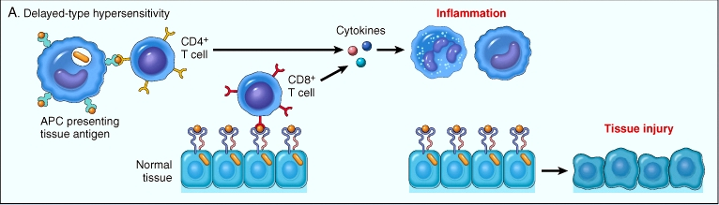



Delayed-Type Hypersensitivity
Subsequent exposure to antigen:

Slide 30
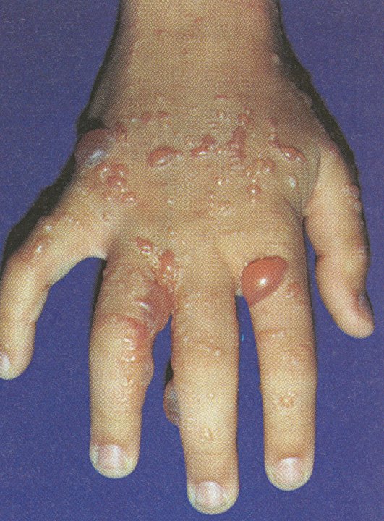
Poison ivy is caused by delayed-type hypersensitivity

Slide 31
Cell-Mediated Cytotoxicity
CD8+ T cells differentiate into cytotoxic T lymphocytes (CTLs) which kill cells that have certain cell-surface antigens
In normal immune reactions, CTLs kill infected cells
In cell-mediated cytotoxicity, CTLs kill cells they shouldn’t (e.g., pancreatic islet cells)

Slide 32
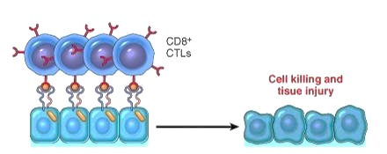

Cell-Mediated Cytotoxicity
CD8
Cytotoxic T cells
MHC I
receptor
Normal cells

Slide 33
Diseases caused by type IV hypersensitivity
Don’t memorize these now! We’ll talk about these diseases later.
Disease | Mechanism | Symptoms
Multiple sclerosis | DTH against antigens in myelin | Neurologic symptoms such as paralysis
Type I diabetes | CTLs destroy insulin-producing islet cells | Hyperglycemia

