Slide 1
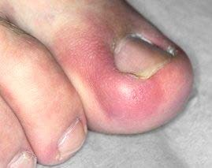
Inflammation
Kristine Krafts, MD

Slide 2
Inflammation Lecture Objectives
Define inflammation and explain its physiologic purposes.
Describe the clinical manifestations of inflammation, including its four cardinal signs.
List some causes of inflammation.
Compare and contrast the cell types and time course of acute and chronic inflammation.
List and describe the steps involved in acute inflammation, including the process of neutrophil extravasation.
Compare and contrast the microscopic appearances of acute and chronic inflammation.

Slide 3
Inflammation Outline
What is inflammation?
Acute inflammation
Chronic inflammation
When is inflammation bad?

Slide 4
Inflammation Outline
What is inflammation?

Slide 5
Inflammation, super-simplified
Inflammation is the body’s normal, protective reaction to local injury.
Cells like neutrophils and lymphocytes travel through blood vessels to the injured tissue.
These cells help kill any infectious agents, and then they clean up the damage.
Inflammation is supposed to be helpful – but if it happens in the wrong place, or lasts too long, it can be destructive.

Slide 6
Some Causes of Inflammation
Infections (bacterial, viral, fungal, parasitic)
Physical trauma (burns, abrasions, cuts)
Chemical agents (toxins, irritants)
Unidentified immune-stimulating agents
(leading to autoimmune and other diseases)

Slide 7

The Four Cardinal Signs of Inflammation
Rubor = redness
Dolor = pain
Calor = warmth
Tumor = swelling

Slide 8
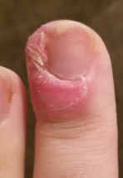
Normally, inflammation kills the bug, cleans up the mess, and the tissue goes back to normal.
Sometimes, inflammation persists, and it ends up causing tissue damage.

Slide 9
“-itis” = inflammation
Appendicitis = inflammation of the appendix
Meningitis = inflammation of the meninges
Pneumonitis = inflammation of the lungs
Nephritis = inflammation of the kidney
Myocarditis = inflammation of the heart

Slide 10
Inflammation Outline
What is inflammation?
Acute inflammation

Slide 11
The Two Types of Inflammation
Acute inflammation
Time course: begins immediately;
ends within 48 hours
Main cell: neutrophils
Chronic inflammation
Time course: begins at 48 hours;
can last days, weeks, even years!
Main cells: lymphocytes and macrophages

Slide 12
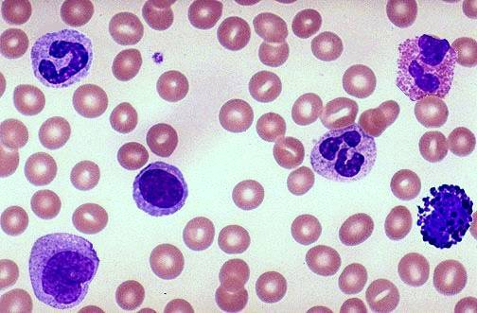
Neutrophil
Eosinophil
Neutrophil
Lymphocyte
Basophil
Monocyte
White blood cells

Slide 13
What happens in acute inflammation?
Vessels constrict (to staunch blood flow).
Vessels dilate (to become more permeable).
Neutrophils leave vessels and enter tissue.
Neutrophils kill any foreign invaders or substances, then take off.

Slide 14
Normal capillary bed
capillaries
arteriole
venule

Slide 15
Vasoconstriction and Vasodilation
Normal
Vasoconstriction
Vasodilation

Slide 16
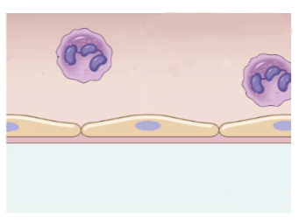
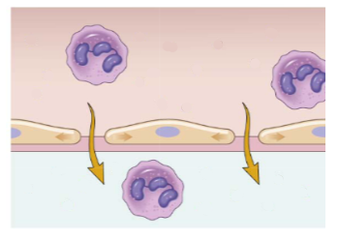
As vessels dilate, they become more permeable!
Neutrophil
Blood vessel lumen
Spaces open up between endothelial cells
Endothelial cell
Injured tissue
Normal blood vessel
Vessel with increased permeability

Slide 17
Vasodilation explains why inflamed
tissue is swollen, red, and warm!

Slide 18




Neutrophils leave blood vessels
(“extravasation”)
Margination
Rolling
Binding
Diapedesis
Blood vessel
lumen
Tissue
Endothelial cells
Dia- = through, across
ped- = foot
-esis = the process of
Diapedesis = the process of putting your
foot through something!

Slide 19
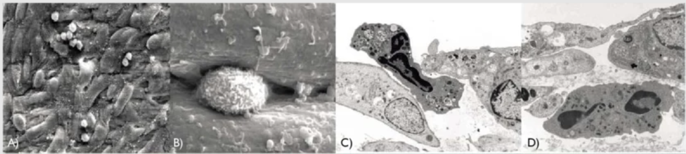
Neutrophils
Neutrophil squeezing
between two endothelial cells
Endothelial cells

Slide 20
Neutrophil
Endothelial cell
Gap through which the neutrophil must squeeze!
Endothelial cell

Slide 21
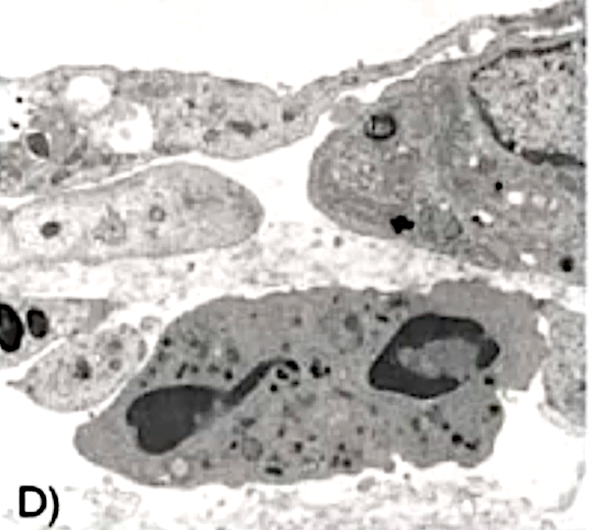










Neutrophil
Endothelial cells
Endothelial cells
Neutrophil
Endothelial cell

Slide 22
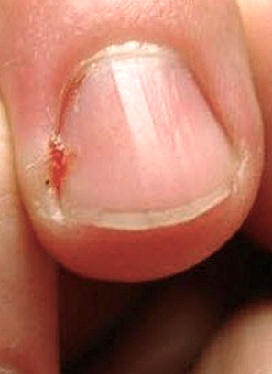
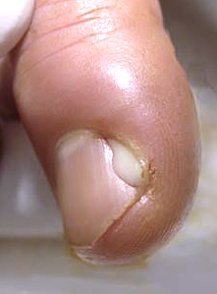
Inflammation is the first response after injury.
Pus
A little hangnail, not doing much.
Uh oh, there’s a
break in the skin!
Bacteria are getting in!
Inflammation to the rescue!

Slide 23
What happens in acute inflammation?
Vessels constrict, then dilate.
Neutrophils leave vessels and enter tissue.
Neutrophils kill any foreign invaders or substances, then take off.

Slide 24






How do neutrophils kill stuff?
Degranulation
Release granules that contain destructive enzymes
Bacteria
Phagocytosis
Eat stuff, then kill it within its little vacuole
Bacteria
Neutrophil

Slide 25
To the naked eye, acute inflammation shows up as PUS!
(a yellow-green, creamy, thick liquid)
Pus in a zit
Pus in a perionychial
(tissue next to the nail) infection

Slide 26
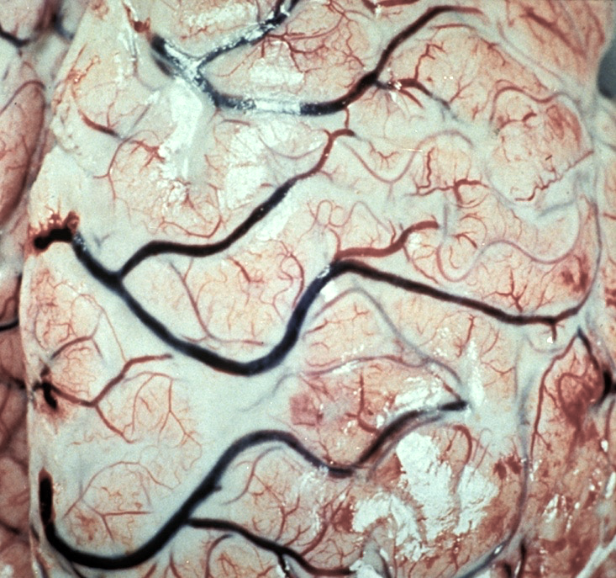
Pus
Acute bacterial meningitis: pus overlying brain surface

Slide 27
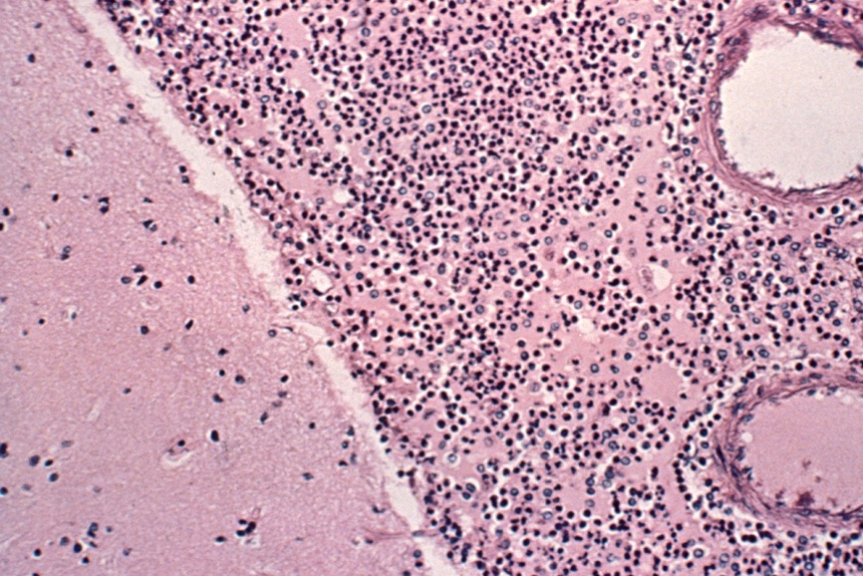
Underneath the microscope,
acute inflammation looks like a bunch of neutrophils
Neutrophils
Brain tissue
Acute bacterial meningitis: neutrophils in subarachnoid space

Slide 28
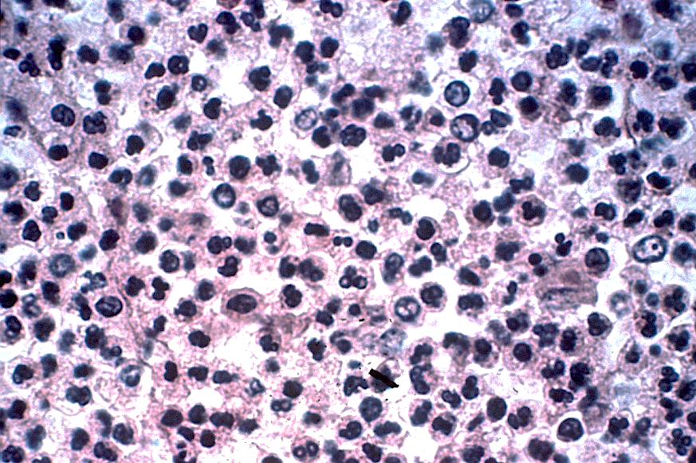
Neutrophils
Same case, higher power: tons of neutrophils

Slide 29
Inflammation Outline
What is inflammation?
Acute inflammation
Chronic inflammation

Slide 30
What happens in chronic inflammation?
Macrophages eat things.
Lymphocytes fight any remaining foreign invaders.
Both cells can trigger the immune system (often in unhelpful ways).

Slide 31
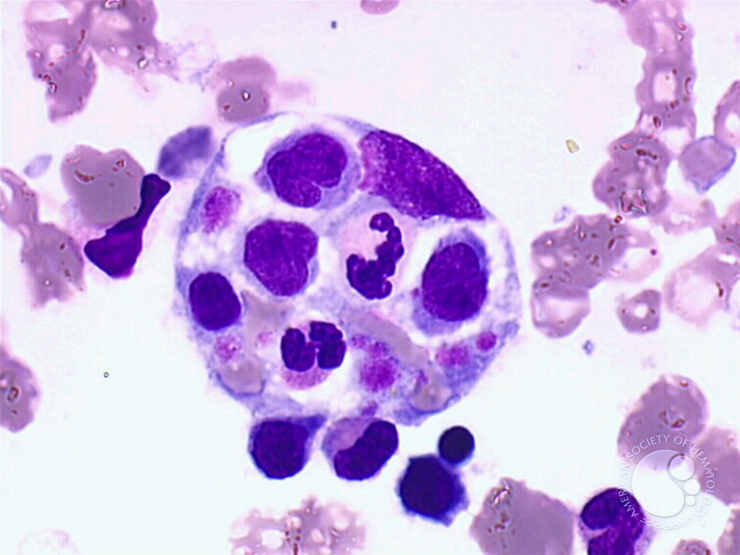
A hungry macrophage in the bone marrow
Macrophage nucleus
Neutrophil!
Eosinophil!
Platelets!

Slide 32
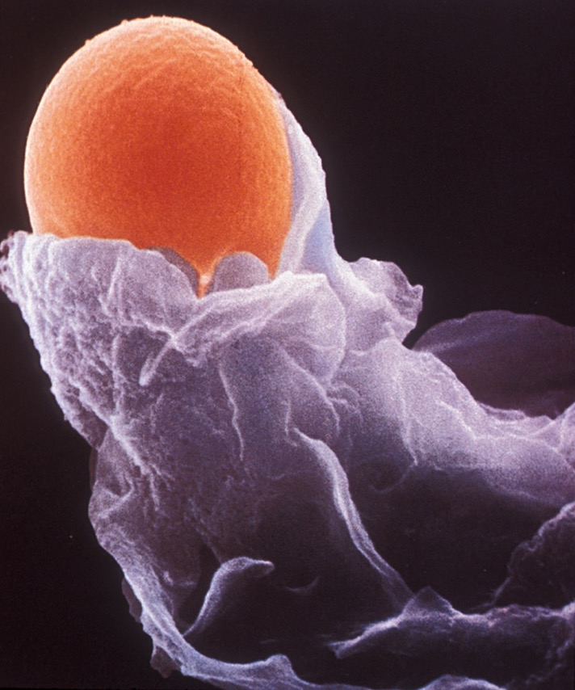

Slide 34
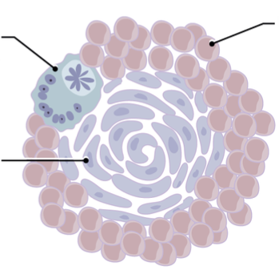
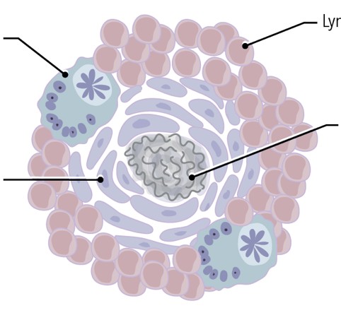
Granulomas
Lymphocytes
Multinucleated giant cells
Lymphocytes
Necrosis
Macrophages
Regular granuloma
Caseating granuloma

Slide 35
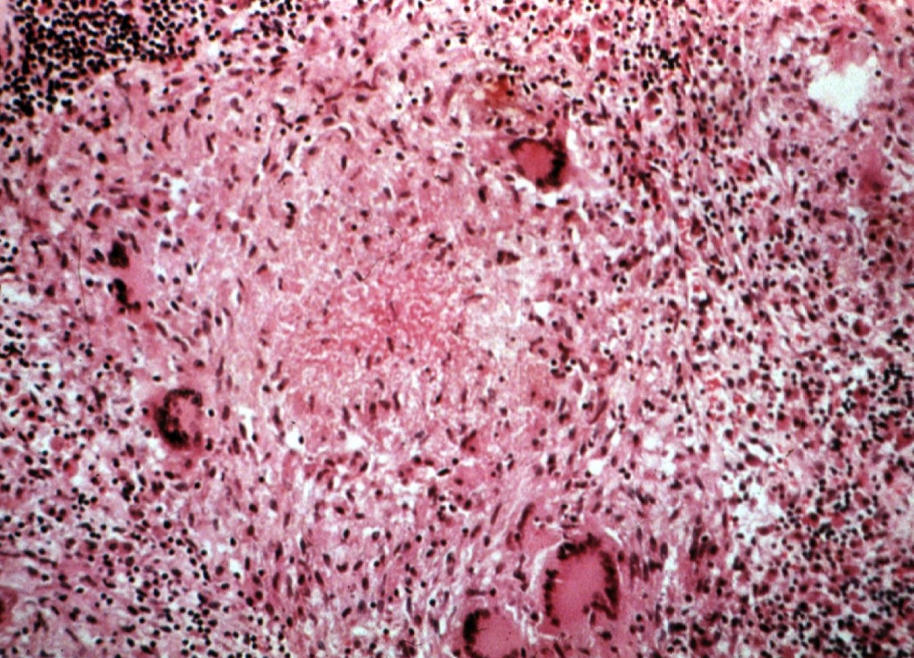
Caseating granuloma

Slide 36
Lymphocyte
Lymphocyte
Finally, lymphocytes get rid of any remaining foreign invaders.

Slide 37
What happens in chronic inflammation?
Macrophages eat things.
Lymphocytes fight any remaining foreign invaders.
Both cells can trigger the immune system (often in unhelpful ways).
Which brings us to...

Slide 38
Inflammation Outline
What is inflammation?
Acute inflammation
Chronic inflammation
When is inflammation bad?

Slide 39
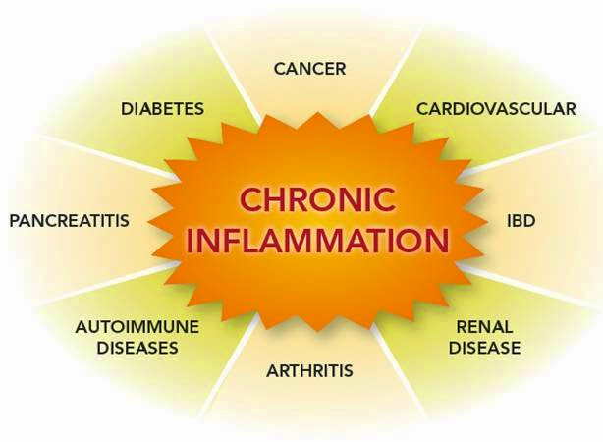
If chronic inflammation doesn’t go away, it can cause disease.

Slide 40
Atherosclerosis is a very common, very dangerous
disease that is caused by inflammation in arteries.

