Slide 1
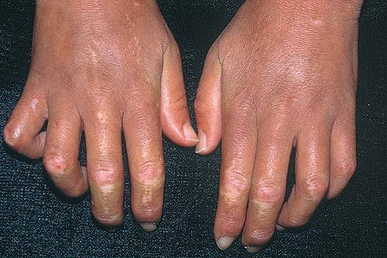
Autoimmune Diseases

Slide 2
Autoimmune Diseases Lecture Objectives
What causes Autoimmune Disease?
Define tolerance and self-tolerance, and explain why there aren’t tons of self-reactive lymphocytes floating around in the body.
Describe how genetic and environmental factors contribute to causing autoimmune diseases.
Lupus
Describe the most common clinical findings seen in lupus.
List the autoantibodies most commonly seen in lupus, and explain how they lead to tissue damage.
Explain how a FANA is done (and why).
Describe the typical clinical course and treatment of lupus.

Slide 3
Rheumatoid Arthritis (RA)
Describe the characteristic clinical and morphologic findings seen in the joints of patients with RA.
List the systemic findings that can be seen in RA.
Explain what rheumatoid factor is, and describe how it can be used in the diagnosis of RA.
Identify the main cause of the tissue damage seen in RA.
Describe the treatment and prognosis of RA.

Slide 4
Sjögren syndrome
Explain what we know about the cause of Sjögren syndrome, and identify the autoantibody seen in most patients.
Describe the clinical findings seen in Sjögren syndrome
Describe how patients with Sjögren syndrome are treated.
Scleroderma
Explain what we know about the cause of scleroderma,
and identify the autoantibody seen in most patients.
Describe the clinical findings seen in scleroderma.
Describe the difference between diffuse and limited scleroderma, and explain what CREST syndrome is.
Describe the overall prognosis for patients with scleroderma.

Slide 5
Immune Diseases Outline
  What causes autoimmune disease?
  Systemic lupus erythematosus
  Rheumatoid arthritis
  Sjögren syndrome
  Scleroderma

Slide 6
Immunologic Tolerance
Tolerance = unresponsiveness to an antigen
Self-tolerance = unresponsiveness to one’s own antigens
In generating billions of B and T cells, some will react against self antigens!
There are two ways of muzzling these cells: central tolerance and peripheral tolerance

Slide 7
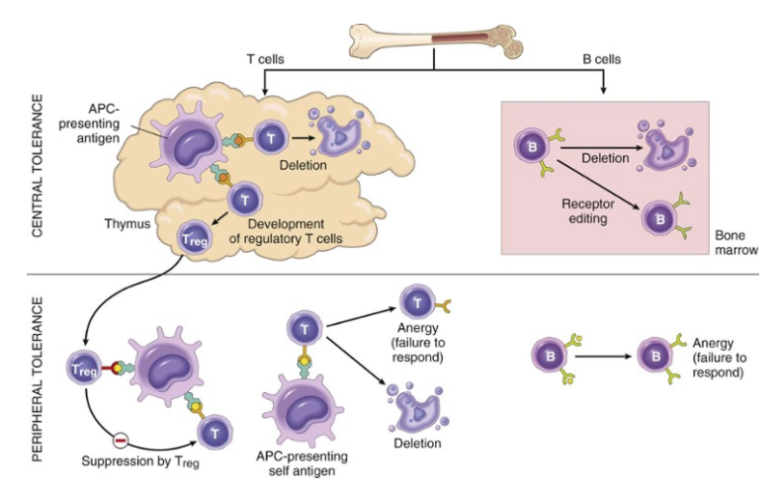

Slide 8
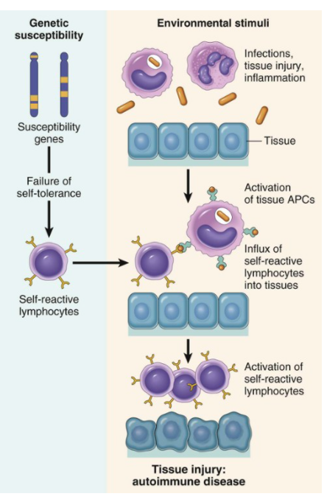
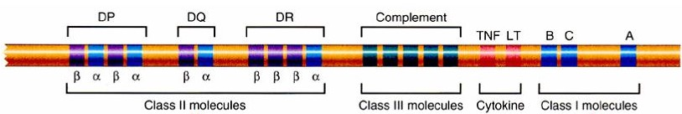
What causes autoimmune disease?
Genes
+
Environment
Example: HLA DR4 = increased risk
for rheumatoid arthritis

Slide 9
Systemic Lupus Erythematosus (SLE)
KNOW THIS
Typical patient: young woman with butterfly rash
Symptoms unpredictable (relapsing/remitting)
Multisystem (skin, kidneys, joints, heart)
Antinuclear antibodies

Slide 10
SLE Etiology
Underlying cause
  Genetic predisposition…
  …plus environmental triggers (UV radiation, drugs, others)
Autoantibodies do the damage
  Antinuclear antibodies (ANAs) are present in all patients with lupus
  Most specific ANA: anti-DS DNA
  Anti-RBC, -lymphocyte, -platelet, or –phospholipid antibodies may be present too
  Other autoantibodies react with other body tissues too

Slide 11
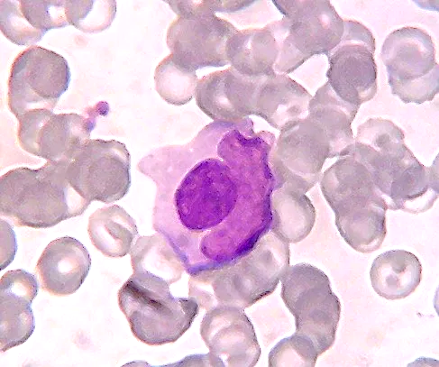
Lupus erythematosus (LE) cell in bone marrow
Macrophage (LE cell)
LE body
(denatured nucleus
from another cell)

Slide 12






Fluorescent antinuclear antibody (FANA) test
Fluorescent-tagged antibody (from test kit)
Patient serum (containing ANAs)
Cells with exposed nuclei (from test kit)
View under fluorescent light

Slide 13
Positive FANA test in SLE
(other AI diseases show different nuclear staining patterns - speckled, etc.)
Cell nuclei stain homogeneously with fluorescent ANAs

Slide 14
SLE Signs and Symptoms
Lupus can present in SO many different ways
that it’s often called “the great imitator.”
Unexplained fever
Fatigue
Butterfly rash
Renal failure
Seizures, psychosis
Arthritis
Endocarditis, pericarditis
Pleuritis
Non-specific oral lesions

Slide 15
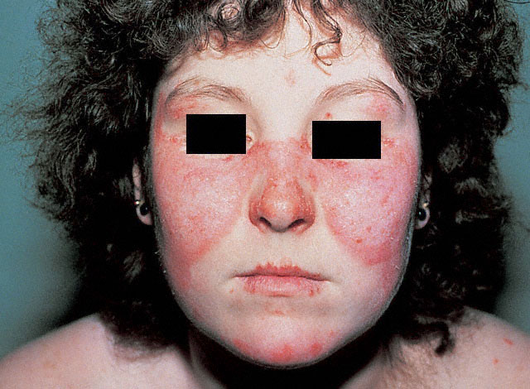

Butterfly rash

Slide 16
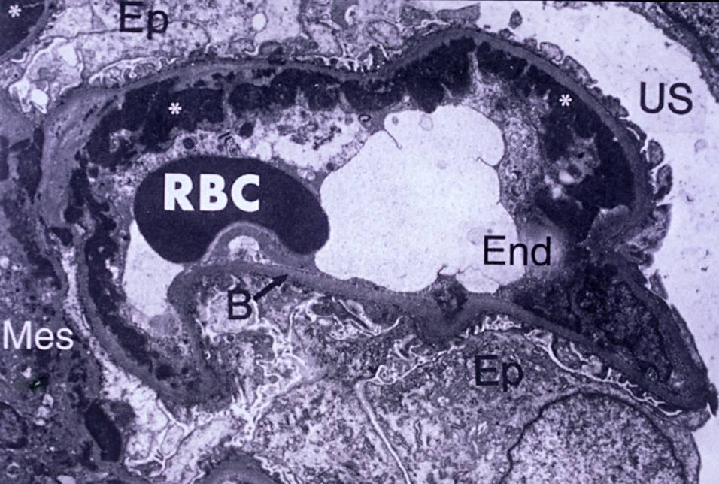
















subendothelial deposits
Renal EM in patient with lupus showing subendothelial deposits

Slide 17
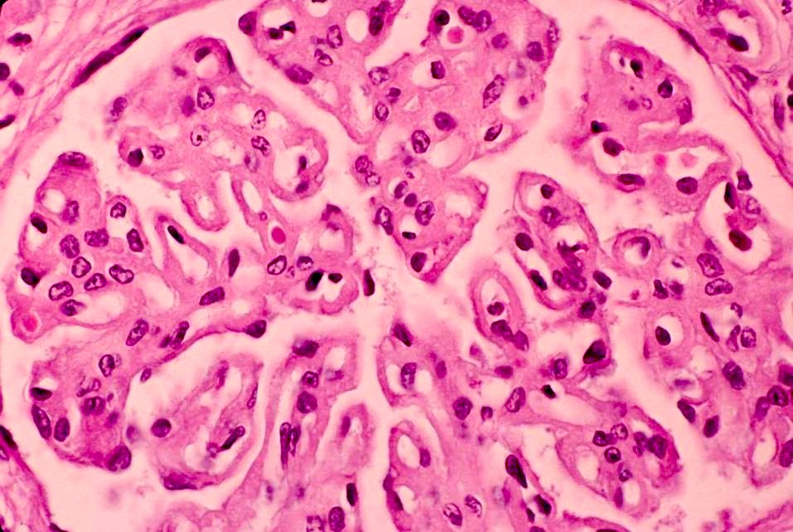

RBC
capillary
“wire loop”
Glomerulus: “wire loop” capillary appearance

Slide 18
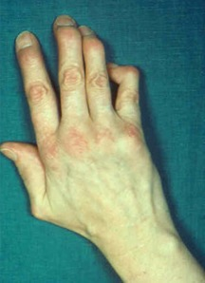
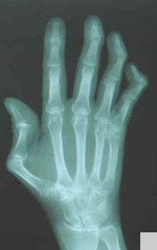
Arthritis: Hitch-hiker’s thumb

Slide 19
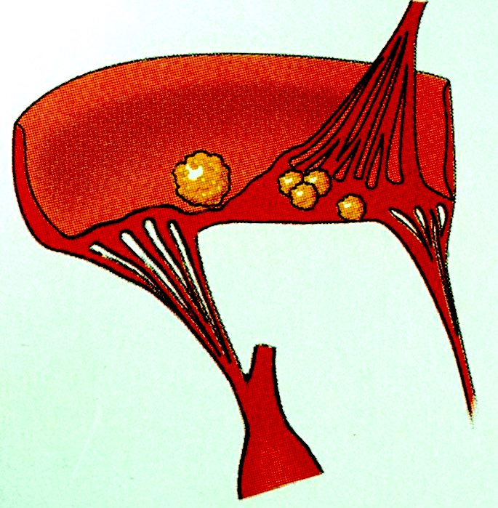
Endocarditis: Libman-Sacks lesions

Slide 20
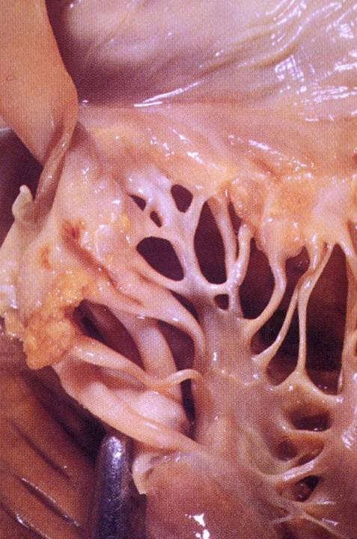

Atrium
Valve
Libman-Sacks lesions
Chordae tendinae
Ventricle
Libman-Sacks lesions

Slide 21
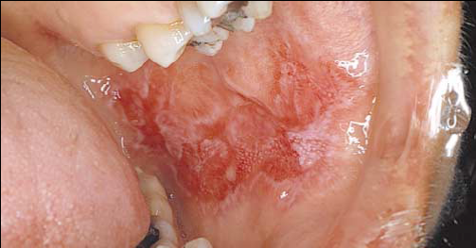
Non-specific buccal lesion

Slide 22
SLE: Things a Dentist Might See
Young woman with polyarthritis and a butterfly
(or other) skin rash
Fatigue
Sensitivity to sunlight
Headaches, seizures, or psychiatric problems
Pleuritic chest pain
Unexplained fever
Oral lesions (not super common though): nonspecific, red-white, erosive

Slide 23
SLE Prognosis
Variable! Some patients have just one or two episodes, rare patients die within months.
Some patients have a limited form involving just skin.
Most patients: relapses/remissions over many years.
Treatment: rituximab, steroids
80% 10-year survival
Most common cause of death: renal failure
Antibody-derived drug that kills B cells

Slide 24
Rheumatoid Arthritis
KNOW THIS
Symmetric arthritis starting in small joints
May have systemic manifestations
Rheumatoid factor helps in diagnosis
Cytokines (especially TNF) cause damage

Slide 25
RA Etiology
Genetic predisposition + environmental trigger
CD4+ T cells react against some joint antigen, and then:
  Stimulate inflammation
  Cause B cells to make antibodies (like rheumatoid factor, an IgM antibody directed against IgG that’s present in most patients) and cytokines.
The cytokine TNF (tumor necrosis factor) causes most of the damage in RA!
  Stimulates even more inflammation
  Tells synovial cells to make cartilage-damaging proteases

Slide 26
RA Signs and Symptoms
Arthritis
Rheumatoid nodules
Fever, fatigue
In severe cases, inflammation of other organs (heart, lungs, eyes…)

Slide 27
Characteristic Features of Arthritis in RA
Mainly small joints (hands), but also knees, elbows, shoulders
Symmetric; characteristic hand features
Chronic synovitis (inflammation of synovium, which lines the joint cavity)
  synovial cell proliferation
  chronic inflammation

Slide 28
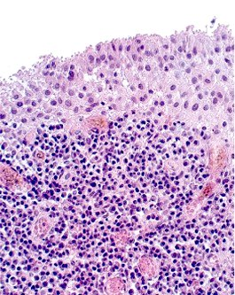

Proliferation of synovial cells
Synovium
Chronic inflammation
Rheumatoid arthritis: synovitis

Slide 29
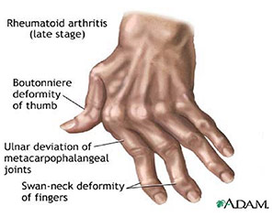
Rheumatoid arthritis joint deformities

Slide 30
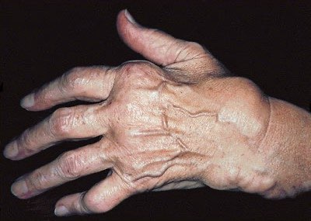






Ulnar deviation
of fingers
Boutonniere deformity
Swelling
Swan-neck deformity
Rheumatoid nodules
Rheumatoid arthritis joint deformities

Slide 31
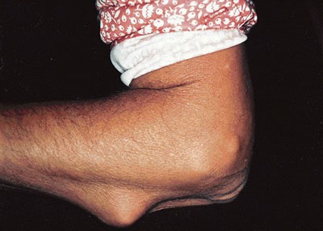


Rheumatoid nodules

Slide 32
RA: Things a Dentist Might See
Female patient with joint pain, swelling
Fingers: ulnar deviation, swan-neck deformities, boutonniere deformity
Rheumatoid nodules

Slide 33
RA: Prognosis
Most patients have chronic disease course with progressive joint destruction and disability
Lifespan shortened by 10-15 years
Treatment: steroids, anti-TNF agents

Slide 34
Sjögren Syndrome
KNOW THIS
Inflammatory disease of salivary and lacrimal glands
Dry eyes, dry mouth
T cells destroy glands
Increased risk of lymphoma

Slide 35
Sjögren Etiology
Genetic predisposition + environmental trigger
CD4+ T cells react against cells in salivary, lacrimal glands
Autoantibodies
  ANAs
  RF
  Anti-SS-A, anti-SS-B antibodies present in 90% of patients!

Slide 36
Sjögren Signs and Symptoms
Salivary and lacrimal glands
  enlarged, inflamed
  dry eyes, dry mouth
  40x increased risk of lymphoma!
Systemic disease
  fatigue
  arthralgia/myalgia
  Raynaud phenomenon
  vasculitis
  peripheral neuropathy

Slide 37

Sjögren: Things a Dentist Might See
Female between 35-45
Enlarged salivary glands
Raynaud phenomenon
Keratoconjunctivitis sicca (dry eyes)
Oral changes:
  xerostomia (dry mouth)
  mucosal atrophy
  candidiasis
  mucosal ulceration
  caries
  taste dysfunction

Slide 38
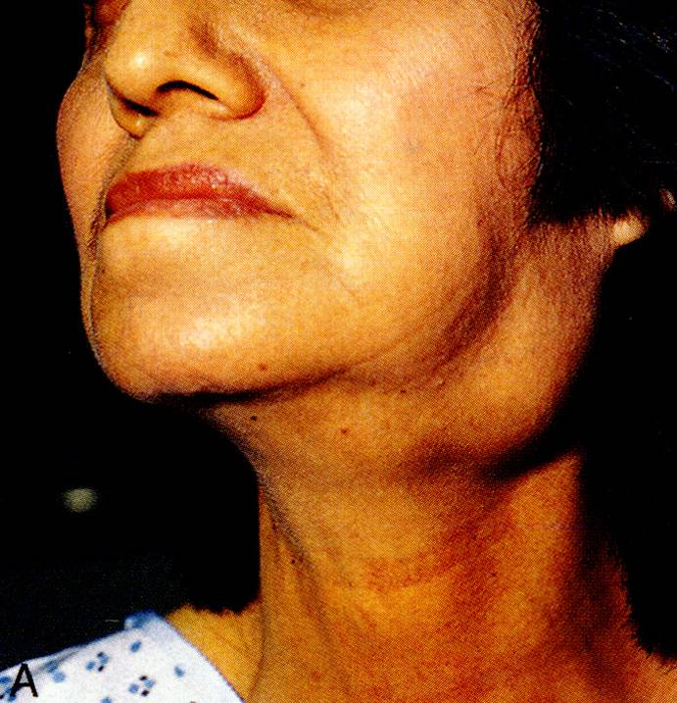
Sjögren syndrome: salivary gland enlargement

Slide 39
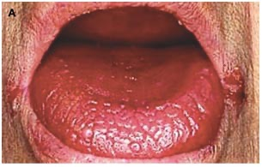
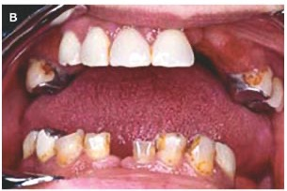
Oral changes in Sjögren Syndrome
atrophic papillae, deeply fissured epithelium
missing teeth and multiple caries
angular cheilitis
Notes:
s.

Slide 40
Sjögren Treatment
Treatment is mostly supportive and symptom-based
Oral treatment: adequate hydration, scrupulous dental hygiene, cholinergic agents (stimulate saliva release), frequent dental exams
Eye treatment: lubricating solutions, surgical procedures
Systemic symptom treatment: steroids, other immunosuppressive drugs

Slide 41
Scleroderma (Systemic Sclerosis)
KNOW THIS
Excessive fibrosis in skin and viscera
Claw hands
Mask-like face
Diffuse and limited types

Slide 42
Scleroderma Etiology
CD4+ T cells accumulate, and activate macrophages
Macrophages release cytokines that stimulate collagen production (“fibrosis”)
B cell activation also occurs but doesn’t play major role
Autoantibody: anti-Scl 70

Slide 43
Scleroderma Signs and Symptoms
(Sclerosis = fibrosis)
Skin: diffuse, sclerotic atrophy. Fingers first.
GI: “rubber-hose” esophagus
Lungs: fibrosis, pulmonary hypertension
Kidneys: narrowed vessels, hypertension
Heart: myocardial fibrosis

Slide 44
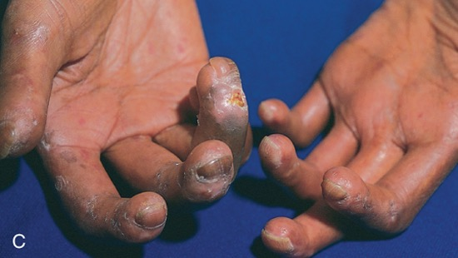

Scleroderma: claw hands

Slide 45
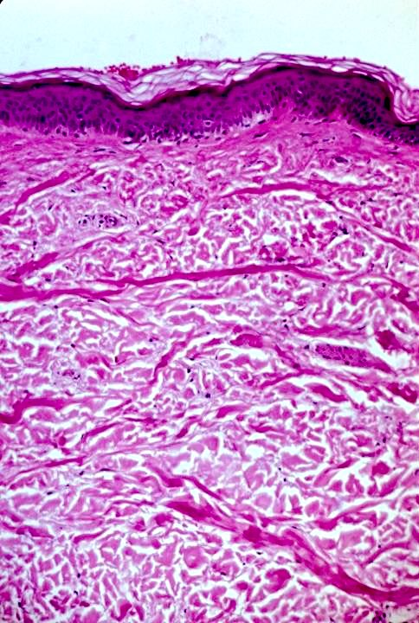
Epidermis
Massive fibrosis (lots of collagen bundles)
Dermis
Scleroderma: sclerotic skin

Slide 46
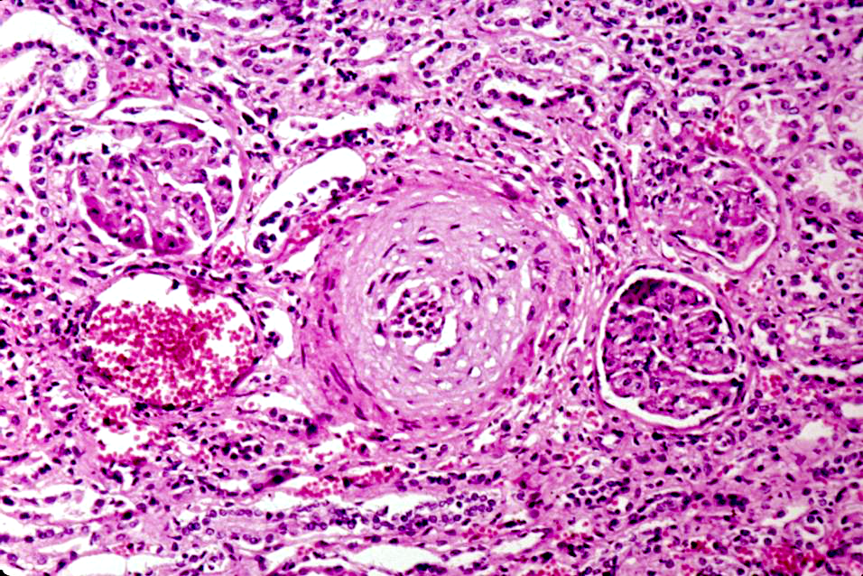





Glomerulus
Arteriole
Glomerulus
Scleroderma: narrowed renal vessel

Slide 47
Limited vs. Diffuse Scleroderma
Limited Scleroderma
Diffuse Scleroderma
Mild skin involvement
Late visceral involvement
Benign course
Widespread skin involvement
Early visceral involvement
Rapid course

Slide 48
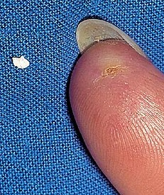
CREST Syndrome (considered “limited”
Calcinosis
Raynaud phenomenon
Esophageal dysmotility
Sclerodactyly
Telangiectasia

Slide 49
Scleroderma: Things a Dentist Might See
Female between 50-60
Raynaud phenomenon
Stiff, claw-like fingers
Mask-like face
Difficulty swallowing
Dyspnea, chronic cough
Difficulty getting dentures in

Slide 50
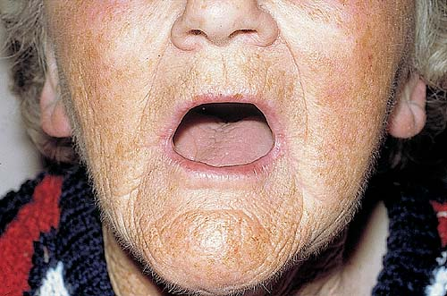
Scleroderma: restricted mouth opening

Slide 51
Scleroderma Prognosis
Steady, slow, downhill course over years
Limited scleroderma may exist for decades without progressing
Diffuse scleroderma is more common and has worse prognosis
Overall 10-year survival = 35-70%

