Slide 1
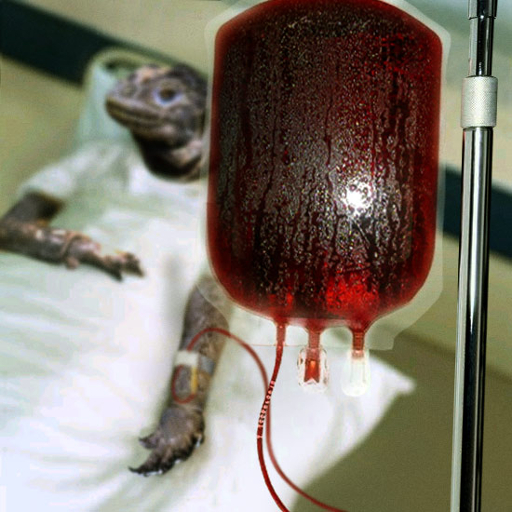
Transfusion Medicine
Kristine Krafts, M.D.

Slide 2
Transfusion Medicine Objectives
  Describe what “blood group” means
  Describe the antigens, antibodies and genes involved in the ABO blood group system, and explain the weird way the genes are expressed (hint: codominance)
  Explain how blood group antibodies work.
  Describe the antigens, antibodies, and genes involved in the Rh blood group system. How are the antibodies in this system different from the antibodies in the ABO system?
  Know what kind of blood you could transfuse into any patient (eg., what kind of blood could you transfuse into an AB+ patient?)

Slide 3
Transfusion Medicine Objectives
  List the types of transfusion reactions that can occur during or after blood transfusion, and know relatively how common they are (don’t memorize numbers!)
  Compare and contrast acute and delayed hemolytic transfusion reactions (clinical presentation, usual blood group antigen responsible, where does hemolysis happen, which is more dangerous?)
  List the infectious agents that can be transmitted through blood transfusion, and know in general how common they are (don’t memorize numbers!)

Slide 4
Transfusion Medicine Outline
  Blood groups
  Introduction
  ABO system
  Rh system
  Blood transfusion
  Blood products
  Testing
  Dangers

Slide 5
Transfusion Medicine Outline
  Blood groups
  Introduction

Slide 6
  AXScdvfbg
  “”:trewqa12w34560-=What Determines a Blood Group?
  Q. What determines a blood group?

Slide 7
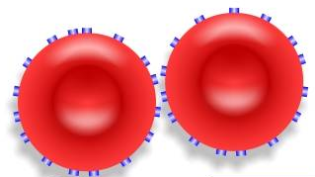
  AXScdvfbg
  “”:trewqa12w34560-=What Determines a Blood Group?
  Q. What determines a blood group?
  A. The antigens on the surface of the red blood cells!

Slide 8
What are red cell antigens?
Antigens are inherited (Mendelian pattern)
Real function unknown
Damn important during transfusion
Lots of antigens exist, grouped into systems)
Most important systems: ABO and Rh

Slide 9
Transfusion Medicine Outline
  Blood groups
  Introduction
  ABO system

Slide 10
What are the antigens in the ABO system?
A and B
Some people have A antigen (“type A”)
Some people have B antigen (“type B”)
Some people have both A and B (“type AB”)
Some people have neither A nor B (“type O”)

Slide 11
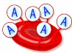
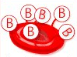
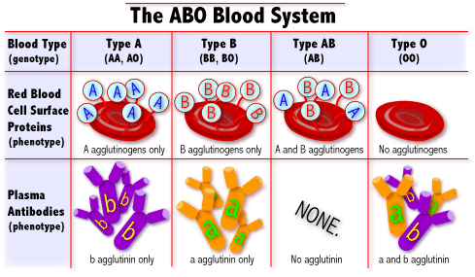
Type A
Type B
Type AB
Type O

Slide 12
What are the antigens in the ABO system?
A and B
Some people have A antigen (“type A”)
Some people have B antigen (“type B”)
Some people have both A and B (“type AB”)
Some people have neither A nor B (“type O”)

Slide 13
How do you make the antigens?
Start with a protein precursor
Add fucose to make H antigen
Add N-acetylgalactosamine to H Ag to make A Ag
Add galactose to H Ag to make B Ag

Slide 14
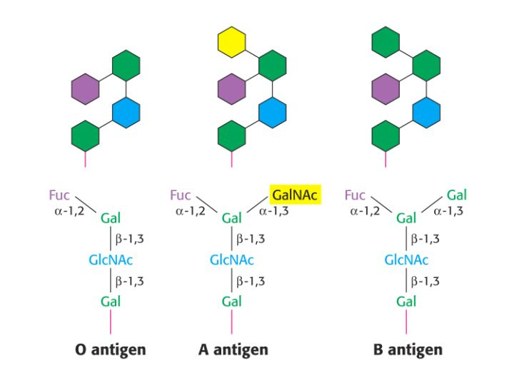
How do you make the antigens?
GalNAc
Precursor
H antigen
A antigen
B antigen
Don’t memorize these molecular structures!
Just know that you start with a precursor molecule, then make H antigen, then A and/or B antigen depending on your genotype.

Slide 15
What are the genes in the ABO system?
H gene
Everyone* has this gene
Encodes the enzyme that makes the H antigen
A gene
Encodes the enzyme that makes the A antigen
B gene
Encodes the enzyme that makes the B antigen
O gene
Encodes something clinically unimportant
*Almost! There are rare people who lack this gene.
Their red cells lack H, A, and B antigens, and are called “Bombay” phenotype

Slide 16
How does the gene inheritance work?
There are three genes (besides H): A, B, and O
Everyone inherits 2 genes, one from each parent
So there are 6 possible genotypes:
AA, AO, AB, BB, BO, and OO

Slide 17
Genotype | Antigens | Blood type
AA | A | A
AO
BB | B | B
BO
AB | A and B | AB
OO | None | O
The genes show codominance!
Neither gene is dominant or recessive - you express both.
(Remember: the O gene doesn’t make an antigen)

Slide 18
So what?
None of this would really matter much…except that we automatically have antibodies against the antigens we don’t have!
Anti-A antibodies lyse type A red cells.
Anti-B antibodies lyse type B red cells.
This is very important during blood transfusion.

Slide 19




Red cells
Serum antibodies
Type A blood
Type B blood
Type AB blood
Type O blood

Slide 20
Genotype | Antigens | Blood type | Antibodies
AA | A | A | anti-B
AO
BB | B | B | anti-A
BO
AB | A and B | AB | none
OO | None | O | anti-A anti-B

Slide 21
Compatible blood types
Recipient blood type | Donor blood type
A | A or O*
B | B or O
AB | AB, A, B, or O
O | O
*Type O is the universal dOnor
The most important thing is to avoid giving donor red cells
that will react against the recipient’s antibodies!

Slide 22
Transfusion Medicine Outline
  Blood groups
  Introduction
  ABO system
  Rh system

Slide 23
What are the antigens in the Rh system?
Most important antigen: D!
The D antigen is sometimes called “Rh factor”.
“Rh” because discovered using Rhesus monkeys.
Two genes: D and d.
The D gene makes D antigen (these cells are called Rh+.)
The d gene doesn’t make anything important (these cells are called Rh-)

Slide 24
Genotype | Antigens | Blood type
DD | D | Rh +
Dd | D | Rh +
dd | none | Rh -

Slide 25
What about anti-D (anti-Rh) antibodies?
Antibodies in this system are acquired!
To make anti-D you must:
    1. lack the D antigen on your red cells
    2. get exposed to D + blood
Donor and recipient are tested for the D antigen.

Slide 26
Transfusion Medicine Outline
  Blood groups
  Introduction
  ABO system
  Rh system
  Blood transfusion
  Blood products

Slide 27
What do you mean, products?
In olden times, there was only whole blood.
Now, we separate blood into its components
Better for the patient (less exposure to stuff you don’t need - so you don’t make unnecessary antibodies)
Conserves blood supply

Slide 28
What are the products?
Whole blood
Red cells
Platelets
Granulocytes (basically, just neutrophils)
Fresh frozen plasma (acellular)
Cryoprecipitate (mostly just coagulation proteins)

Slide 29
Transfusion Medicine Outline
  Blood groups
  Introduction
  ABO system
  Rh system
  Blood transfusion
  Blood products
  Testing

Slide 30
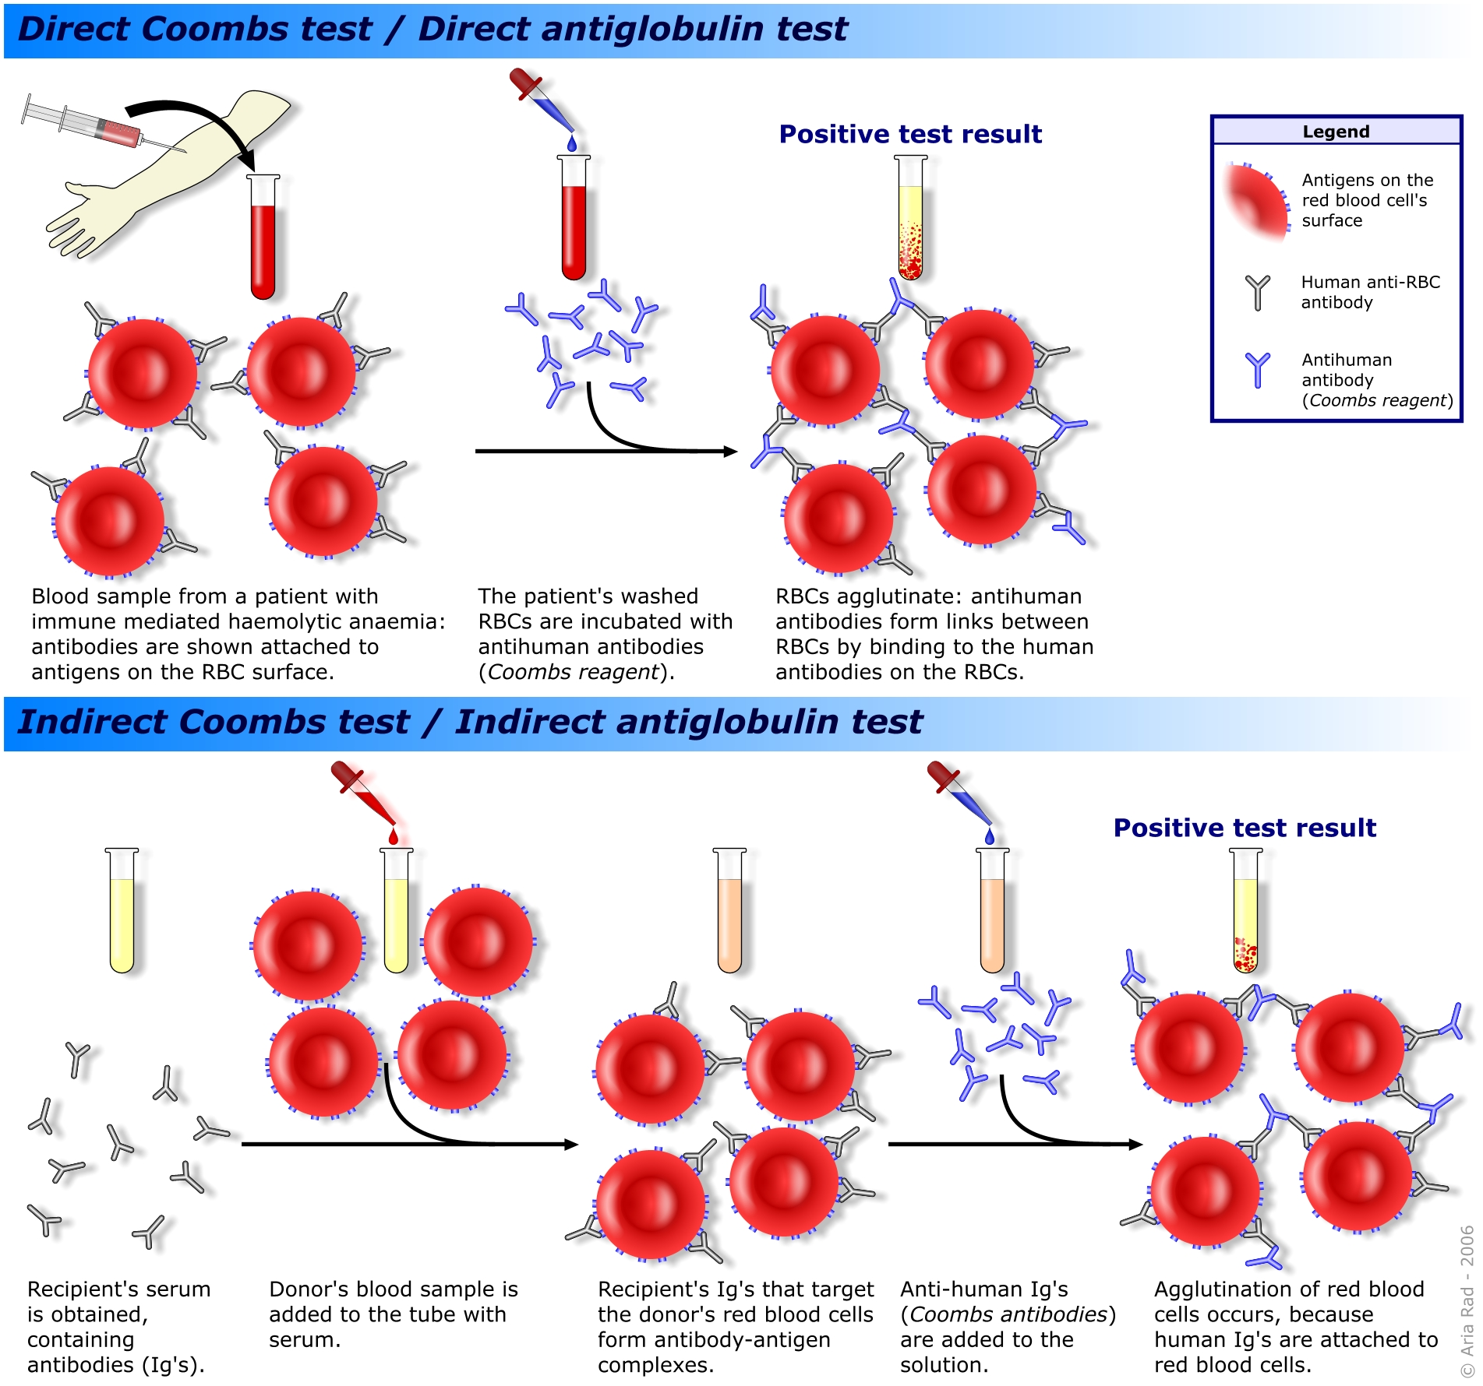
Forward Typing
This is done to find out what antigens are present on the patient’s red cells
anti-A antibodies
AHG
patient
red cells
(type A)
Positive test result: clumping of patient red cells!
Forward typing is done twice - once using anti-A antibodies,
and then again using anti-B antibodies!

Slide 31
Reverse Typing
This is done to find out what antibodies the patient has in his/her serum!
Add type B
red cells
AHG
patient serum
(with anti-B Ab)
Positive test result: clumping of type B red cells!
Reverse typing is done twice - once using type A red cells,
and then again using type B red cells!

Slide 32
Crossmatch
This is like a little mini-transfusion, done in the lab.
Add donor
red cells
AHG
AHG
patient serum
Oh no!!
Clumping!
If you do a crossmatch, and it results in clumping of donor red cells,
you CAN’T give the patient those donor red cells!

Slide 33
Transfusion Medicine Outline
  Blood groups
  Introduction
  ABO system
  Rh system
  Blood transfusion
  Blood products
  Testing
  Dangers

Slide 34
What can go wrong?
Hemolytic transfusion reactions
  Acute
  Delayed
Non-hemolytic transfusion reactions
  Febrile
  Allergic
Infections

Slide 35
Acute hemolytic transfusion reactions
Happen when patient has ABO antibodies against the donor red cells.
Most common reason: clerical error!
Symptoms: fever, chest pain, hypotension.
Hemoglobin in serum, urine.
Labs: ↓ haptoglobin, ↑ bilirubin, DAT positive.

Slide 36
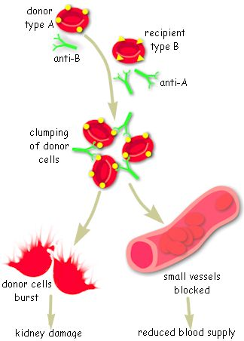
Acute hemolytic transfusion reaction

Slide 37
Delayed hemolytic transfusion reactions
Hemolysis occurs days after transfusion.
Caused by antibodies to non-ABO antigens.
Hemolysis usually happens in the spleen.
Presentation: falling Hgb after transfusion.
Usually not severe.

Slide 38
Non-hemolytic transfusion reactions
Febrile (caused by recipient antibodies against donor WBC).
Allergic (probably a reaction to donor plasma proteins).

Slide 39
What’s the risk of transfusion reactions?
Complication | Risk
Allergic reaction | One in 100 (severe: one in 20,000)
Febrile reaction | One in 300,000
Delayed hemolytic transfusion reaction | One in 4,000 (fatal: one in 4 million)
Acute hemolytic transfusion reaction | One in 20,000 (fatal: one in 600,000)
Don’t memorize exact numbers! Just know relative risk.

Slide 40
Infections
Donor tests: HIV, HTLV, Hepatitis B and C, syphilis.
Despite testing, these diseases can still transmitted.
Other transmissible infections:
  bacteria (dangerous!)
  viruses (EBV, CMV)
  parasitic diseases (malaria, Lyme disease))

Slide 41
What’s the risk of infection?
Bug | Risk
Bacterial infection | One in 50,000 - 500,000 *
Hepatitis B | One in 300,000
Hepatitis C | One in 2 million
HIV | One in 2 million
Don’t memorize exact numbers! Just know relative risk.
* 1 in 50,000 platelet transfusions; 1 in 500,000 RBC transfusions

