Slide 1

Neoplasia II: Tumor Characteristics

Slide 2
Tumor Characteristics Lecture Objectives
Define tumor differentiation, and explain the difference between well-differentiated, moderately-differentiated, and poorly-differentiated tumor cells.
Define anaplasia, and describe what anaplastic cells typically look like.
Define dysplasia, describe what dysplastic cells look like, and explain why it matters whether cells are mildly, moderately, or severely dysplastic.
Explain what “growth fraction” means, and list some factors that affect a tumor’s growth fraction.
Describe the three ways tumors metastasize.
Compare and contrast grading and staging (just know what they are...don’t memorize tiny details!)

Slide 3
Tumor Characteristics Lecture Outline
Differentiation, dysplasia, and anaplasia
Rate of growth
Metastasis
Grading and staging

Slide 4
Tumor Characteristics Lecture Outline
Differentiation, dysplasia, and anaplasia

Slide 5
Differentiation
Differentiation = the degree to which tumor cells
resemble their cell of origin
Well-differentiated: closely resemble
Moderately-differentiated: sort of resemble
Poorly-differentiated: barely resemble
Benign tumors are usually well-differentiated
Malignant tumors can show any level of differentiation

Slide 6
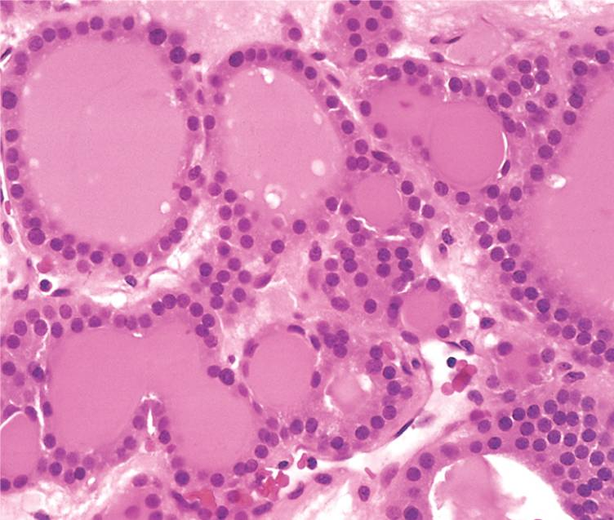
Thyroid adenoma, well-differentiated

Slide 7
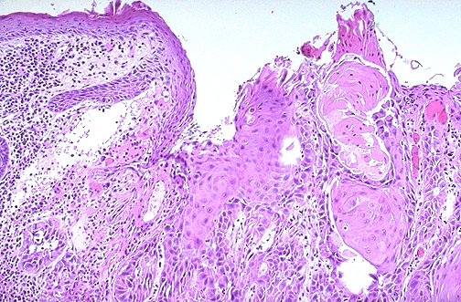


Squamous cell carcinoma, well-differentiated

Slide 8
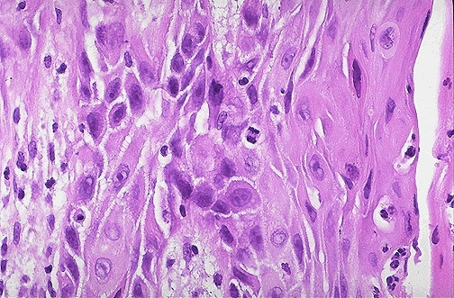
Intercellular bridges
Squamous cell carcinoma, poorly-differentiated

Slide 9
Anaplasia
Anaplasia = a state of complete un-differentiation
Literally, “to grow (-plasia) backwards (ana-)”
Means tumor cells do not resemble their cell of origin at all
Almost always indicates malignancy

Slide 10
Characteristics of Anaplastic Cells
Pleomorphism
Hyperchromatic, large nuclei
Bizarre nuclear shapes, distinct nucleoli
Lots of mitoses, and atypical mitoses
Architectural anarchy

Slide 11
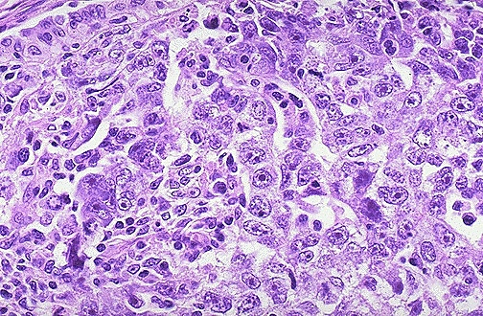

Anaplastic carcinoma

Slide 12
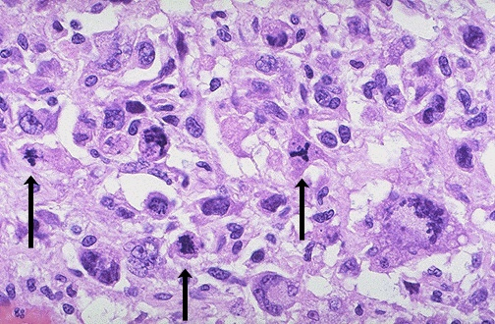


Lots of mitoses
Abnormal mitoses

Slide 13
Dysplasia
Dysplasia = disorderly (dys-) growth (-plasia)
Used to describe changes in non-neoplastic epithelial cells
Graded as mild, moderate, or severe
Next step after severe dysplasia is carcinoma in situ
...and the next step after that is invasive carcinoma

Slide 14
Dysplastic cells show:
Pleomorphism
Hyperchromatic, large nuclei
Lots of mitoses
Architectural anarchy

Slide 15
Q. Wait a minute, “dysplasia” sounds suspiciously
similar to “differentiation” – what’s the difference?
A. Both terms describe whether cells look normal or not!
BUT:
Dysplasia is used to describe non-neoplastic cells, and differentiation is used to describe neoplastic cells.
Dysplasia is used to describe epithelial cells, and differentiation can be used to describe any cell type.

Slide 16
Dysplasia
Non-neoplastic epithelial cells
carcinoma in situ
mild dysplasia
moderate dysplasia
severe dysplasia
Differentiation
Neoplastic cells
well-differentiated
moderately-differentiated
poorly-differentiated
anaplastic

Slide 17
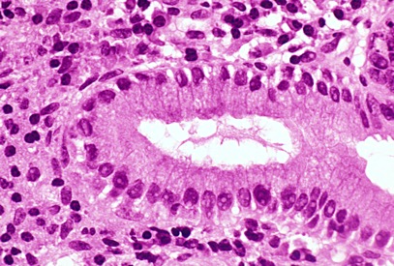
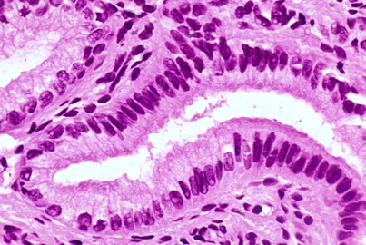
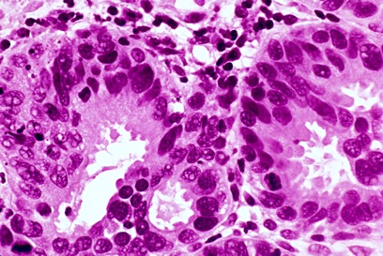
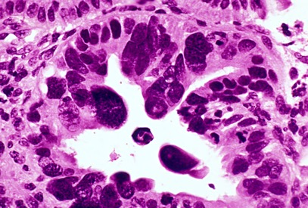



Normal glandular epithelium
Architectural anarchy
Pleomorphism
Crowding
Mild dysplasia
Moderate dysplasia
Severe dysplasia
Hyperchromatic nuclei

Slide 18
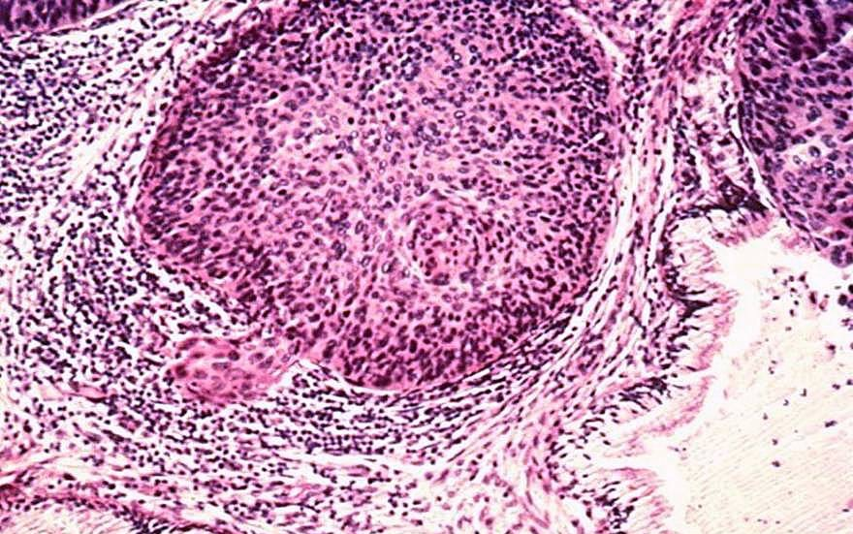




Invasive carcinoma

Slide 19
Tumor Characteristics Lecture Outline
Differentiation, dysplasia, and anaplasia
Rate of growth

Slide 20
Generalizations about Tumor Growth
Malignant tumors grow faster than benign ones.
Poorly-differentiated tumors grow faster than
well-differentiated ones.
Growth is dependent on:
  Blood supply
  Hormonal factors
  Emergence of aggressive sub-clones

Slide 21
Growth Fraction
Growth fraction (GF) = % of tumor cells that are dividing
Age of tumor matters
  Early on (subclinical), GF high.
  Later (clinically detectable), GF low.
Type of tumor matters
  Leukemias, lymphomas, small-cell lung cancer: high GF
  Breast, colon cancer: low GF
Important for treatment
  High GF tumor: treat with chemotherapy/radiation
  Low GF tumor: treat by debulking

Slide 22
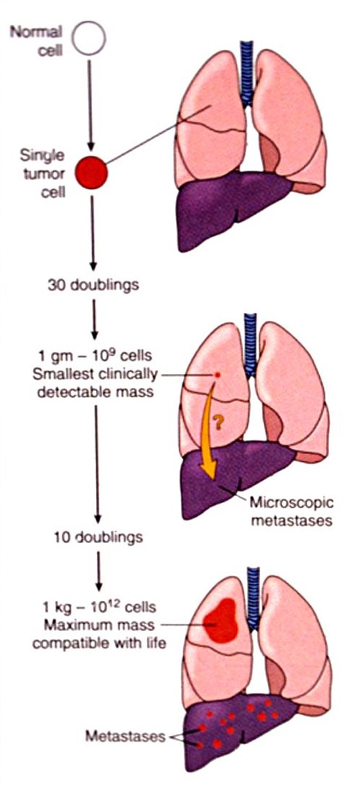




Slide 23
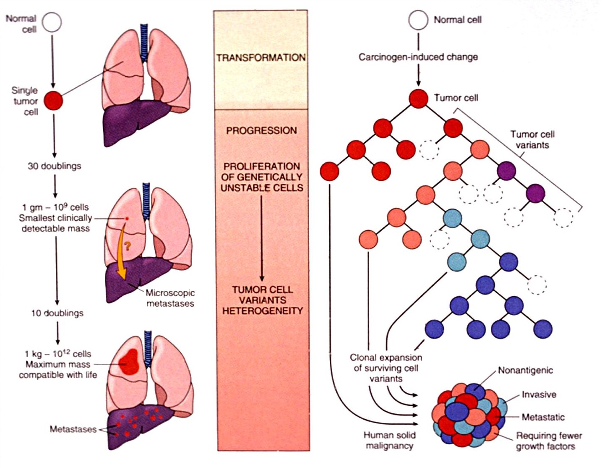



Slide 24
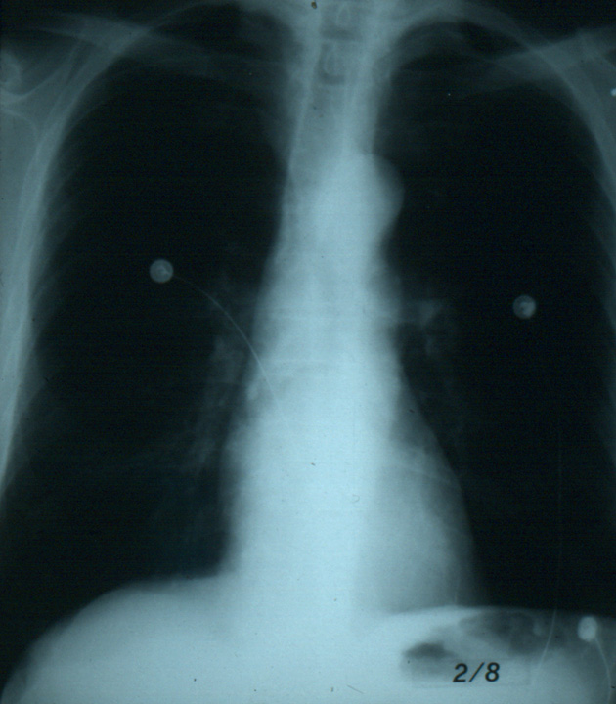

Slide 25
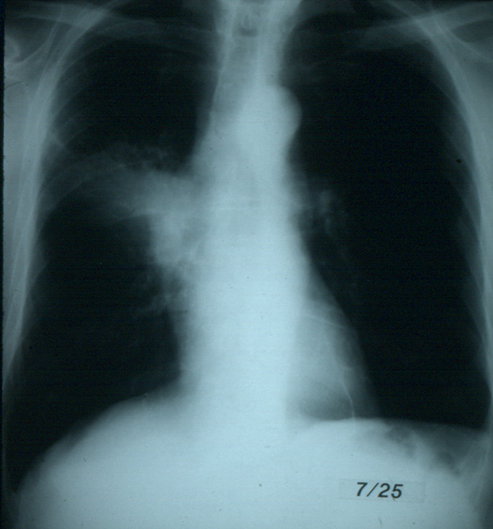


Slide 26
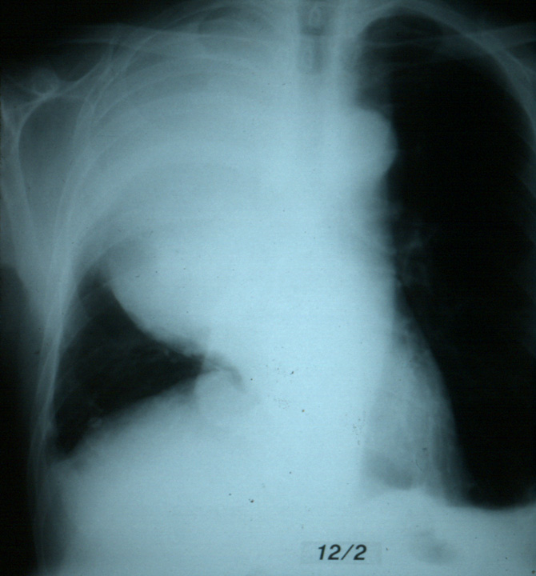


Slide 27
Tumor Characteristics Lecture Outline
Differentiation, dysplasia, and anaplasia
Rate of growth
Metastasis

Slide 28
Metastasis
Metastasis = development of secondary tumor implants
in distant tissues
Half of all patients with malignancies have mets at the time of diagnosis!!
The speed and location of metastasis is related to:
  Type of tumor
  Size of tumor
  Degree of differentiation of tumor

Slide 29
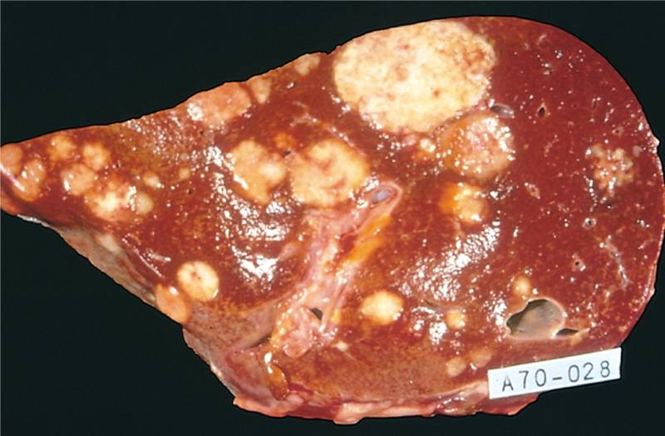
Liver with multiple metastases

Slide 30
Three Ways Tumors Metastasize
Seeding
Lymphatic spread
Hematogenous spread

Slide 31
Three Ways Tumors Metastasize
Seeding
  Tumor floats through a body cavity
  Bits break off and implant on peritoneal surfaces
  Ovarian cancer can spread easily this way

Slide 32
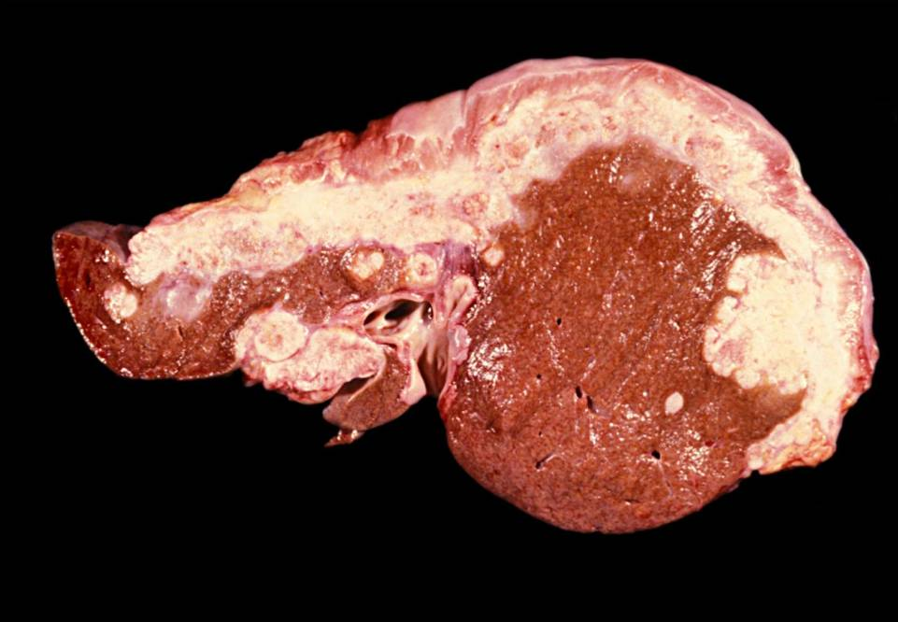

Liver seeded with metastatic ovarian carcinoma

Slide 33
Three Ways Tumors Metastasize
Seeding
Lymphatic spread
  Tumor spreads through lymphatics
  Sentinel lymph node first
  Carcinomas prefer to spread this way

Slide 34
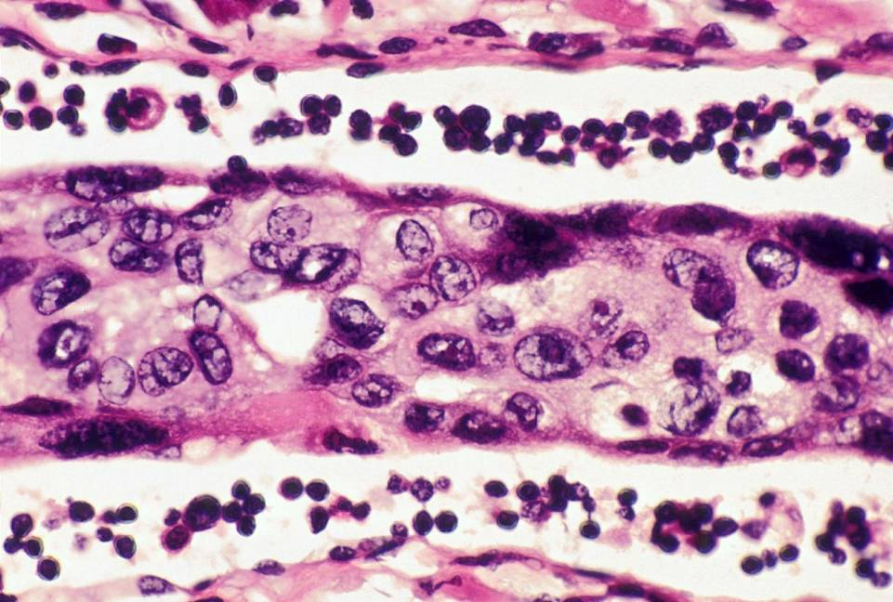



Tumor in lymphatic

Slide 35
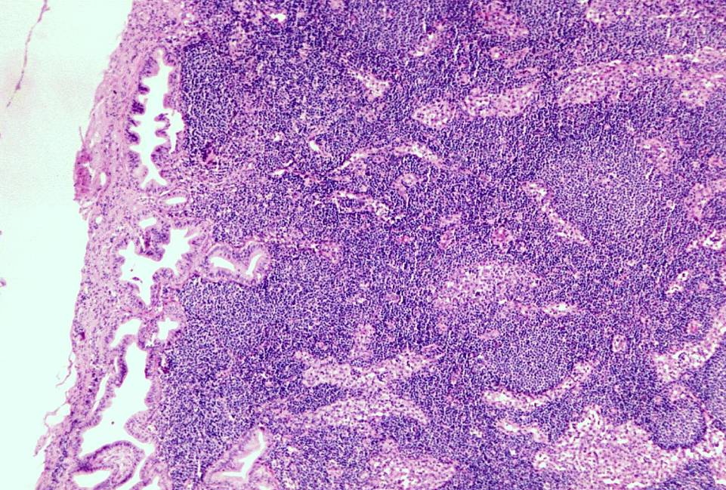










Tumor in lymph node

Slide 36
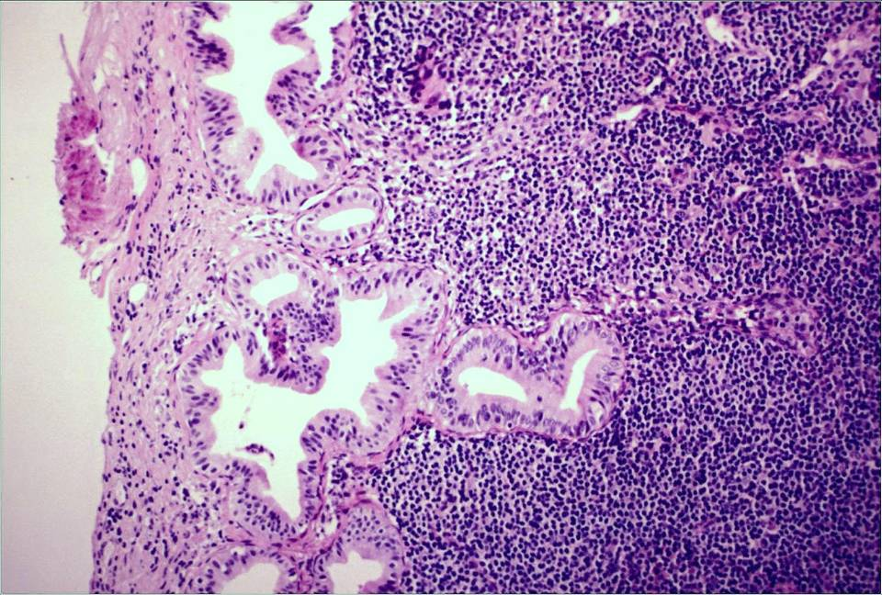




Tumor in lymph node

Slide 37
Three Ways Tumors Metastasize
Seeding
Lymphatic spread
Hematogenous spread
  Tumor spreads through blood vessels
  Liver and lungs are the most common destinations
  Sarcomas prefer to spread this way

Slide 38
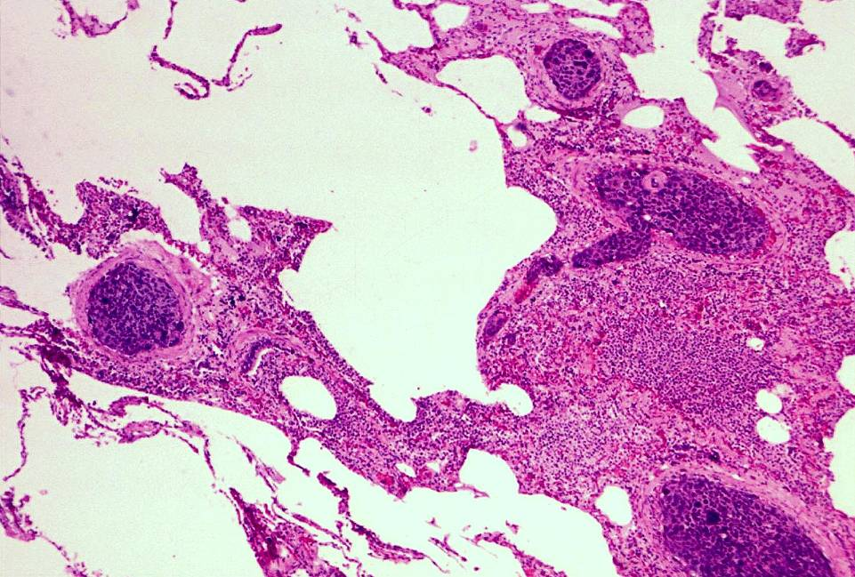






Sarcoma metastatic to lung

Slide 39
Neoplasia Outline
Differentiation, dysplasia, and anaplasia
Rate of growth
Metastasis
Grading and staging

Slide 40
Grading and Staging
Used for malignant tumors
Useful for determining treatment and prognosis
Grading
  Tells you how nasty the tumor looks
  Use microscope
  Can be useful in some tumors
Staging
  Tells you how far the tumor has spread
  Use imaging
  Very useful in most tumors

Slide 41

Grading system for breast cancer*
Tubules
lots of tubules
some tubules
rare tubules
Pleomorphism
small, uniform cells
larger, less uniform cells
markedly pleomorphic cells
Mitoses
0-9 mitoses/10 hpf
10-19 mitoses/10 hpf
≥20 mitoses/10 hpf
1
2
3
1
2
3
1
2
3
add all points together
Score
Grade
5y survival
3-5
Low grade
>95%
6-7
Intermediate grade
80%
8-9
High grade
60%
*Don’t memorize this slide!! It’s just here to give you an example of how the system works.

Slide 42
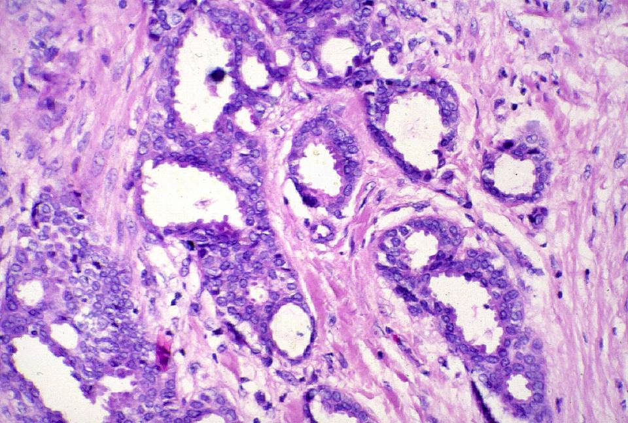



tubules
Breast carcinoma low grade
Notes:
The invasive ductal carcinoma forms many tubules (Grade 1). Nuclei show moderate variation in size or shape (Grade 2). Few mitoses are seen (Grade 1). This is a well differentiated breast cancer. Photographed at 63x magnification

Slide 43
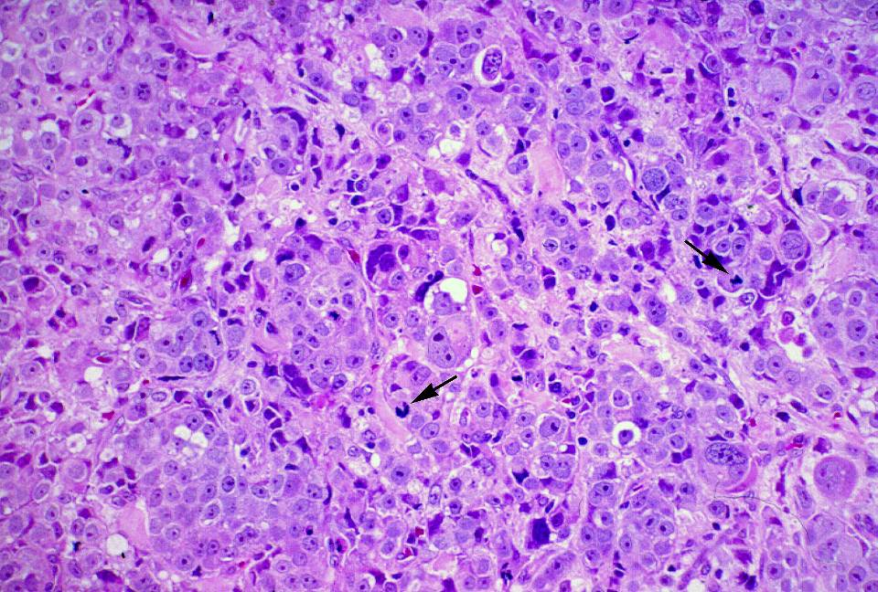
mitoses
pleomorphism
Breast carcinoma high grade
Notes:
This invasive ductal carcinoma forms no tubules (Grade 3). Nuclei are displaying marked variation in size and shape (Grade 3). Arrows point to mitoses that are seen at a rate of 10-19/ten high power fields (Grade 2). This is a poorly differentiated breast cancer.

Slide 44
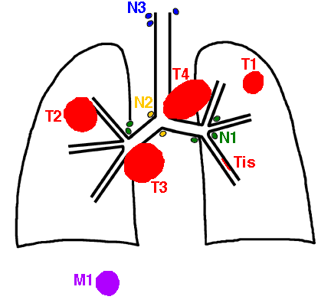
TNM staging system for non-small cell lung cancer
T = Tumor size
Tis – in situ tumor
T1 – small tumor
T2 – larger tumor
T3 – larger or invasive tumor
T4 – very large/very invasive
N = Nodes
N0 – no lymph node involvement
N1 – a few regional nodes
N2 – lots of regional nodes
N3 – distant nodes
M =Metastases
M0 – no metastases
M1 – metastases

Slide 45
TNM staging system for non-small cell lung cancer*
Stage
T
N
M
Treatment
5y survival
Stage 0
Stage I
Stage II
Stage III
Stage IV
Tis
T1 or T2
T1
T2
T3
T1 or T2
T3
Any T
T4
Any T
N0
N0
N1
N1
N0
N2
N1 or N2
N3
Any N
Any N
M0
M0
M0
M0
M0
M0
M0
M0
M0
M1
Surgery only
Surgery ± radiation
Surgery and radiation
± chemotherapy
Chemotherapy ± radiation to debulk
Maybe surgery
Palliative care
Maybe chemo or radiation
75%
50%
30%
10%
<2%
*Don’t memorize this slide!! It’s just here to give you an example of how the system works.

