Slide 1

Cardiac Pathology:
Blood Vessels
Kristine Krafts, M.D.

Slide 2
Blood Vessels Lecture Objectives
List the major (modifiable and unmodifiable) and minor risk factors for atherosclerosis.
Describe where (which type of blood vessel, and which layer?) atheromas occur, and outline themain steps in their development.
What’s so bad about atherosclerosis (list the three outcomes when an advanced/vulnerable plaque progresses).
Describe how hypertension is categorized and know which type of hypertension is the most common.

Slide 3
Blood Vessels Lecture Objectives
What are the possible causes and outcomes of essential hypertension?
Describe what an aneurysm is and list the risk factors and potential outcomes of an abdominal aortic aneurysm.
Describe what an aortic dissection is, list the most commonly-affected patient, and describe its potential outcomes.
Describe the typical age and sex in which Takayasu arteritis occurs. List where in the body this arteritis occurs, and explain how that leads to its typical symptoms.

Slide 4
Blood vessels Lecture Objectives
Describe the typical patient age and presentation of Kawasaki syndrome. What are the possible outcomes of this syndrome, and how is it usually treated?
Compare and contrast the presentation and location of capillary hemangioma and pyogenic granuloma. Why is pyogenic granuloma a stupid name for this disease?
Describe what cell Kaposi sarcoma originates from; list the four types, and explain its possible outcomes.
Describe what cell angiosarcoma originates from; list the most common locations in which it occurs, list some risk factors, and describe its prognosis.

Slide 5
Cardiac Pathology Outline
Blood Vessels
Heart I
  Heart Failure
  Congenital Heart Disease
  Ischemic Heart Disease
Heart II
  Valvular Heart Disease
  Cardiomyopathies
  Tumors

Slide 6
Cardiac Pathology Outline
Blood Vessels
  Atherosclerosis
  Hypertension
  Aneurysms
  Vasculitis
  Tumors

Slide 7
Cardiac Pathology Outline
Blood Vessels
  Atherosclerosis

Slide 8
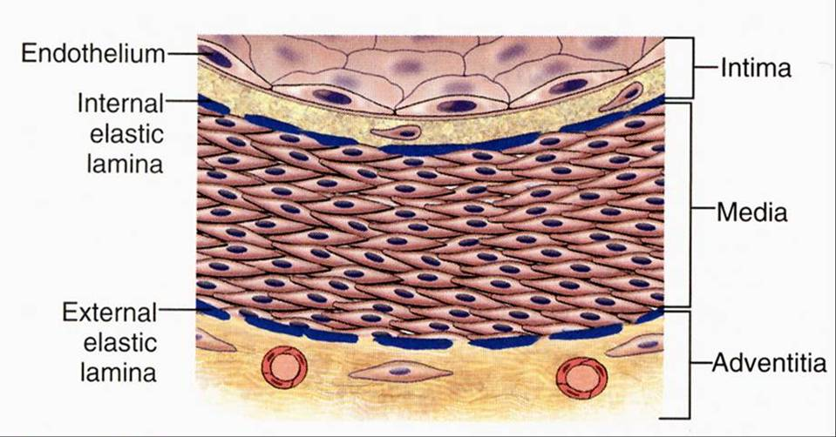
Normal blood vessel

Slide 9
Atherosclerosis
Characterized by atheromas (plaques)
Half of deaths in US!
Most common cause of myocardial infarction
Most common cause of cerebral infarction

Slide 10
Major Risk Factors for Atherosclerosis
Non-modifiable
Increasing age
Male sex*
Family history
Genetic abnormalities
Modifiable
Hyperlipidemia
Hypertension
Cigarette smoking
Diabetes
* Sort of. MI is uncommon in premenopausal women, but
after menopause, incidence in women exceeds that in men.

Slide 11
Other Risk Factors for Atherosclerosis
Inflammation
Metabolic syndrome
Obesity
Lack of exercise
Stress

Slide 12
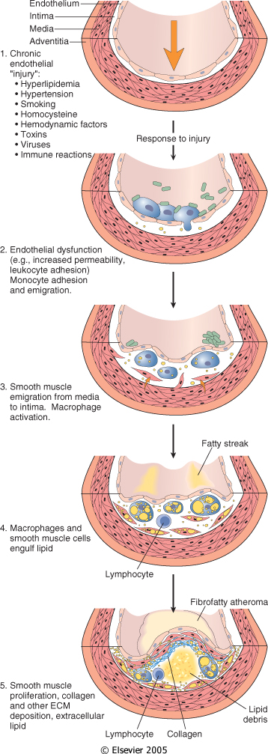
How to Make an Atheroma
1
Chronic endothelial injury

Slide 13
How to Make an Atheroma
2
Endothelial dysfunction
Monocyte adhesion and emigration

Slide 14
How to Make an Atheroma
3
Macrophage activation
Smooth muscle recruitment

Slide 15
How to Make an Atheroma
4
Macrophages and smooth muscle cells engulf lipid

Slide 16
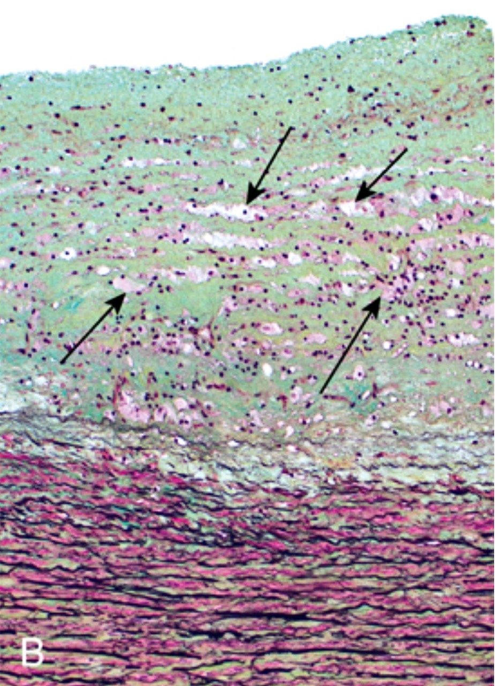
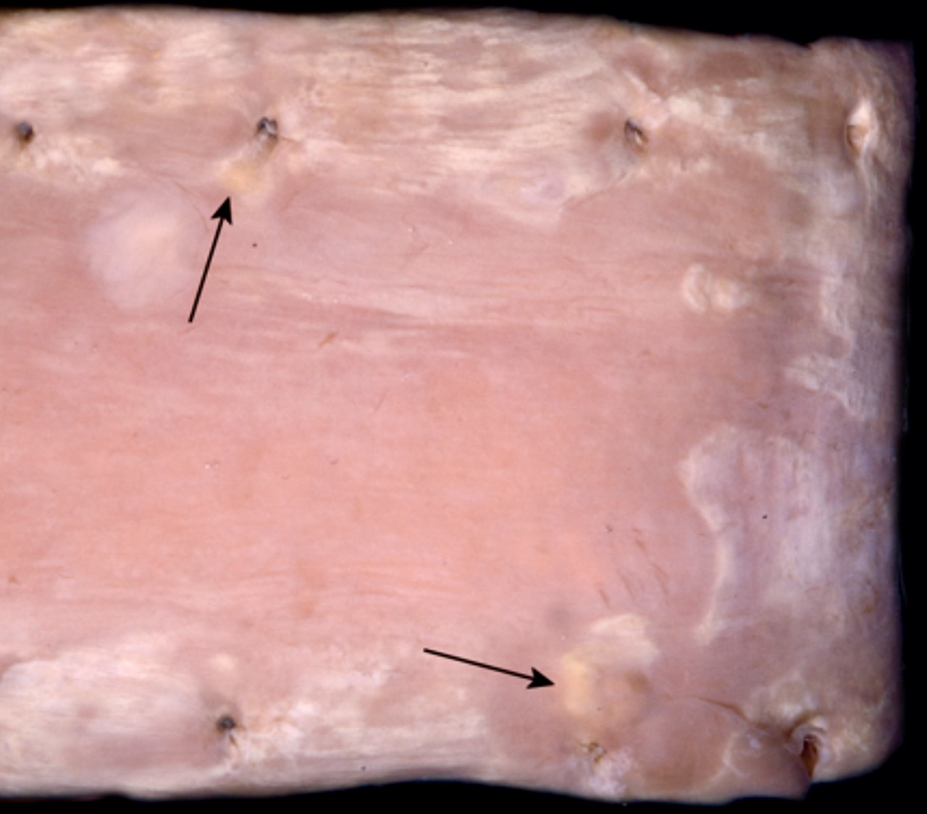
Foamy macrophages
Fatty streak
Fatty streak
Aorta, gross
Aorta, microsopic

Slide 17
How to Make an Atheroma
5
Smooth muscle proliferation
Collagen and extracellular lipid deposition

Slide 18
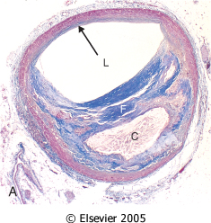




Vessel wall
Fibrous tissue
(composed of collagen fibers, which stain blue with trichrome stain)
Vessel lumen
Plaque
Necrotic core
(composed of cholesterol and other lipids)
Atheromatous plaque (trichrome stain)

Slide 19
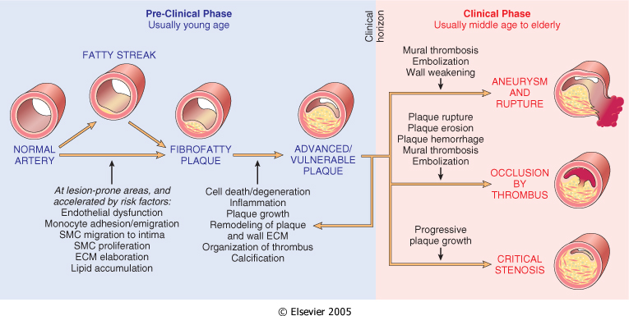
Natural history of atherosclerosis

Slide 20
Prevention of Atherosclerosis
Primary prevention
  Lessen risk factors
  Statins
Secondary prevention
  Aspirin, statins, beta blockers
  Surgery

Slide 21
Cardiac Pathology Outline
Blood Vessels
  Atherosclerosis
  Hypertension

Slide 22
Types of Hypertension
Benign hypertension
  Essential (idiopathic) hypertension
  Secondary hypertension
Malignant hypertension

Slide 23
Essential Hypertension
Common problem (25% of population)
Asymptomatic until late
Contributes to coronary artery disease, stroke, cardiac hypertrophy, heart failure
Mechanisms largely unknown
>140/90

Slide 24
Essential Hypertension
Idiopathic! But probably related to…
Reduced renal sodium excretion
Vascular changes
Genetic factors
Environmental factors

Slide 25
Essential Hypertension
Consequences
Accelerates atherogenesis
Potentiates aortic dissection and stroke
Causes small blood vessel disease (hyaline arteriolosclerosis)

Slide 26
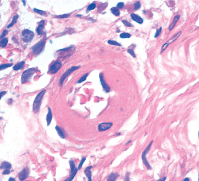
Thickened vessel wall
Hyaline arteriolosclerosis

Slide 27
Cardiac Pathology Outline
Blood Vessels
  Atherosclerosis
  Hypertension
  Aneurysms

Slide 28
Aneurysms
Aneurysm: localized abnormal vessel dilation
“True” aneurysm: involves all three layers
“False” aneurysm: hole covered with hematoma

Slide 29
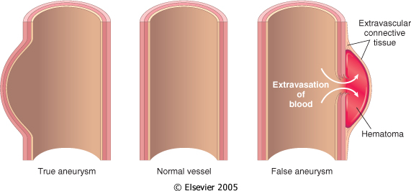
True and false aneurysms

Slide 30
Causes of Aneurysms
Atherosclerosis
Cystic medial degeneration of wall
Trauma
Congenital defects (berry aneurysm)

Slide 31
Abdominal Aortic Aneurysm
Males >50
Atherosclerosis, genetic defects (Marfan syndrome)
Below renal arteries, above bifurcation
May present as pulsating abdominal mass
May rupture, obstruct branches or embolize

Slide 32
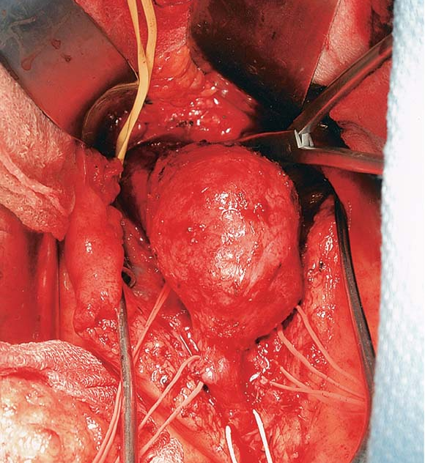
Abdominal aortic aneurysm

Slide 33
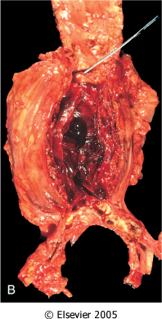
Abdominal aortic aneurysm

Slide 34
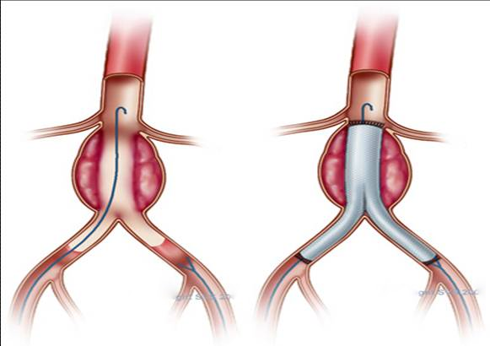
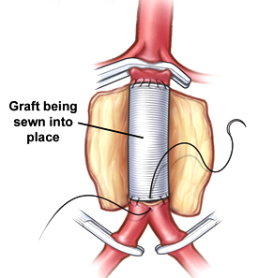
Abdominal aortic aneurysm repair

Slide 35
Aortic Dissection
Blood tracks up through media, creating a channel
Hypertensive men, 40-60 (most cases)
Sudden onset excruciating pain
Can rupture → massive hemorrhage or cardiac tamponade
Rapid diagnosis, surgery = 65-75% of patients survive

Slide 36
Cardiac Pathology Outline
Blood Vessels
  Atherosclerosis
  Hypertension
  Aneurysms
  Vasculitis

Slide 37
Vasculitis
Inflammation of vessel walls
Many possible symptoms
Constitutional signs/symptoms common
Immune-mediated or infectious

Slide 38
Takayasu Arteritis
Women <40
Granulomatous vasculitis of aortic arch
Severe narrowing of major branches
Weakening of pulses in upper extremities (“pulseless disease”)
Ocular disturbances

Slide 39
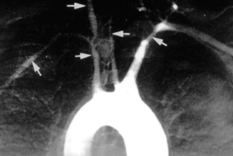
Takayasu arteritis

Slide 40
Kawasaki Disease
Children <4
Acute, febrile, usually self-limiting
Danger: involvement of coronary arteries
“Mucocutaneous lymph node syndrome”
Delayed-type hypersensitivity reaction?
Treatment: intravenous Ig

Slide 41
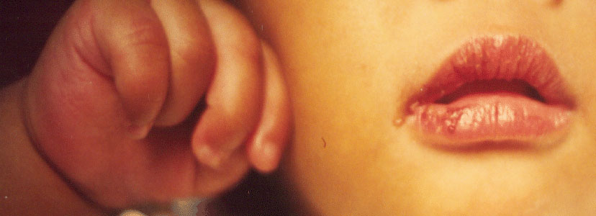
Kawasaki Disease: hand edema, mouth lesions

Slide 42
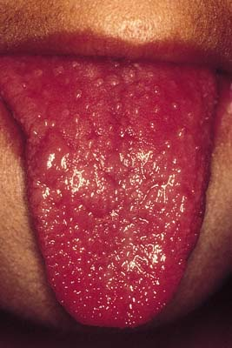
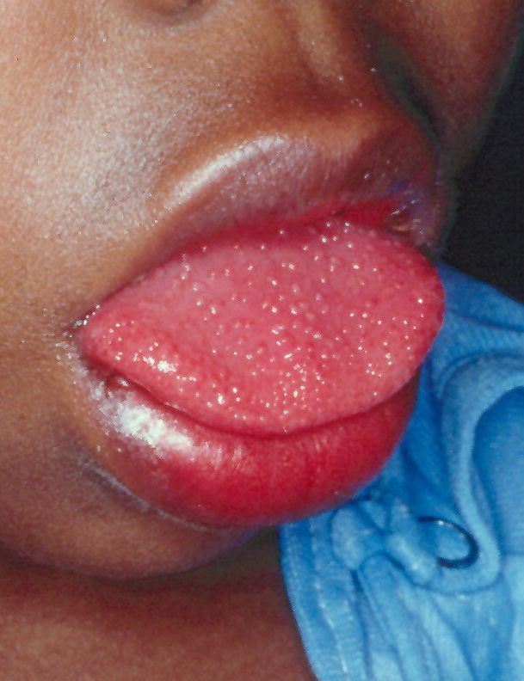
Kawasaki Disease: “strawberry” tongue

Slide 43
Cardiac Pathology Outline
Blood Vessels
  Atherosclerosis
  Hypertension
  Aneurysms
  Vasculitis
  Tumors

Slide 44
Hemangioma
Very common benign tumor of blood vessels
Capillary hemangioma
  Skin, oral mucosa, sometimes organs
  “Strawberry” type present at birth, regresses
Pyogenic granuloma
  Rapidly growing red nodule on skin, in mouth
  Microscopically resembles granulation tissue

Slide 45
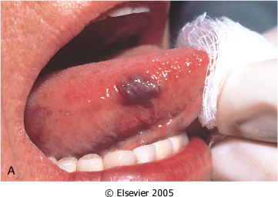
Capillary hemangioma

Slide 46
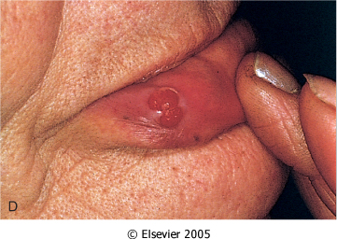
Pyogenic granuloma

Slide 47
Kaposi Sarcoma
Low-grade malignancy of endothelial cells
Four forms: Chronic (older Ashkenazi Jewish males), African, transplant-associated, AIDS-associated
Clinical course varies (chronic = best)
Excision can be curative

Slide 48
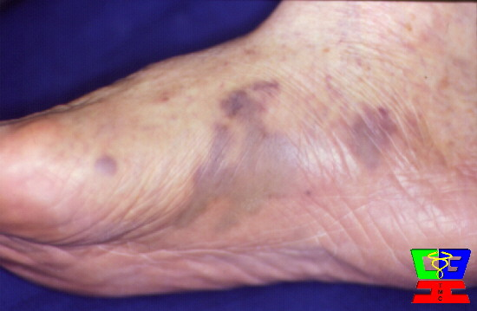
Kaposi sarcoma

Slide 49
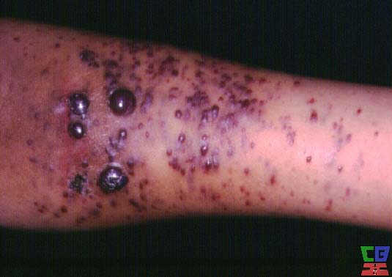
Kaposi sarcoma

Slide 50
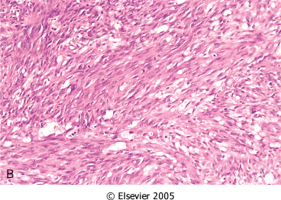
Kaposi sarcoma

Slide 51
Angiosarcoma
Malignancy of endothelial cells
Prefers skin, soft tissue, breast, liver
Arsenic and PVC increase risk
Well-differentiated to anaplastic
Metastasize rapidly. 5ys 30%.

Slide 52
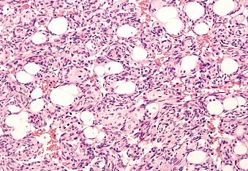
Angiosarcoma

Slide 53
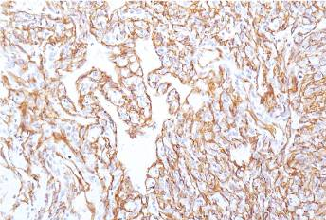
Angiosarcoma cells positive for CD31 (an endothelial marker)

Slide 54
Cardiac Pathology Outline
Blood Vessels
  Atherosclerosis
  Hypertension
  Aneurysms
  Vasculitis
  Tumors
Heart I
Heart II

