Slide 1

Heart I:
Heart Failure,
Congenital Heart Disease,
and Ischemic Heart Disease
Kristine Krafts, M.D.

Slide 2
Cardiac Pathology Outline
Blood Vessels
Heart I
  Heart Failure
  Congenital Heart Disease
  Ischemic Heart Disease

Slide 3
Heart I Lecture Objectives
Describe in simple terms what heart failure is.
Explain how the heart tries to adapt to heart failure and list three consequences that can result when adaptation fails.
To make it easier on yourself (so you can understand more and memorize less), review the basics of heart blood flow (i.e., where does blood from the left side vs. the right side of the heart go?)
Look at slides 9-12 and make sure you understand why the symptoms in left and right sided heart failure make sense.

Slide 4
Heart I Lecture Objectives
Define the following terms: pulmonary edema, ascites, peripheral edema, dyspnea, orthopnea, paroxysmal nocturnal dyspnea, cor pulmonale, nutmeg liver.
Explain what’s wrong with the heart in the four congenital heart diseases covered in lecture.
Explain what can happen clinically in atrial and ventricular septal defect.
Compare and contrast left-to-right and right-to-left shunts. Define Eisenmenger syndrome and know which congenital defects it occurs in.

Slide 5
Heart I Lecture Objectives
What does the ductus arteriosus do in the fetus? What normally happens to it after birth? Make sure you understand the direction of blood flow in the fetus and how that changes after birth. Check out the posts online from Path Student (posted on our home page) if this seems confusing.
Make sure you know the four features of Tetralogy of Fallot. There is a way to understand the disease so you don’t have to just memorize four seemingly random features – we’ll talk about that in class.

Slide 6
Heart I Lecture Objectives
Define ischemic heart disease, and list the three syndromes that are associated with it.
Define angina pectoris, and describe the symptoms and underlying causes of both typical and unstable angina.
Define myocardial infarction and explain what makes it different from angina. Describe the usual series of events that lead up to myocardial infarction.
Describe the histologic findings seen in myocardial infarction on day 1, day 3, and day 7.

Slide 7
Heart I Lecture Objectives
List the clinical symptoms of myocardial infarction (MI), and compare and contrast how troponins and CK-MB change over time after an MI.
List some potential complications of MI, and describe in general what the prognosis is for someone who has had an MI.
Okay – these objectives are LONG. But they cover EVERYTHING you need to know. I decided to err on the side of a little too wordy rather than skip things.

Slide 8
Cardiac Pathology Outline
Blood Vessels
Heart I
  Heart Failure

Slide 9
Heart Failure
End point of many heart diseases
Common!
  5 million affected each year
  300,000 fatalities
Heart can’t pump blood fast enough to meet needs of body
Most due to systolic dysfunction
Some due to diastolic dysfunction, valve failure, or abnormal load

Slide 10
Heart Failure
System responds to failure by
  Releasing hormones (e.g., norepinephrine)
  Frank-Starling mechanism (increased stretching of heart muscle cells)
  Hypertrophy
Initially, this works
Eventually, it doesn’t
  Myocytes degenerate
  Heart needs more oxygen
  Myocardium becomes vulnerable to ischemia

Slide 11
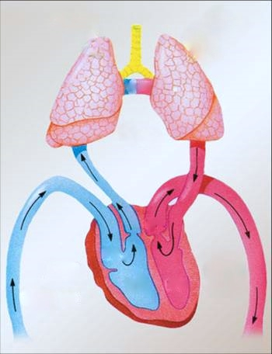
R
L

Slide 12
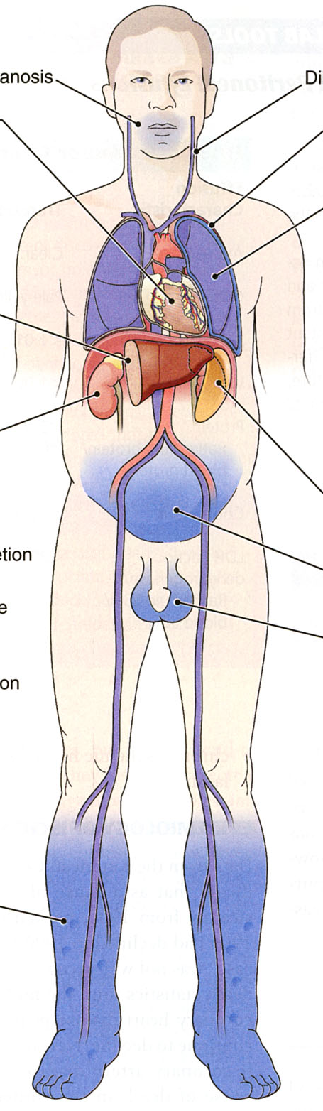
cyanosis
pulmonary edema
hepatomegaly
Clinical consequences of left and right heart failure
splenomegaly
ascites
peripheral edema

Slide 13
Left Heart Failure
Left ventricle fails; blood backs up in lungs
Most common causes
  Ischemic heart disease (IHD)
  Hypertension
Heart changes
  LV hypertrophy, dilation
  LA may be enlarged too (risk of atrial fibrillation)

Slide 14
Left Heart Failure
Symptoms
Dyspnea, orthopnea, paroxysmal nocturnal dyspnea
Crackles or rales in lungs (pulmonary edema)
Later: mitral regurgitation, systolic murmur
If atrium is big, “irregularly irregular” heartbeat

Slide 15

Right Heart Failure
Right ventricle fails; blood backs up in body
Commonest causes
  Left heart failure
  Lung disease (“cor pulmonale”)
  Some congenital heart diseases
Heart changes
  right ventricular hypertrophy, dilation
  right atrial enlargement
Definition:
Right heart failure due to some intrinsic lung disease

Slide 16
Right Heart Failure
Symptoms
Peripheral edema
Big, congested liver (“nutmeg liver”)
Big spleen
Most chronic cases of heart failure are bilateral

Slide 17
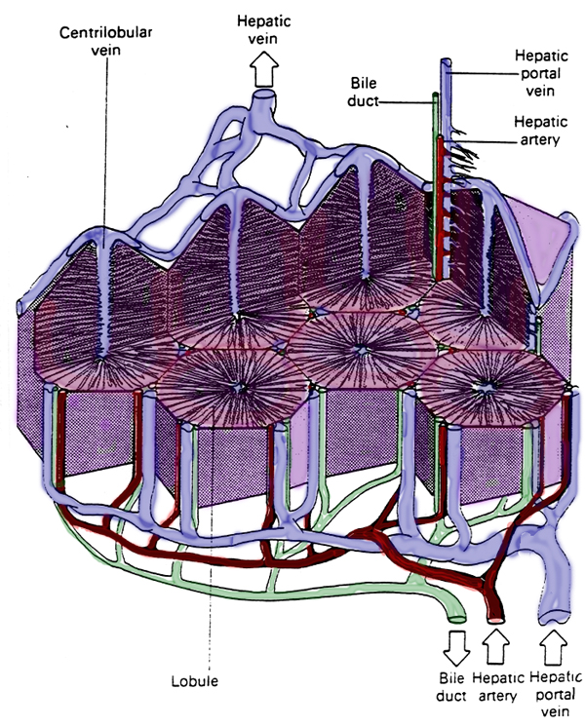
Hepatic blood flow

Slide 18
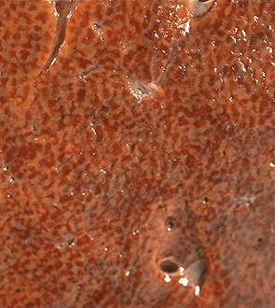
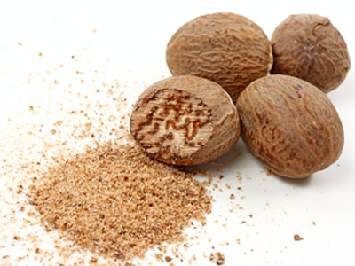
“Nutmeg” liver
Nutmeg

Slide 19
Cardiac Pathology Outline
Blood Vessels
Heart I
  Heart Failure
  Congenital Heart Disease

Slide 20
Congenital Heart Disease
Abnormalities of heart/great vessels present from birth
Faulty embryogenesis, weeks 3-8
Broad spectrum of severity
Cause unknown in 90% of cases

Slide 21
Atrial Septal Defect
Initially, shunt is left-to-right (asymptomatic)
Sometimes, pulmonary vessels become constricted (pulmonary hypertension)
Eventually, shunt can reverse, becoming right-to-left ( this is called Eisenmenger syndrome)
Surgical repair prevents irreversible pulmonary changes and heart failure

Slide 22
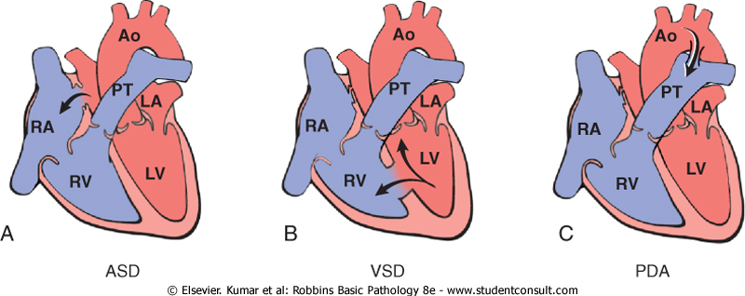
ASD

Slide 23
Ventricular Septal Defects
Most common congenital cardiac anomaly
Most close spontaneously in childhood
Small VSD: asymptomatic
Large VSD: big left-to-right shunt which may eventually become right-to-left

Slide 24
VSD

Slide 25
Patent Ductus Arteriosus
Ductus: allows flow from PA to aorta in fetus
Closes spontaneously by day 1-2 of life
Small PDA: asymptomatic
Large PDA: big left-to-right shunt which may eventually become right-to-left

Slide 26
PDA

Slide 27
Tetralogy of Fallot
Most common cause of cyanotic congenital heart disease
Four features:
  VSD
  obstruction to RV outflow tract
  overriding aorta
  RV hypertrophy
Right-to-left shunt causes cyanosis, paradoxical emboli

Slide 28
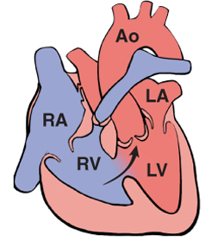
Tetralogy of Fallot

Slide 29
Cardiac Pathology Outline
Blood Vessels
Heart I
  Heart Failure
  Congenital Heart Disease
  Ischemic Heart Disease

Slide 30
Ischemic Heart Disease
Myocardial perfusion can’t meet demand
Usually caused by decreased coronary artery blood flow (“coronary artery disease”)
Three syndromes:
  angina pectoris
  acute MI
  sudden cardiac death

Slide 31
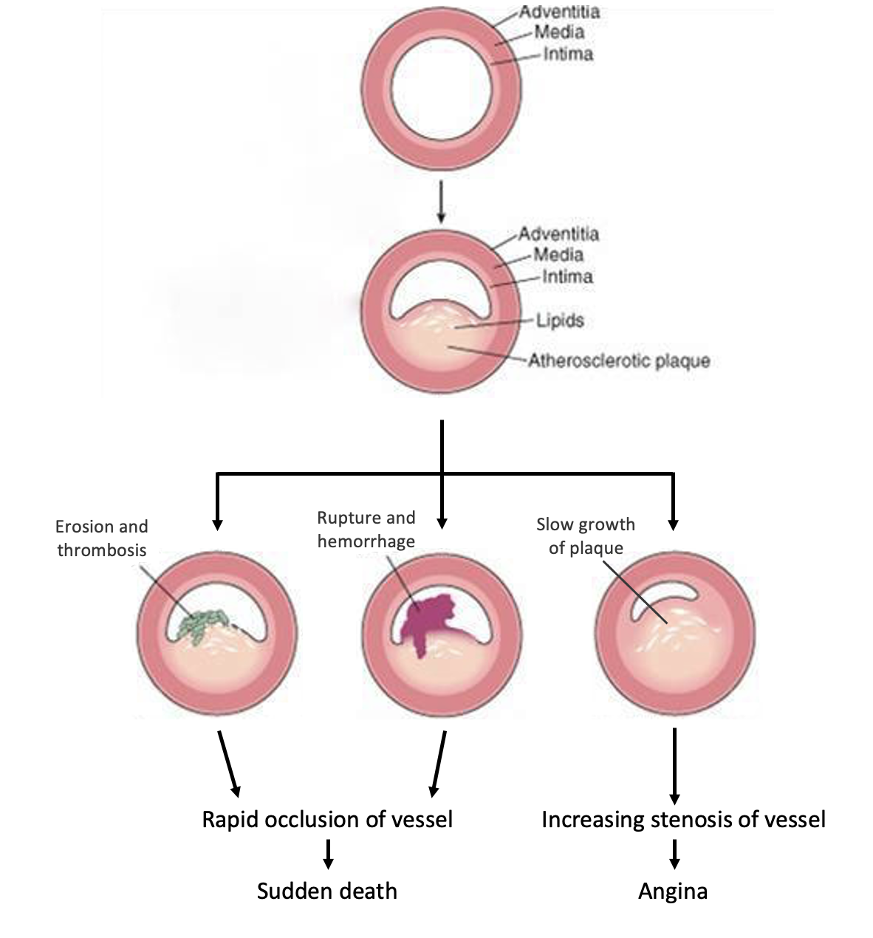
MI or sudden death
Angina

Slide 32
Angina Pectoris
Intermittent chest pain caused by transient, reversible ischemia
Typical (stable) angina
  pain on exertion
  fixed narrowing of coronary artery
Unstable (pre-infarction) angina
  increasing pain with less exertion
  plaque disruption and thrombosis

Slide 33
Myocardial Infarction
Necrosis of heart muscle caused by ischemia
1.5 million people get MIs each year
Most due to acute coronary artery thrombosis
  sudden plaque disruption
  platelets adhere
  coagulation cascade activated
  thrombus occludes lumen within minutes
  irreversible injury/cell death in 20-40 minutes
Prompt reperfusion can salvage myocardium

Slide 34
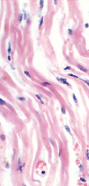
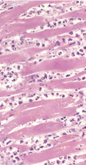
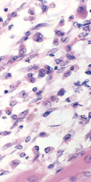
Coagulative
necrosis
Neutrophil
infiltration
Macrophage
infiltration
MI: day 1, day 3, day 7

Slide 35
Myocardial Infarction
Clinical features
  Severe, crushing chest pain ± radiation
  Not relieved by nitroglycerin, rest
  Sweating, nausea, dyspnea
  Sometimes NO symptoms!
Laboratory evaluation
  Troponins increase within 2-4 hours,
  remain elevated for a week.
  CK-MB increases within 2-4 hours,
  returns to normal within 72 hours.

Slide 36
Myocardial Infarction
Complications
  contractile dysfunction
  arrhythmias
  rupture
  chronic progressive heart failure
Prognosis
  depends on remaining function and perfusion
  overall 1 year mortality: 30%
  3-4% mortality per year thereafter

Slide 37
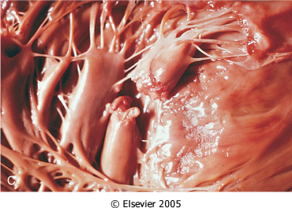
Rupture of papillary muscle after MI

Slide 38
Cardiac Pathology Outline
Blood Vessels
Heart I
  Heart Failure
  Congenital Heart Disease
  Ischemic Heart Disease

