Slide 1

Heart II:
Valvular Heart Disease, Cardiomyopathies,
and Tumors
Kristine Krafts, M.D.

Slide 2
Cardiac Pathology Outline
Blood Vessels
Heart I
Heart II
  Valvular Heart Disease
  Cardiomyopathies
  Tumors

Slide 3
Heart II Lecture Objectives
Compare and contrast the causes and symptoms of aortic stenosis, mitral insufficiency, and mitral stenosis.
Compare and contrast the cause, symptoms, and mortality of acute vs. subacute infective endocarditis.
Compare and contrast the cause, main physiologic problem, clinical symptoms/potential outcomes, and mortality of the three types of cardiomyopathy.
Describe the most common primary heart tumor.

Slide 4
Valvular Heart Disease
Aortic stenosis: from wear and tear over time, can cause angina, fainting, CHF
Mitral insufficiency: caused by valve prolapse, usually asymptomatic
Mitral stenosis: caused by rheumatic fever (multisystem immune-mediated disease following untreated strep throat infection)

Slide 5
Infective Endocarditis
Bacterial form “vegetations” on heart valves
Fever, flu-like symptoms
Acute endocarditis
  highly virulent bug attacks normal valve
  abrupt onset, 50% mortality rate (sepsis, emboli)
Subacute endocarditis
  low virulence bug colonizes abnormal valve
  slow onset, most patients recover

Slide 6
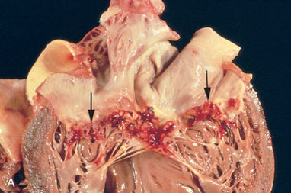
Infective endocarditis: vegetations on valve

Slide 7
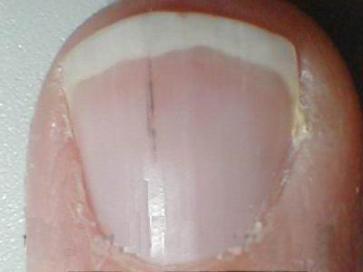
Infective endocarditis: splinter hemorrhage of nail bed

Slide 8
Cardiac Pathology Outline
Blood Vessels
Heart I
Heart II
  Valvular Heart Disease
  Cardiomyopathies

Slide 9
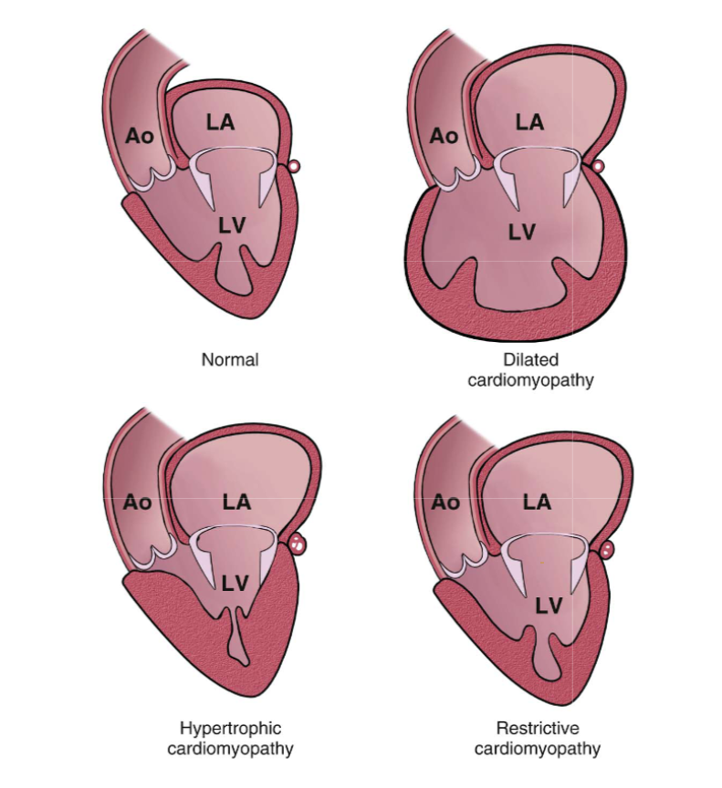
Normal
Dilated
cardiomyopathy
Hypertrophic
cardiomyopathy
Restrictive
cardiomyopathy

Slide 10
Dilated
cardiomyopathy
Hypertrophic
cardiomyopathy
Restrictive
cardiomyopathy
Genetic, infectious, toxic (esp. alcohol)
Heart is dilated and can’t contract well
Progressive CHF
Relatively high mortality

Slide 11
Dilated
cardiomyopathy
Hypertrophic
cardiomyopathy
Restrictive
cardiomyopathy
Mutation in sarcomere protein gene
Heart is hypertrophic and can’t fill well
Atrial fib, arrhythmia, sudden death
Variable mortality

Slide 12
Dilated
cardiomyopathy
Hypertrophic
cardiomyopathy
Restrictive
cardiomyopathy
Restrictive
cardiomyopathy
Secondary to radiation, amyloidosis, sarcoidosis
Heart is stiff and can’t fill well
Shortness of breath, edema
Relatively high mortality

Slide 13
Cardiac Pathology Outline
Blood Vessels
Heart I
Heart II
  Valvular Heart Disease
  Cardiomyopathies
  Tumors

Slide 14
Cardiac Tumors
Heart tumors are rare!
Metastatic tumors are more common than primary tumors.
Most common primary tumor: myxoma

Slide 15
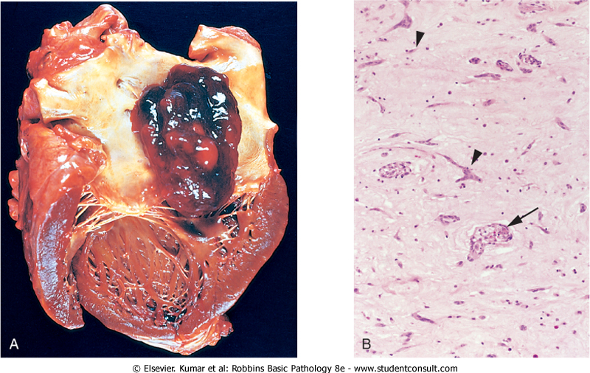
Cardiac myxoma

