Slide 1
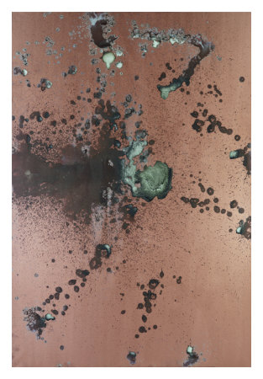
Renal
Pathology
Kristine Krafts, M.D.

Slide 2
Renal Pathology Learning Objectives
Define azotemia and uremia.
Describe how acute and chronic renal failure present.
List the four components of nephritic and nephrotic syndromes. What’s the underlying cause of each? List the main diseases that cause each syndrome.
For each of the glomerular diseases, make sure you understand the concepts on the “things you must know” slides.
What is pyelonephritis, how does it present, and what causes it?

Slide 3
Renal Pathology Learning Objectives
What are the usual symptoms of urinary tract infection? Describe who gets complicated vs. uncomplicated UTIs, and know the most common organism causing each.
For acute tubular necrosis, benign nephrosclerosis, and malignant nephrosclerosis, refer to the “things you must know” slides.
Compare and contrast the inheritance pattern, morphologic appearance, and general prognosis of adult vs. childhood polycystic kidney disease.
For renal cell and bladder carcinoma, refer to the ”things you must know” slides.

Slide 4
Renal Pathology Outline
Introductory stuff
Glomerular diseases
Tubular and interstitial diseases
Diseases involving blood vessels
Cystic diseases
Tumors

Slide 5
Renal Pathology Outline
Introductory stuff

Slide 6
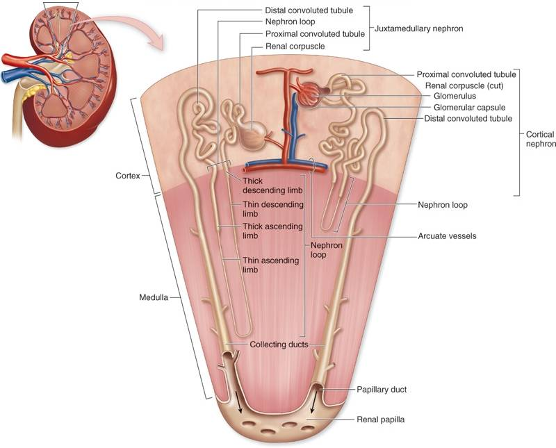

Slide 7
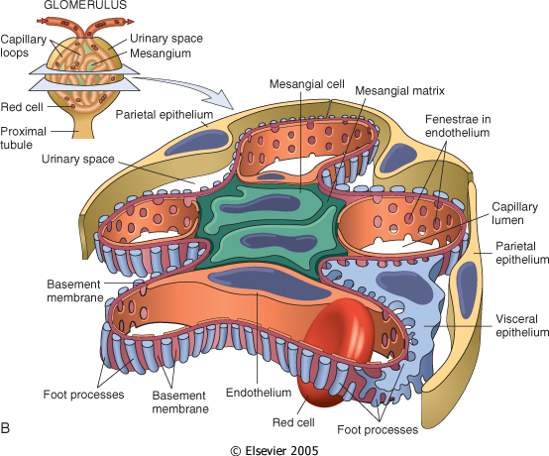

Slide 8
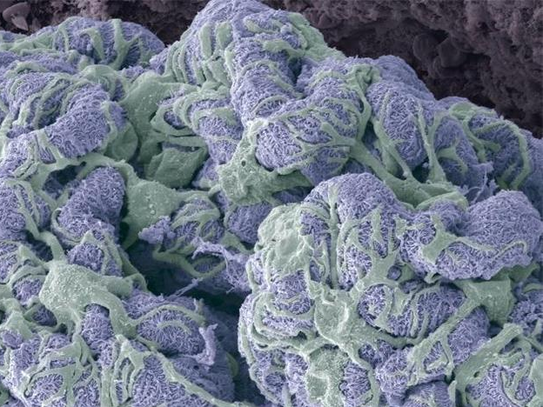
Notes:
Diffuse thickening of the glomerular basement membrane.

Slide 9
Introductory Stuff
Azotemia: ↑ BUN, creatinine
Uremia: azotemia + more problems
Acute renal failure: oliguria
Chronic renal failure: prolonged uremia

Slide 10
Renal Pathology Outline
Introductory stuff
Glomerular diseases

Slide 11
Renal Pathology Outline
Introductory stuff
Glomerular diseases
  Nephrotic syndrome
    Minimal change disease
    Membranous nephropathy
  Nephritic syndrome
    Postinfectious GN
    IgA nephropathy

Slide 12
Nephrotic syndrome
Nephritic syndrome
proteinuria
inflamed glomerulus
Massive proteinuria
Hypoalbuminemia
Edema
Hyperlipidemia/-uria
Hematuria
Oliguria
Azotemia
Hypertension

Slide 13
Nephrotic syndrome
Nephritic syndrome
Massive proteinuria
Hypoalbuminemia
Edema
Hyperlipidemia/-uria
Hematuria
Oliguria
Azotemia
Hypertension

Slide 14
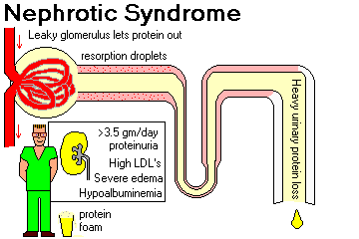

Slide 15
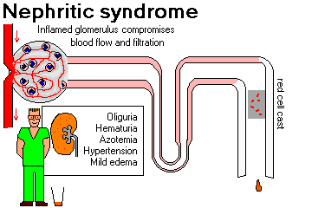

Slide 16
Renal Pathology Outline
Introductory stuff
Glomerular diseases
  Nephrotic syndrome

Slide 17
Symptoms of Nephrotic Syndrome
Massive proteinuria
Hypoalbuminemia
Edema
Hyperlipidemia, lipiduria

Slide 18
Causes of Nephrotic Syndrome
Adults: systemic disease (diabetes)
Children: minimal change disease
Characterized by loss of foot processes

Slide 19
Renal Pathology Outline
Introductory stuff
Glomerular diseases
  Nephrotic syndrome
    Minimal change disease

Slide 20
Minimal Change Disease
Things You Must Know
#1 cause of nephrotic syndrome in children
Loss of foot processes
Pathogenesis unknown
Good prognosis

Slide 21
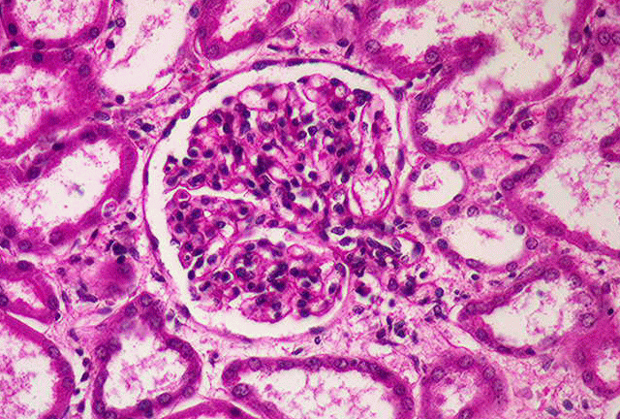
Minimal change disease

Slide 22
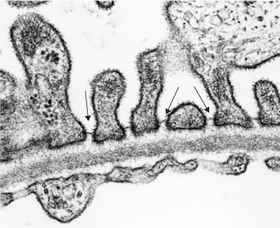
Normal glomerulus

Slide 23
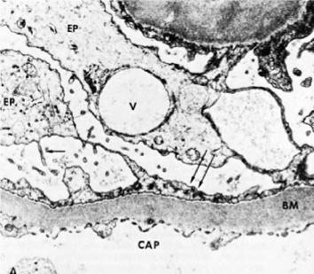
Minimal change disease

Slide 24
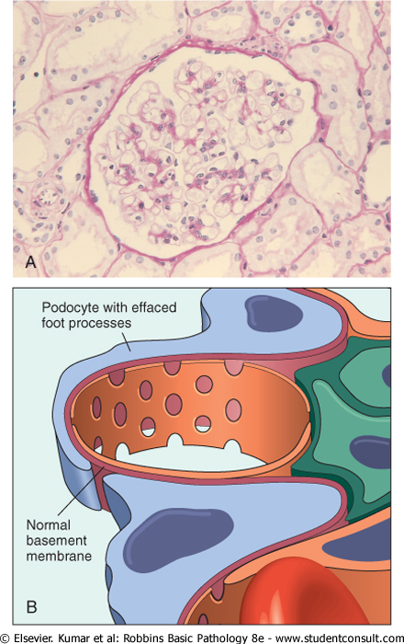
Minimal change disease

Slide 25
Renal Pathology Outline
Introductory stuff
Glomerular diseases
  Nephrotic syndrome
    Minimal change disease
    Membranous nephropathy

Slide 26
Membranous Nephropathy
Things You Must Know
Autoimmune reaction against unknown renal antigen
Immune complexes
Thickened GBM
Subepithelial deposits/spikes

Slide 27
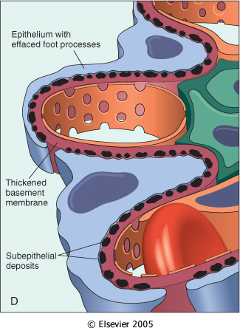
Membranous nephropathy

Slide 28
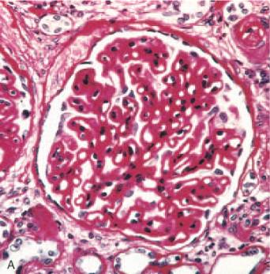
Membranous nephropathy

Slide 29
Renal Pathology Outline
Introductory stuff
Glomerular diseases
  Nephrotic syndrome
    Minimal change disease
    Membranous nephropathy
  Nephritic syndrome

Slide 30
Symptoms of Nephritic Syndrome
Hematuria
Oliguria, azotemia
Hypertension

Slide 31
Causes of Nephritic Syndrome
Post-infectious GN, IgA nephropathy
Immunologically-mediated
Characterized by proliferative changes and inflammation

Slide 32
Renal Pathology Outline
Introductory stuff
Glomerular diseases
  Nephrotic syndrome
    Minimal change disease
    Membranous nephropathy
  Nephritic syndrome
    Postinfectious GN

Slide 33
Post-Infectious Glomerulonephritis
Things You Must Know
Child after strep throat
Immune complexes
Hypercellular glomeruli
Subepithelial humps

Slide 34
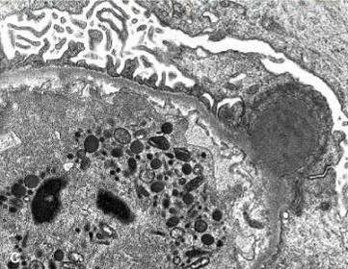
Post-infectious glomerulonephritis

Slide 35
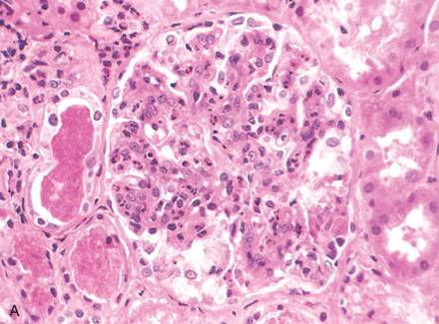
Post-infectious glomerulonephritis

Slide 36
Renal Pathology Outline
Introductory stuff
Glomerular diseases
  Nephrotic syndrome
    Minimal change disease
    Membranous nephropathy
  Nephritic syndrome
    Postinfectious GN
    IgA nephropathy

Slide 37
IgA Nephropathy
Things You Must Know
Common!
Child with hematuria after URI
IgA in mesangium
Variable prognosis

Slide 38
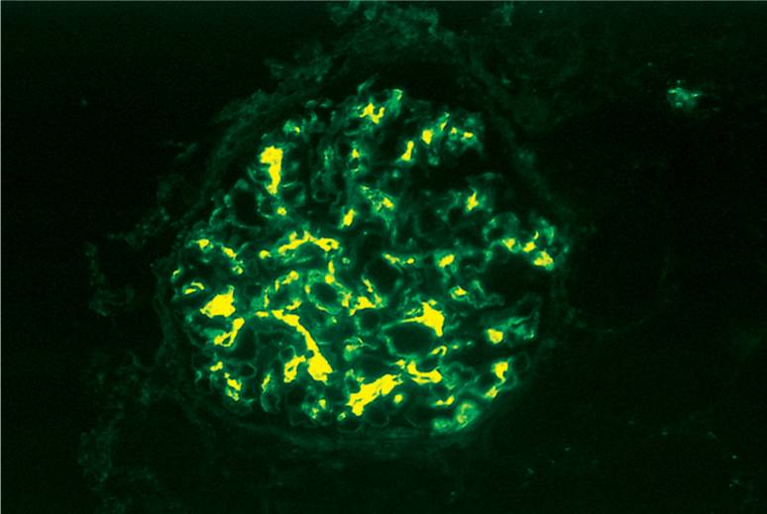
IgA nephropathy

Slide 39
Renal Pathology Outline
Introductory stuff
Glomerular diseases
Tubular and interstitial diseases
  Pyelonephritis
  Acute tubular necrosis

Slide 40
Renal Pathology Outline
Introductory stuff
Glomerular diseases
Tubular and interstitial diseases
  Pyelonephritis

Slide 41
Pyelonephritis
Things You Must Know
Invasive kidney infection
Usually ascends from UTI
Fever, flank pain
Organisms: E. coli, Proteus

Slide 42
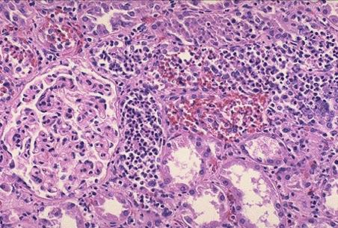
Acute pyelonephritis

Slide 43
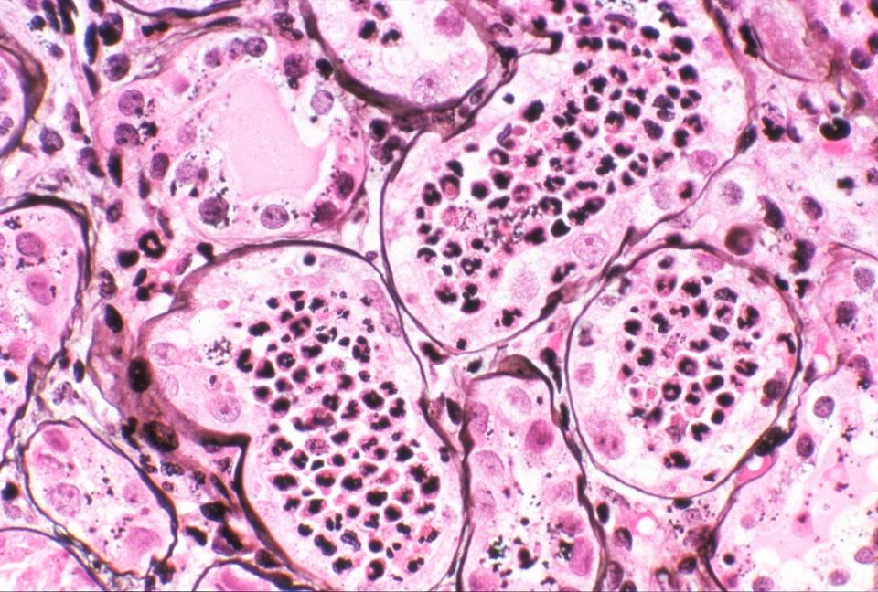
Acute pyelonephritis

Slide 44
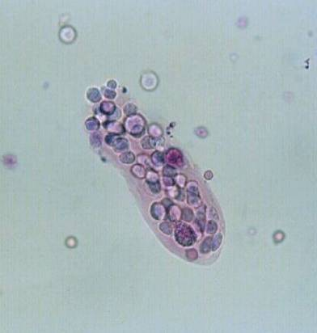
Cellular cast

Slide 45
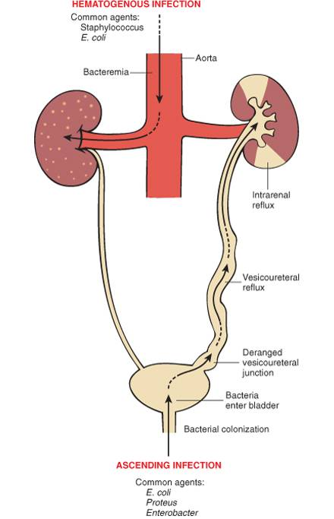

Slide 46
Urinary Tract Infection
Women, elderly
Patients with catheters or malformations
Dysuria, frequency
Organisms: E. coli, Proteus

Slide 47
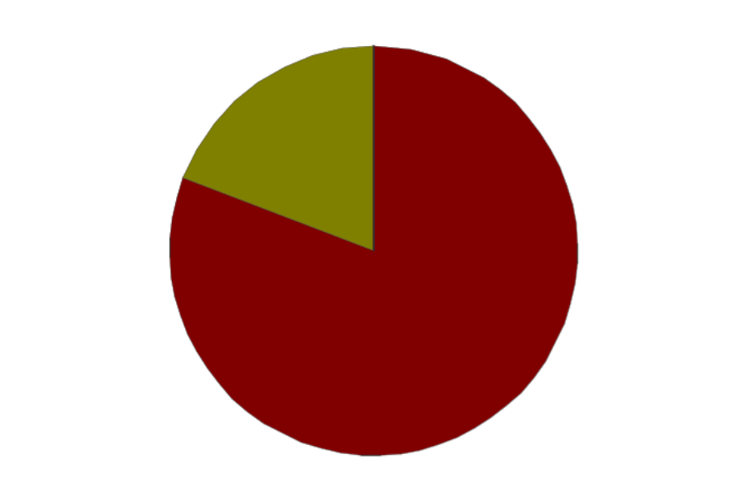
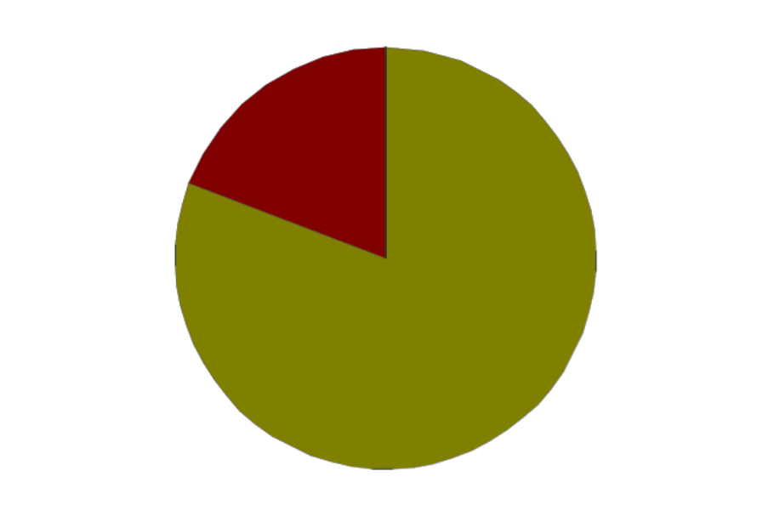
UTI: Common Bugs
E. coli
uncomplicated
complicated

Slide 48
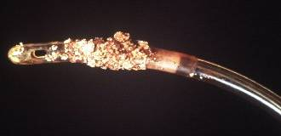
Urinary catheter colonized by Proteus

Slide 49
Renal Pathology Outline
Introductory stuff
Glomerular diseases
Tubular and interstitial diseases
  Pyelonephritis
  Acute tubular necrosis

Slide 50
Acute Tubular Necrosis
Things You Must Know
The most common cause of acute renal failure!
Reversible tubular injury
Many causes: ischemic (shock), toxic (drugs)
Most patients recover

Slide 51
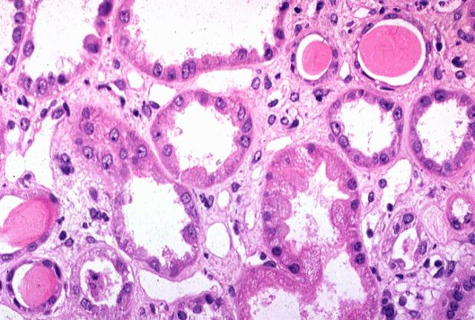
Acute tubular necrosis

Slide 52
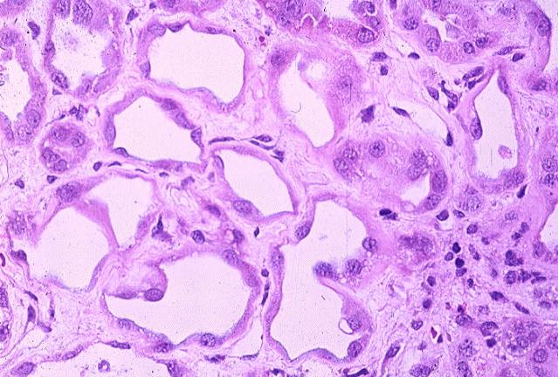
Acute tubular necrosis

Slide 53
Renal Pathology Outline
Introductory stuff
Glomerular diseases
Tubular and interstitial diseases
Diseases involving blood vessels
  Benign nephrosclerosis
  Malignant nephrosclerosis

Slide 54
Benign Nephrosclerosis
Things You Must Know
Found in patients with benign hypertension
Hyaline thickening of arterial walls
Leads to mild functional impairment
Rarely fatal

Slide 55
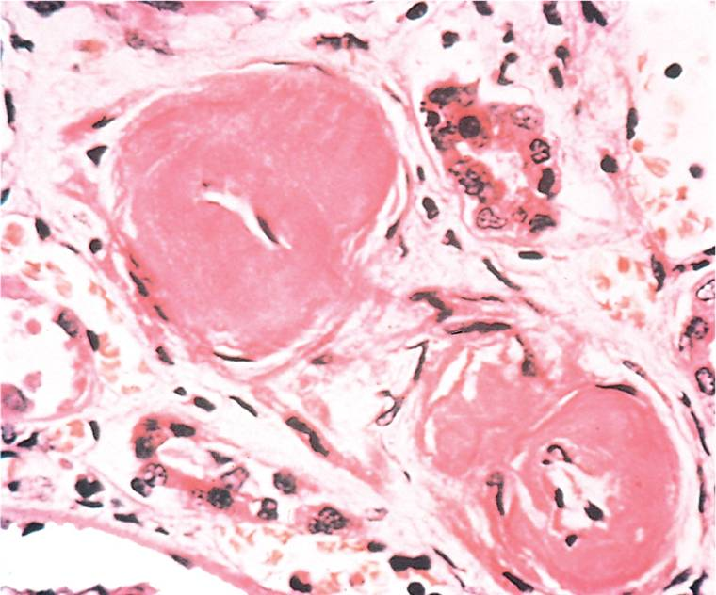
Benign nephrosclerosis

Slide 56
Malignant Nephrosclerosis
Things You Must Know
Arises in malignant hypertension
Hyperplastic vessels
Ischemia of kidney
Medical emergency

Slide 57
Malignant Hypertension
5% of cases of hypertension
Super-high blood pressure, encephalopathy, heart abnormalities
First sign often headache, scotomas
Decreased blood flow to kidney leads to increased renin, which leads to increased BP!
5y survival: 50%

Slide 58
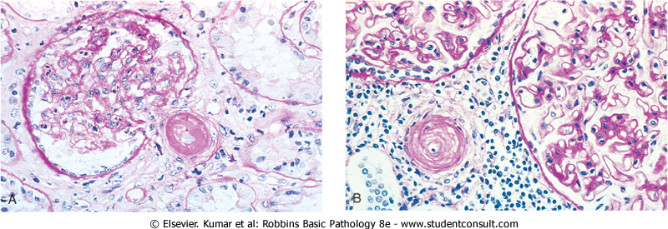
Malignant nephrosclerosis

Slide 59
Malignant nephrosclerosis

Slide 60
Renal Pathology Outline
Introductory stuff
Glomerular diseases
Tubular and interstitial diseases
Diseases involving blood vessels
Cystic diseases
  Adult polycystic kidney disease
  Childhood polycystic kidney disease

Slide 61
Adult Polycystic Kidney Disease
Things You Must Know
Autosomal dominant
Huge kidneys full of cysts
Usually no symptoms until 30s
Associated with brain aneurysms

Slide 62
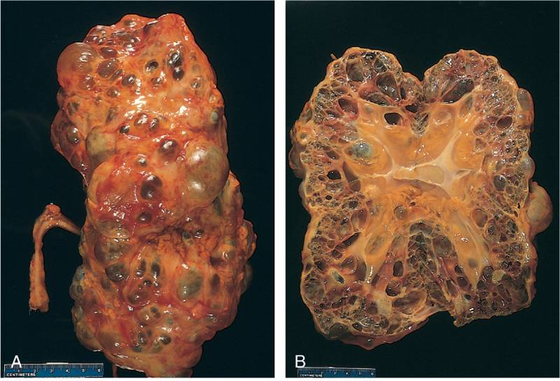
Adult polycystic kidney disease

Slide 63
Childhood Polycystic Kidney Disease
Things You Must Know
Autosomal recessive
Numerous small cortical cysts
Associated with liver cysts
Patients often die in infancy

Slide 64
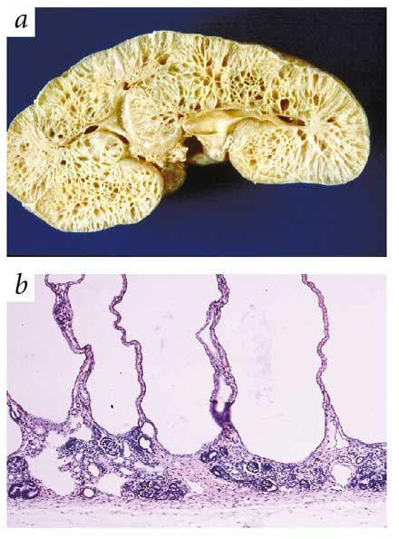
Childhood polycystic kidney disease

Slide 65
Renal Pathology Outline
Introductory stuff
Glomerular diseases
Tubular and interstitial diseases
Diseases involving blood vessels
Cystic diseases
Tumors
  Renal cell carcinoma
  Bladder carcinoma

Slide 66
Renal Cell Carcinoma
Things You Must Know
Derived from tubular epithelium
Smoking, hypertension, cadmium exposure
Hematuria, abdominal mass, flank pain
If metastatic, 5y survival = 5%

Slide 67
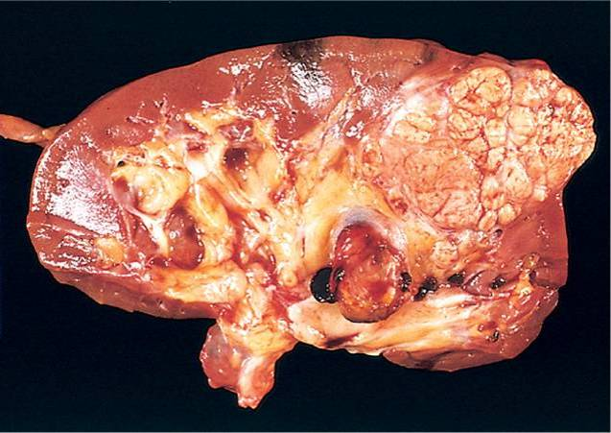
Renal cell carcinoma

Slide 68
Bladder Carcinoma
Things You Must Know
Derived from transitional epithelium
Presents with painless hematuria
Prognosis depends on grade and depth of invasion
Overall 5y survival = 50%

Slide 69
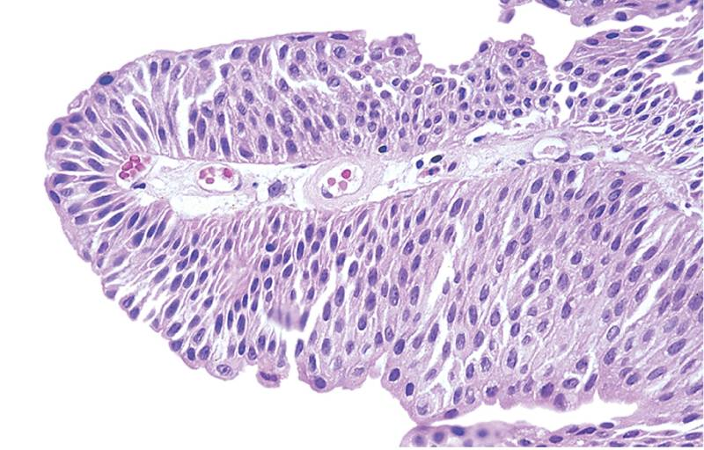
Bladder carcinoma

Slide 70
Renal Pathology Outline
Introductory stuff
Glomerular diseases
Tubular and interstitial diseases
Diseases involving blood vessels
Cystic diseases
Tumors

