Slide 1
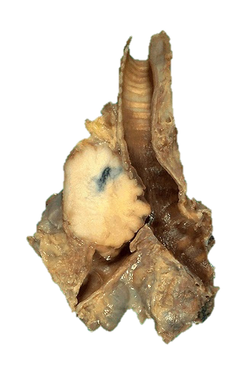
Respiratory Pathology
Kristine Krafts, M.D.

Slide 2
Respiratory Pathology Learning Objectives
Describe what happens to alveoli in acute respiratory distress syndrome (ARDS). List the causes of ARDS, and describe its clinical presentation and morphology.
List the four obstructive lung diseases, and know which two often occur in the same patient population. Compare and contrast the causes, morphology, and symptoms of each of the four diseases.
Describe the clinical course and morphology of idiopathic pulmonary fibrosis.

Slide 3
Respiratory Pathology Learning Objectives
What main category of lung disease do pneumoconiosis fall under? What causes them?
Define “embolism.” Where do most pulmonary emboli come from? Describe the different clinical features of small, medium, and large pulmonary emboli.
Explain why pneumonia occurring in different clinical settings (e.g., immunocompromised patients, patients in the hospital, patients in the community) is caused by different types of bacteria.

Slide 4
Respiratory Pathology Learning Objectives
What’s the difference between interstitial and alveolar pneumonia? What type of infectious agent is most often associated with each?
Describe how a lung abscess is different than pneumonia, and list some causes of lung abscess.
Know what bacterium causes tuberculosis (TB), and the stain you need to use to be able to see it microscopically. Describe how TB is spread. What’s the difference between primary and secondary TB? What’s the difference between a regular granuloma and a caseating one?

Slide 5
Respiratory Pathology Learning Objectives
What organisms commonly cause opportunistic pneumonia?
What are some of the symptoms of lung cancer? Describe the morphologic appearance of adenocarcinoma, squamous cell carcinoma, and small cell lung carcinoma. Which type has the worst prognosis?
What are the similarities and differences between lung cancer (in general) and mesothelioma?

Slide 6
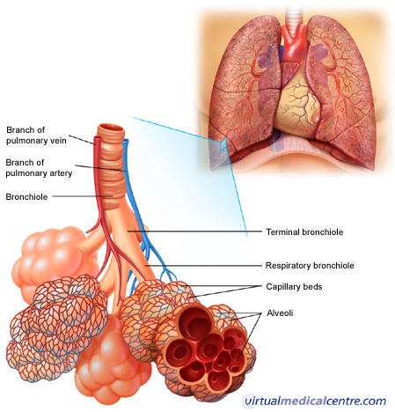

Slide 7
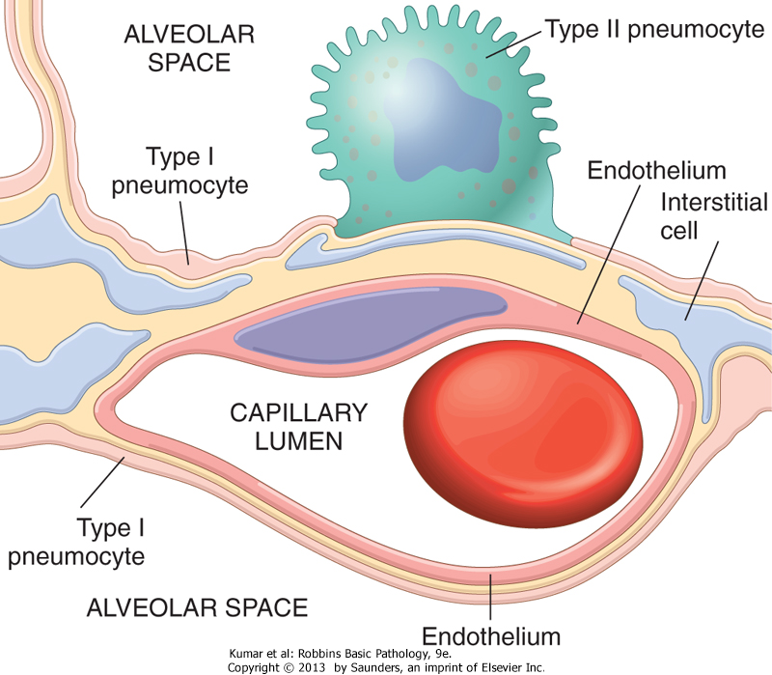

Slide 8
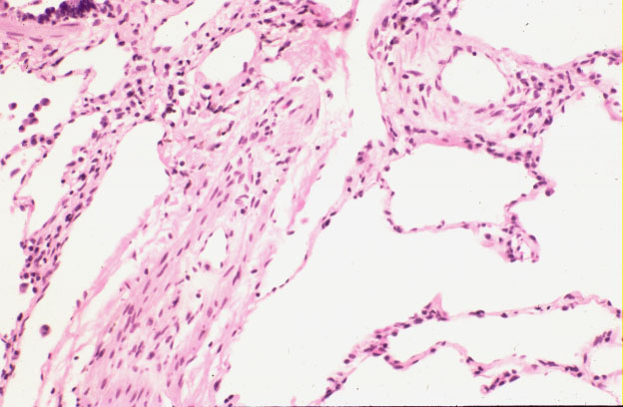
Normal lung: alveolar spaces

Slide 9
Respiratory Pathology Outline
Acute respiratory distress syndrome
Obstructive lung diseases
Restrictive lung diseases
Vascular diseases
Infections
Carcinoma

Slide 10
Respiratory Pathology Outline
Acute respiratory distress syndrome

Slide 11
Acute respiratory distress syndrome
Symptoms: rapid onset respiratory insufficiency that doesn’t respond to oxygen
Associated with pneumonia, aspiration of gastric contents, sepsis, severe trauma
Pathogenesis: Damage to alveolar capillary membrane; neutrophils play a big role
Morphology: “diffuse alveolar damage” with hyaline membranes

Slide 12
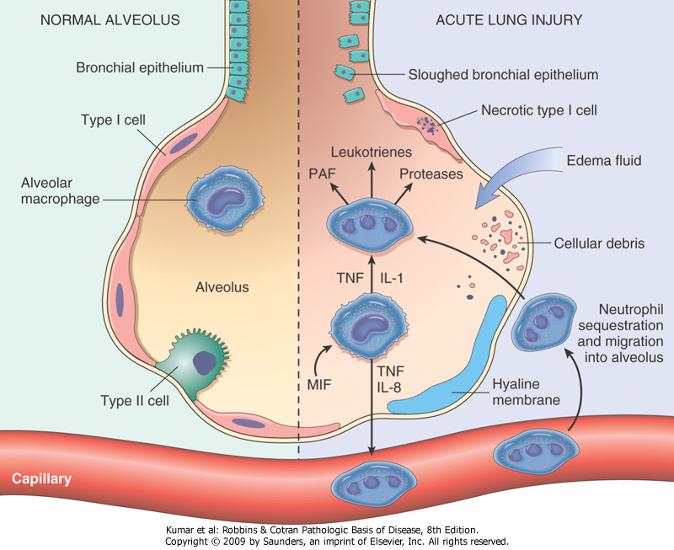

Slide 13
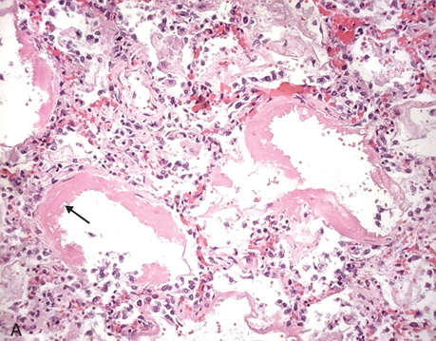
Diffuse alveolar damage: hyaline membranes

Slide 14
Respiratory Pathology Outline
Acute respiratory distress syndrome
Obstructive lung diseases

Slide 15
Respiratory Pathology Outline
Acute respiratory distress syndrome
Obstructive lung diseases
  Emphysema
  Chronic bronchitis
  Asthma
  Bronchiectasis

Slide 16
Emphysema
Destruction/enlargement of airspaces
Centriacinar emphysema
  Destruction of proximal acinus
  Worse in upper lobes of lung
  Smoking
Panacinar emphysema
  Destruction of entire acinus
  Worse in lower lobes of lung
  Alpha-1-antitrypsin deficiency

Slide 17
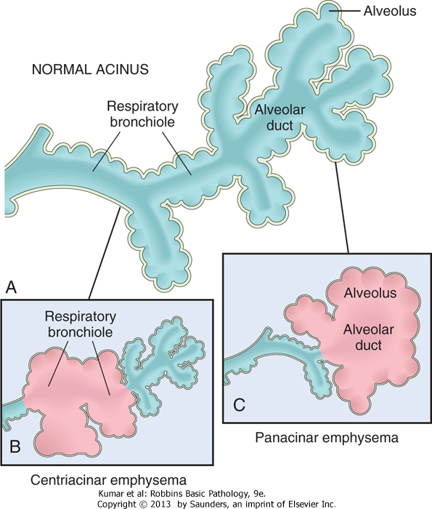

Slide 18

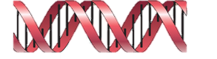
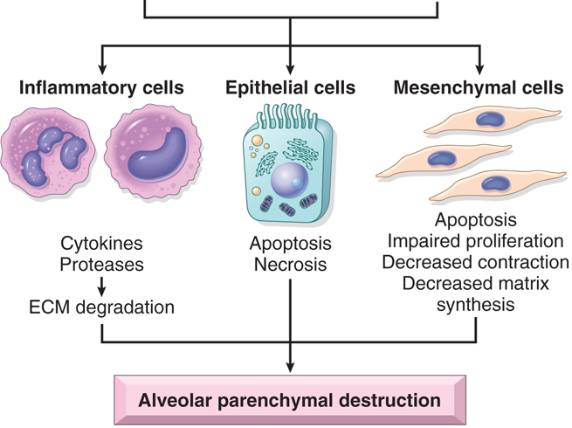
Pathogenesis of emphysema
Smoking
α-1 antitrypsin deficiency

Slide 19
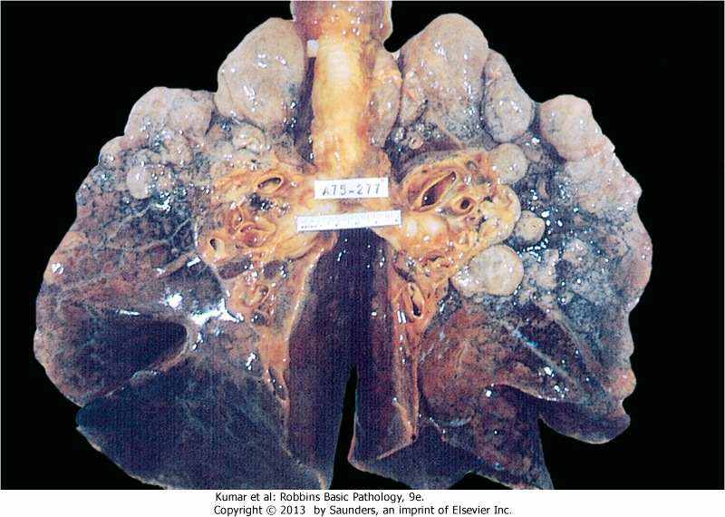
Emphysema: dilated air spaces

Slide 20
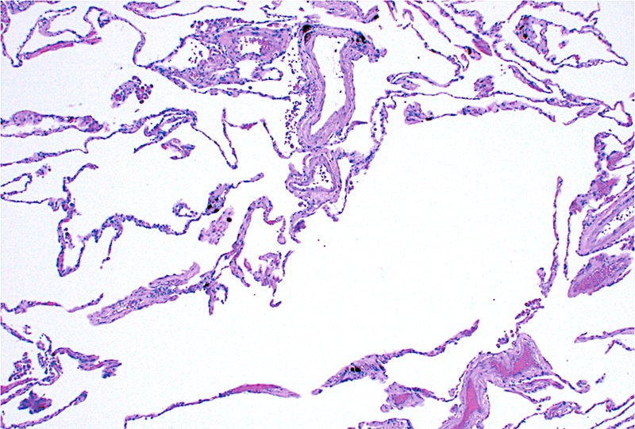
Emphysema: dilated air spaces

Slide 21
Chronic Bronchitis
Definition: persistent, productive cough for ≥ 3 months in ≥ 2 consecutive years
Pathogenesis: hypersecretion of mucous
Cause: smoking (mostly) and pollution

Slide 22
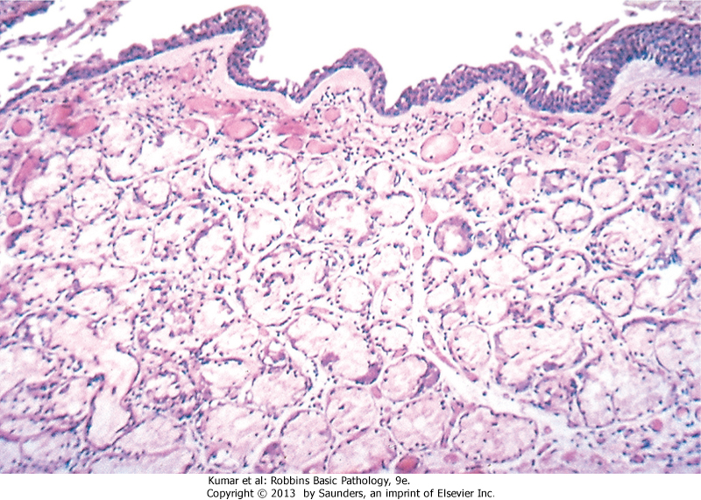
Chronic bronchitis: mucous gland hyperplasia

Slide 23
Asthma
Chronic inflammatory disease of airways leading to bronchial constriction
Symptoms: wheezing, breathlessness
Hallmarks: intermittent, reversible airway obstruction, chronic inflammation, increased mucus.
Atopic (allergic) vs. non-atopic
Triggers: allergens, infection, smoke, cold, exercise

Slide 24
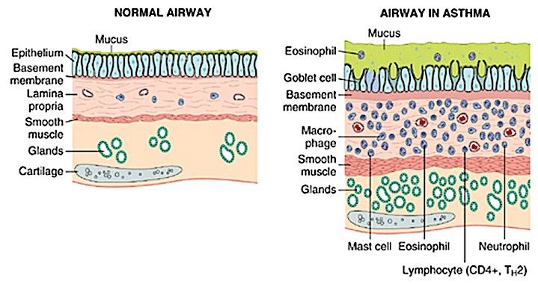

Slide 25
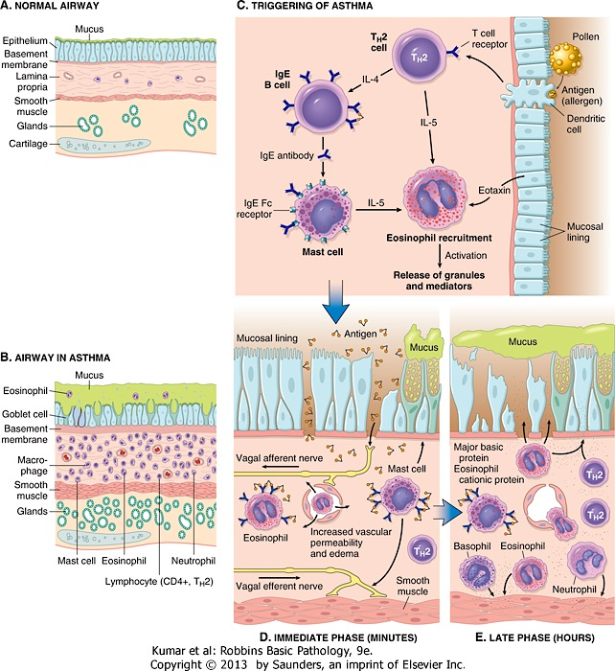
How is asthma triggered?

Slide 26
Then what happens?

Slide 27
Bronchiectasis
Permanent dilation of bronchi and bronchioles due to chronic inflammation
Secondary to:
  obstruction (tumor)
  congenital conditions (cystic fibrosis)
  bad pneumonia

Slide 28
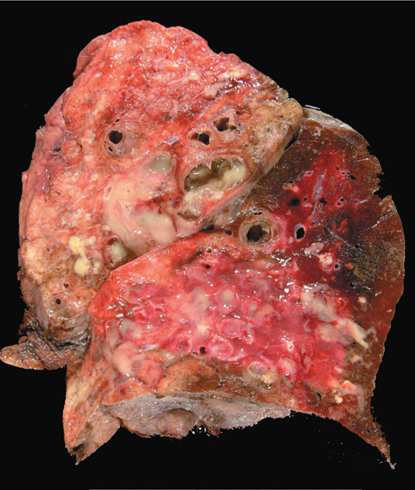
Bronchiectasis

Slide 29
Respiratory Pathology Outline
Acute respiratory distress syndrome
Obstructive lung diseases
Restrictive lung diseases

Slide 30
Idiopathic pulmonary fibrosis
Patchy, progressive lung fibrosis
Symptoms: gradual onset cough, dyspnea. Respiratory failure and cor pulmonale within about 3 years
Radiologic and histologic term: “usual interstitial pneumonia”

Slide 31
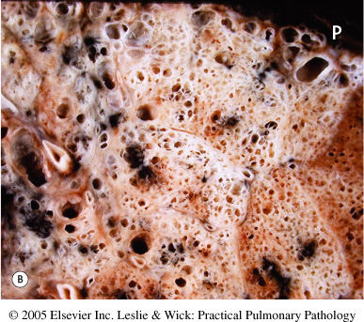
IPF: fibrotic lung

Slide 32
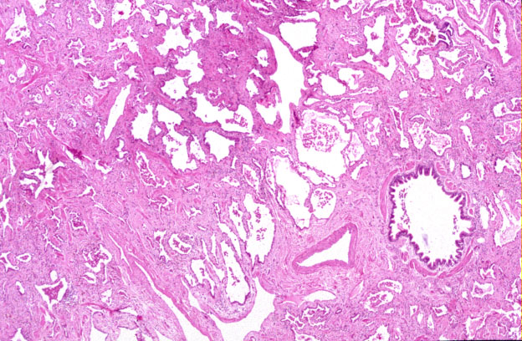
IPF: tons of fibrosis

Slide 33
Pneumoconioses
Disorders caused by inhalation of mineral dusts
Size matters (1-5 μm particles are worst)
Three main dust particles:
  Carbon (coal workers)
  Silica (sandblasting, mining, ceramics)
  Asbestos (mining, insulation removal)

Slide 34
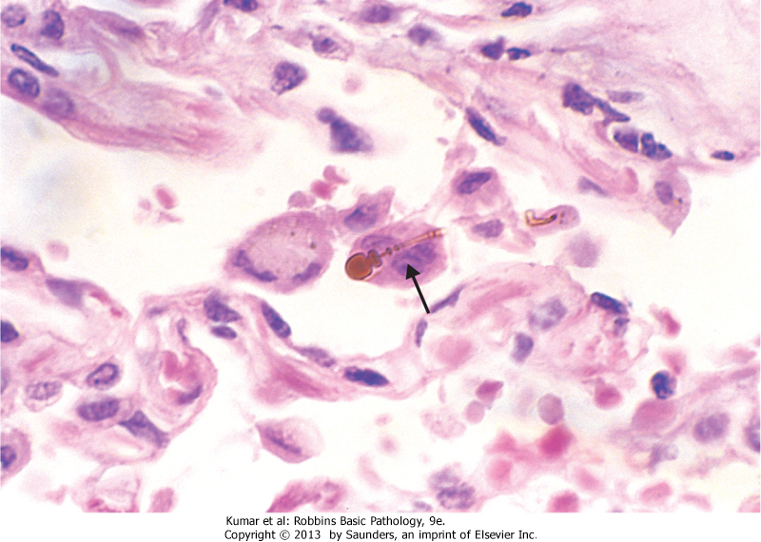
Asbestos fibers

Slide 35
Respiratory Pathology Outline
Acute respiratory distress syndrome
Obstructive lung diseases
Restrictive lung diseases
Vascular diseases

Slide 36
Pulmonary embolism
Most arise from leg veins
Small emboli may be asymptomatic, cause infarction, or cause hemoptysis
Medium-sized emboli (less common) cause shortness of breath and infarction
Large emboli (even less common) can cause sudden death

Slide 37
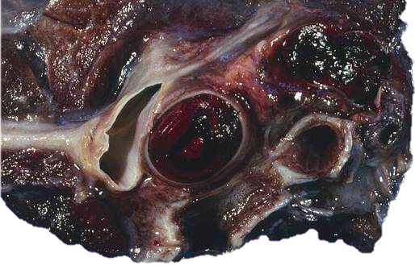
Pulmonary embolism

Slide 38
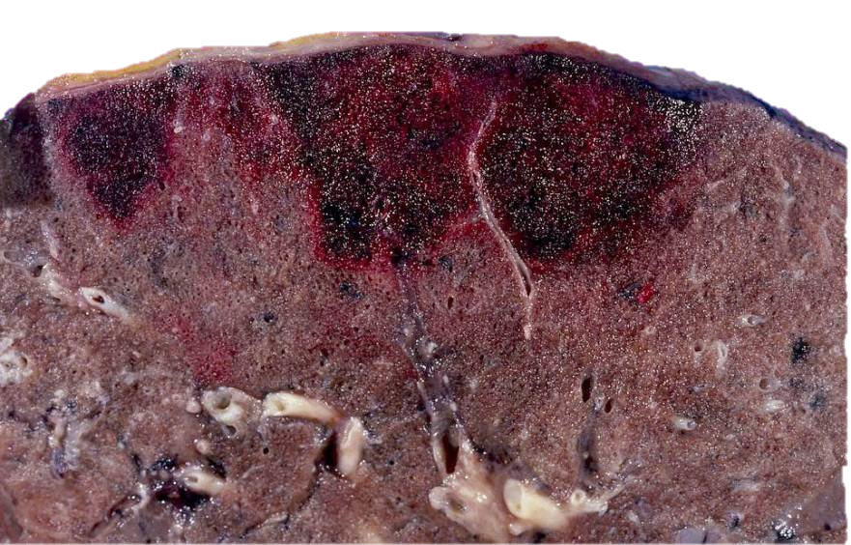
Pulmonary infarcts

Slide 39
Respiratory Pathology Outline
Acute respiratory distress syndrome
Obstructive lung diseases
Restrictive lung diseases
Vascular diseases
Infections

Slide 40
Pneumonia
1/6 of all deaths in the US!
Can be acute or chronic
Causes: bacteria, viruses
Different anatomic patterns
Different clinical settings

Slide 41
Typical bugs in different clinical settings
Community-acquired
Streptococcus pneumoniae
Haemophilus influenzae
Mycoplasma pneumoniae
viruses
Immunocompromised
Cytomegalovirus
Pneumocystis jiroveci
Aspergillus
Nosocomial
gram-negative rods
Staphylococcus aureus
Chronic
Mycobacterium tuberculosis
Histoplasma capsulatum
Aspiration
Anaerobic bacteria

Slide 42
Most community-acquired pneumonias are one of these:
Alveolar
Streptococcus pneumoniae*
Staphylococcus aureus
Hemophilus influenzae
Interstitial
viruses
Mycoplasma pneumoniae
* Most common

Slide 43
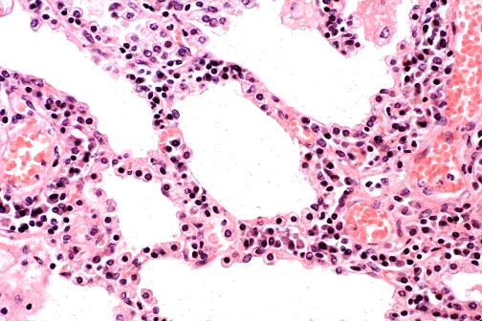
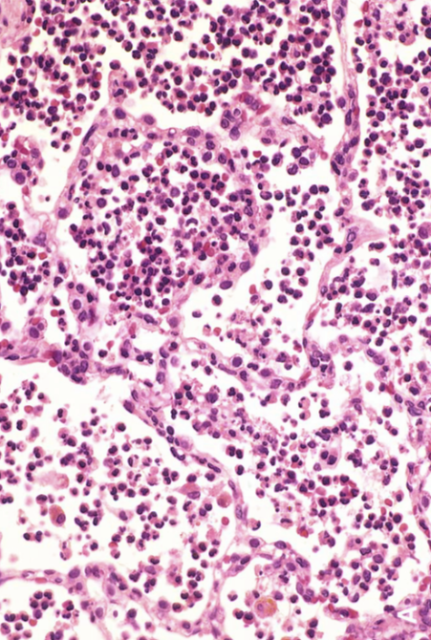
interstitial inflammation
alveolar inflammation
Viral pneumonia
Bacterial pneumonia

Slide 44
Lung abscess
Localized collection of pus
Bugs: Staph, Strep, gram-negative bugs, anaerobes, or mixture
Pathogenesis: aspiration of infected material (from teeth, sinuses), aspiration of gastric contents, as complication of nasty bacterial pneumonia

Slide 45
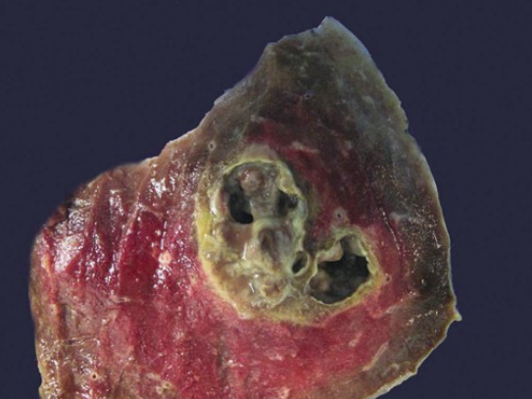
Lung abscess

Slide 46
Tuberculosis
Cause: Mycobacterium tuberculosis
Chronic, granulomatous disease that can involve any organ but often involves lungs
Spread by respiratory droplet
Primary (initial) TB: Ghon complex.
Secondary (reactivation) TB: Cavitating granulomas.

Slide 47
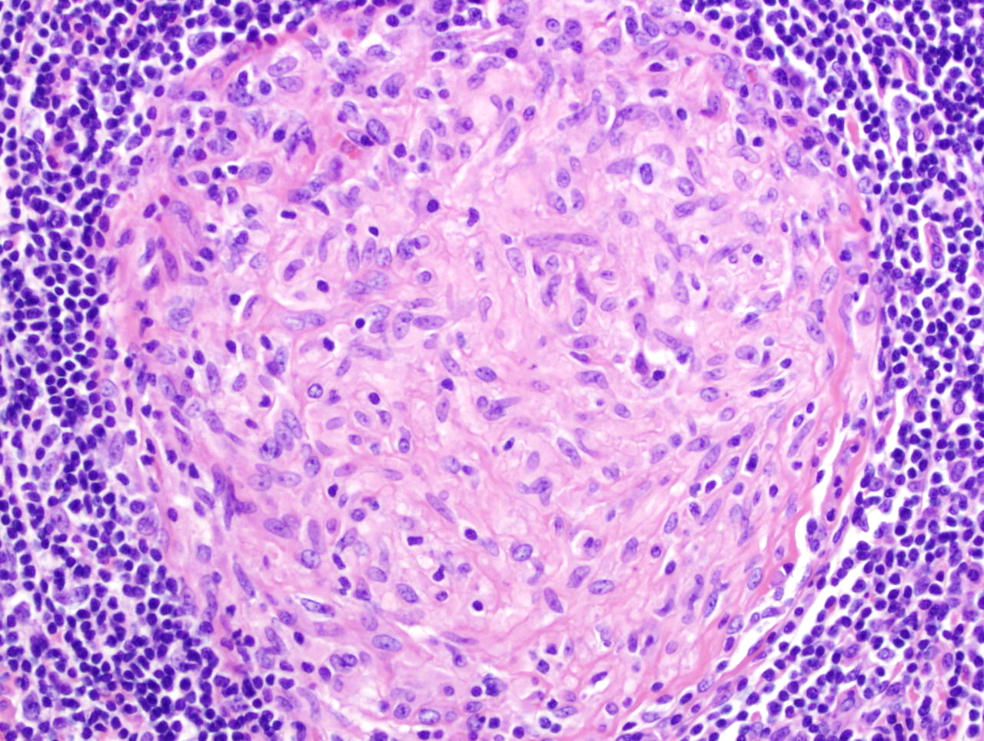
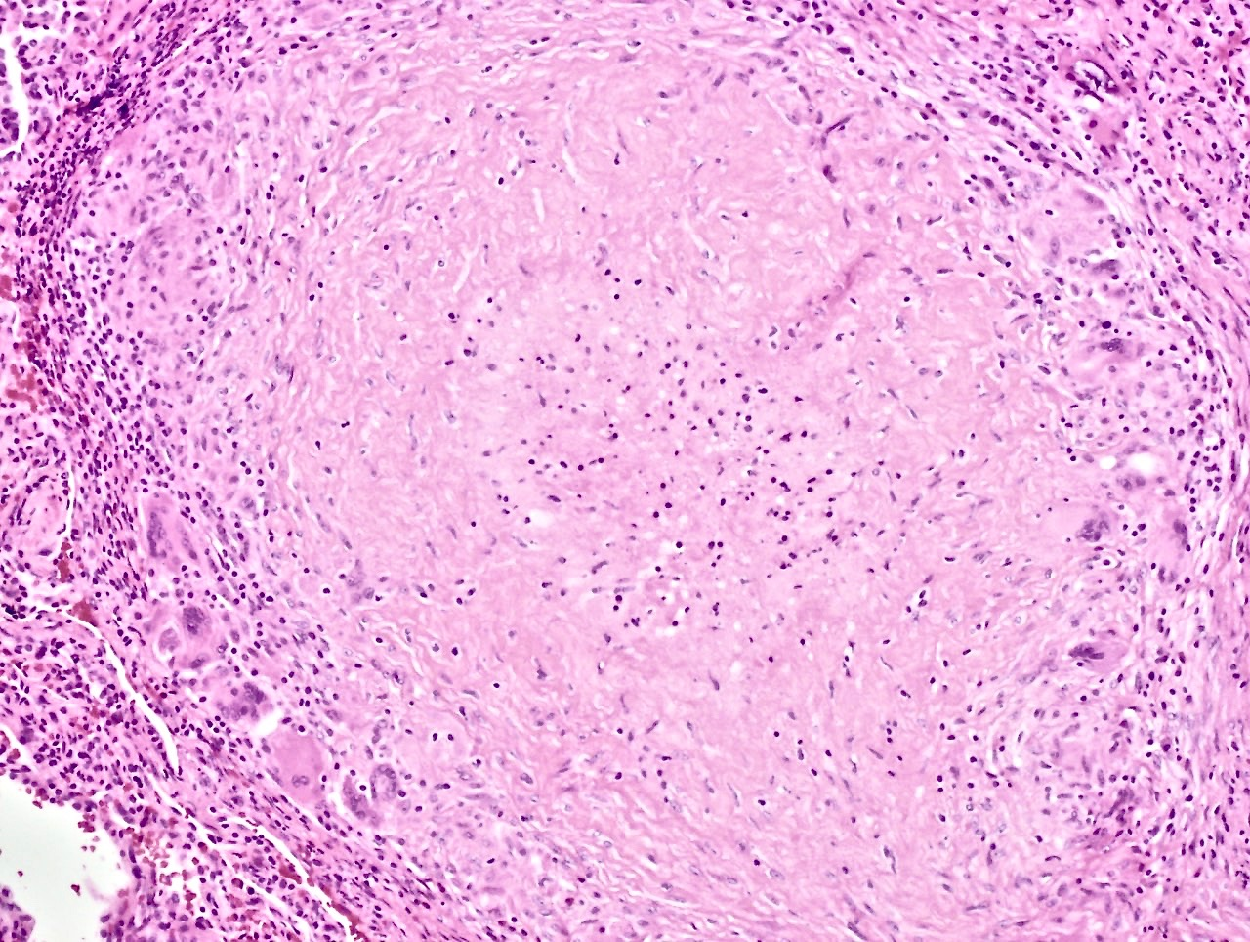
necrotic debris
just macrophages (no necrotic debris)
lymphocytes
macrophages
Regular (non-caseating) granuloma
Caseating granuloma

Slide 48
regular macrophages
necrotic debris
foreign-body giant cells
Caseating granuloma

Slide 49
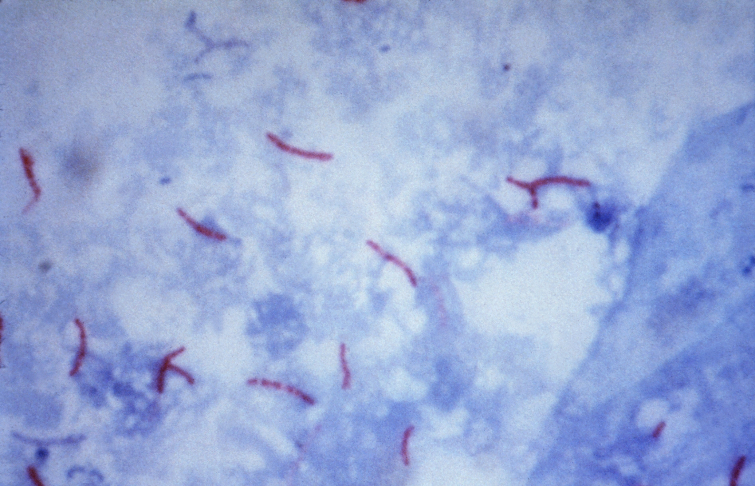
TB organisms (acid-fast stain)

Slide 50
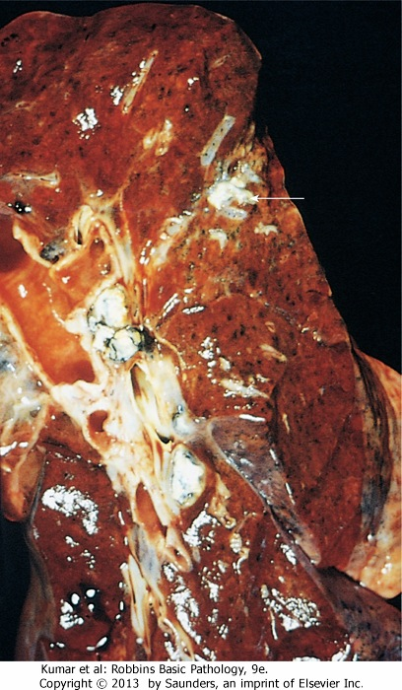
lung lesion
involved
lymph nodes
Ghon complex: lung lesion + involved nodes

Slide 51
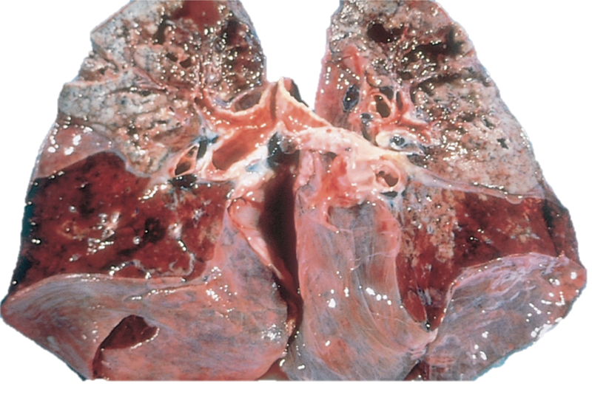
Secondary TB: tons of caseating, cavitating necrosis

Slide 52
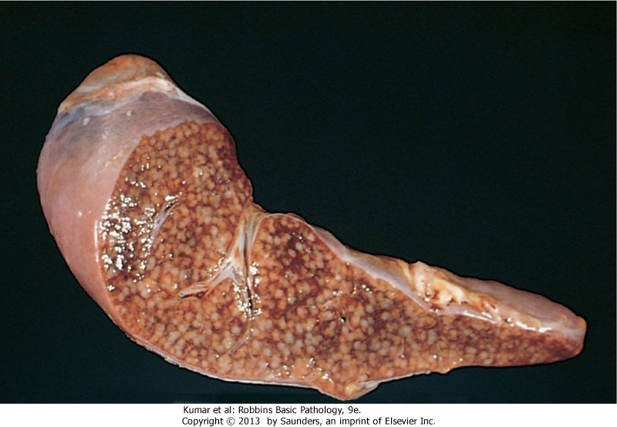
Spleen: miliary TB

Slide 53
Opportunistic pneumonias
Affect immunosuppressed patients (patients with AIDS, cancer, post-transplant)
Unusual organisms:
  Pneumocystis jiroveci
  Aspergillus
  Cytomegalovirus

Slide 54
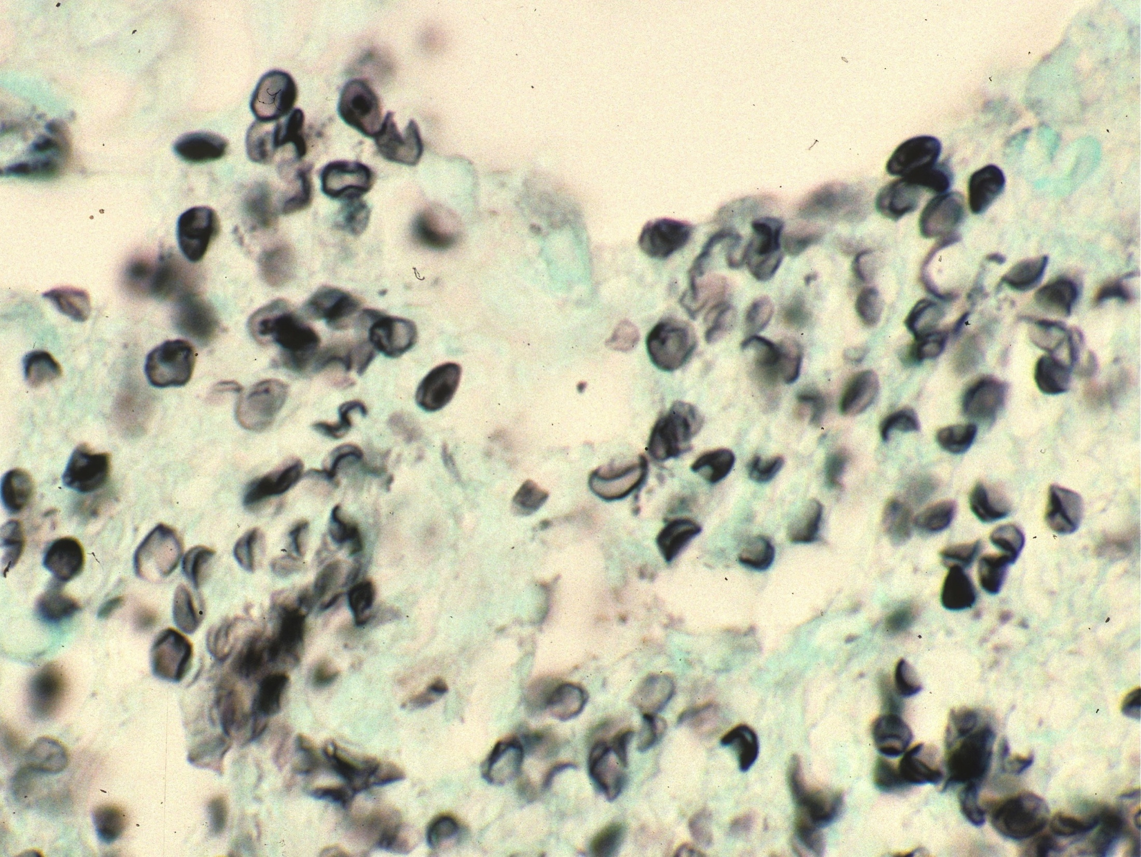
Crushed Ping-Pong ball shaped organisms
Crescent shaped organisms
Pneumocystis

Slide 55
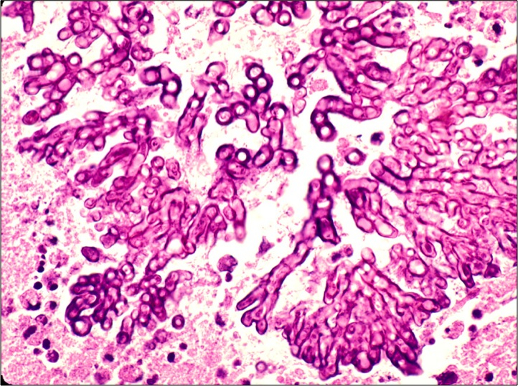
Aspergillus

Slide 56
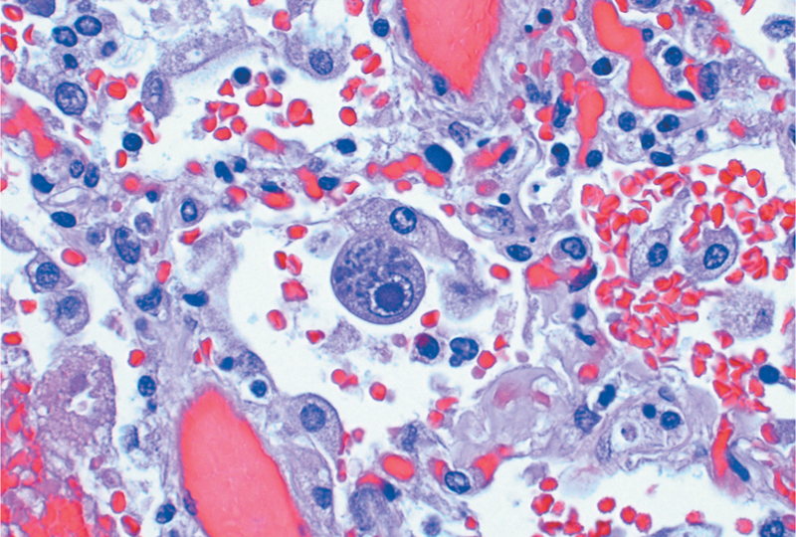
Cytomegalovirus (two kinds of inclusions)

Slide 57
Respiratory Pathology Outline
Acute respiratory distress syndrome
Obstructive lung diseases
Restrictive lung diseases
Vascular diseases
Infections
Carcinoma

Slide 58
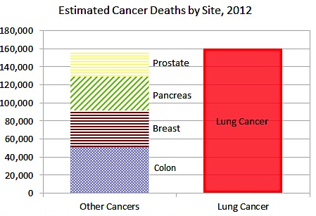

Slide 59
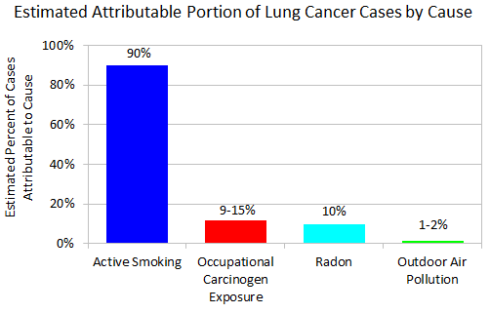

Slide 60
Types of lung cancer
Adenocarcinoma
Squamous cell carcinoma
Large cell carcinoma
Small cell carcinoma

Slide 61
Types of lung cancer
Adenocarcinoma
Squamous cell carcinoma
Large cell carcinoma
Small cell carcinoma
NSCLC
SCLC

Slide 62
Presenting symptoms
Potentially curable
asymptomatic
cough
hemoptysis
Usually incurable
dyspnea
chest pain
anorexia & weight loss
hoarseness
bone pain

Slide 63
Survival statistics…bad.
At diagnosis, >50% have metastases
Overall (all stages) 5ys = 16%
Localized disease 5ys = 45%

Slide 64
Adenocarcinoma
Most common type, especially in women and non-smokers
Usually peripherally located
Adenocarcinoma in situ is a rare form of adenocarcinoma with a better prognosis (5ys = 40%)

Slide 65
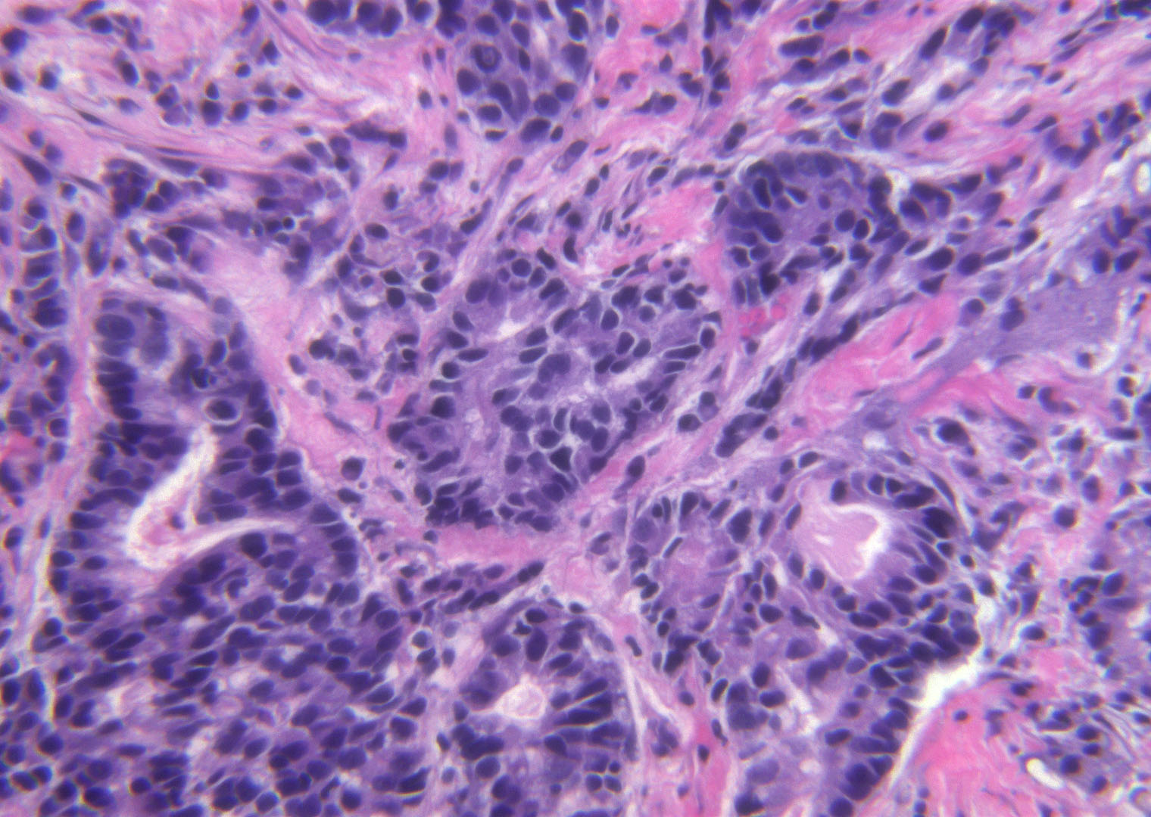
Adenocarcinoma

Slide 66
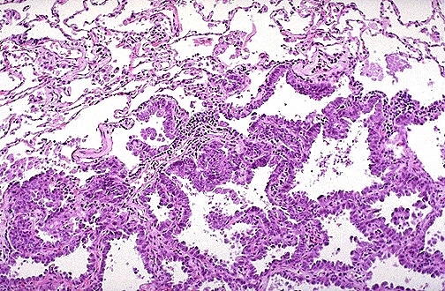
Adenocarcinoma in situ

Slide 67
Squamous cell carcinoma
Malignant tumor of squamous cells
Usually centrally located
Usually preceded by distinct lesions

Slide 68
Squamous cell carcinoma

Slide 69
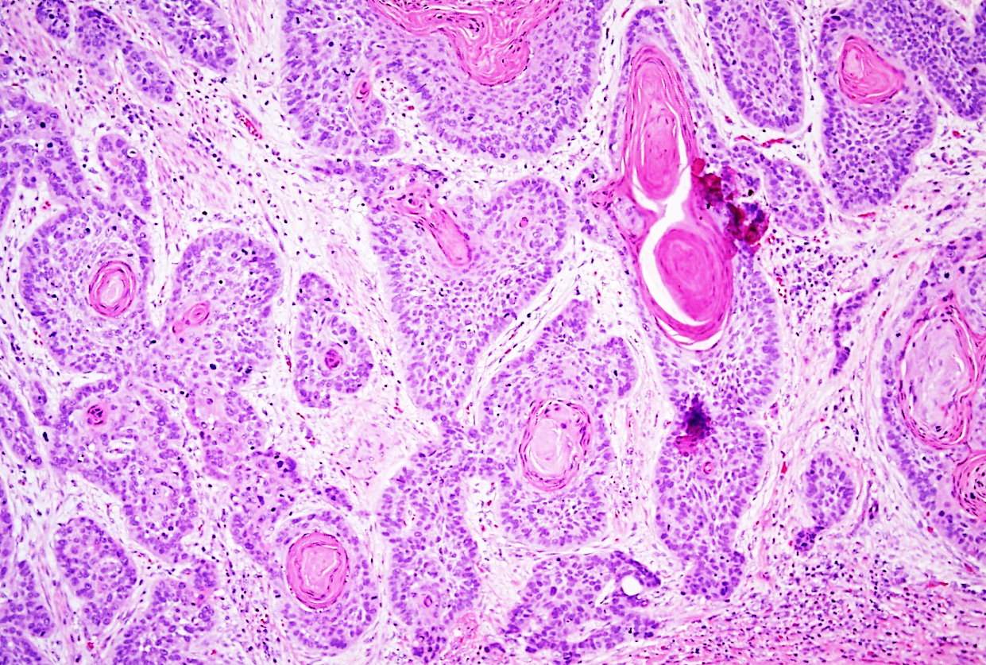
Squamous cell carcinoma

Slide 70
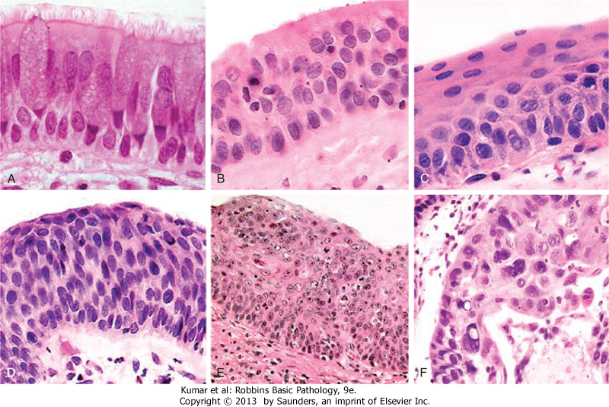
Squamous cell carcinoma precursor lesions
squamous metaplasia
dysplasia
carcinoma in situ

Slide 71
Small cell carcinoma
VERY high mortality
Small cells, minimal cytoplasm, “molding”
High growth fraction yet treatment ineffective
Median survival (with treatment) = 1 year

Slide 72
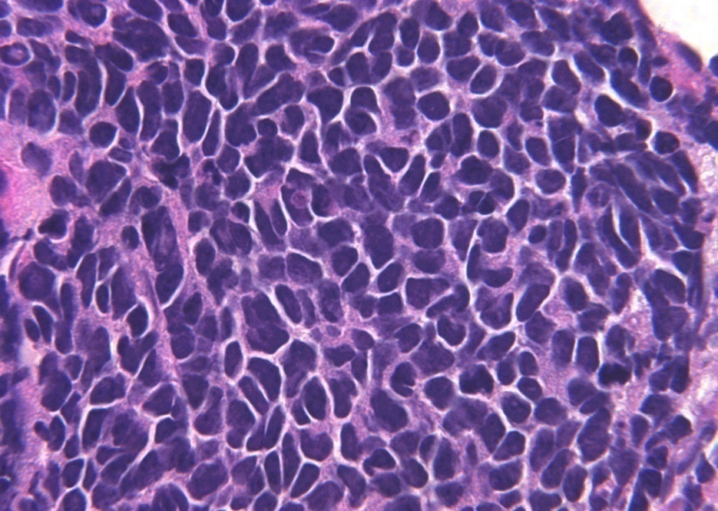
Small cell carcinoma

Slide 73
Mesothelioma
Malignant tumor of mesothelial cells
Most patients have had asbestos exposure
Not related to smoking
Highly malignant; short survival.

Slide 74
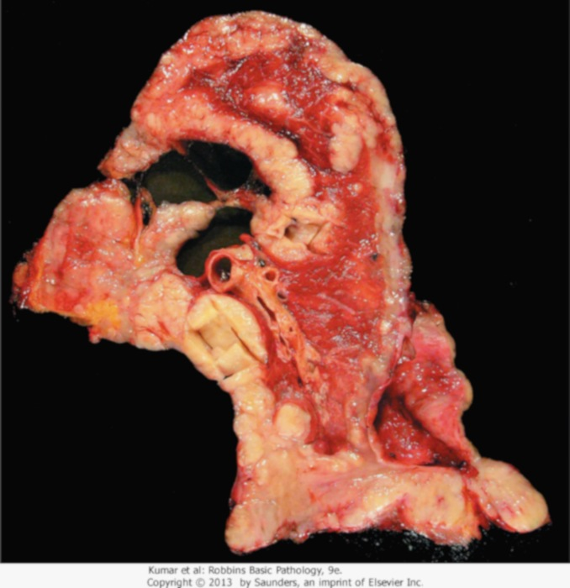
Mesothelioma

