Slide 1
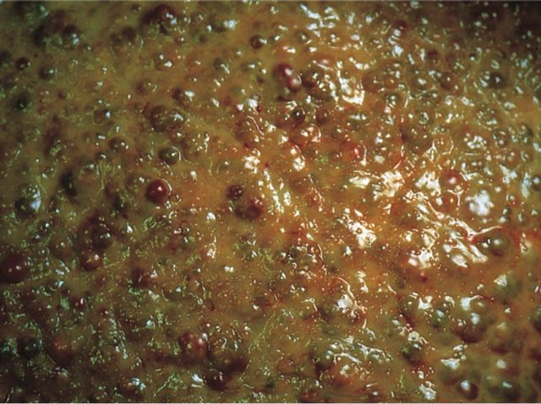
Liver, Gallbladder, and Pancreas Pathology
Kristine Krafts, M.D.

Slide 2
GI Pathology Outline
Esophagus
Stomach
Intestine
Liver
  Hepatitis
  Alcoholic liver disease
  Hemochromatosis
  Wilson disease
  Carcinoma

Slide 3
Liver Learning Objectives
For hepatitis A, B, and C, compare and contrast the transmission, and risk of developing chronic hepatitis and carcinoma
Explain normal bilirubin metabolism (How is it made? What happens to it in the liver? How is it excreted?)
What’s the difference between conjugated and unconjugated bilirubin?
Explain why conjugated bilirubin could appear in excess in the blood, and list two specific causes.
Same thing for unconjugated hyperbilirubinemia – why would it happen? List 3 causes.

Slide 4
Liver Learning Objectives
What’s the difference between hepatocyte integrity and hepatocyte function? What lab tests could you use to distinguish between the two?
What substances increase in the blood when the biliary tree is damaged or not working?
Describe what a liver with cirrhosis looks like. What causes cirrhosis? What are the potential consequences?
How would you define portal hypertension in your own words? What’s the usual cause? What are four clinical consequences?

Slide 5
Liver Learning Objectives
List typical causes and symptoms of liver failure.
What oral manifestations could you see in someone with a damaged liver?
What are two liver conditions caused by excessive alcohol use that are typically reversible with abstinence?
What typically happens to the liver if a person continues to use alcohol excessively and chronically?
What are some causes of death in end-stage alcoholism?

Slide 6
Liver Learning Objectives
Describe the inheritance pattern of hereditary hemochromatosis. What does the mutation in the hemochromatosis gene cause? What are some symptoms and treatments of this disease?
Same questions for Wilson disease!
What are the causes, symptoms, and general mortality (not numbers) of liver carcinoma?

Slide 7
Gallbladder Learning Objectives
What’s the difference between cholelithiasis and cholecystitis?
List risk factors for cholesterol stones and pigment stones.
List the possible presentations of cholelithiasis.

Slide 8
Pancreas Learning Objectives
Define acute pancreatitis, list how it presents and what causes it, and list two substances that increase in the blood. What’s the general prognosis?
Define chronic pancreatitis, identify the most common cause, and describe its symptoms and prognosis.
What’s the biggest risk factor for pancreatic carcinoma? Why is the mortality so high?

Slide 9
Viral Hepatitis
Caused by Hepatitis A, B, or C viruses
Some cases asymptomatic
Some cases symptomatic:
  Acute (jaundice)
  Chronic (may lead to cirrhosis and liver failure)
  Fulminant (liver failure)

Slide 10
 | Hepatitis A | Hepatitis B | Hepatitis C
Transmission | Fecal-oral | Body fluids Needles | Body fluids Needles
Chronic Hepatitis | None | 5% | >85%
Carcinoma | No | Yes | Yes
Other stuff | 50% of people > 50 are + | Vaccine effective | New drugs are promising
Bottom line | Benign, self-limited disease | Most recover; small % die | Nasty! Almost 10% die

Slide 11
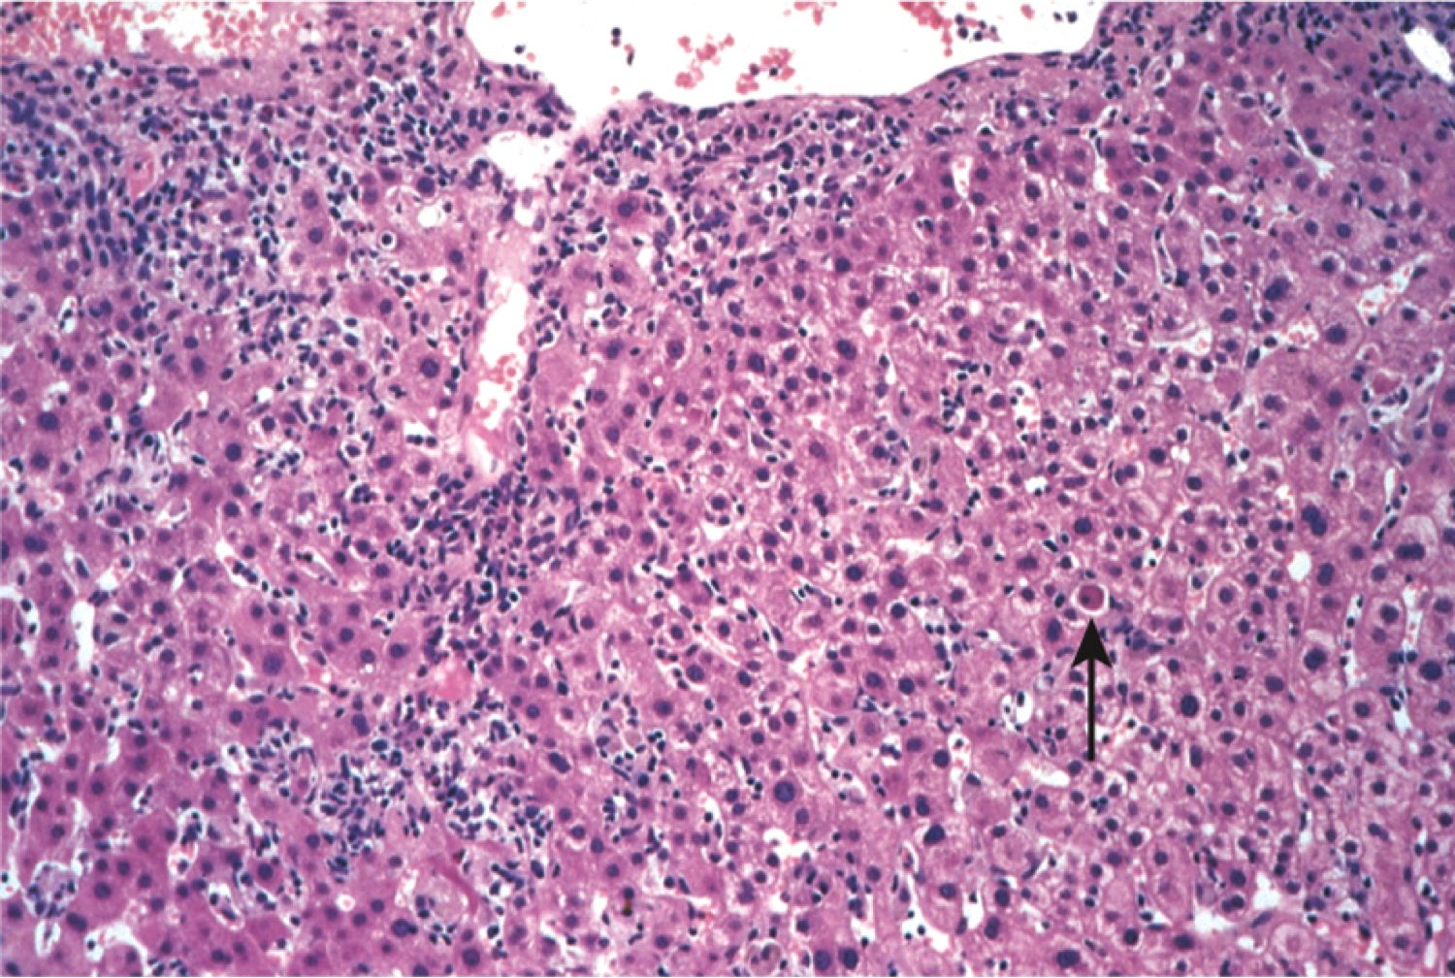
Acute viral hepatitis

Slide 12
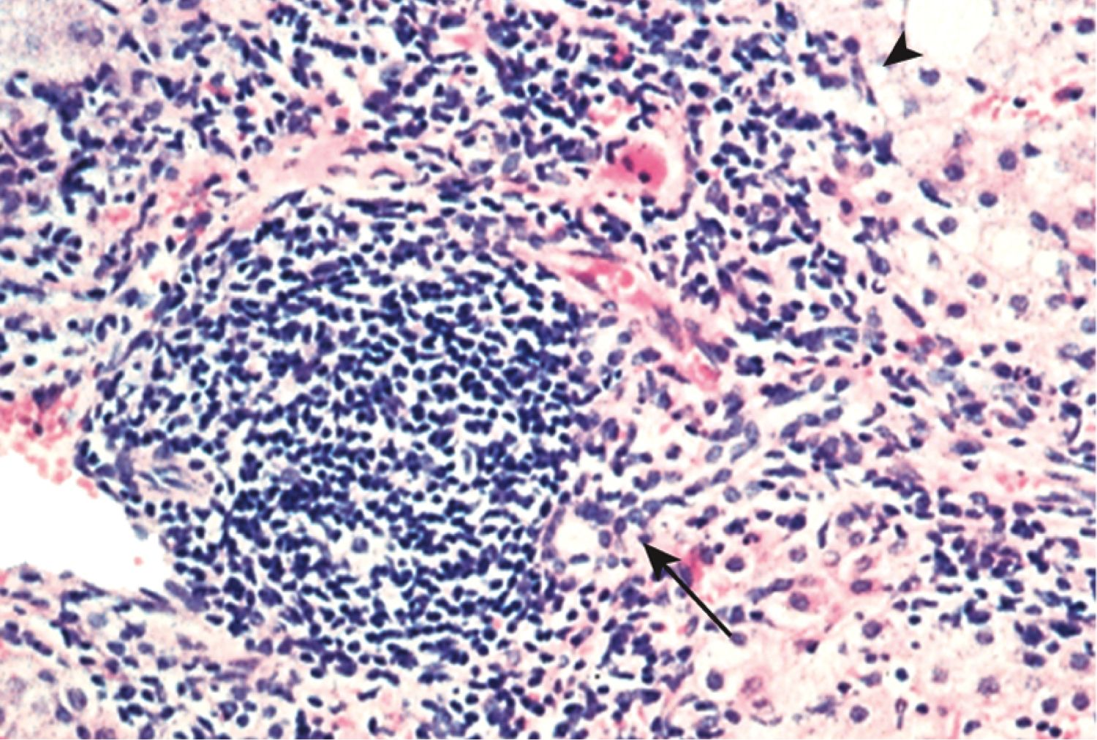
Chronic viral hepatitis

Slide 13
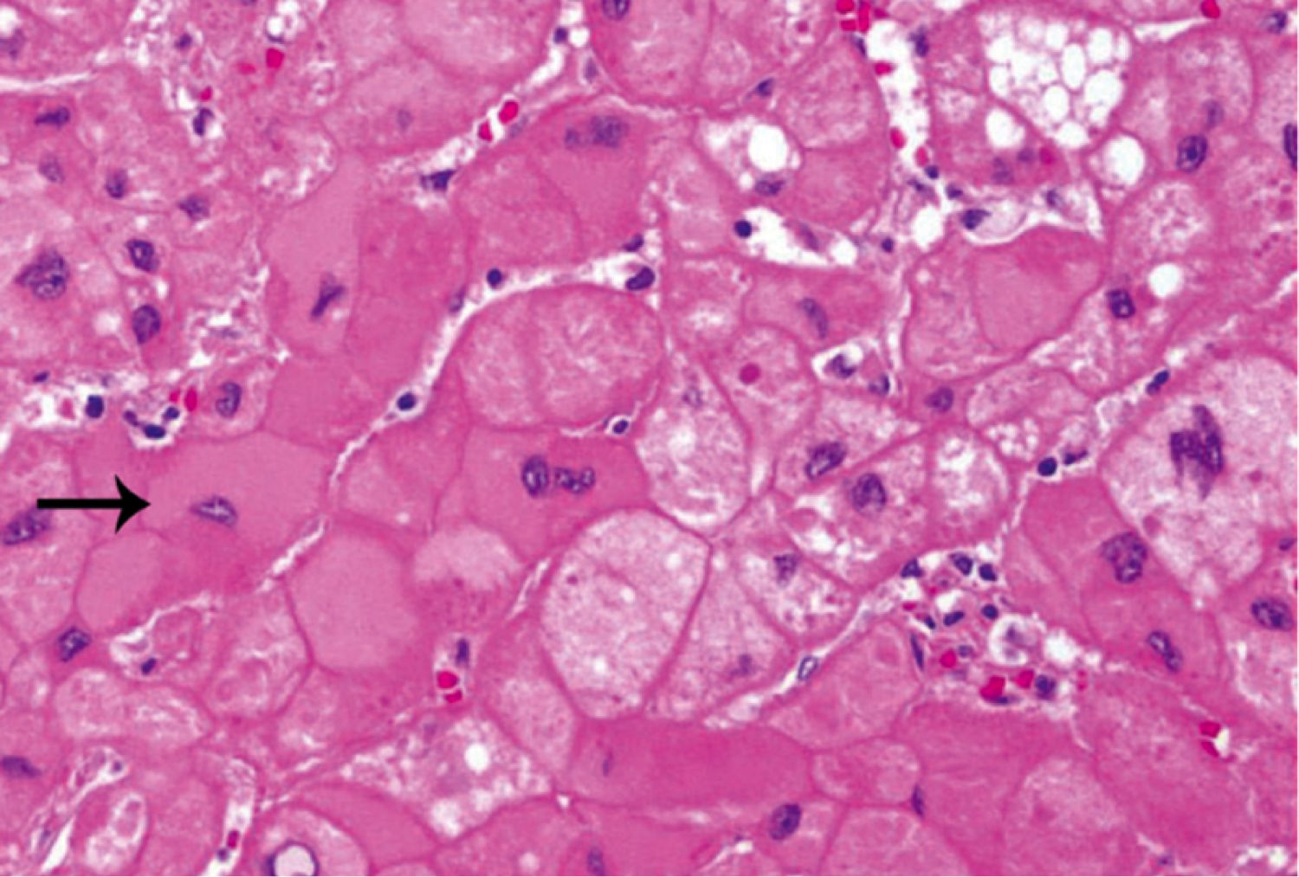
Chronic viral hepatitis: ground-glass hepatocytes

Slide 14
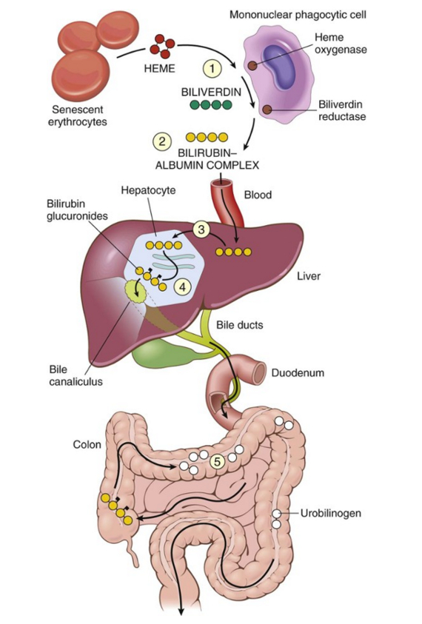
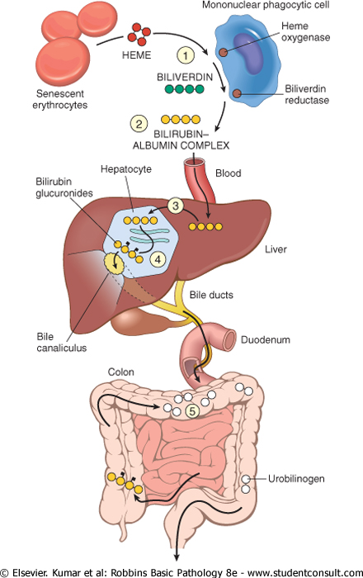
Bilirubin metabolism and elimination

Slide 15
Jaundice
Yellow discoloration of the skin due to hyperbilirubinemia (excess bilirubin in the blood)
The amount of bilirubin in the blood depends on the rate of:
  bilirubin production (from breakdown of red cells)
  bilirubin uptake by the liver
  bilirubin conjugation by the liver
  bilirubin excretion into bile ducts

Slide 16
Hyperbilirubinemia
Conjugated bilirubin = water-soluble (excreted in urine)
Unconjugated bilirubin = insoluble (toxic to tissues!)
Causes of conjugated hyperbilirubinemia:
  blockage in bile flow (e.g., tumor near bile duct)
  congenital disorders affecting bile excretion
Causes of unconjugated hyperbilirubinemia:
  excess bilirubin production (e.g., massive hemolysis)
  impaired bilirubin uptake by liver
  Impaired bilirubin conjugation

Slide 17
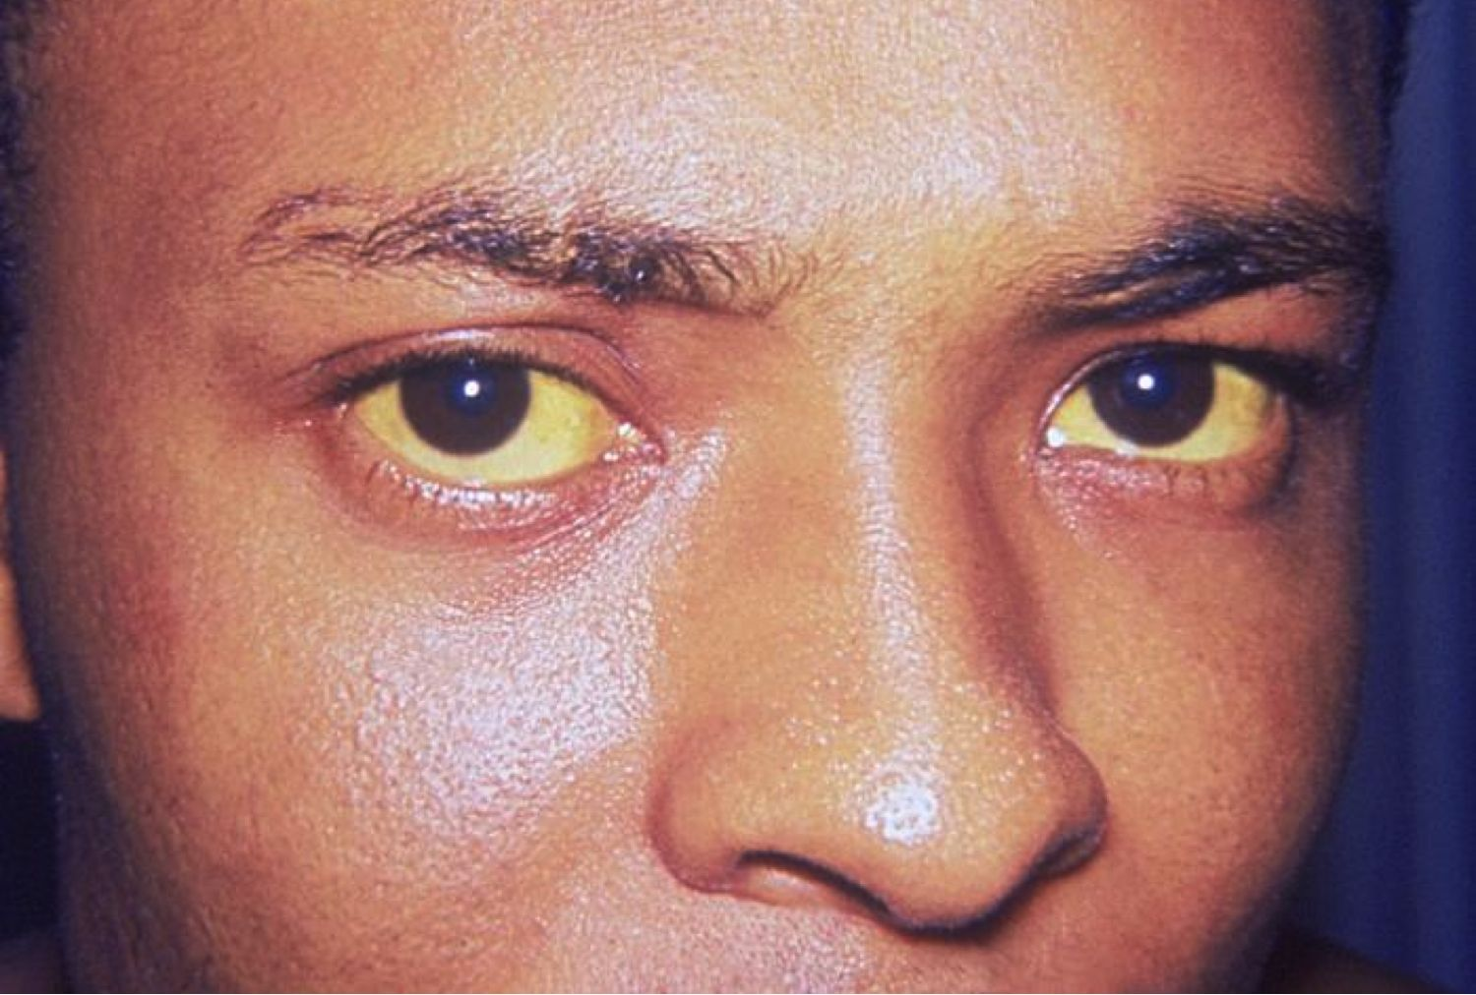
Icterus (only eyes are yellow; may precede jaundice)

Slide 18
Jaundice (yellow skin, eyes, mucous membranes)

Slide 19
Laboratory Tests
Hepatocyte integrity | Serum aspartate aminotransferase (AST)
 | Serum alanine aminotransferase (ALT)
Biliary function | Serum bilirubin (total and direct)
 | Serum alkaline phosphatase
Hepatocyte function | Serum albumin
 | Prothrombin time

Slide 20
Cirrhosis
Fibrotic, nodular liver
Causes: alcoholism, hepatitis
Leads to portal hypertension and liver failure
Increased risk of liver carcinoma

Slide 21
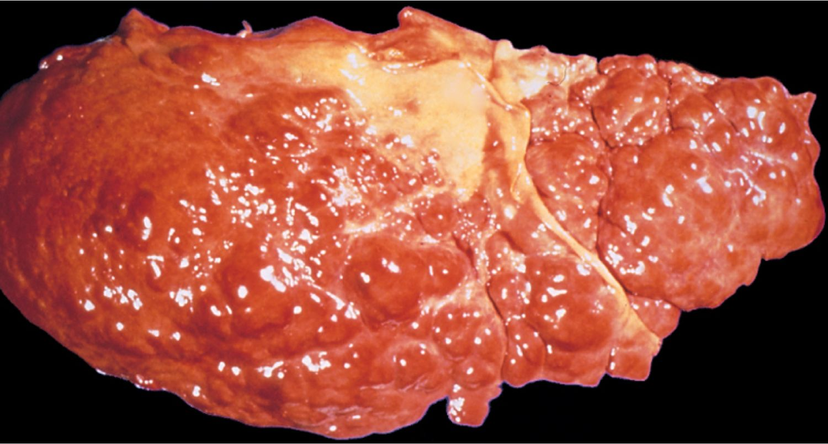
Cirrhosis

Slide 22
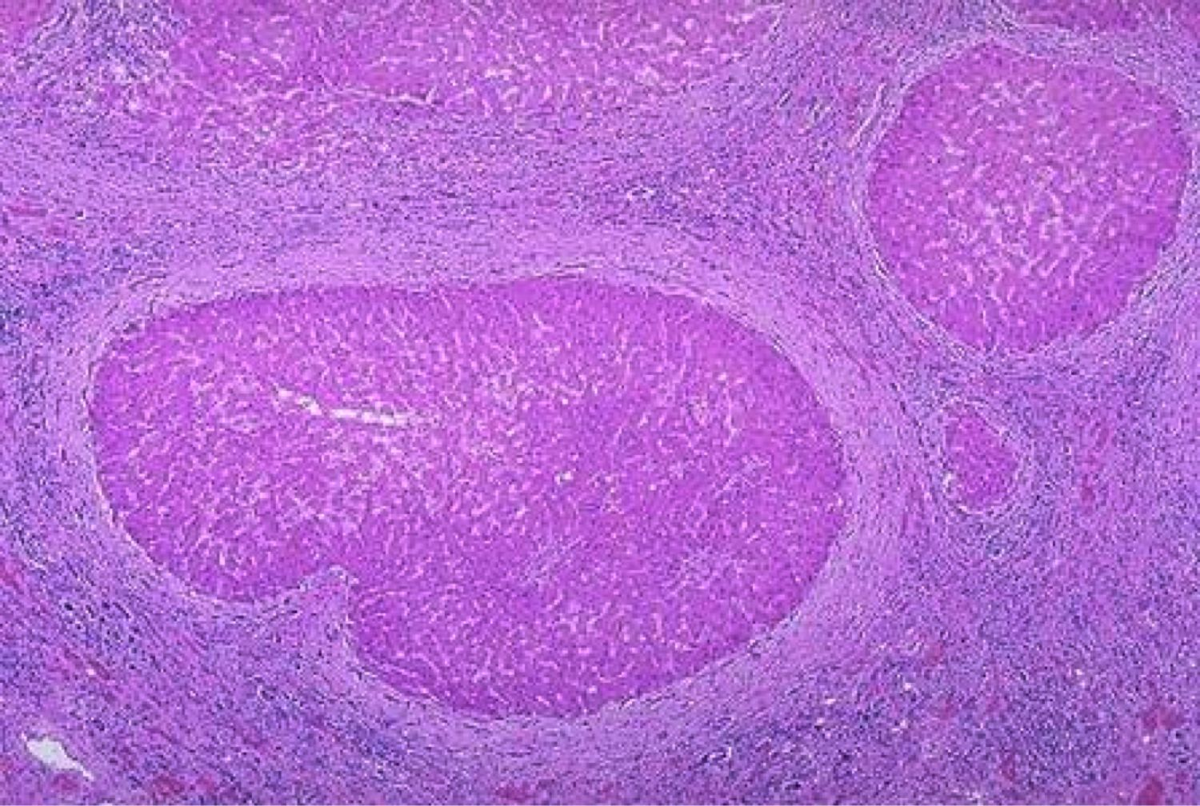
Cirrhosis

Slide 23
Portal Hypertension
Impaired flow of blood through liver
Blood backs up in portal system
Most common cause: cirrhosis
Four main clinical consequences
  ascites (↑ fluid in peritoneal cavity)
  esophageal varices (dilated esophageal veins)
  congestive splenomegaly
  hepatic encephalopathy

Slide 24
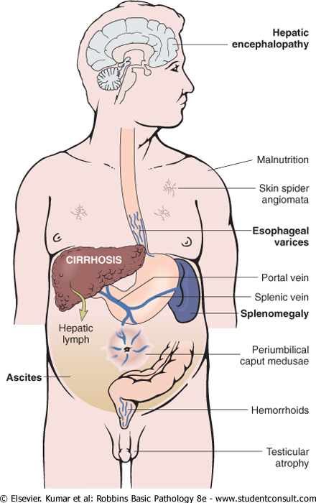
Consequences of portal hypertension

Slide 25
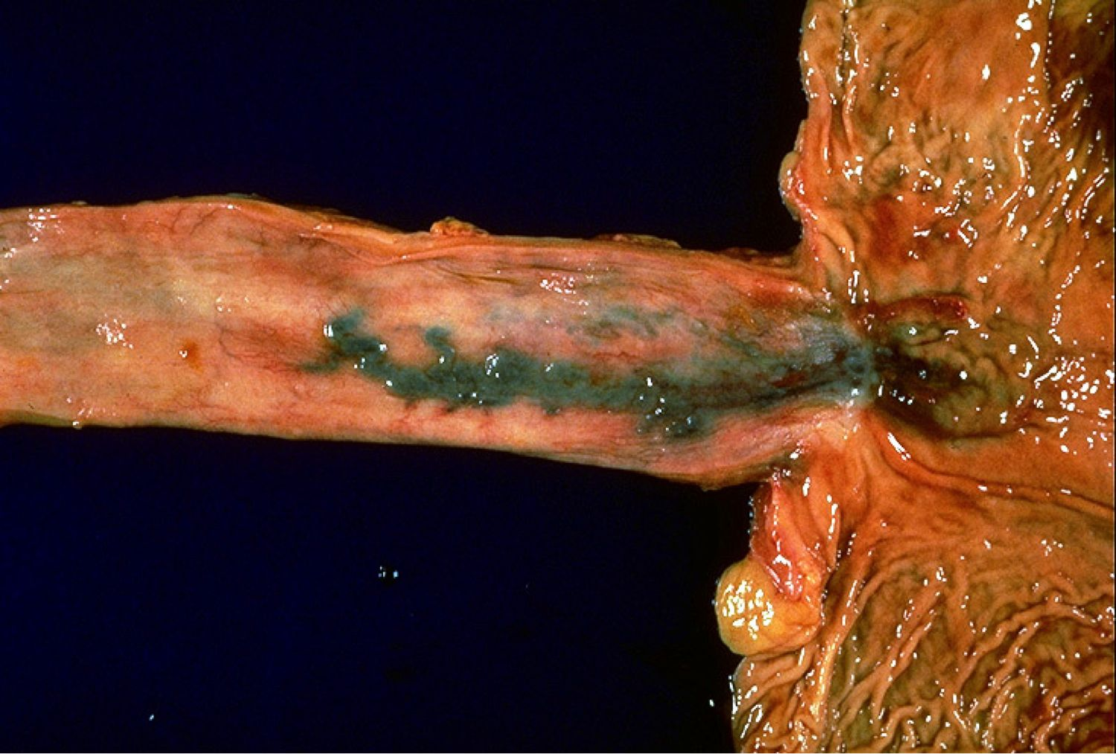
Esophageal varices

Slide 26
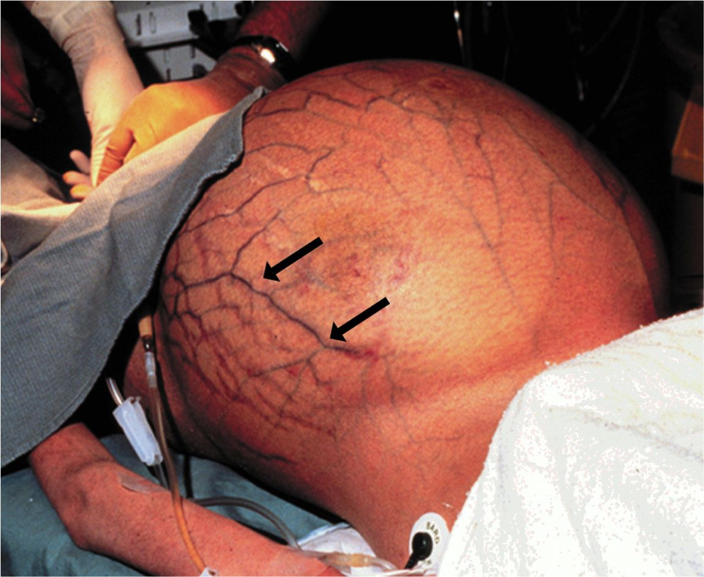
Caput medusae (dilated periumbilical veins)

Slide 27
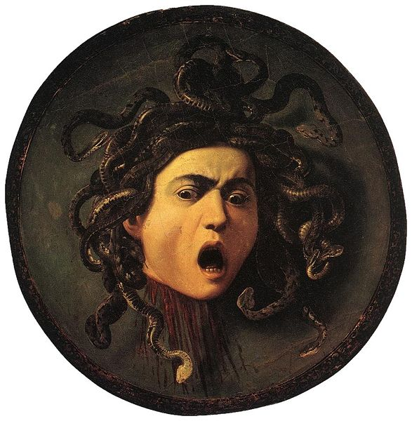
Medusa

Slide 28
Liver Failure
End point of severe liver disease
Causes: fulminant hepatitis, cirrhosis, drug overdose
Symptoms: jaundice, edema, bleeding, hyperammonemia
Multiple organ-system failure
  Hepatic encephalopathy
  Hepatorenal syndrome

Slide 29
Oral Manifestations of Liver Injury
Hematomas, gingival bleeding
Jaundiced mucosa
Glossitis (in alcoholic hepatitis)
Reduced healing after surgery

Slide 30
Alcoholic Liver Disease
100,000 -200,000 deaths/year
Effects on liver: steatosis, hepatitis, cirrhosis
How much do you need to drink?
  Short-term ingestion of 8 beers/day → reversible steatosis
  Long-term ingestion of 5 beers/day → severe injury

Slide 31
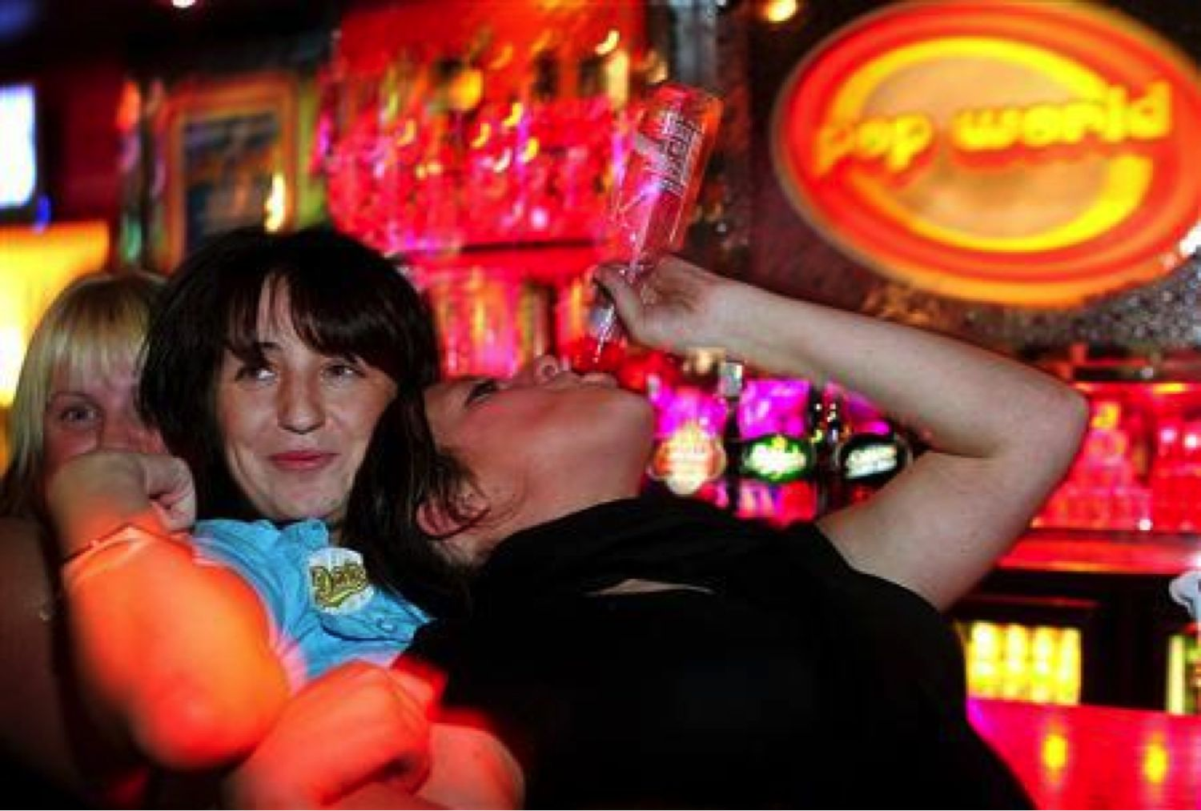
More youth with irreversible liver disease now

Slide 32
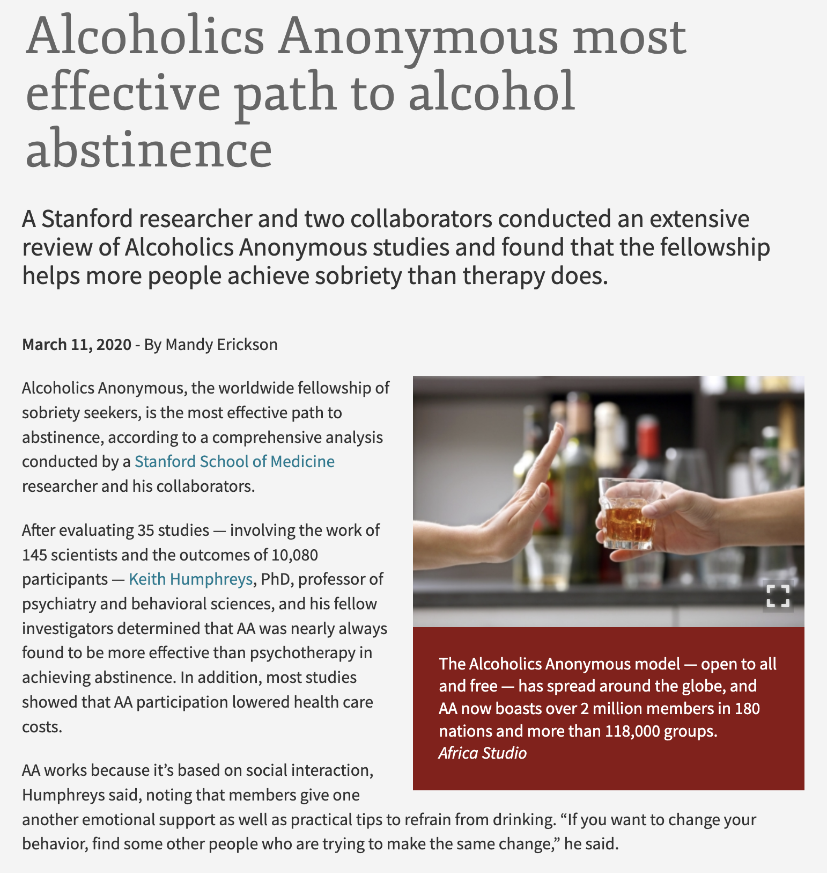

Slide 33
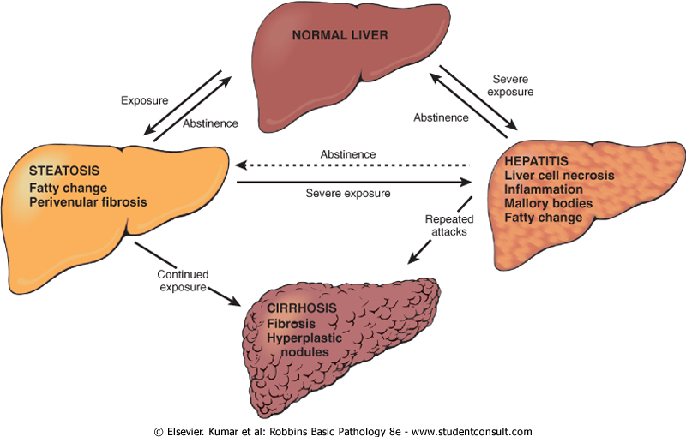
Alcoholic liver disease

Slide 34
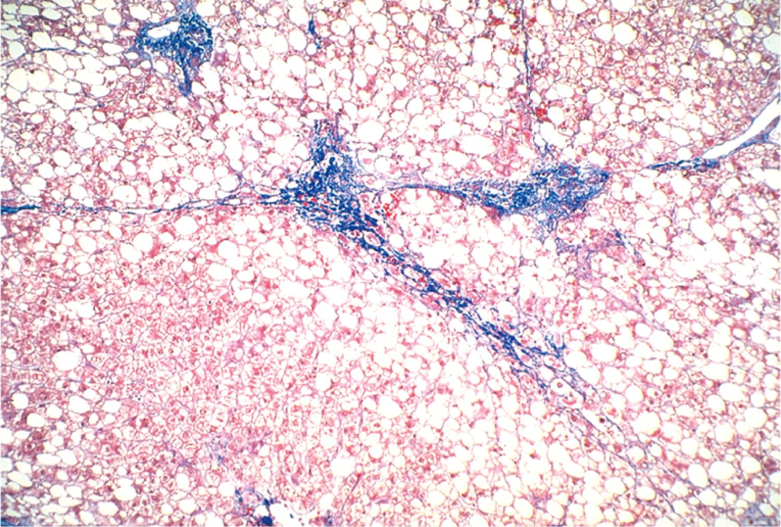
Alcoholic steatosis

Slide 35
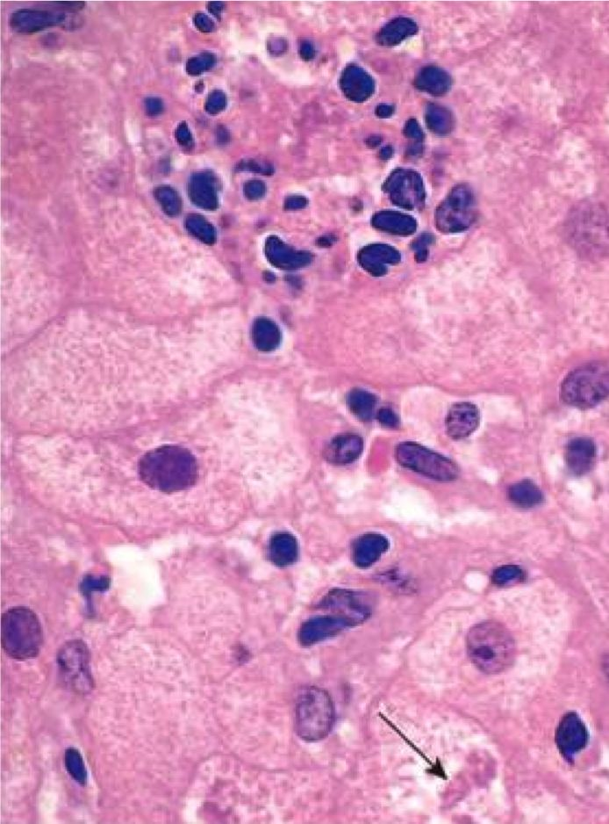
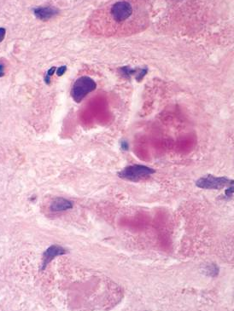
Alcoholic hepatitis: inflammation and Mallory bodies

Slide 36
Alcoholic Liver Disease
Abstinence: 5ys is 90%
Continued drinking: 5ys drops to 50-60%
Causes of death in end-stage alcoholism:
  Liver failure
  Massive GI bleed
  Infection
  Hepatorenal syndrome
  Hepatocellular carcinoma

Slide 37
Hereditary Hemochromatosis
Autosomal recessive disease: ↑ body iron
Cause: mutations in hemochromatosis gene (regulates iron absorption)
Cirrhosis, skin discoloration, liver carcinoma
Early detection and treatment (phlebotomy, iron chelators) = normal life expectancy

Slide 38
Grey-brown skin discoloration in hemochromatosis

Slide 39
Wilson Disease
Autosomal recessive disease: ↑ body copper
Cause: mutation in gene regulating copper excretion
Symptoms: acute and chronic liver disease, neuropsychiatric manifestations, Kayser-Fleisher rings in cornea
Treatment: copper chelation therapy

Slide 40
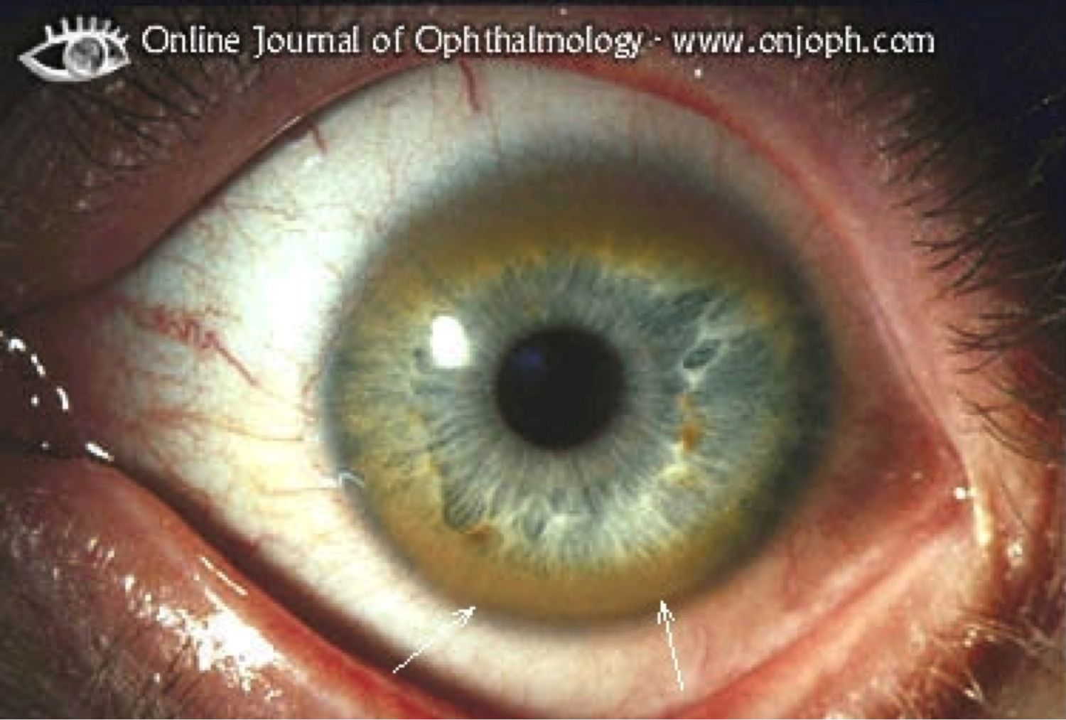
Kayser-Fleischer Rings

Slide 41
Hepatocellular Carcinoma
Strongly associated with hepatitis B and C, chronic liver disease, and aflatoxins
Rapid increase in liver size, worsening ascites, fever and pain
↑↑↑ alpha fetoprotein level
Median survival 7 months (death from bleeding, liver failure, cachexia)

Slide 42
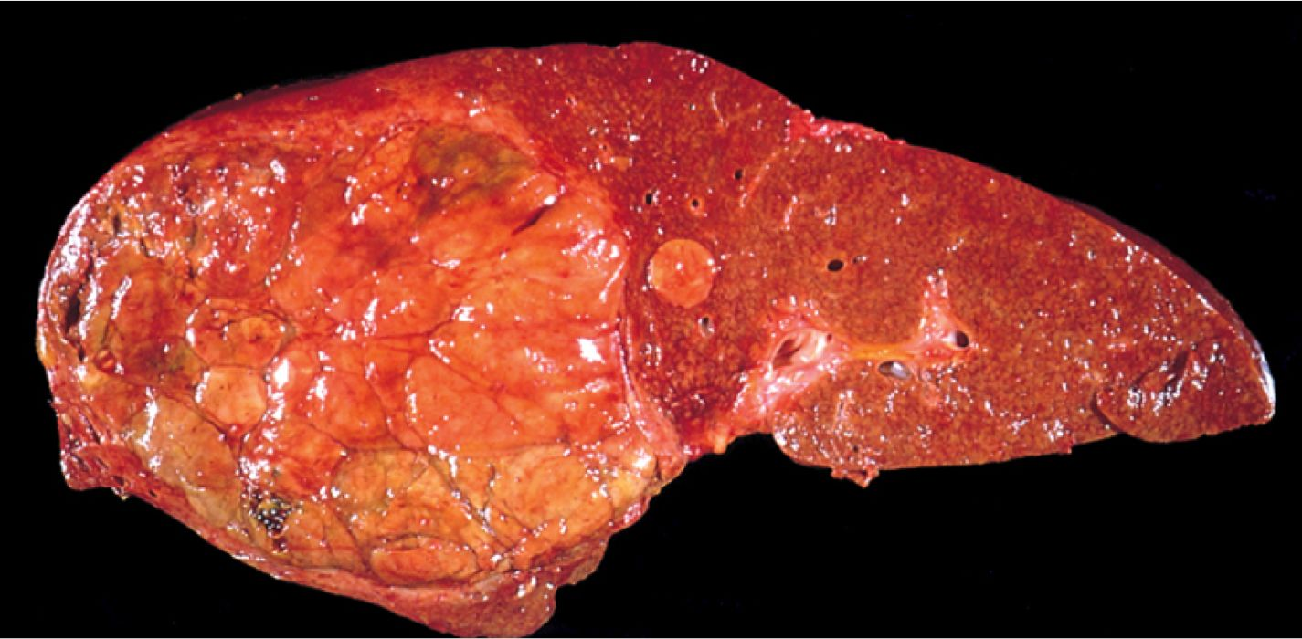
Hepatocellular carcinoma

Slide 43
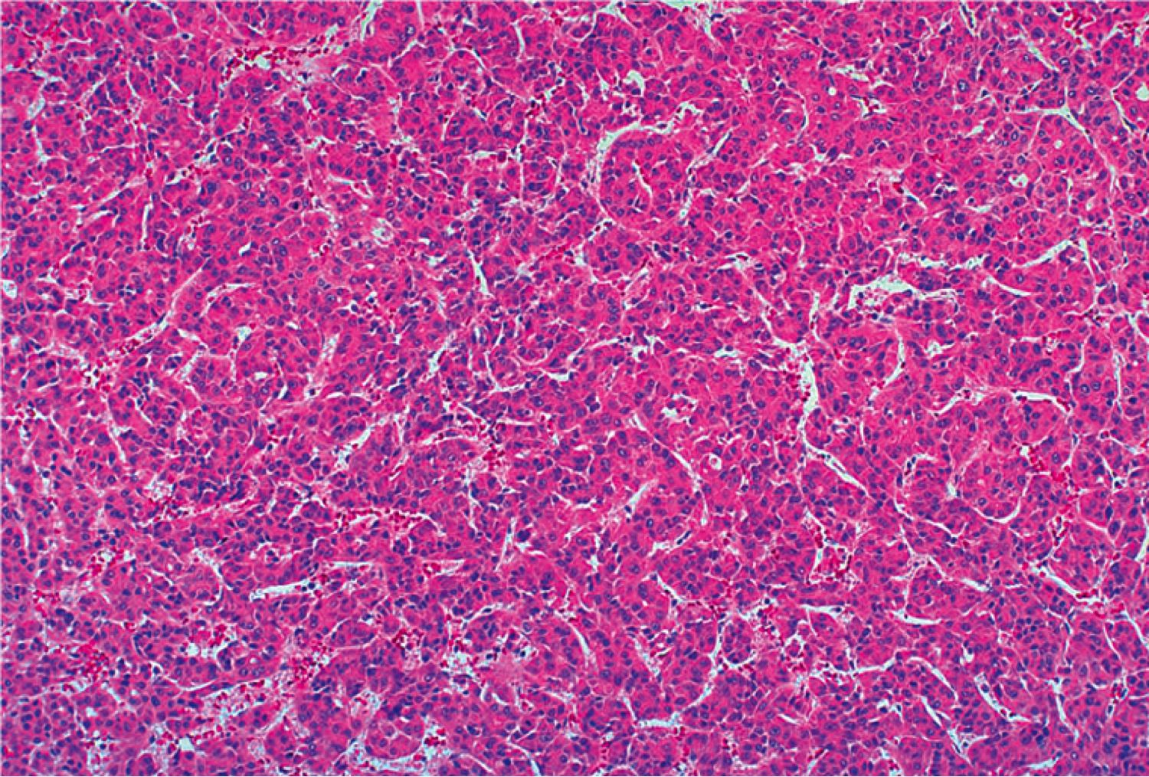
Hepatocellular carcinoma

Slide 44
Metastatic Carcinoma
Most common malignancy in the liver
Usually multiple lesions
Most common primaries: colon, lung, breast, pancreas, stomach.

Slide 45
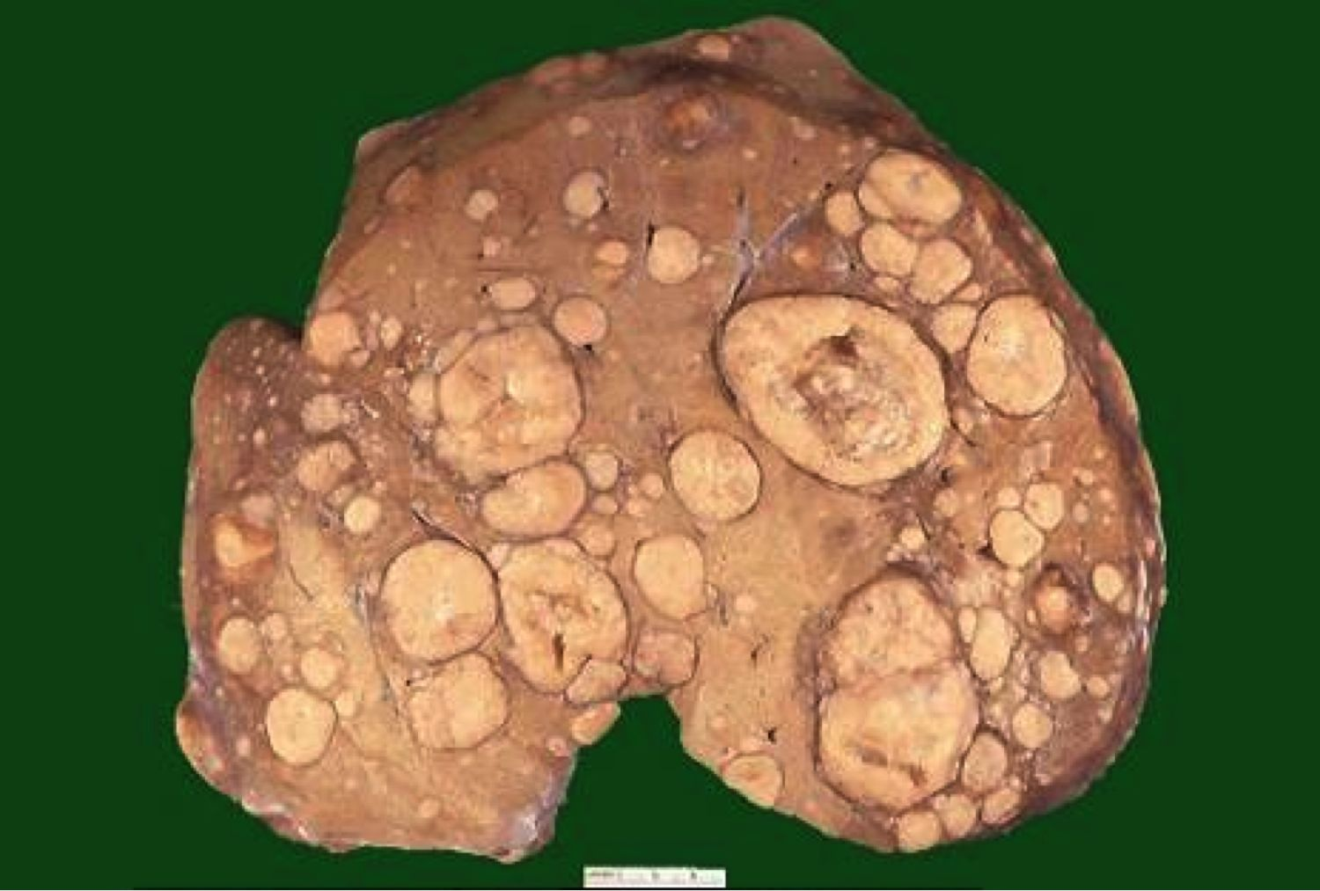
Metastatic carcinoma

Slide 46
GI Pathology Outline
Esophagus
Stomach
Intestine
Liver
Gallbladder
  Cholelithiasis
  Cholecystitis

Slide 47
Cholelithiasis
Common! (10% of adults in US)
Cholesterol stones: Female, Fat, Fertile, Forty
Pigment (bilirubin) stones: Asian countries, hemolytic anemia and biliary infections
Symptoms: None, or excruciating pain
Complications: cholecystitis (inflamed gallbladder), perforation, obstruction, pancreatitis

Slide 48
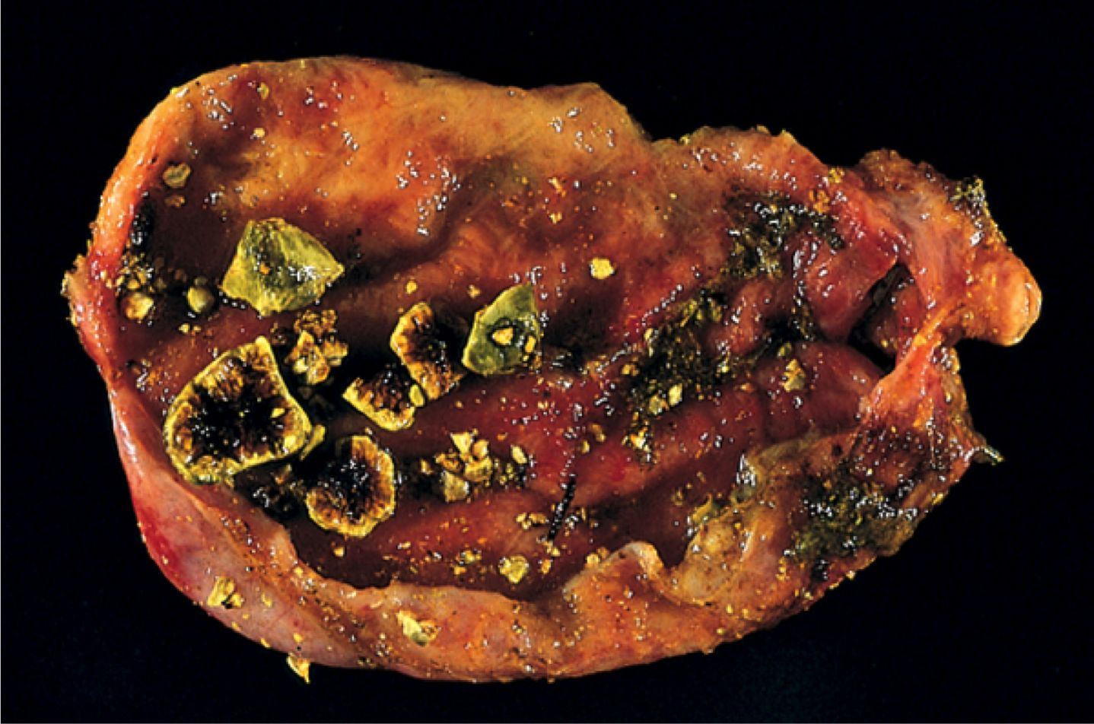
Cholesterol gallstones

Slide 49
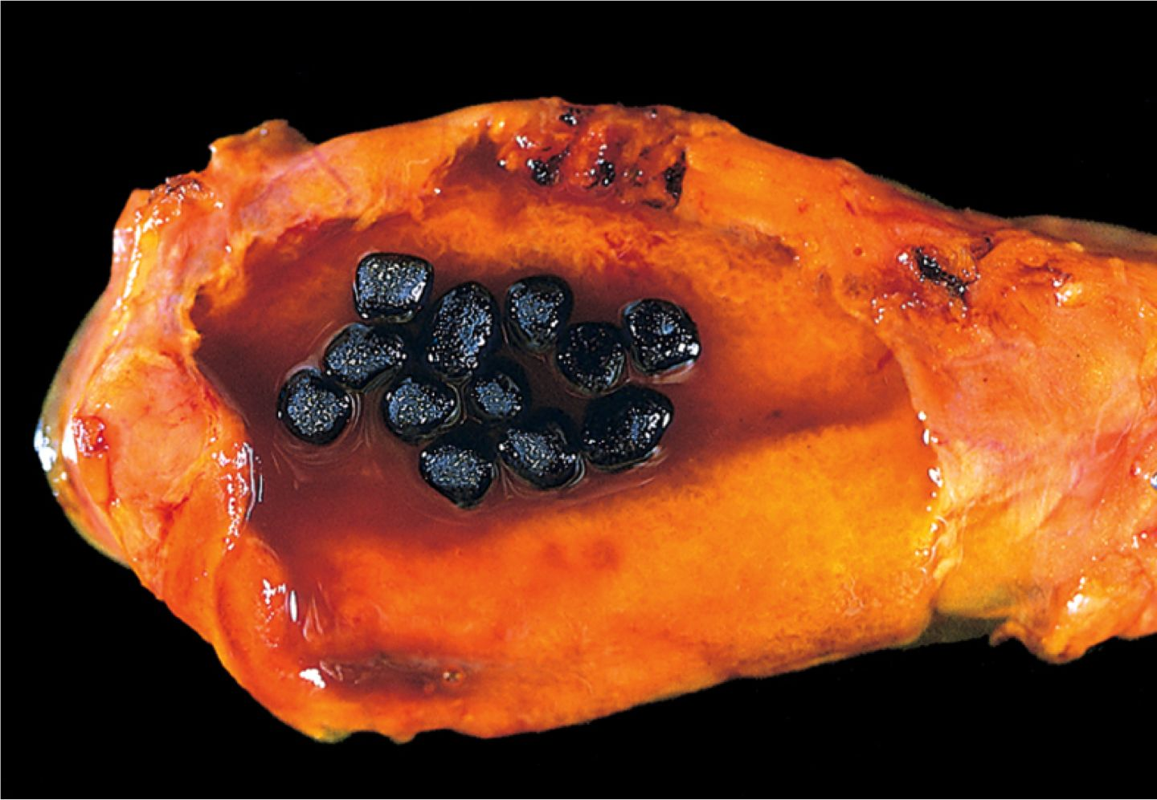
Pigmented gallstones

Slide 50
GI Pathology Outline
Esophagus
Stomach
Intestine
Liver
Gallbladder
Pancreas
  Pancreatitis
  Carcinoma

Slide 51
Normal Pancreas
Exocrine pancreas
  Makes enzymes for digestion
  Diseases: pancreatitis, cystic fibrosis, tumors
Endocrine pancreas
  Makes insulin, glucagon, other hormones
  Diseases: diabetes, tumors

Slide 52
Acute Pancreatitis
Acute inflammation and reversible destruction of pancreas
Symptoms: abdominal pain radiating to back
Main causes: alcoholism, gallstones
Labs: elevated serum amylase and lipase
Prognosis: Most recover, but 5% die in first week

Slide 53
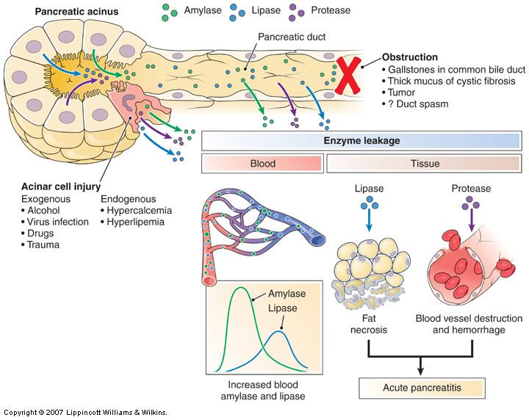
Obstruction
(gallstones)
Cell injury
(alcohol)

Slide 54
Chronic Pancreatitis
Longstanding, irreversible pancreatic destruction
Most are alcohol related, some idiopathic
Symptoms: silent, or bouts of jaundice and pain
Prognosis: poor (50% mortality over 20 years)

Slide 55
Pancreatic Carcinoma
4th leading cause of cancer death in US
Biggest risk factor: smoking
Highly invasive
Silent until late; then pain, jaundice
Very high mortality: 5ys <5%

Slide 56
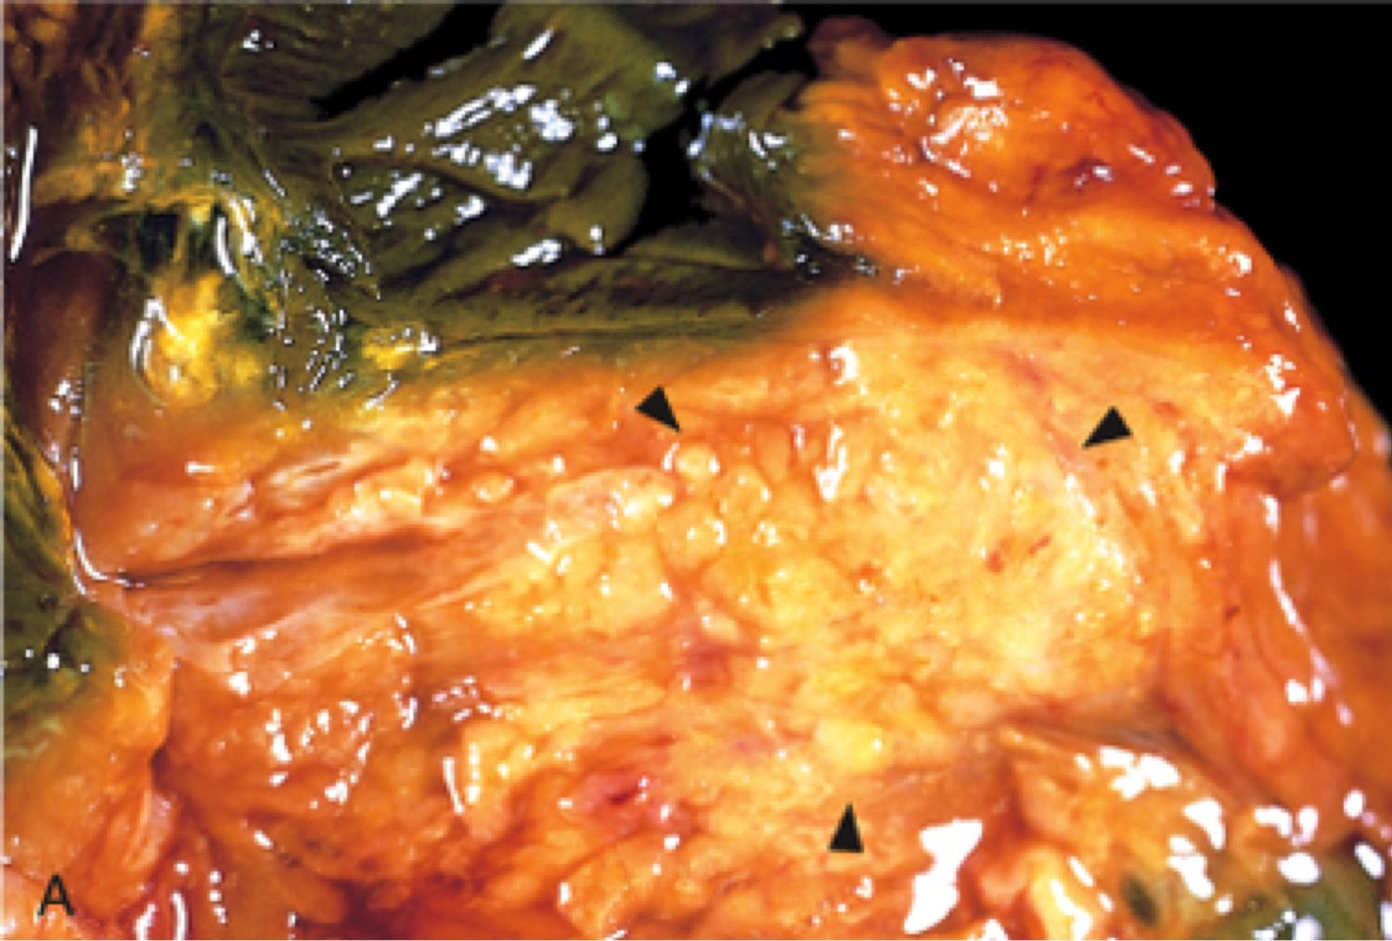
Pancreatic carcinoma

Slide 57
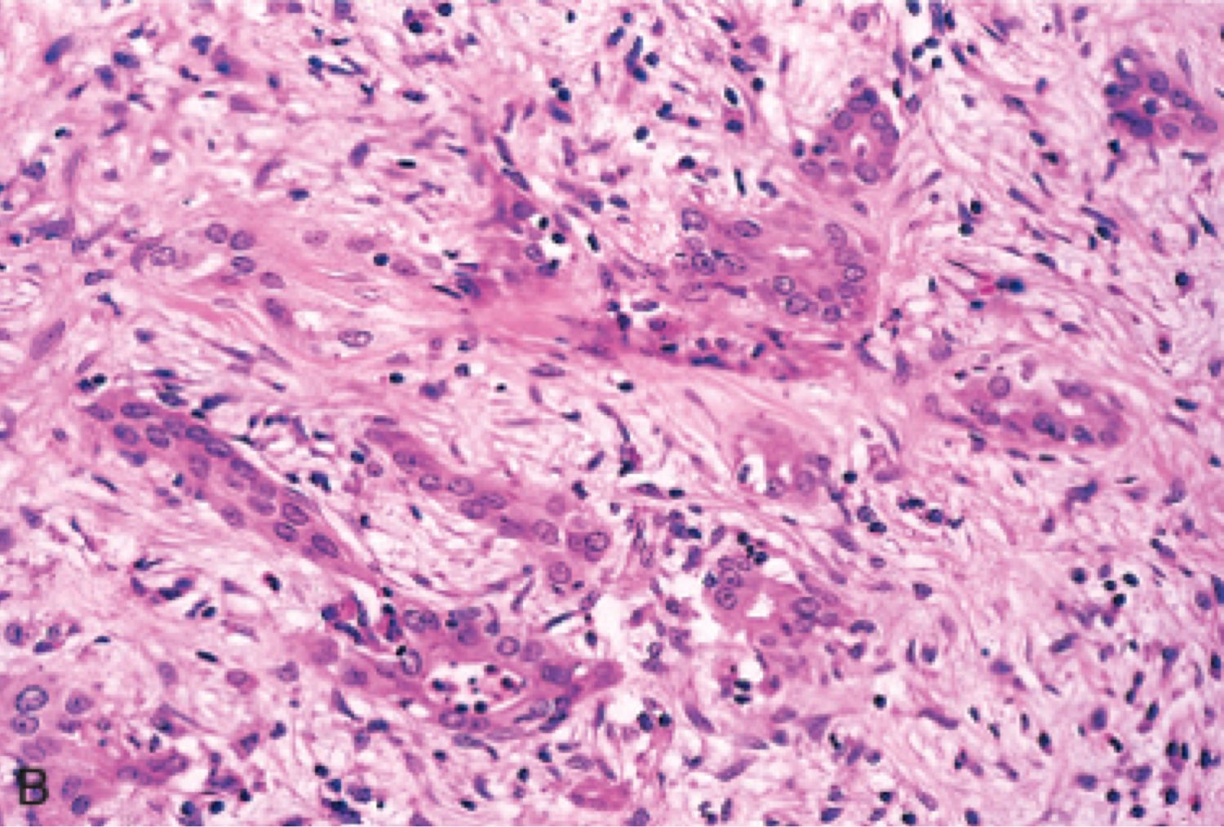
Pancreatic carcinoma

