Slide 1
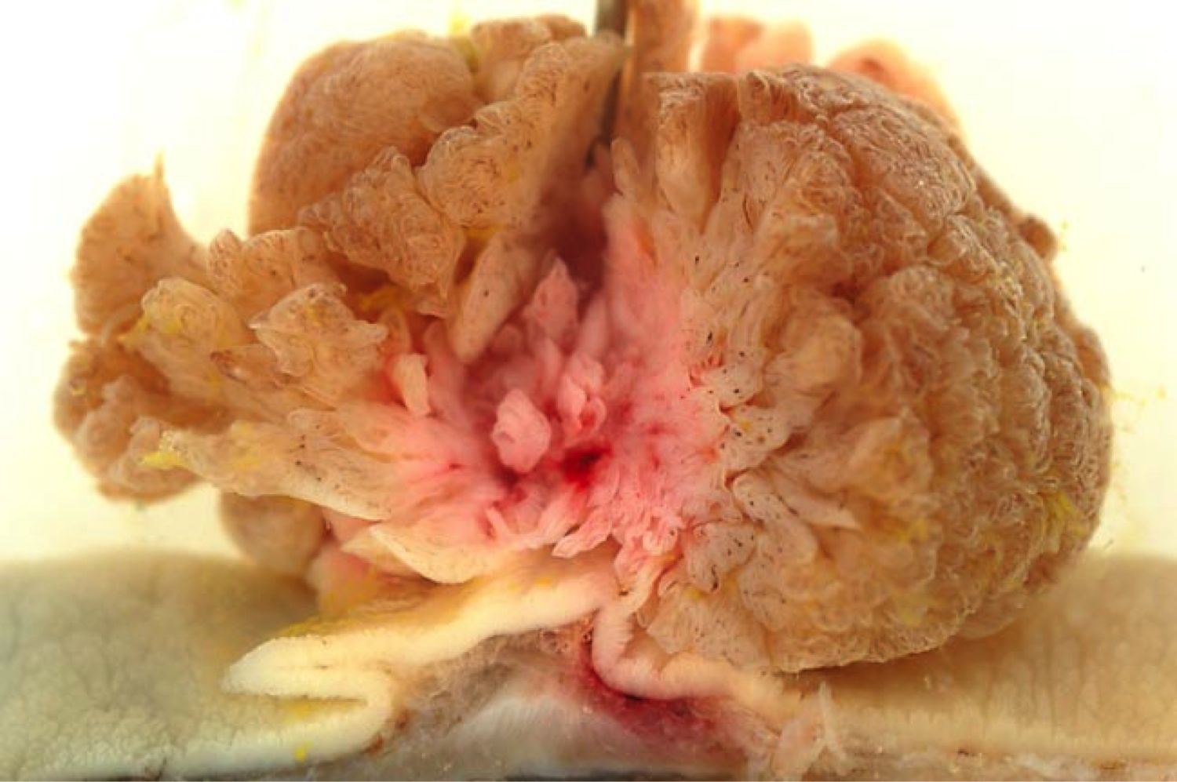
Lower Gastrointestinal Pathology
Kristine Krafts, M.D.

Slide 2
GI Pathology Outline
Esophagus
Stomach
Intestine
  Diverticulosis
  Inflammatory bowel disease
  Adenoma
  Carcinoma

Slide 3
Lower GI Lecture Objectives
Explain what diverticulosis is, and how it differs from diverticulitis.
Compare and contrast Crohn disease and ulcerative colitis: what parts of the GI tract are usually affected; how do they differ microscopically, which one responds better to surgery?
Describe what a colon adenoma is. Is it benign or malignant? When does it become scary? How common is it?

Slide 4
Lower GI Lecture Objectives
What increases the risk of getting colon carcinoma?
How does colon cancer typically present?
Describe in general (no numbers!) what the prognosis is for stage 1 vs. stage 4 colon carcinoma.

Slide 5
Diverticulosis
Mucosa/submucosa herniates through muscle wall
Older patients, low fiber diet
Sigmoid colon
Asymptomatic unless infected (“diverticulitis”)

Slide 6
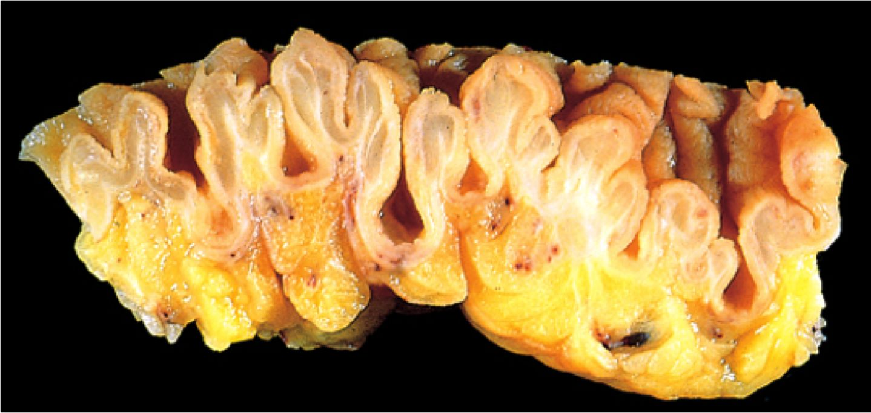
Diverticulosis

Slide 7
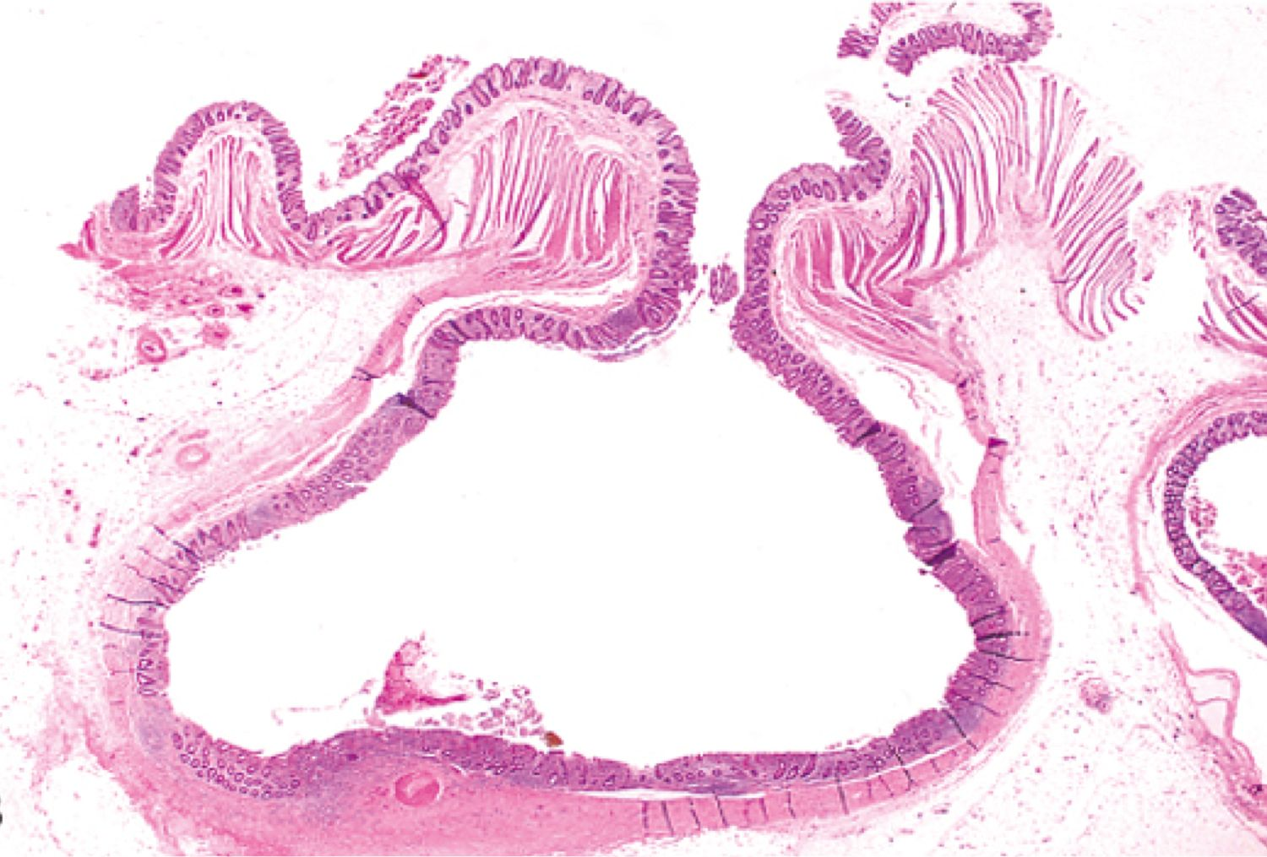
Diverticulosis

Slide 8
Inflammatory Bowel Disease
Crohn Disease
Anywhere
Patchy
Transmural
Poor response to surgery
Increased risk of cancer
Ulcerative Colitis
Colon only
Continuous
Superficial
Good response to surgery
Increased risk of cancer

Slide 9
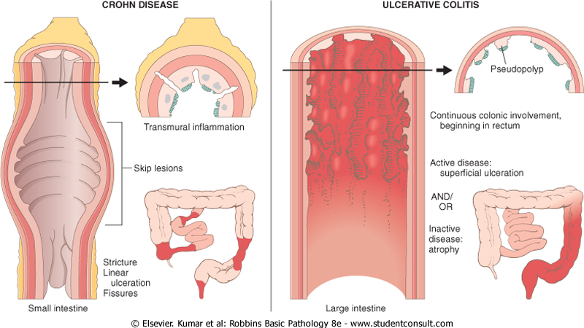
Crohn disease
Ulcerative colitis

Slide 10
Adenoma
Common! 50% of people >60.
Benign glands; may become dysplastic
More dangerous when:
  Large (>1 cm)
  Villous architecture
  Severely dysplastic

Slide 11
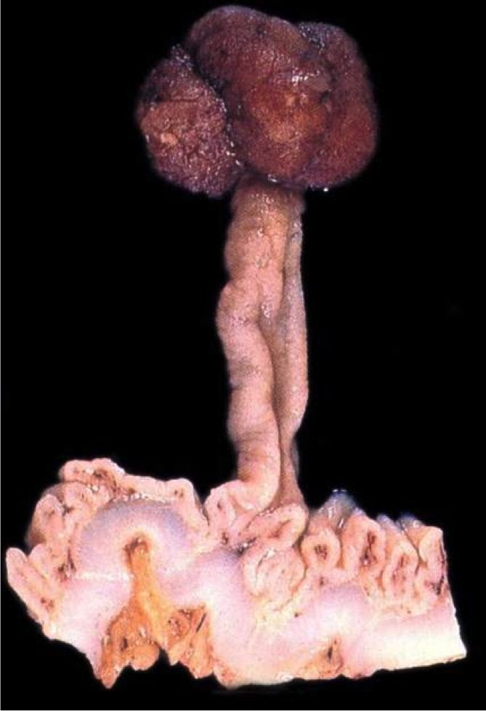
Tubular adenoma of colon

Slide 12
Villous adenoma of colon

Slide 13
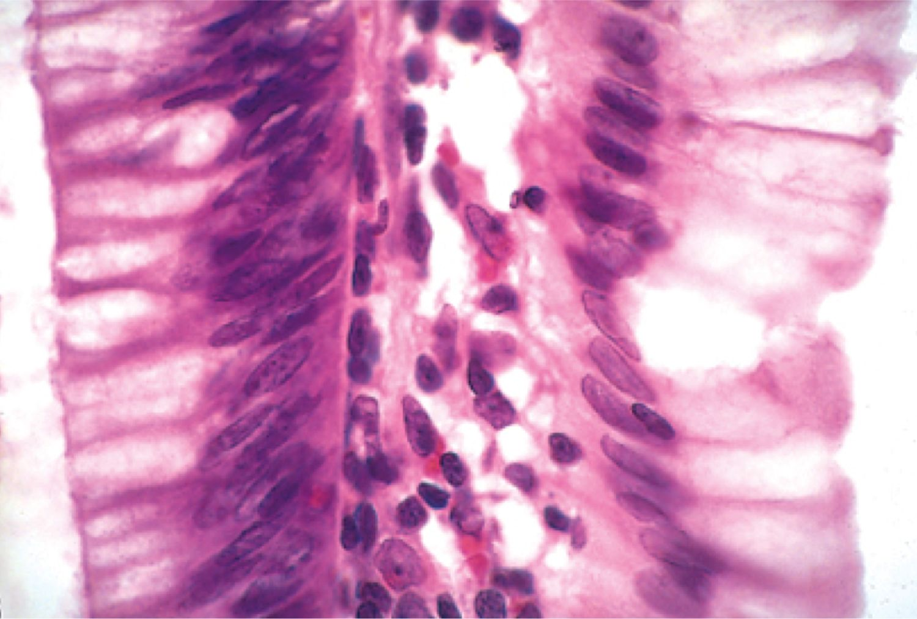
Dysplastic (L) vs. normal (R) epithelium

Slide 14
Colon Carcinoma
Almost always arises in adenomatous polyp
Diet: low fiber, high fat, lots of refined carbs
Symptoms:
  silent for years
  fatigue, weakness, iron-deficiency anemia
  occult bleeding, crampy pain
5 year prognosis: 4% (stage 4) - 90% (stage 1)

Slide 15
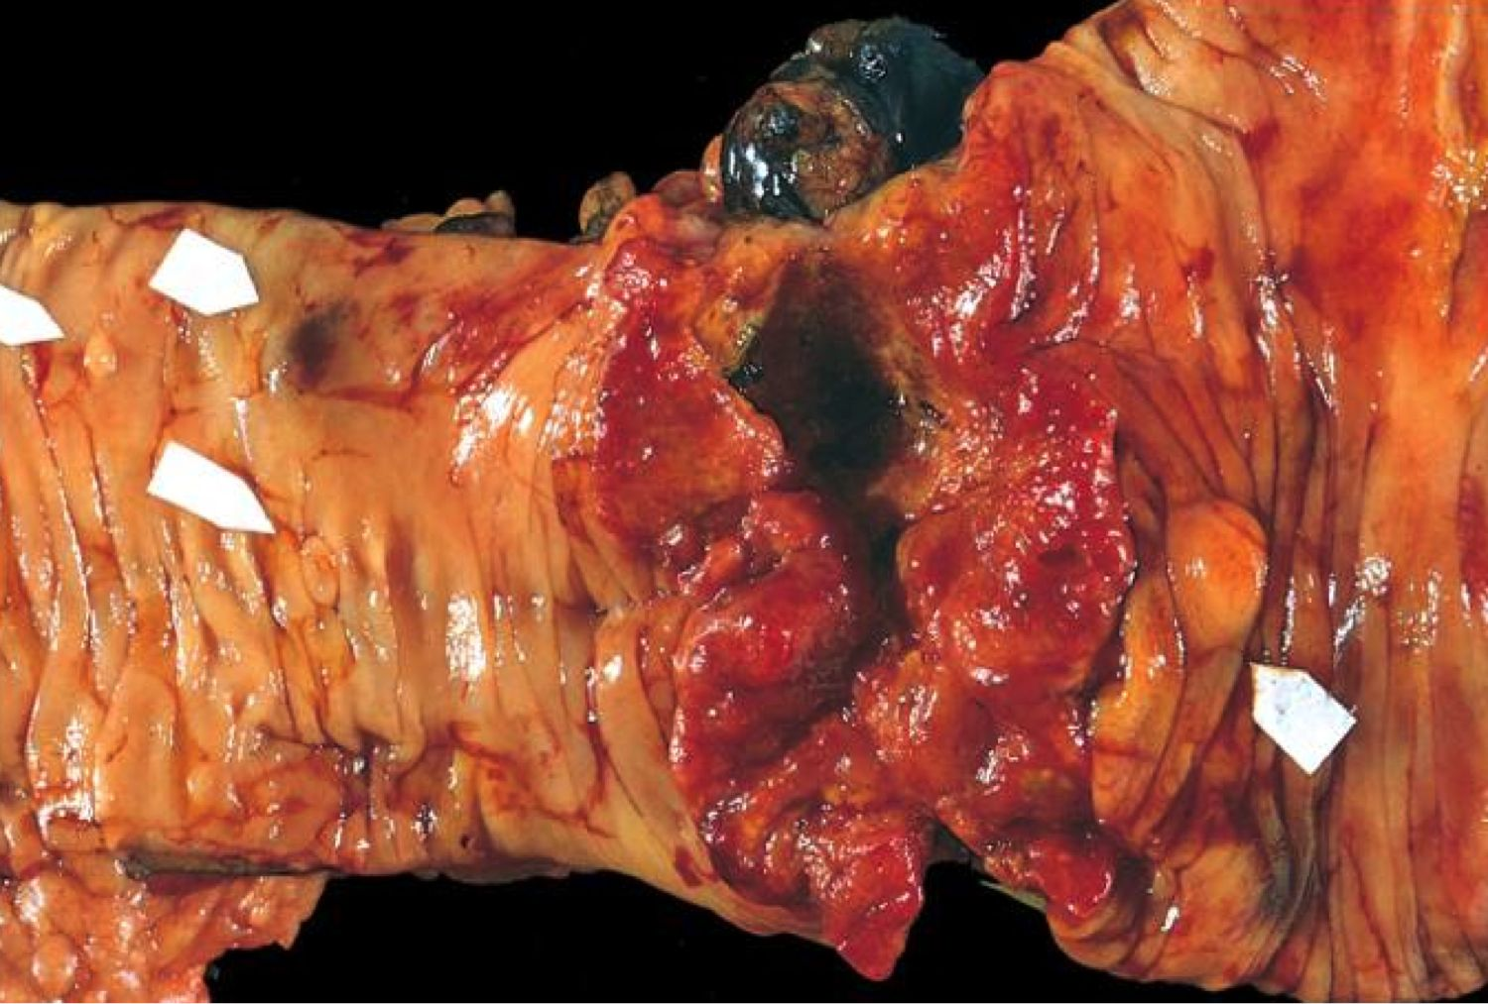
Colon carcinoma

Slide 16
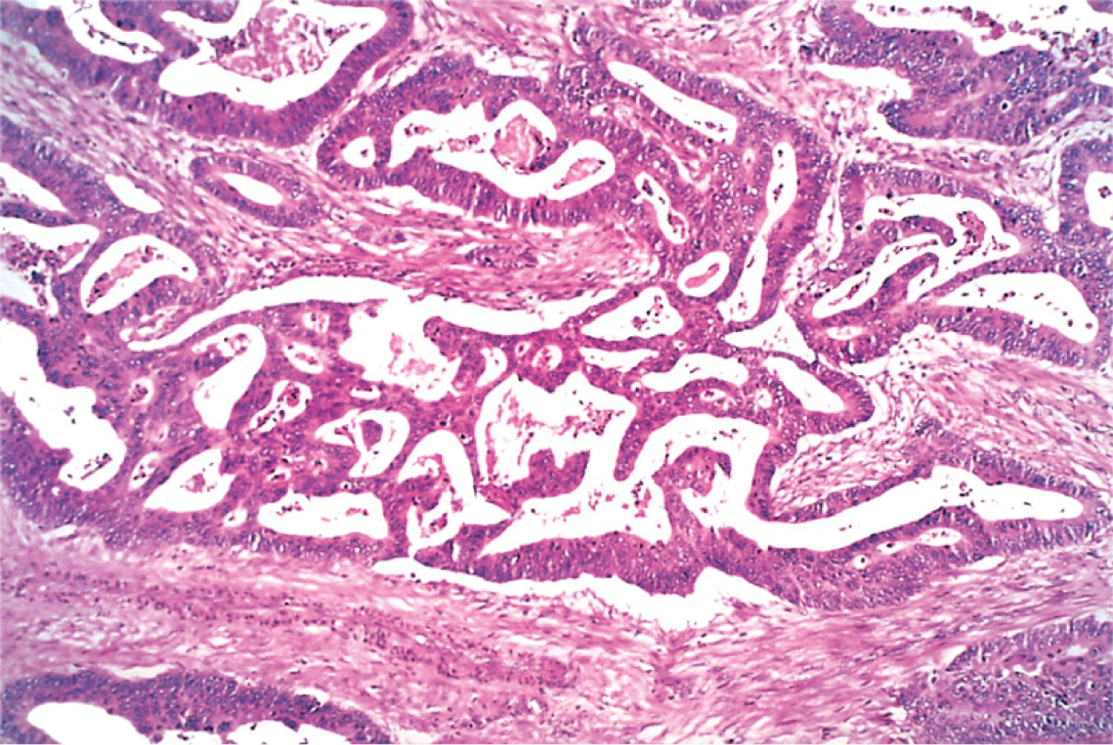
Colon carcinoma

