Slide 1
Skin
Pathology
Kristine Krafts, M.D.

Slide 2
Skin Pathology Lecture Objectives
Be able to define the clinical terms on slide 11.
Compare and contrast impetigo and erysipelas (cause, typical patient age, location, and clinical appearance).
Necrotizing fasciitis: what is its clinical course and how is it treated?
Compare and contrast acne vulgaris and acne rosacea (cause, appearance).
Ringworm: what causes it, and what does it look like?
“Rose gardener’s disease”: what causes it, and what does it look like?

Slide 3
Skin Pathology Lecture Objectives
Verruca vulgaris: what’s the common name and cause?
Molluscum contagiosum: what’s the cause and appearance? Why is “contagiosum” in the name?
Erythema multiforme: what are the causes and appearances? What dangerous disease is it related to?
Scabies: what’s the cause, location, symptoms, and appearance?
Compare and contrast psoriasis and lichen planus (cause, appearance, and location). Which one has oral lesions? What are those called, and what can they look like?

Slide 4
Skin Pathology Lecture Objectives
Make a little table comparing pemphigus vulgaris and bullous pemphigoid (antibody target, type of bullae, location). Which one occurs in the mouth first? Why on earth are their names so maddeningly similar?
What do you call a benign neoplasm of melanocytes? What are its characteristic clinical features?
What does keratoacanthoma look like? Is it malignant?
Seborrheic keratosis: what’s the typical patient age and clinical appearance? Is it malignant?
Actinic keratosis: what does it look like? What does “actinic” mean? Is it malignant?

Slide 5
Skin Pathology Lecture Objectives
Fill in this table comparing skin malignancies.
Type | Appearance | Patient age | Prognosis (best, middle, worst)
Basal cell carcinoma
Squamous cell carcinoma
Melanoma

Slide 6
Skin Pathology Lecture Objectives
A few more questions about skin malignancies
and then you’re done!
Which skin malignancy virtually NEVER metastasizes?
What is the most important factor determining prognosis in melanoma? What other factors matter?
What are some clinical features that would make you worry about melanoma (as compared to a nevus)?

Slide 7
Skin Pathology Outline
Introduction
Infectious disorders
Inflammatory disorders
Bullous disorders
Benign neoplasms
Malignant neoplasms

Slide 8
Skin Pathology Outline
Introduction

Slide 10
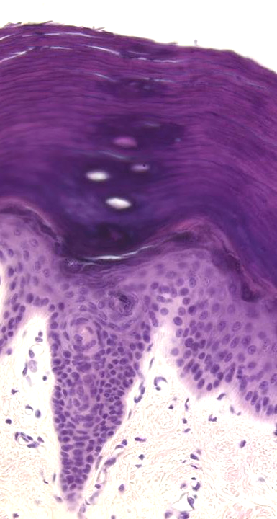
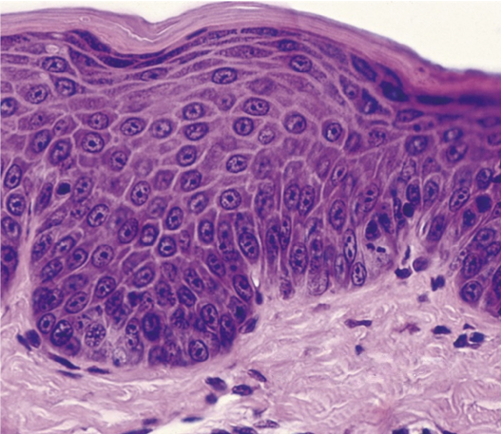
Thick skin
Thin skin
corneum
lucidum
granulosum
spinosum
basale

Slide 11
Clinical Terms You Should Know
Erythema: redness
Macule: flat lesion
Patch: a large macule (<1cm)
Papule: a raised lesion
Plaque: a large papule (>1cm)
Vesicle: a blister
Bulla: a big blister
Pustule: a blister that contains pus

Slide 12
Skin Pathology Outline
Introduction
Infectious disorders

Slide 13
Impetigo
Staph aureus or Strep pyogenes
Children
Face
“Honey-crusted” pustules

Slide 14
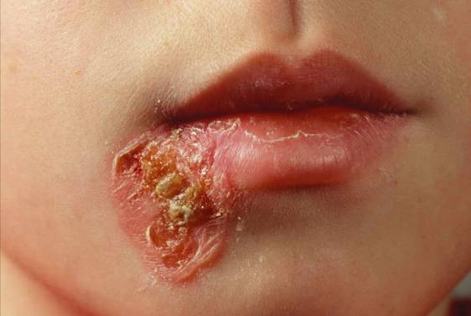
Dermal Abscess - Staphylococcus aureus
Impetigo

Slide 15
Erysipelas
Staph aureus or Strep pyogenes
Adults
Face/scalp
Sharply-circumscribed, erythematous plaques

Slide 16
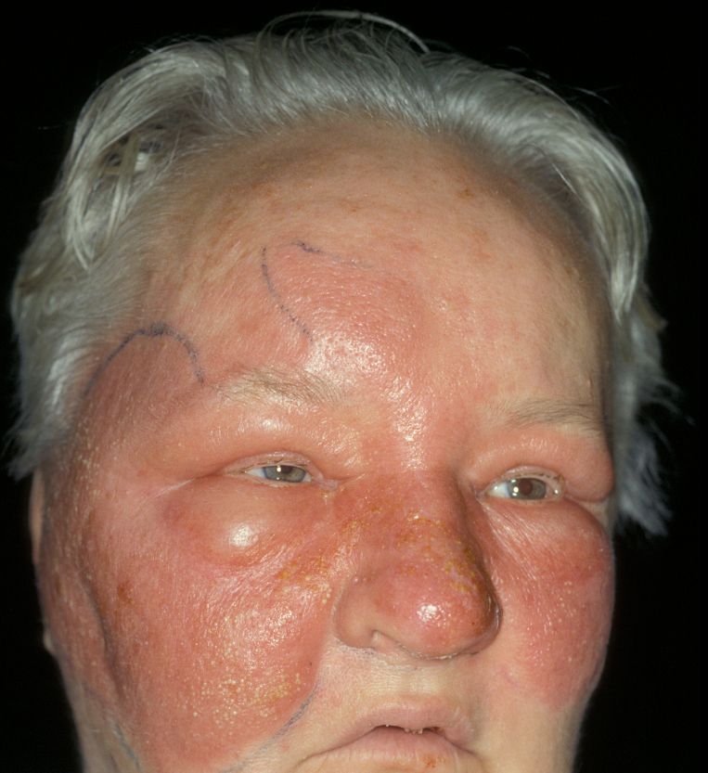
Erysipelas

Slide 17
Necrotizing Fasciitis
Many potential organisms
Excessive pain following small injury
Rapidly progressive tissue necrosis and gangrene
Need early, aggressive treatment (surgery and IV antibiotics)

Slide 18
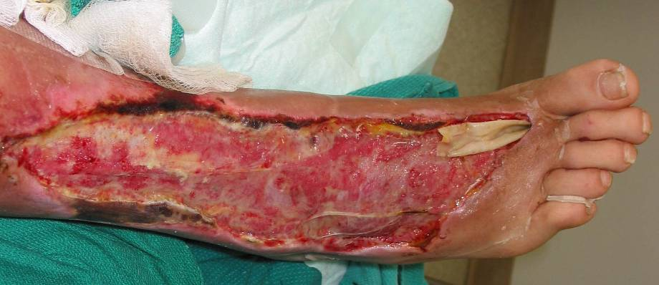
Dermal Abscess - Staphylococcus aureus
Necrotizing fasciitis

Slide 19
Acne vulgaris
Proprionibacterium acnes
Sebaceous glands get plugged, then bacteria cause inflammation of the hair follicle/sebaceous gland
Comedones and/or pustules

Slide 20
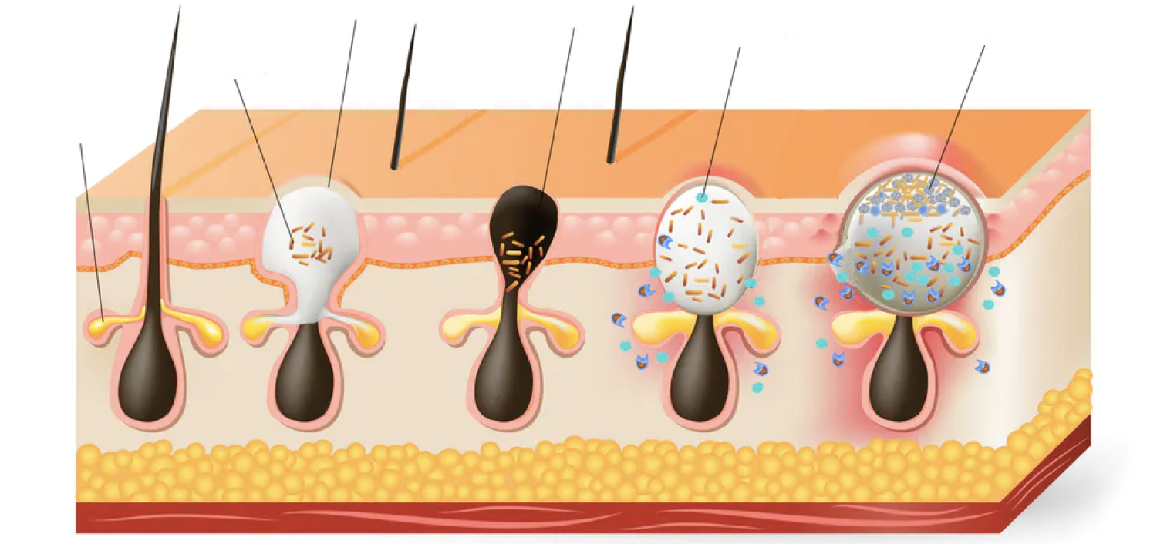
Types of Acne Lesions
Covered
by skin
Not covered
by skin
Dead cells
and debris
Neutrophils
Bacteria
Sebaceous gland
Open comedone (whitehead)
Closed comedone (blackhead)
Pustules

Slide 21
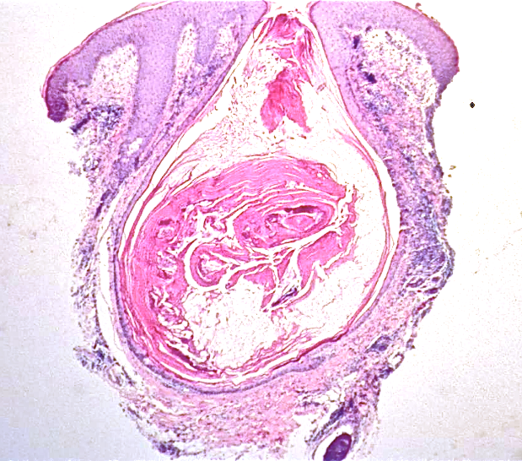
Acne vulgaris

Slide 22
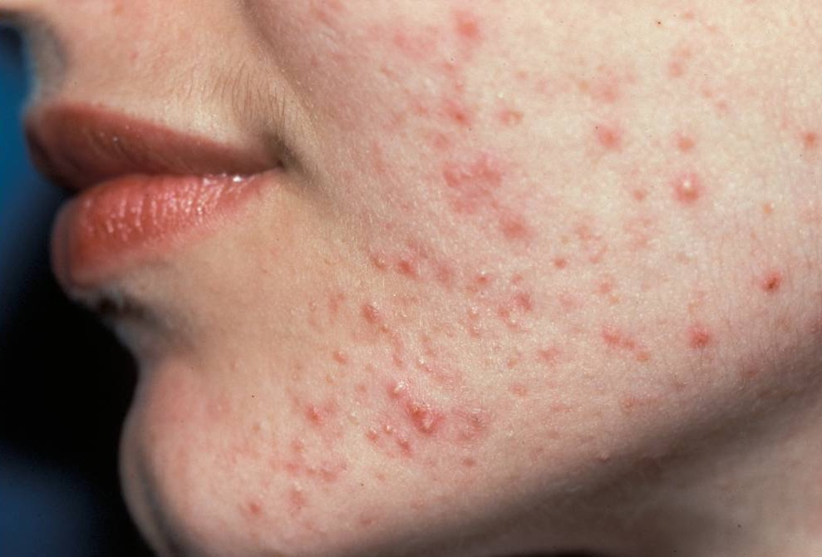
Acne vulgaris

Slide 23
Acne rosacea
Immune-mediated disease
(no known microbial trigger)
Follicles are inflamed and plugged
Four stages:
  Flushing episodes
  Persistent redness and telangiectasias
  Pustules
  Rhinophyma

Slide 24
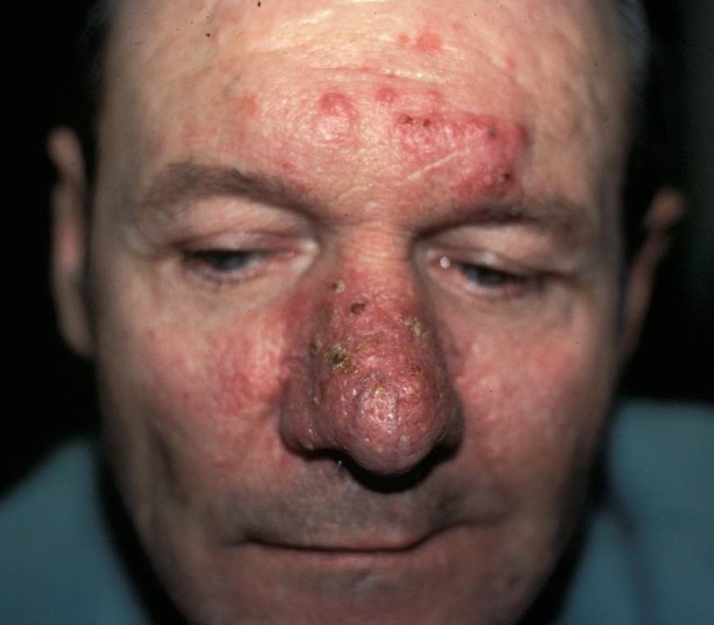
Redness and telangiectasia
Rhinophyma
Rosacea

Slide 25
Ringworm (tinea)
Caused by dermatophytic (skin-loving) fungi like microsporum and trichophyton
Red, scaly, “ring-shaped” lesions
Named by anatomic site
  tinea corporis = ringworm on body in general
  tinea pedis = ringworm of foot (athlete’s foot)
  tinea cruris = ringworm in groin (jock itch)

Slide 26
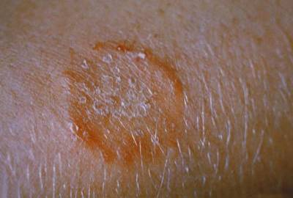
Tinea corporis

Slide 27
Sporotrichosis
Fungus: Sporotrichum schenkii
“Rose gardener’s disease”
Painless papule, then open sore

Slide 28
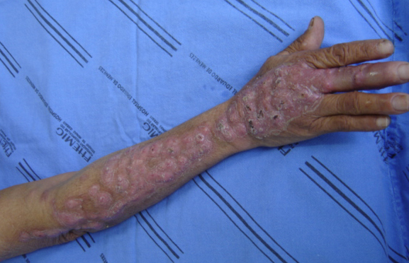
Sporotrichosis

Slide 29
Verruca vulgaris
HPV (usually serotypes 2 and 4)
Common wart
Most common on extremities
Most regress spontaneously

Slide 30
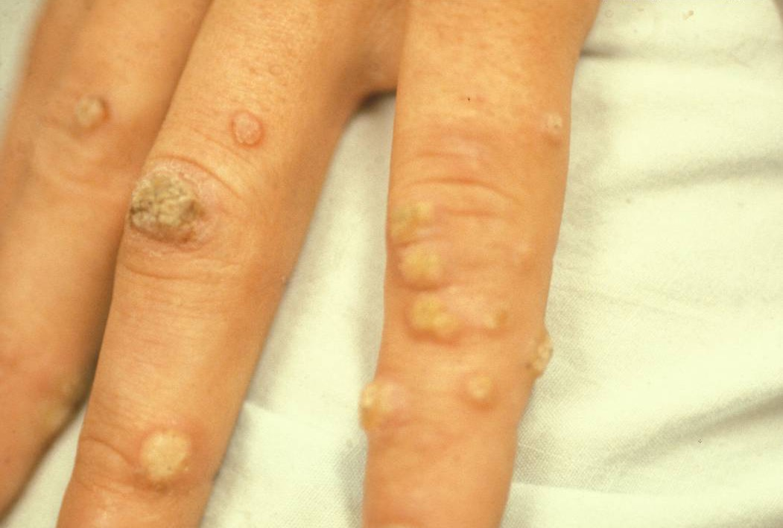
Verruca vulgaris

Slide 31
Molluscum contagiosum
Pox virus
Centrally-umbilicated red papules
Very contagious

Slide 32
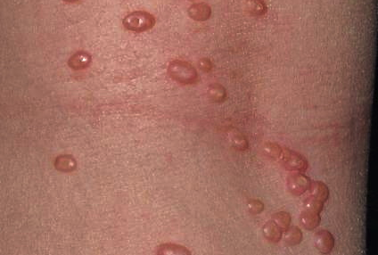
Umbilication
Molluscum contagiosum

Slide 33
Erythema multiforme
Usually HSV; sometimes drug-related
“Target” lesions and/or vesicles on skin, mucous membranes
Stevens-Johnson syndrome is a related disease characterized by skin necrosis.

Slide 34
Erythema multiforme

Slide 35
Scabies
Parasite: Sarcoptes scabei
Hands/wrists, abdomen/groin
Itchy rash, may see “burrows”
Highly contagious

Slide 36
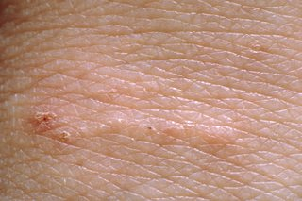
Burrow
Scabies

Slide 37
Skin Pathology Outline
Introduction
Infectious disorders
Inflammatory disorders

Slide 38
Psoriasis
Common, inherited, autoimmune disease
Itchy red lesions with silvery scales
Most common on elbows, knees, scalp
Patients may also have arthritis

Slide 39
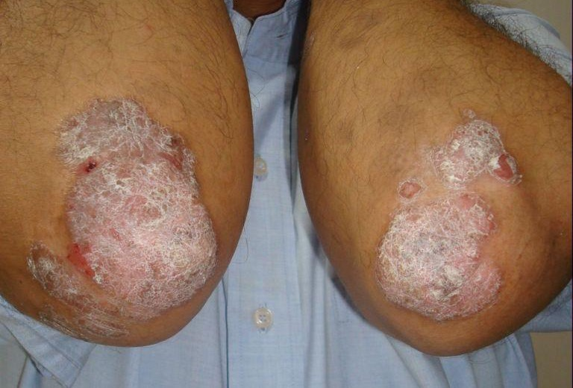
Psoriasis

Slide 40
Lichen planus
Common, chronic, immune-mediated disease
Skin: purple polygonal papules
Mucous membranes: lacy-appearing lesions (Wickham’s striae), erosions, or white patches

Slide 41
Lichen planus

Slide 42
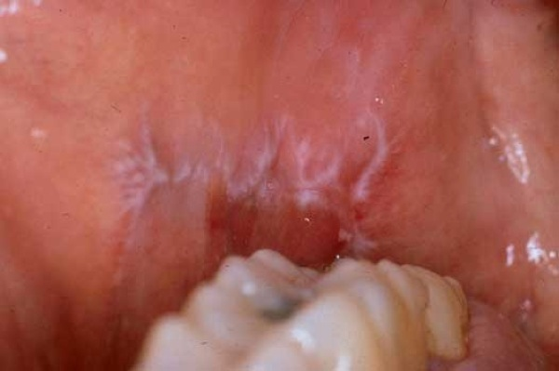
Wickham’s striae

Slide 43
Skin Pathology Outline
Introduction
Infectious disorders
Inflammatory disorders
Bullous disorders

Slide 44
Two bullous diseases
Pemphigus vulgaris
Bullous pemphigoid
Antibodies against spot desmosomes
Superficial bullae
Mouth first, then skin
Antibodies against hemidesmosomes
Subepidermal bullae
Groin, axillae, arms

Slide 45
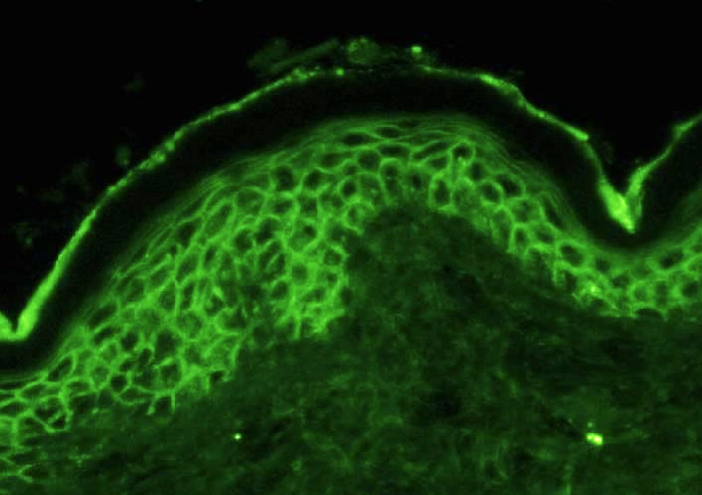
Pemphigus vulgaris
Bullous pemphigoid
Antibodies against
spot desmosomes
(between epidermal cells)
Antibodies against
hemidesmosomes
(beneath epidermal cells)

Slide 46
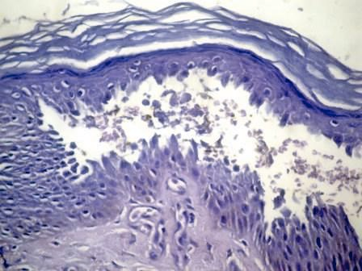
Pemphigus vulgaris
Bullous pemphigoid
Separation between epidermal cells
Separation between epidermis and dermis

Slide 47
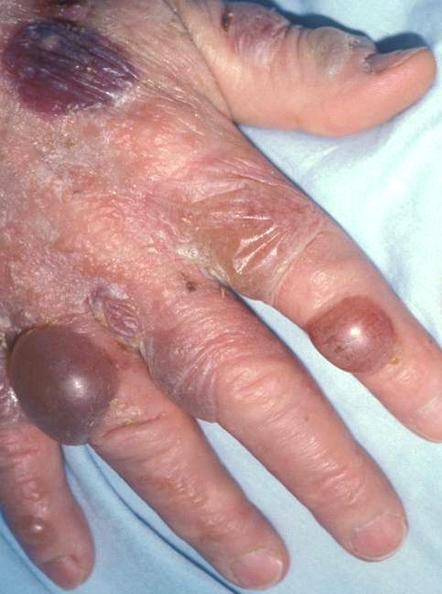
Pemphigus vulgaris
Bullous pemphigoid
Ruptured bullae
Intact bullae

Slide 48
Skin Pathology Outline
Introduction
Infectious disorders
Inflammatory disorders
Bullous disorders
Benign neoplasms

Slide 49
Nevus (mole)
Benign neoplasm of melanocytes
Round, evenly-pigmented
Progresses from junctional to compound to intradermal over time
Melanoma occasionally develops in nevi – so watch for changes (size, shape, color)

Slide 50
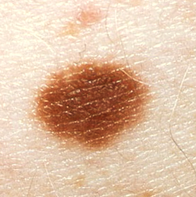
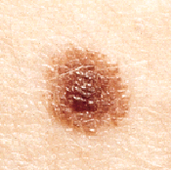
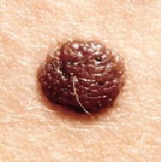
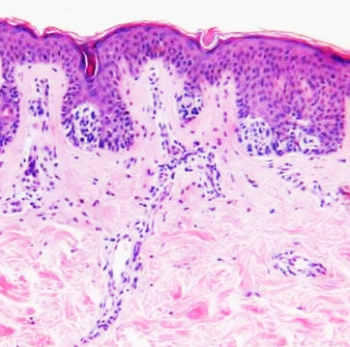
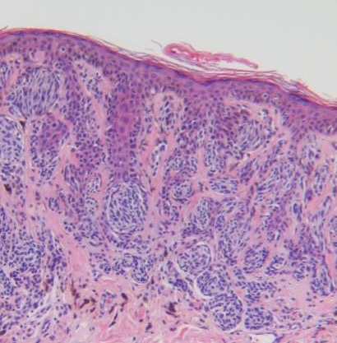
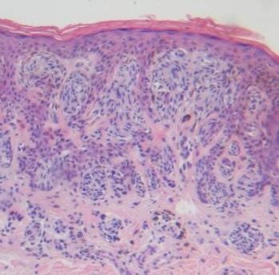
Junctional nevus
Compound nevus
Intradermal nevus
Melanocytes at dermal-epidermal junction
Melanocytes at junction AND in dermis
Melanocytes in dermis

Slide 51
Hemangioma
Common benign tumor of blood vessels
“Strawberry hemangioma” occurs at birth, usually regresses within a year

Slide 52
Hemangiomas
Strawberry hemangiomas

Slide 53
Keratoacanthoma
Rapidly-growing, crater-like nodule
May evolve into squamous cell carcinoma (must be removed)

Slide 54
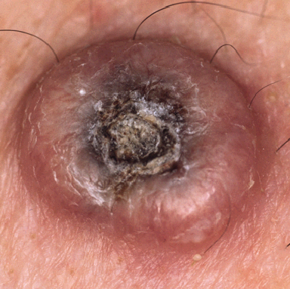
Keratoacanthoma

Slide 55
Seborrheic keratosis
Common benign epidermal tumor
Increasing incidence with age
Brown-grey, velvety-waxy plaque
“Stuck-on” appearance

Slide 56
Seborrheic keratoses

Slide 57
Actinic keratosis
Dysplastic epidermal cells
Ill-defined, rough patches
Related to sun exposure (“actinic”)
Considered pre-malignant

Slide 58
Actinic keratosis

Slide 59
Skin Pathology Outline
Introduction
Infectious disorders
Inflammatory disorders
Bullous disorders
Benign neoplasms
Malignant neoplasms

Slide 60
Basal cell carcinoma
Malignant tumor of cells in basal layer of epidermis
Raised, “pearly” nodule
Older patients, sun-exposed skin
Locally aggressive, but almost never metastasizes!

Slide 61
Basal cell carcinoma

Slide 62
Basal cell carcinoma “rodent ulcer”

Slide 63
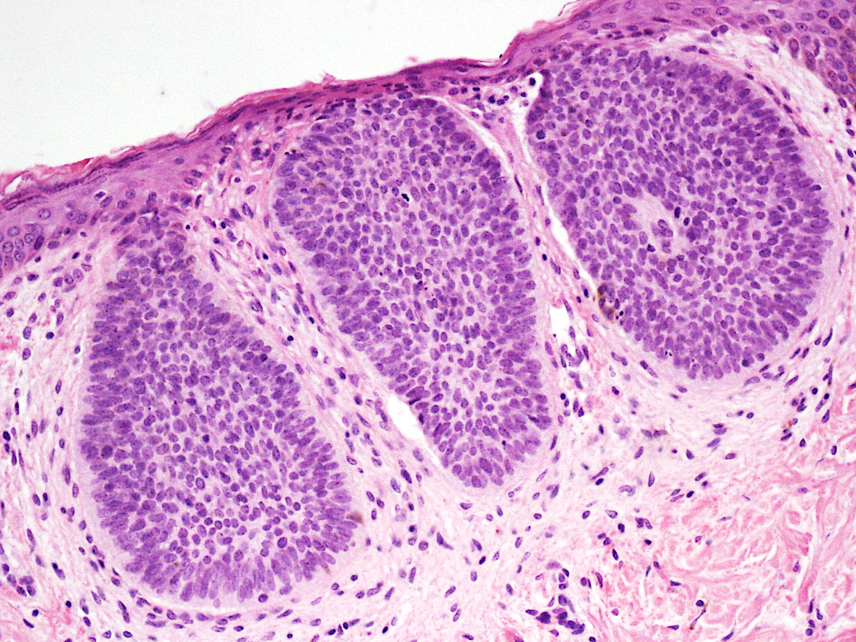
Basal cell carcinoma

Slide 64
Squamous cell carcinoma
Malignant tumor of squamous cells
Reddish nodule or plaque
Older patients, sun-exposed skin
Can metastasize

Slide 65
Squamous cell carcinoma

Slide 66
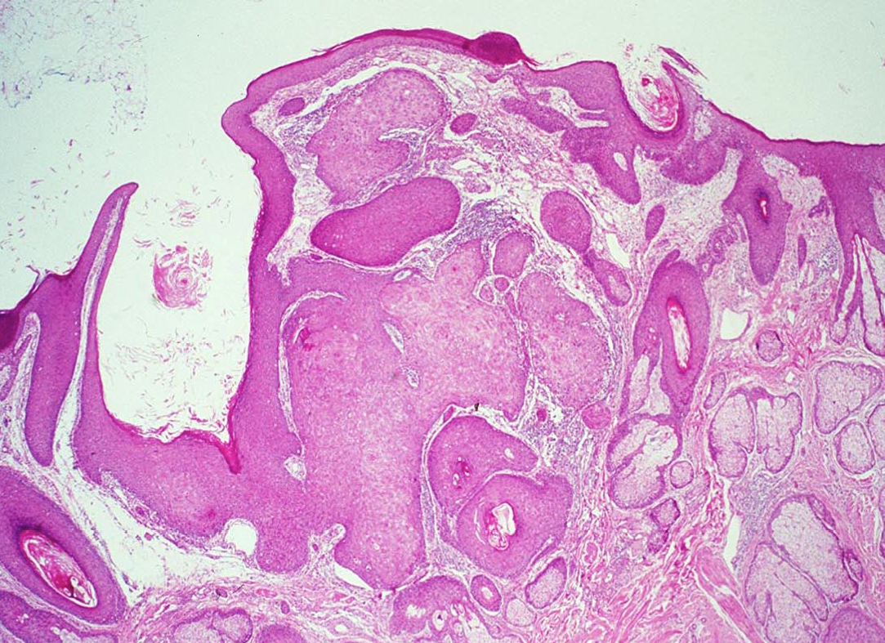
Squamous cell carcinoma

Slide 67
Melanoma
Malignant tumor of melanocytes
All ages, sun-exposed skin
Worst prognosis of all skin cancers
Prognosis directly related to depth of invasion

Slide 68
Is it melanoma, or just a mole?
Look for:
Asymmetry (in shape or color)
Border (irregular)
Color (variegated)
Diameter (usually >6mm)
Elevation (or textural change within lesion)

Slide 70
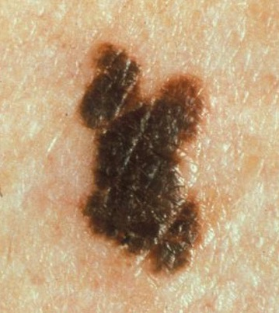
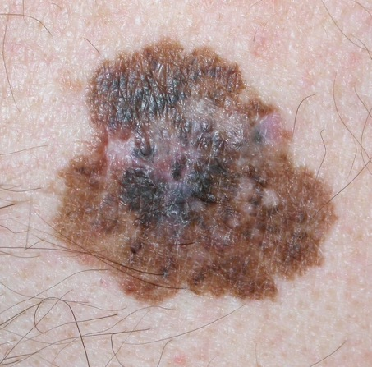
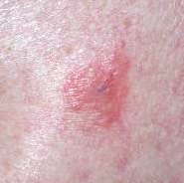
More examples of melanoma
Amelanotic melanoma

Slide 71
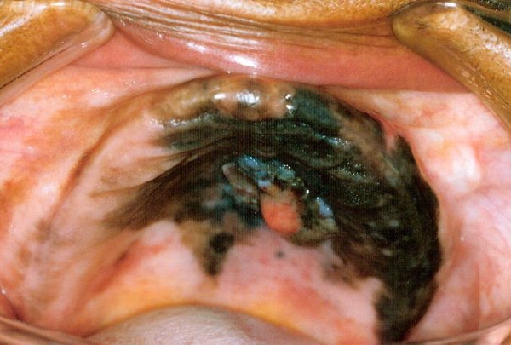
Oral melanoma

Slide 72
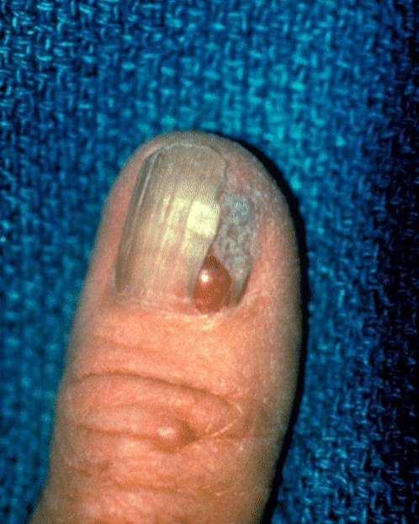
Acral melanoma

Slide 73
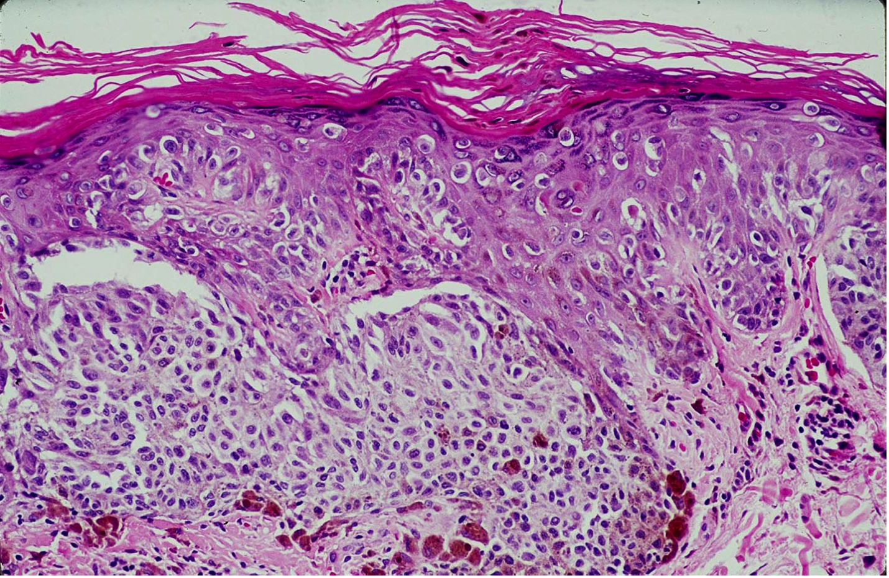
Melanoma

Slide 74
Melanoma prognosis
Depth of invasion = most important factor
Measure depth by Breslow thickness
Presence of metastases = worse prognosis
Ulcerated surface = worse prognosis

Slide 75
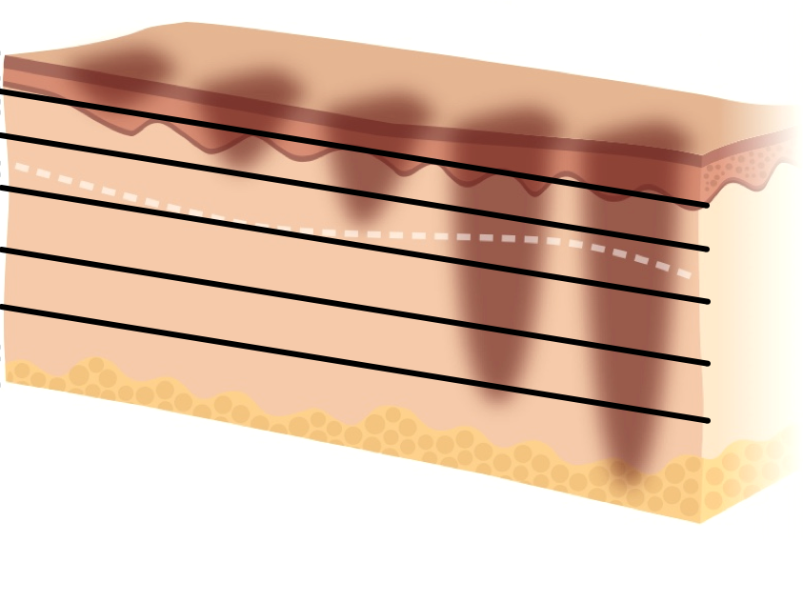
Breslow thickness and 10-year survival
90%
1 mm
80%
2 mm
60%
3 mm
50%
4 mm
40%
5 mm

